Slide 1
Kućna osobna računala s početka 1980-ih
Home PCs - the beginning of the 1980s

Slide 2
Created by:
II. osnovna škola Čakovec, Croatia
eTwinning project On the Track of Our Recent Past
Ina Zečar
7.b
18.01.2016
Teacher: Iva Naranđa

Slide 3
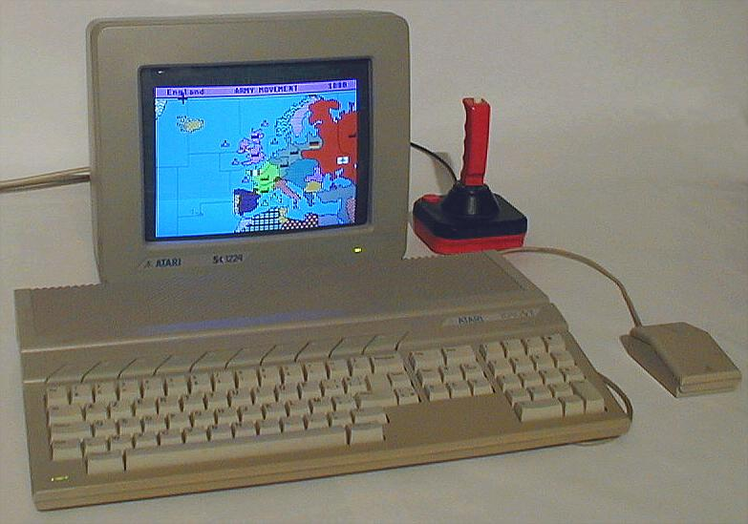
Atari ST
Motorola 68000
CPU - 8 MHz
RAM - 524.288 B - 4.194.304 B
1985
OS: TOS 1.x

Slide 4
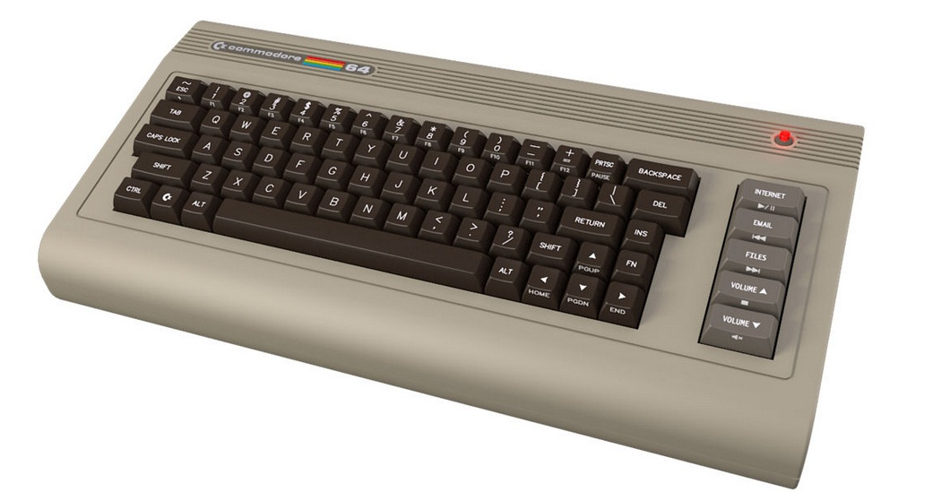
Commodore 64
CPU - 7 MHz
Memory 256 Kb
Microprocessor - MOS Technology 6510/8500
RAM – 64 Kb
ROM – 20 Kb

Slide 5
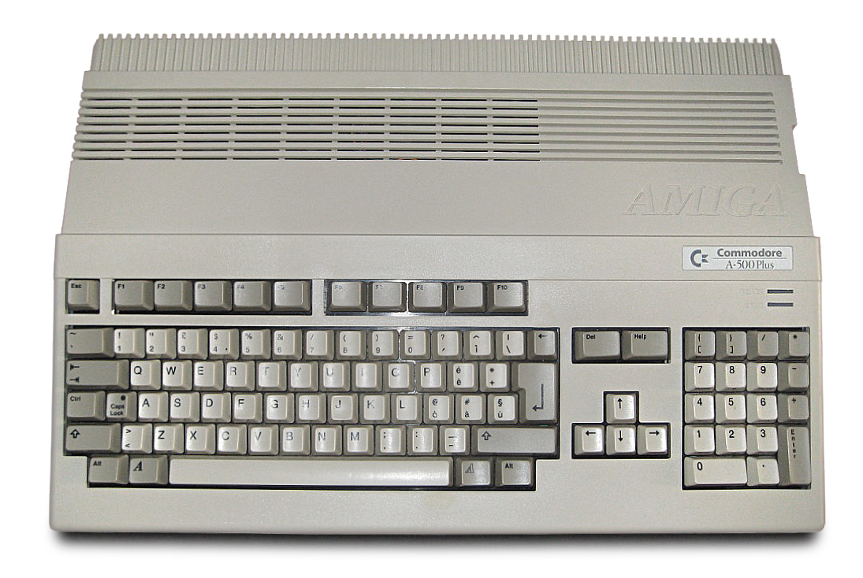
Amiga
OS – Commodore
Microprocessor - Motorola 68000, 68020, 68030 and 68040

Slide 6
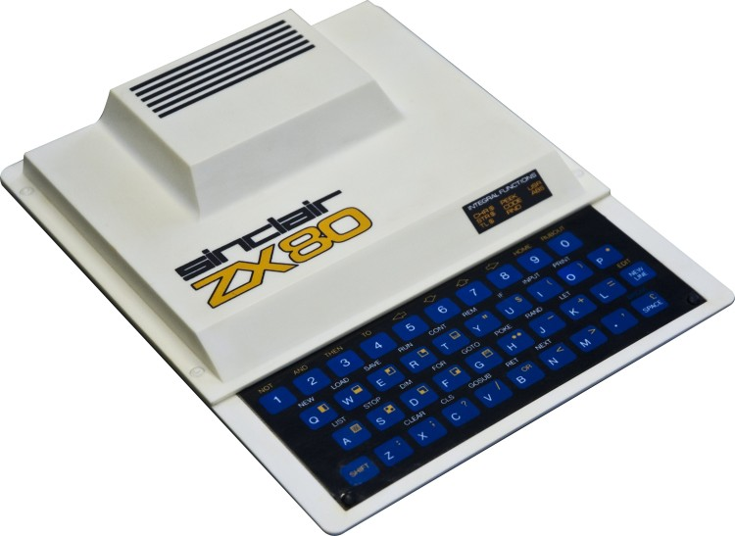
ZX 80
OS - Sinclair Research
1980
Microprocessor - NEC μPD780C-1 (clone Zilog Z80)
CPU – 3,25 MHz
RAM – 1 Kb - 16 Kb
ROM – 4 Kb

Slide 7
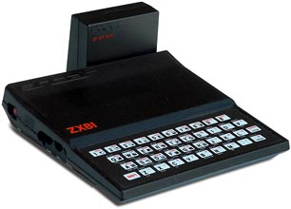
ZX 81
1981
CPU - NEC Z-80A, 3.25 MHz
RAM - 1 Kb - 64 Kb
OS - ROM BASIC

Slide 8
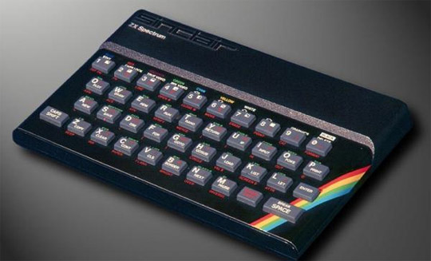
ZX Spectrum
1982
Microprocessor – Zilog Z80
CPU – 3,5 MHz
ROM – 16 Kb
RAM – 48 Kb
OS - Sinclair BASIC

Slide 9
Links
https://hr.wikipedia.org/wiki/Atari_ST
https://hr.wikipedia.org/wiki/Commodore_64
https://hr.wikipedia.org/wiki/Amiga
https://hr.wikipedia.org/wiki/ZX_80
https://hr.wikipedia.org/wiki/ZX_81
https://hr.wikipedia.org/wiki/ZX_Spectrum

