Slide 1
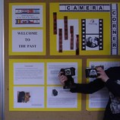
Kodak Vollenda 620 Kodak Retina I

Slide 2
Kodak Vollenda 620
Specifications
Film: roll 620 film, frame size: 6x9cm or 6x6cm
Lens: it offered varios lens/shutter combinations, eg.Kodak Anastigmat 105mm f/4.5, Carl Zeiss Tessar 105mm f/4.5
Shutter: Compur, Compur-S with speeds 1-1/250 +T & B
Focusing: manual, lens mount have a distance scale
Viewfinders: brilliant finder and sports frame finder
Self-timer

Slide 3
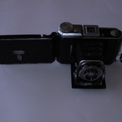
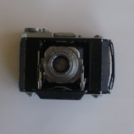
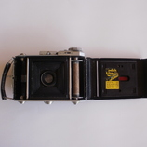
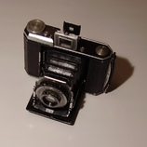
Kodak Vollenda 620

Slide 4
Kodak Retina I
Specifications
Lens: Kodak Anastigmat Ektar 50mm f/3.5 filter slip on
Focus range: 1-10m +inf
Focusing: by a small handle and scale behind the lens-shutter barrel
Shutter: Compur Rapid leaf shutter, speeds: 1-1/500 + T&B
Others: Tripod socket: 3/8 inch; Embossing on the back cover: Retina; Sticker inside of the back cover: Kodak Film, Panatomic 135, SS Panchromatic 135; Serial no.inside the camera
Body: metal, Weight: 471g

Slide 5
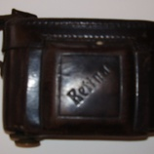
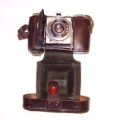
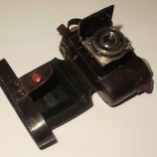
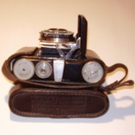
Kodak Retina I

Slide 6
Sources:
http://camerapedia.wikia.com/wiki/Kodak_Vollenda_620
http://camerapedia.wikia.com/wiki/Kodak_Retina_I

Slide 7
eTwinning project: On the Track of Our Recent Past
Made by: Jakov Novak
Teacher: Iva Naranđa
School: II. osnovna škola Čakovec, Croatia
April, 2016

