Slide 1
Nigeria!!!

Slide 2
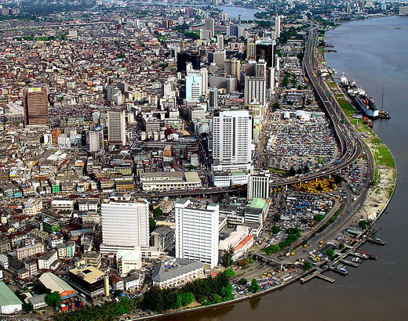
The houses in the centre of Nigeria!!!
The houses in the centre of Nigeria are huge block of flats and skyscrapers. They are constructed by concrete ,like in every big city.

Slide 3
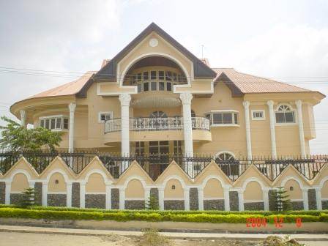
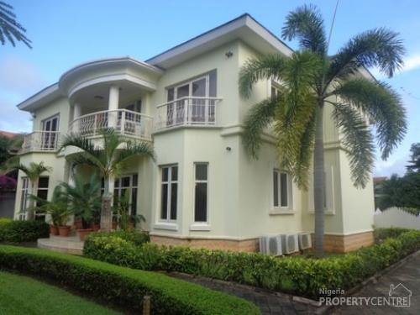
The houses in the suburbs of Nigeria:
The houses in the suburbs of Nigeria are two-storied and luxurious!!!Some of them have a big garden.

Slide 4
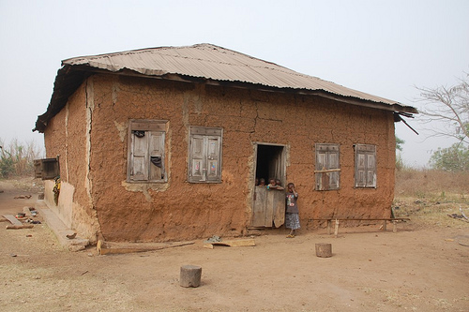
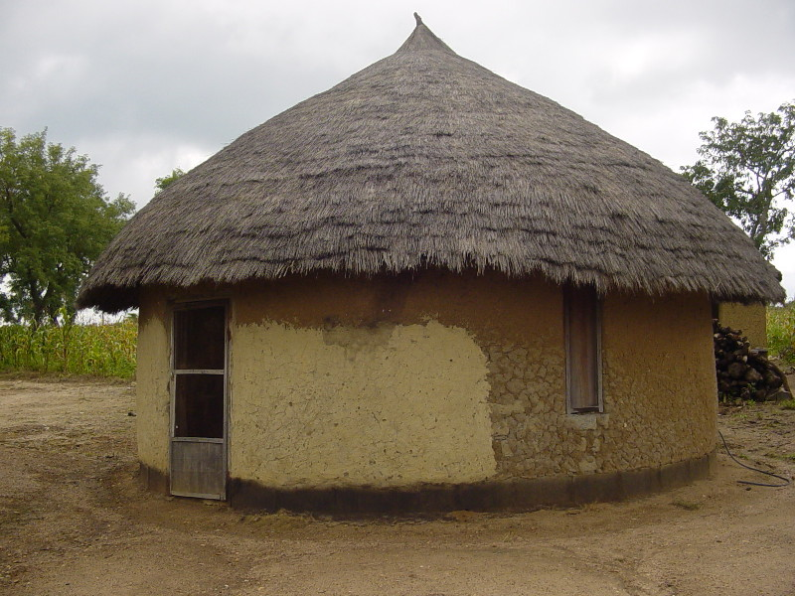
The houses in the villages :
The houses are made of pressed mud. They do not have electricity or water sources. Some minutes before sunset, the sun colors these mud houses orange. The floor is made of mud and sometimes the owners straw mats and torn fabrics. When it rains the houses flood and the mud walls smell mould!!!

