Slide 1
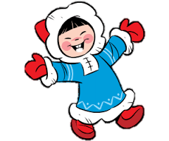
Eskimo Languages
^{Eskimo Languages}

Slide 2
Alaska is home to at least twenty distinct indigenous languages. More than just dialectal variants, these different languages reflect the diverse cultural heritage of Alaska's Native peoples. For more information about particular languages, click on one of the language names on the left.

Slide 3
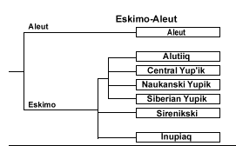
Family Tree of Language Relationship
Family Tree
of Language Relationship

Slide 4
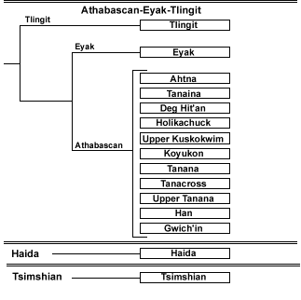
Family Tree of Language Relationship
Family Tree
of Language Relationship

Slide 5
Comparative Yupik and Inuit
Four distinct Yupik (or Western Eskimo) languages are spoken along the shores of the Gulf of Alaska, in southwestern Alaska, and on the easternmost tip of Siberia. The Inuit (or Eastern Eskimo) language continuum is spoken in northern Alaska, Canada, and Greenland. Another Eskimo language, the virtually extinct Sirenikski of Siberia, is usually grouped with the Yupik languages although it may actually constitute a third distinct branch.
.

Slide 6
Comparative
Yupik and Inuit
The sound system of the Yupik branch of Eskimo differs from that of the Inuit branch perhaps principally in the following ways:
Grammatical structures of Yupik and Inuit are very similar.

Slide 7
Comparative
Yupik and Inuit
The Inuit language is a continuum, or dialect chain, that includes Alaskan Inupiaq and stretches from Unalakleet on Norton Sound across northern Alaska and northern Canada to east Greenland. The change from west to east is marked by the dropping of vestigial Yupik-like features and increasing consonant assimilation (the word for 'thumb' goes from kumlu to kuvlu to kullu) adding to the significant gemination (consonant lengthening) already in Inuit.

Slide 8
The Alphabet
Brevi | Lunghe | Traslitterazione | Brevi | Lunghe | Traslitterazione | Brevi | Lunghe | Traslitterazione | Finali | Traslitterazione
ᐃ | ᐄ | i | ᐅ | ᐆ | u | ᐊ | ᐋ | a | ᐦ | h
ᐱ | ᐲ | pi | ᐳ | ᐴ | pu | ᐸ | ᐹ | pa | ᑉ | p
ᑎ | ᑏ | ti | ᑐ | ᑑ | tu | ᑕ | ᑖ | ta | ᑦ | t
ᑭ | ᑮ | ki | ᑯ | ᑰ | ku | ᑲ | ᑳ | ka | ᒃ | k
ᒋ | ᒌ | gi | ᒍ | ᒎ | gu | ᒐ | ᒑ | ga | ᒡ | g
ᒥ | ᒦ | mi | ᒧ | ᒨ | mu | ᒪ | ᒫ | ma | ᒻ | m
ᓂ | ᓃ | ni | ᓄ | ᓅ | nu | ᓇ | ᓈ | na | ᓐ | n
ᓯ | ᓰ | si | ᓱ | ᓲ | su | ᓴ | ᓵ | sa | ᔅ | s
ᓕ | ᓖ | li | ᓗ | ᓘ | lu | ᓚ | ᓛ | la | ᓪ | l
ᔨ | ᔩ | ji | ᔪ | ᔫ | ju | ᔭ | ᔮ | ja | ᔾ | j
ᕕ | ᕖ | vi | ᕗ | ᕘ | vu | ᕙ | ᕚ | va | ᕝ | v
ᕆ | ᕇ | ri | ᕈ | ᕉ | ru | ᕋ | ᕌ | ra | ᕐ | r
ᕿ | ᖀ | qi | ᖁ | ᖂ | qu | ᖃ | ᖄ | qa | ᖅ | q
ᖏ | ᖐ | ngi | ᖑ | ᖒ | ngu | ᖓ | ᖔ | nga | ᖕ | ng
ᙱ | ᙲ | nngi | ᙳ | ᙴ | nngu | ᙵ | ᙶ | nnga | ᖖ | nng
ᖠ | ᖡ | łi | ᖢ | ᖣ | łu | ᖤ | ᖥ | ła | ᖦ | ł

Slide 9
Inuktitut
Italiano
ᐊᐃᓐᖓᐃ
Aingai
Ciao (anche di commiato)
ᖃᓄᐃᐱᑦ?
Qanuippit?
Come stai?
ᐄ
ii
Sì

Slide 10
Inuktitut
Italiano
ᐋᒃᑲ
aakka
No
ᐅᓪᓛᓴᒃᑯᑦ
Ullaakkut
Buon giorno
Buon pomeriggio
Buona sera
Buona notte
ᐅᓐᓄᓴᒃᑯᑦ
Unnusakkut

Slide 11
Inuktitut
Italiano
ᑲᑎᒐᒃᑭᑦ ᖁᕕᐊᓇᖅ
Katiruutarivagit
Piacere di conoscerti
ᑭᓇᐅᕕᑦ?
Kinauvit?
Come ti chiami?
Sei di queste parti?
ᒫᓂᒥᐅᑦᓴᔭᐅᕕᑦ?
Maanimiutsajauvit?

Slide 12
Inuktitut
Italiano
ᐃᑕᓕᐊᑲᓐᓃᓐᒑᖔᖅᓯᒪᔪᖓ
Italiakanniingaaqsimajunga
Vengo dall'Italia
ᓇᓪᓕᐅᓂᖅᓯᐅᑦᓯᐊᕆᑦ!
Nalliuniqsiutsiarit!
Buon compleanno!
Sei di queste parti?
ᒫᓂᒥᐅᑦᓴᔭᐅᕕᑦ?
Maanimiutsajauvit?

Slide 13
Inuktitut
Italiano
Grazie
ᓇᑯᕐᒦᒃ
Nakurmiik
ᖁᔭᓐᓇᒦᒃ
Qujannamiik

Slide 14

Common Phrases
in Conversation
Iñupiaq
How are you? Qanuq itpiñ?
I am fine. Nakuuruŋa.
What’s your name? Kiña ilviñ?
I am Nanuq. Uvaŋa Nanuq.

Slide 15
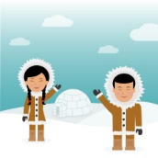
eTwinning Project
Just Like Me
eTwinning Project
Just Like Me
Angela De Vito
English
Teacher
Angela De Vito
English
Teacher
Cira Serio
ICT
Coordinator
Cira Serio
ICT Coordinator

