Slide 1
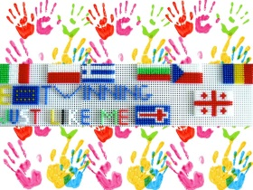
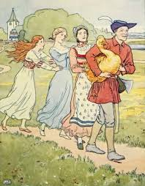
eTwinning project JUST LIKE ME Get ready for Kahoot!
The Golden Goose

