Slide 1
Sacrifice in the name of friendship

Slide 2
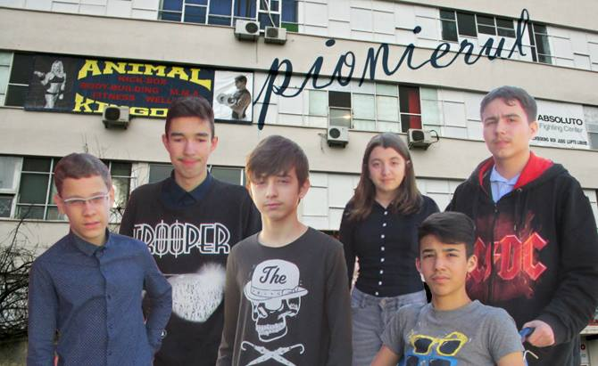
On the evening of the 30th October 2015 there were Halloween parties going on in Bucharest; at the same time, a rock concert was taking place at Colectiv Club where the members of Goodbye to Gravity band were launching their new album. There were hundreds of people at the concert, including the protagonists of our story, 14-15-year-olds Mihai, Pavlos and Laur.

Slide 3
It had all started a week earlier, when Mihai was going to be invited to the first rock concert in his life by his best childhood friend, Pavlos. Mihai was suffering from a medical condition which kept him in a wheelchair, so he rarely left the house and did not have many friends either. (Pavlos was his closest and most devoted of all friends). That’s why the event was even more special to him.

Slide 4
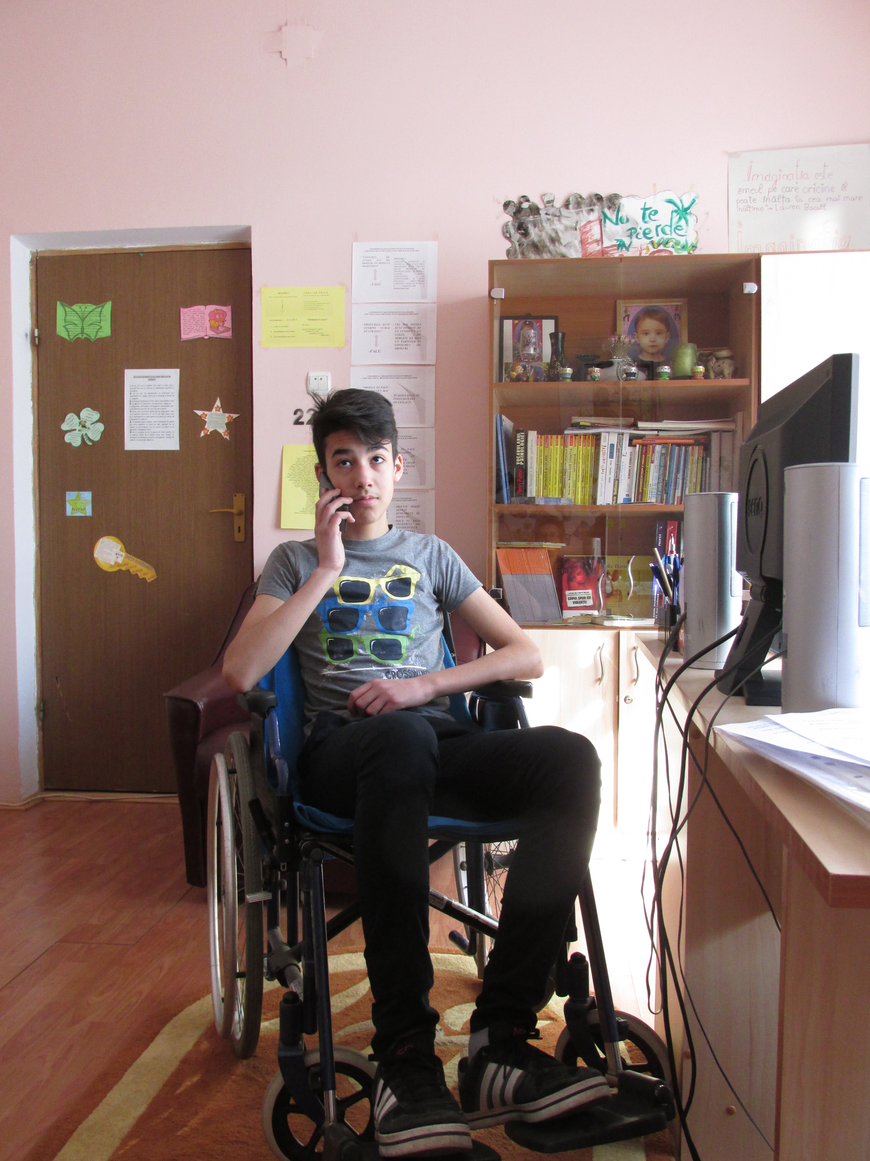
It took a while for Pavlos to prepare everything …
Pavlos: Hi Mihai! I heard there will be a rock concert this Friday at Colectiv Club! Do you want to come? Laur is going to be there too!
Mihai: I don’t think so! How am I going to get there, in a wheelchair?
Pavlos: There won’t be any problem! You will be with me and with Laur, relax!
Mihai: Ok, But my mother, she won’t agree!
Pavlos: I’ll convince her!

Slide 5
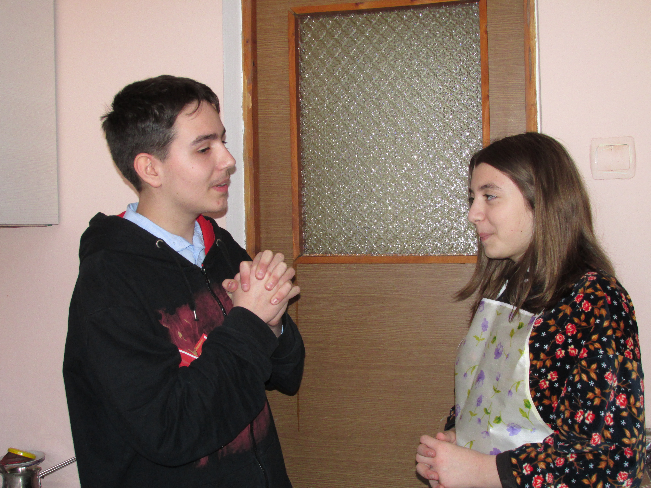
… but he was finally able to convince Mihai’s parents.
Pavlos: Please let Mihai come to the rock concert with us!
Mom: NO, he’s in a wheelchair and it is better for him to stay home.
Pavlos: Please, we will take care of him! He loves rock music and you know that; besides, all the guests are serious and reliable teens.
Mom: Ok, if you promise you will take great care of him I’ll let him go!

Slide 6
The day of the concert had finally arrived. Friday night, 9.30 pm, over 400 fans were ecstatic about the concert, including the 3 friends Mihai, Pavlos and Laur.

Slide 7
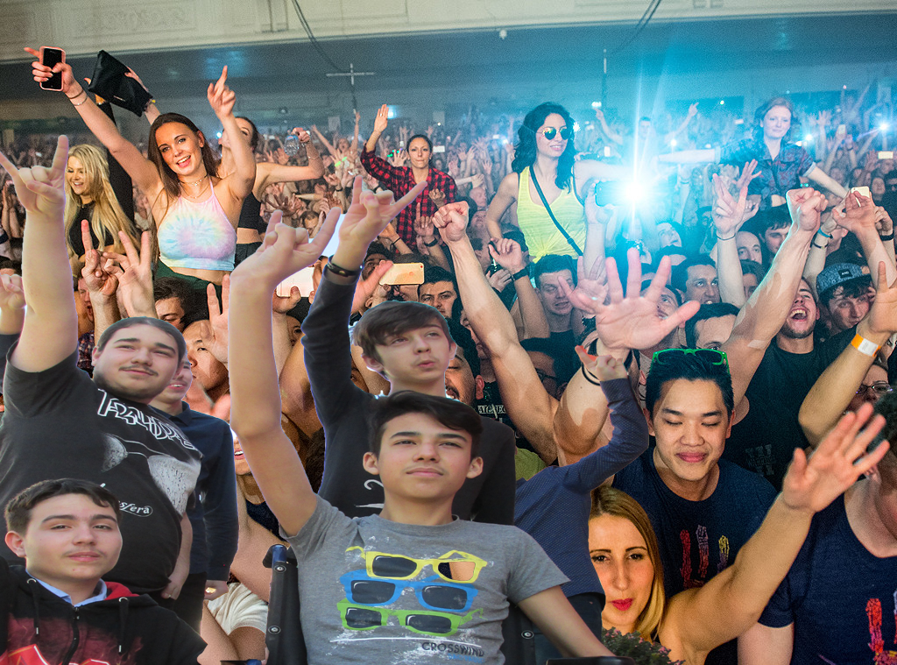
In fact, Mihai was in the front row, fully enjoying the show by his favourite band. His friends close, it all seemed magical and nothing bad could happen.

Slide 8
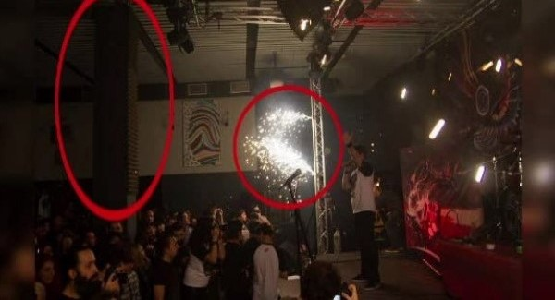
One hour later, however, a real nightmare was about to start – while the band were ironically playing the song called “The day we die”, the firework show which had just begun got out of control. A few sparkles lit up the sponge covering the pillars there and soon the whole ceiling caught fire. It all lasted around 10 seconds but the fire turned into real chaos.

Slide 9
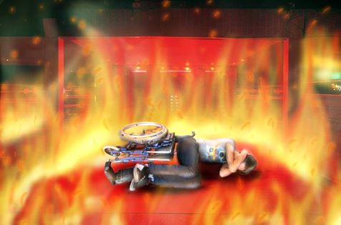
The young people there were all trying to save themselves, and so were Pavlos and Laur, rushing through the only exit available. But Mihai couldn’t move, he was stuck in the wheelchair. He thought he would die there. His chair overturned, he covered his head with his hands, but it was in vain: the fire was unstoppable and so was the people’s dread.

Slide 10
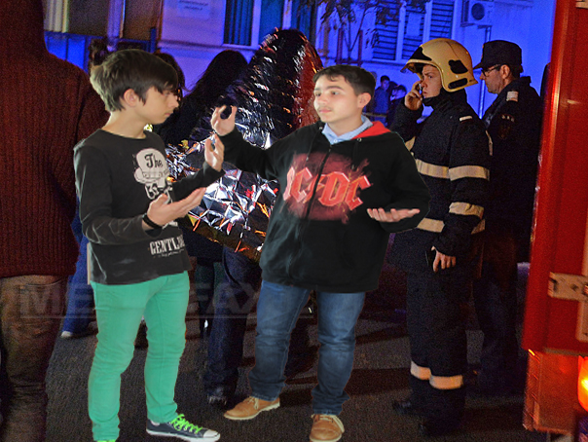
And then something incredible happened: Pavlos realized that his friend Mihai was unable to save himself, so he decided to go back inside and look for him, even if this meant risking his own life.
Pavlos: Finally, we got out!! Air, I need air !!!
Laur: Where’s Mihai???
Pavlos: Oh noo, Mihai’s still in there!!! Don’t worry Mihai, I am coming for you!!!!!

Slide 11
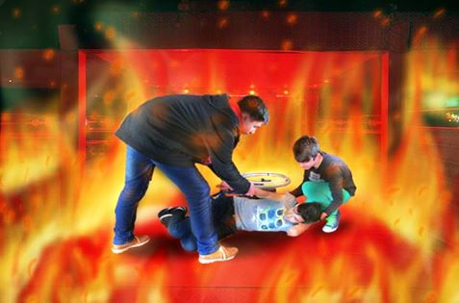
Together with Laur, forcing their way through the crowd, the 2 boys went back into the club. Helped by Laur, Pavlos acted like a hero and managed to carry his friend on his back out of the hellish fire.

Slide 12
They had saved Mihai’s life but they were all badly injured and were finally taken to hospital. Pavlos, the hero, was in critical condition, with burn injuries covering more than 60 % of his total body surface area, a severe infection and burn injury of the respiratory tract.
His life was initially in great danger and for weeks the doctors did not give him much chance of survival, but despite everything, he had managed to rescue his best friend and come back to life himself.

Slide 13
In the meantime, 63 people, most of them under 30 years of age, had died and many others were seriously injured.

Slide 14
Pavlos is on the road to recovery and will soon be joining his two friends, who had previously left the hospital. He has become famous now and his heroism has brought him many friends and their support.

Slide 15
Pavlos has come to represent sacrifices made in the name of friendship. The name Pavlos now equals the concept of a child-hero in present-day Romania.

Slide 17
This video was made as a part of the Erasmus+ KA2 project “We are the world, we are the children” 2014 - 2016

