Slide 1
‘’A fire hero, telemachos’’
Platon schools

Slide 2
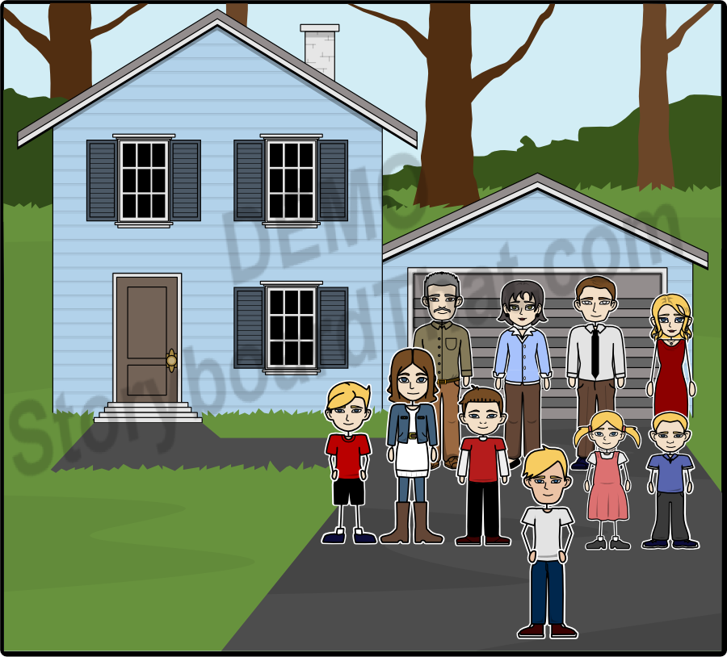
Once upon a time,in a region of Greece,there was a child who was special compared to the rest.His name was Telemachos.It was the child who,one day,would be sacrificed for his beloved siblings.

Slide 3
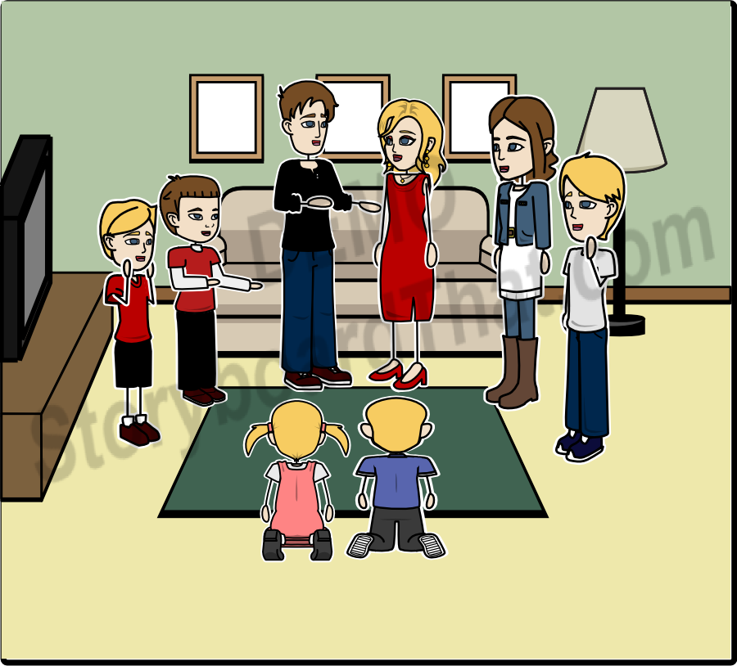
One day of December,his family got ready to visit their grandparents' village.The preparation started with plenty of joy,pleasure and excitement.

Slide 4
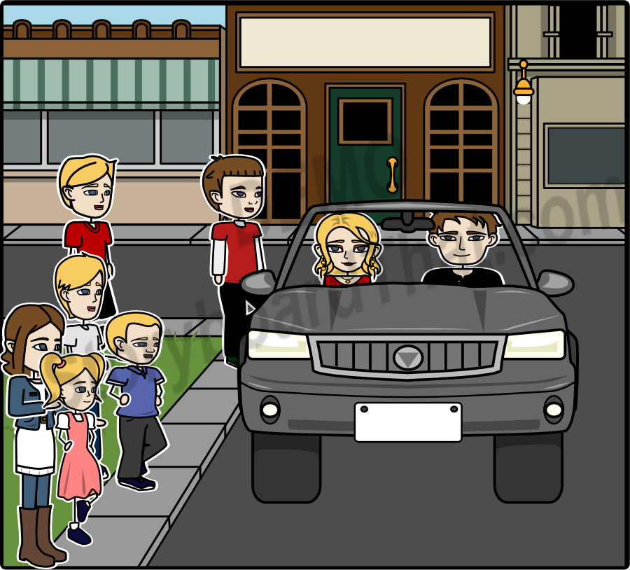
Everyone was ready to go.Pleasant voices,games and teasings created a happy atmosphere.Everybody got into the car at once and set up for the trip.

Slide 5
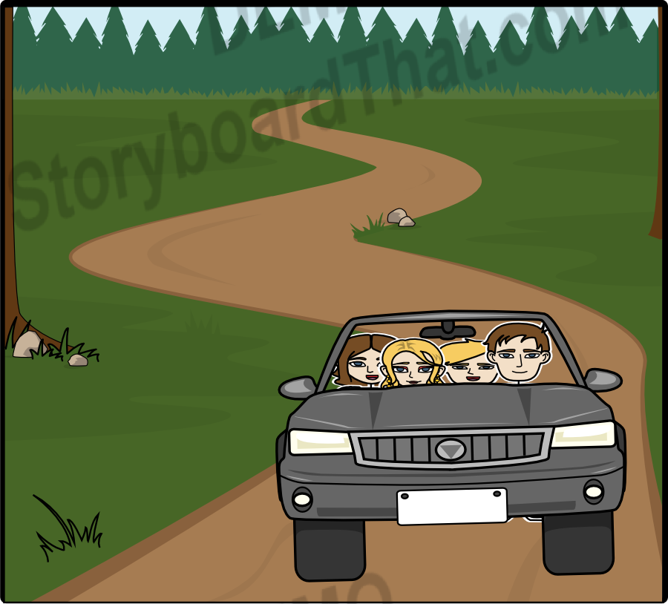
The journey was amusing,as each one was telling a funny story.This way,they passed through hills,rivers and lakes, while, on both sides, there were trees , fully bloomed grounds and the blue sky all around the place.

Slide 6
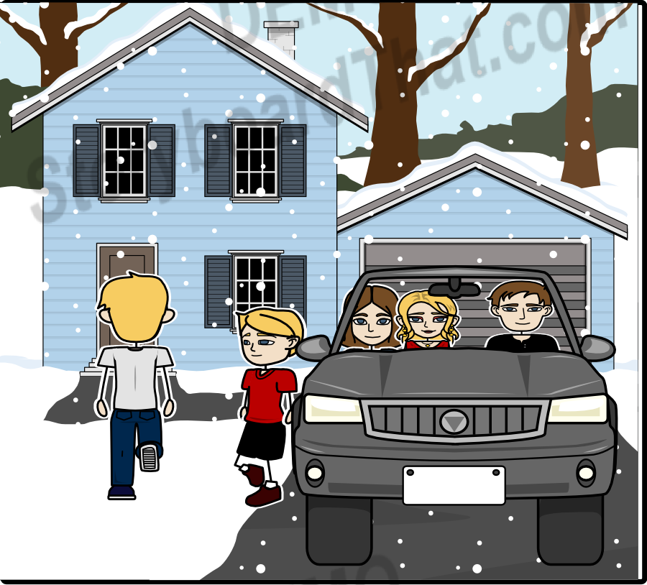
Not a moment too soon, until they arrived to their destination.

Slide 7
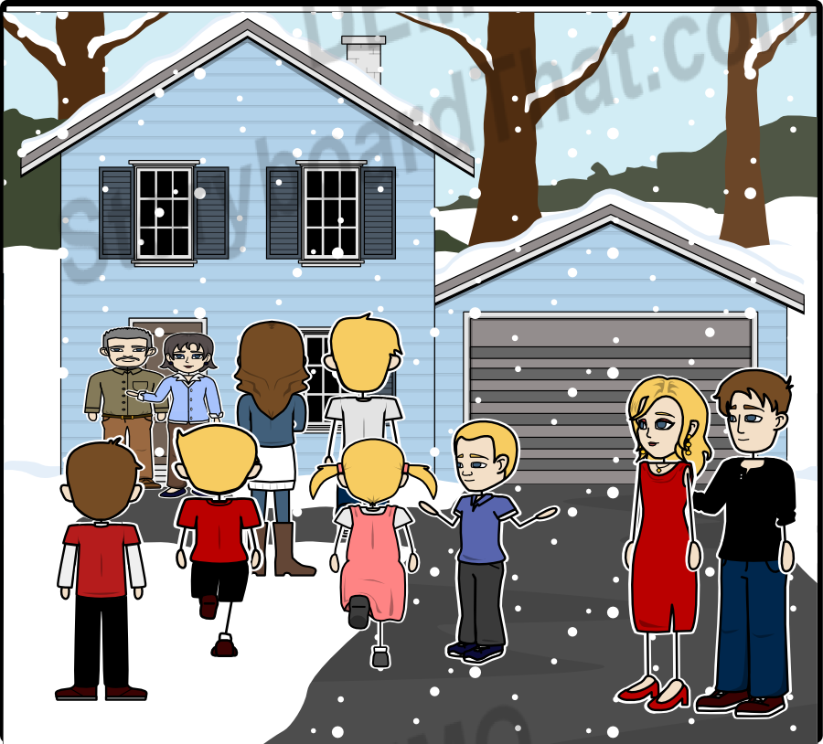
The car had already stopped,when the first snowflakes touched the ground.The grandparents welcomed them with joy.

Slide 8
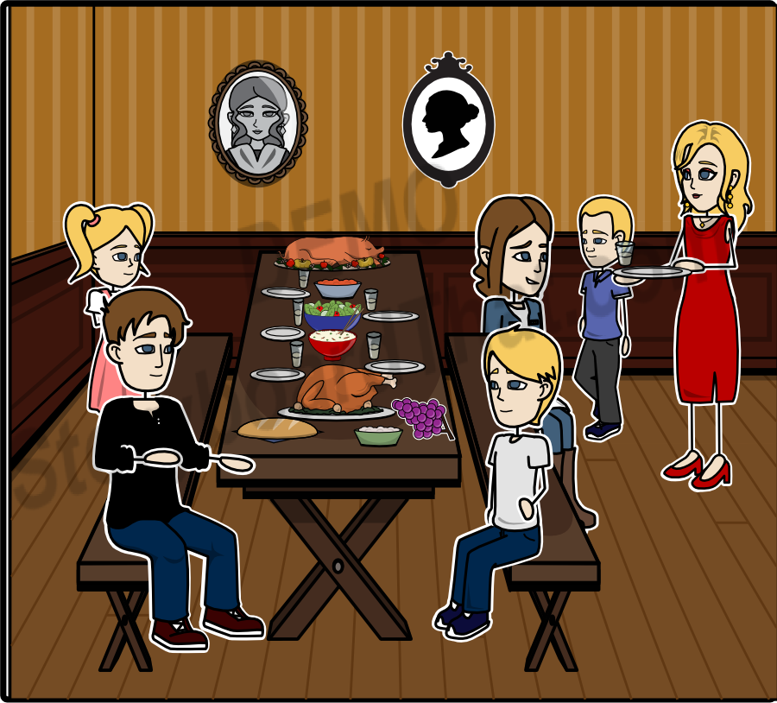
A table full of well-cooked food was awaiting the travellers.They sat all around the table and dined while discussing.Time was passing by and after they had finished dinner,they gathered all together around the stove,which was lit.

Slide 9
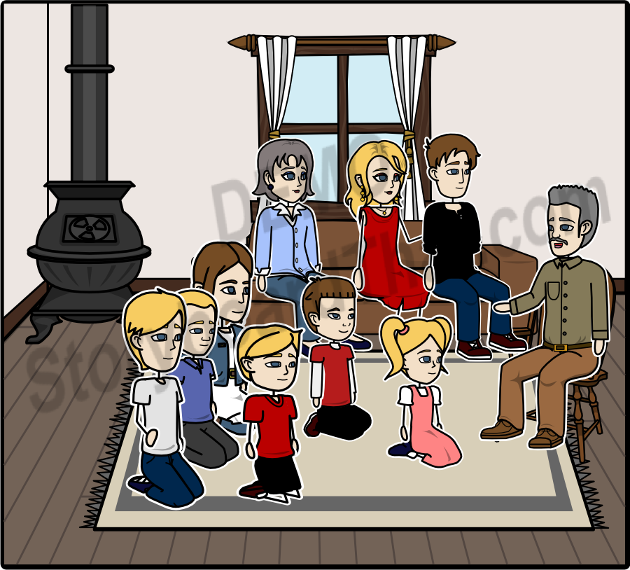
The grandpa reflected stories of his youth and was teaching life lessons to the younger ones.

Slide 10
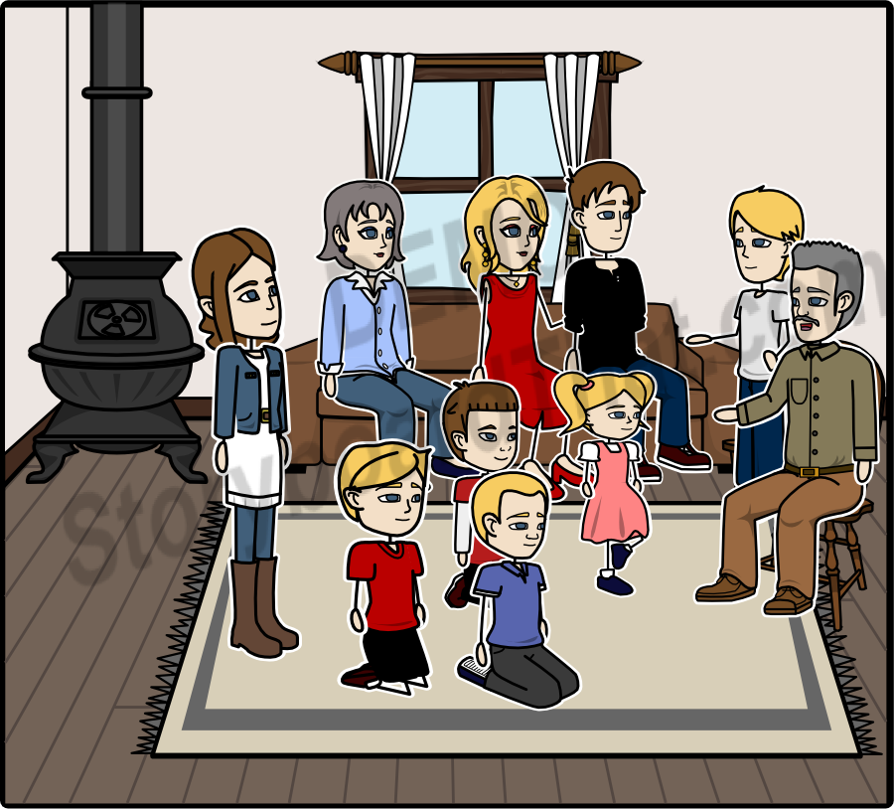
He was saying that life is pleasant and someone needs to be talented in order to live it, that we all should offer whatever possible to our beloved ones and to struggle for their behalf.He was also saying, that we should be each other's angels.

Slide 11
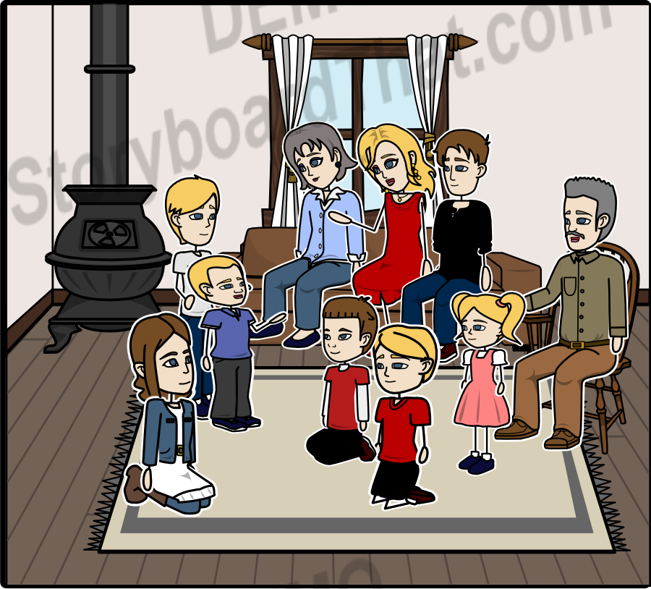
At the moment , the youngest of the family asked: “What’s an angel, mommy?” “Angel means love and care . It is something without any substance and leaves in the sky, taking care of the people living on the earth’’, she answered . This way , they spent their night, until it was time to go to bed. Delighted by their family meeting, they lied on their fluffy and warm beds.

Slide 12
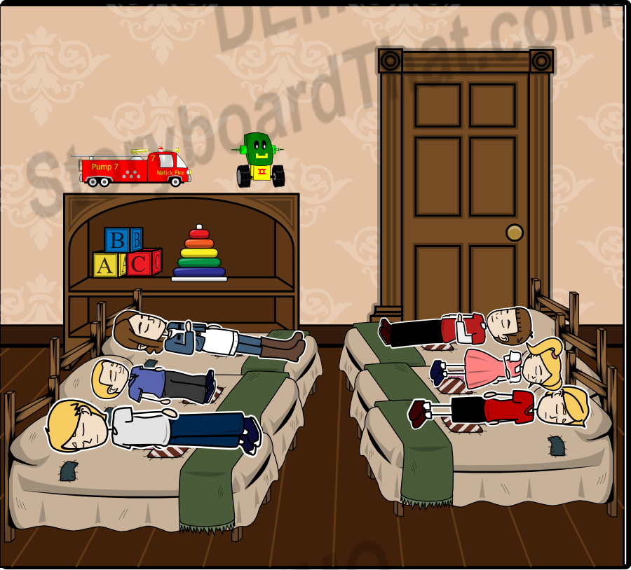
Several hours later ,the grandparents felt a strange warmth inside the house.

Slide 13
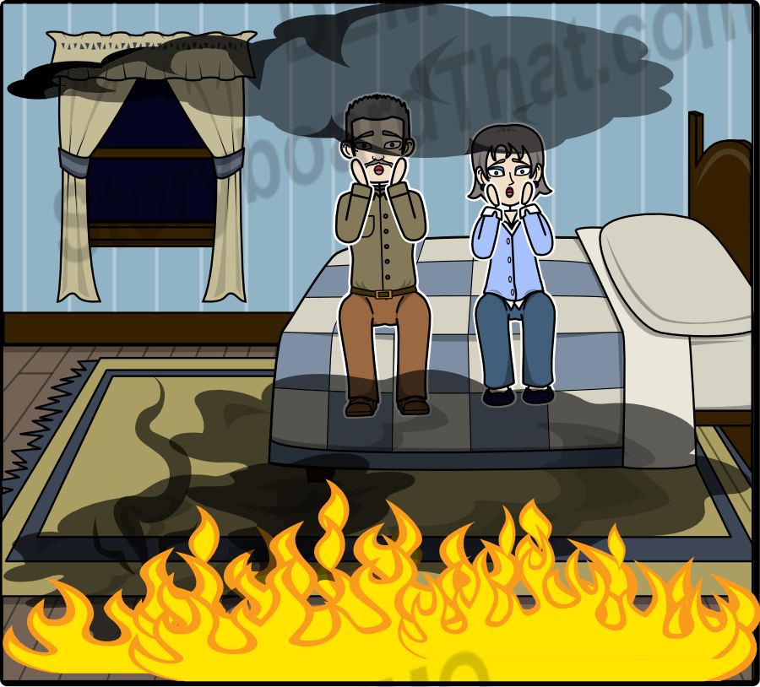
They woke up filled with horror.Flames and smoke were surrounding their two-floor residence.

Slide 14
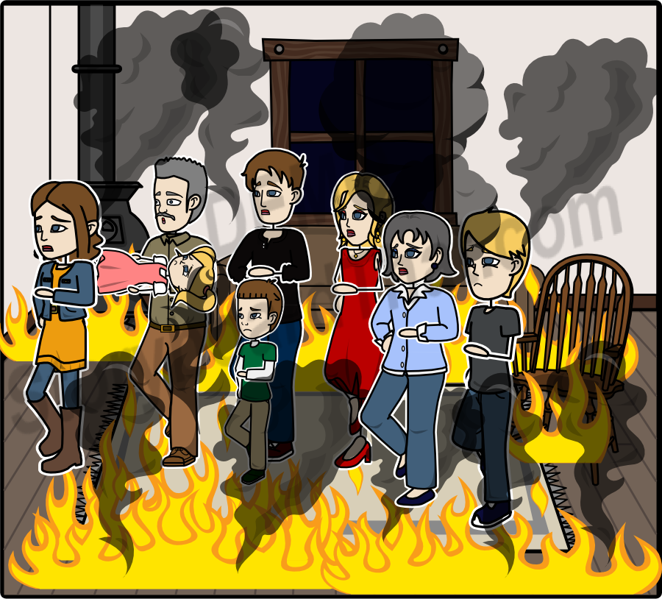
All of a sudden , everyone was awake . The grandparents along with the parents were the first ones to pour water onto the fire , using anything they could.Most of the children got out at once in an effort to help.

Slide 15
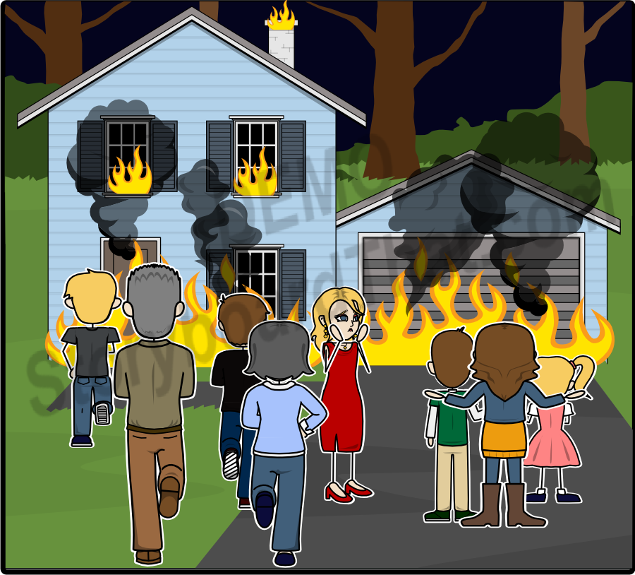
At some point , they gave up trying and the mother looked around so as to find her children ."The children , the children haven't come out!".Fear was visible on everyone's face. Two out of six children were trapped inside the house which was still in flames.

Slide 16
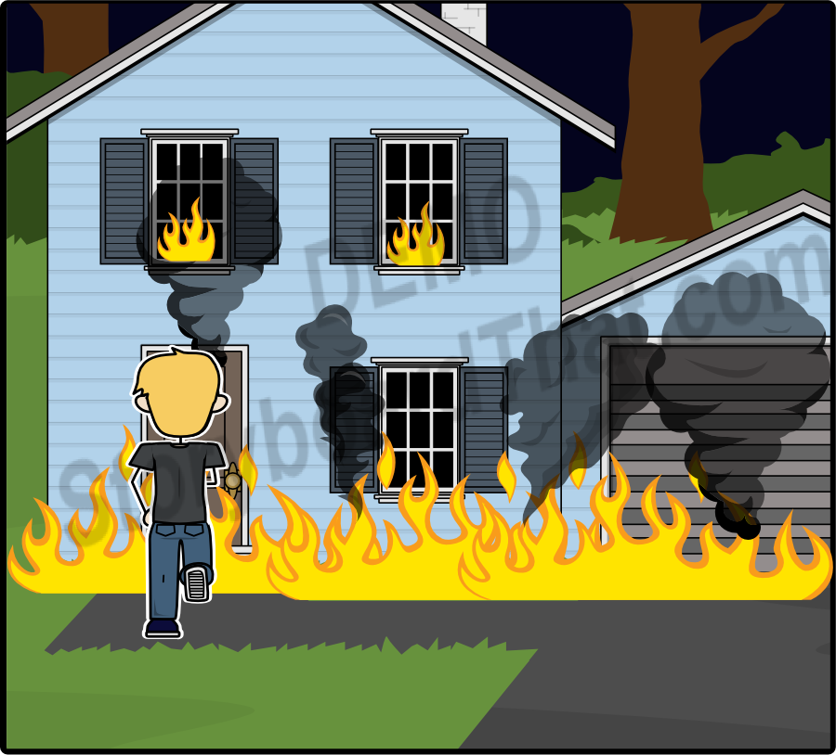
Without any words or second thoughts , Telemachos , still wearing his slippers and pyjamas, got back into the flames again .

Slide 17
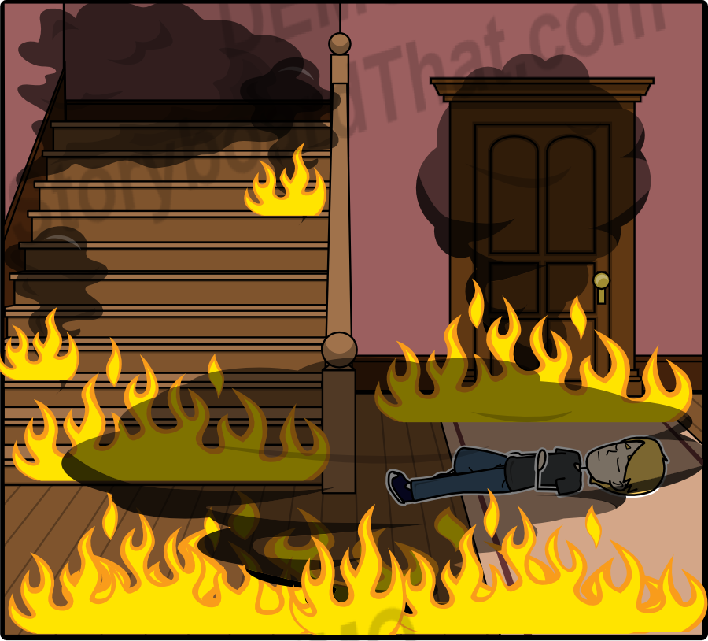
He was desperately looking into the house , but the thick smoke wouldn't let him see and he lost his senses in no time because of the vapors.

Slide 18
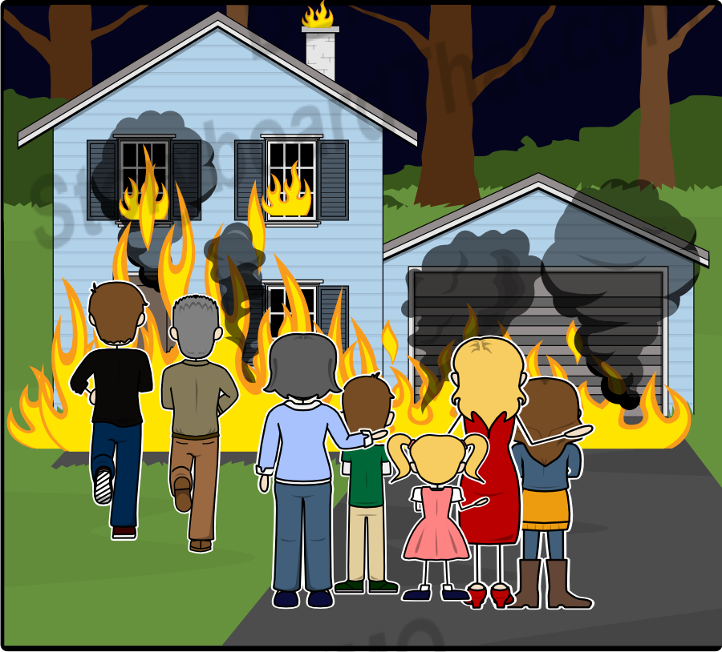
Time was passing by , but neither Telemachos nor his younger siblings , showed up . The father and the grandpa vainly tried to pass through the flames in order to help . The residence collapsed . The fire was put out , as well as the hope of the family .

Slide 19
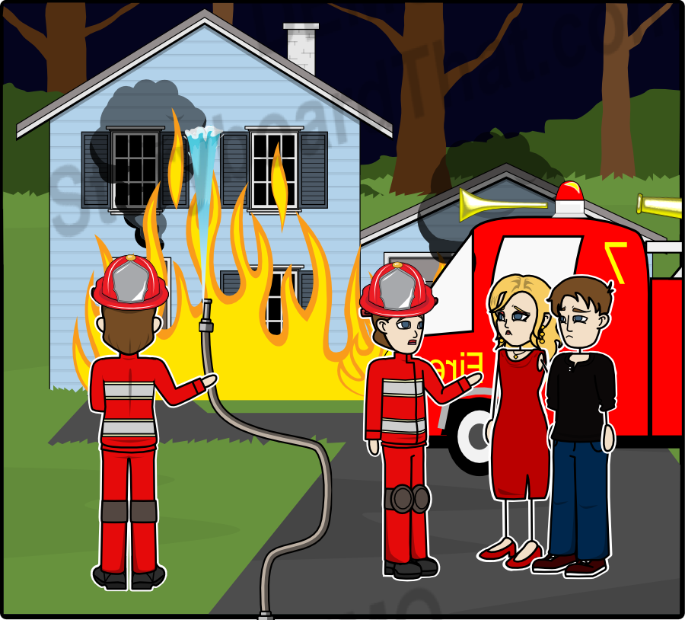
Add Title Here
The firefighters sadly informed everyone about the bad news.Everybody was mourning the loss of the young children , but admired Telemachos' bravery. Telemachos became their hero.

Slide 20
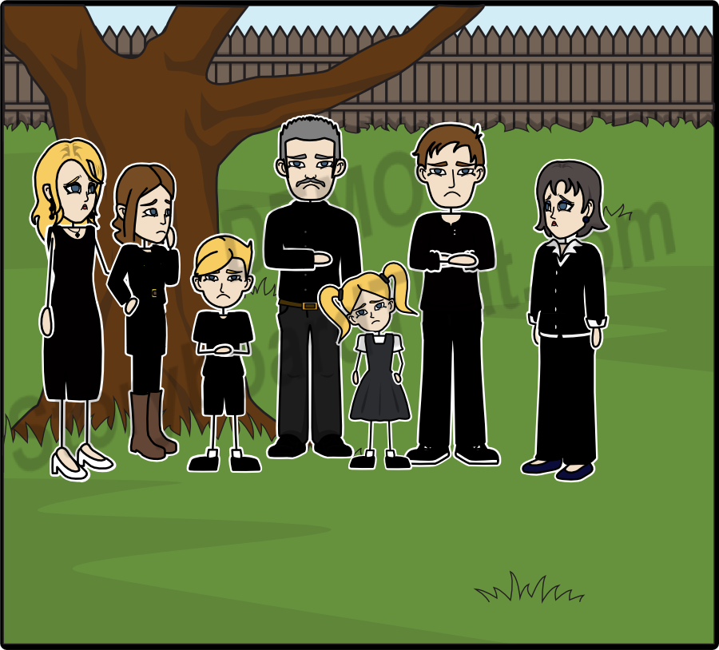
Everyone was comfortless. They couldn’t believe that Telemachos , the favorite child of the neighborhood , the best student , the best friend , the kindest person wouldn’t be around anymore.

Slide 21
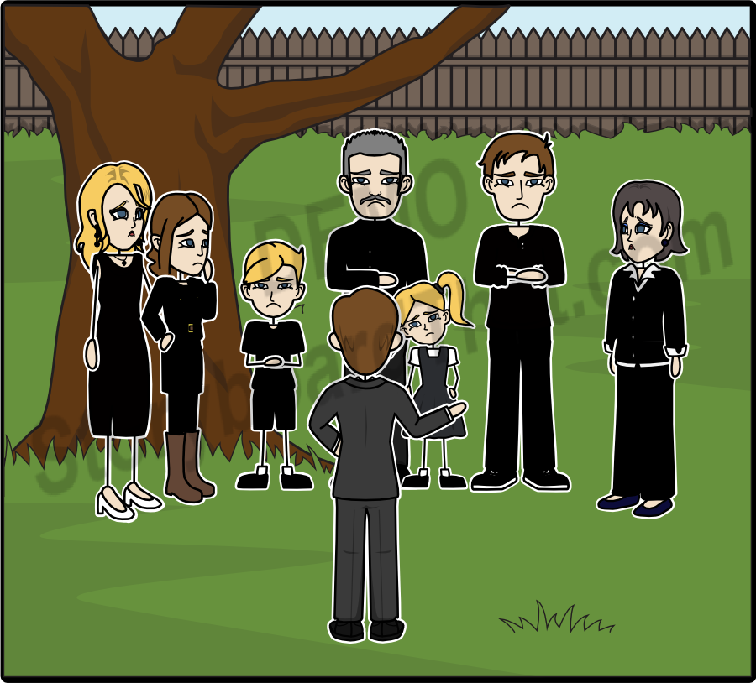
Then , the children’s uncle , approached them in an effort to console them and said:”He immediately lost his senses and fell down. So , he didn’t realize the journey towards the sky. And it is a really long trip,because it is a great honor to become an angel.

Slide 22
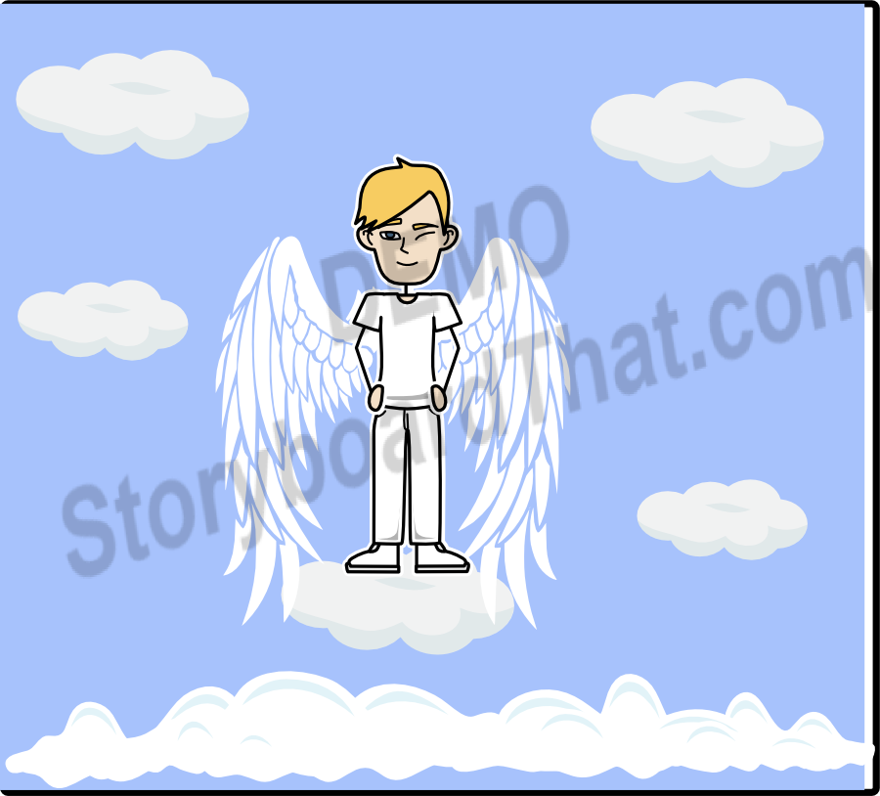
It is a great honor indeed for somebody to become a hero.

