Slide 1
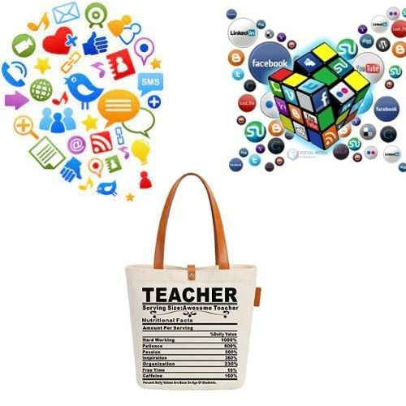
WEB2 TOOLS
YASEMİN SÜTÇÜ

Slide 2
INDEX
1. Digitization of Classroom
2. How we adapt digital technologies in our classes
3. e-Twinning Projects ( Happy Kids With Steam & Nature’s Media)
4. Life Long Learning
5. A sample Of Digital Planning
6. In-service training
7. Advantages

Slide 3
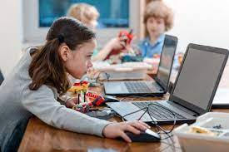
Digitization of Classroom
With the developing technology, it has become inevitable to use digital tools in the teaching of young people and children born as digital natives.
In adult education, it is very important to use digital tools both to catch up with the requirements of the age and to prepare for business life.

Slide 4
How we adapt digital technologies in our classes
Classroom environment needs to be enriched for students with different learning styles and speeds.
Classroom as an interactive learning zone where my students can flourish and learn no matter what their learning style.
Gamification activates the learning process for all learners, regardless of age.

Slide 5
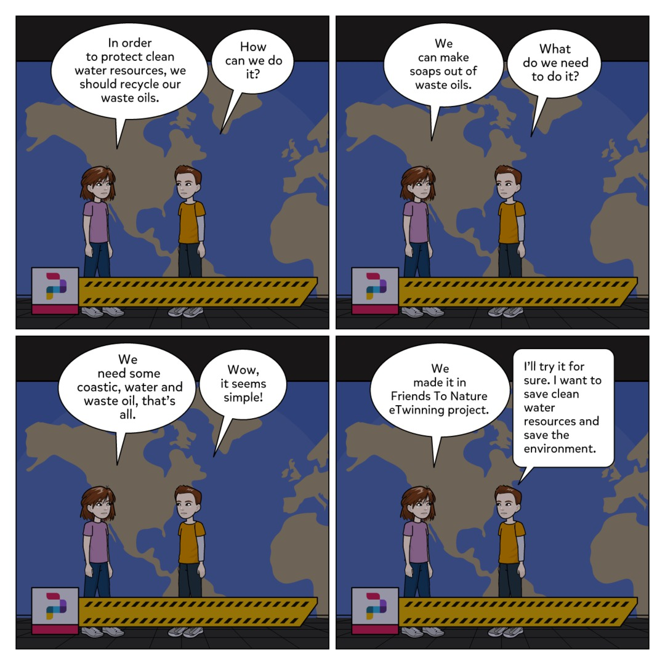
WEB TOOLS TO ORGANIZE AND NOURISH THE LESSONS EXAMPLES WEB TOOLS UUSED DURING eTWINNING PROJECTS
PIXTON AND STORY BOARD
CARTOON AND COMIC BOOKS CAN BE PREPARED USING THE WEB2 TOOLS TO DRAW ATTENTION

Slide 6
Mind / concept maps prepared by our partners using web2 tools such as coggle, mindmeister, mindomo, popplet, edraw mindmaster,mindmup, bubble us.

Slide 7
CHATTERKID

Slide 8
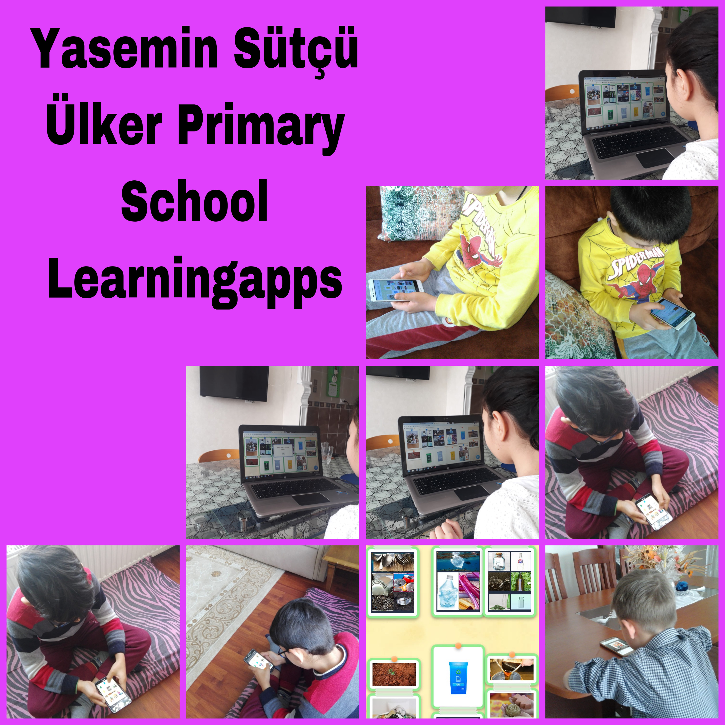
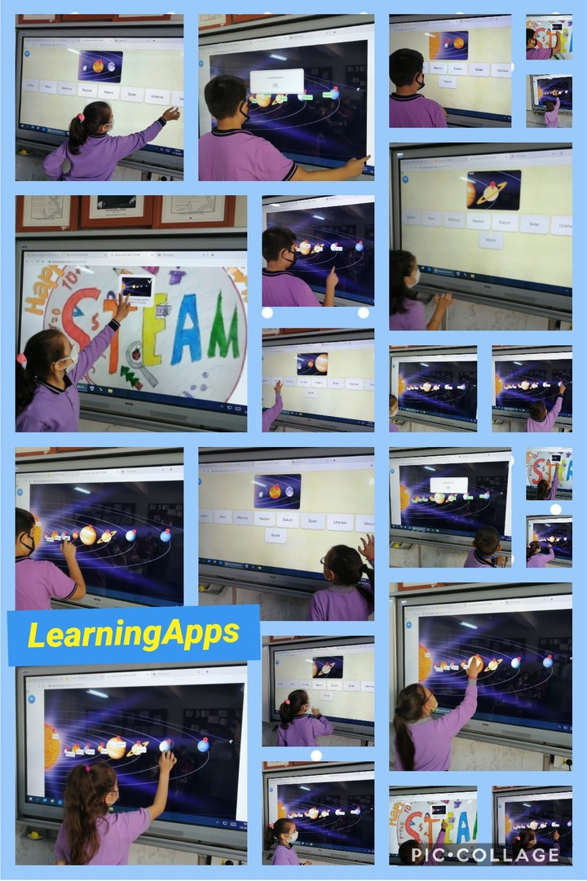
LEARNINGAPPS
HAPPY KIDS WITH STEAM
NATURE’S MEDIA

Slide 9
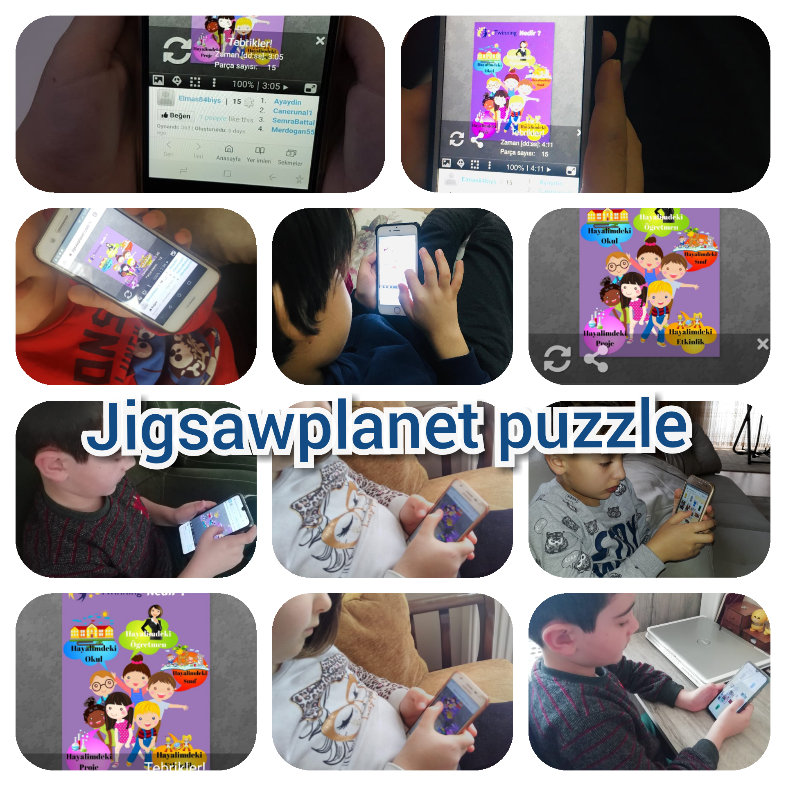
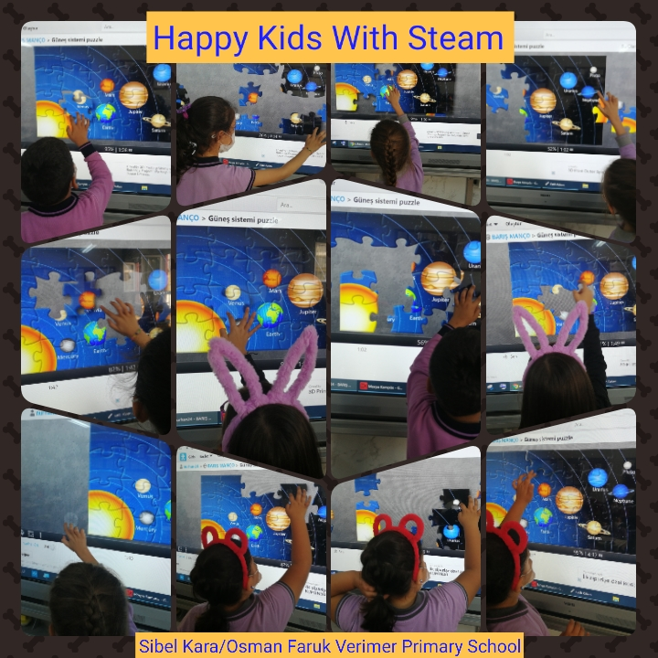
JIGSAW PLANET

Slide 10
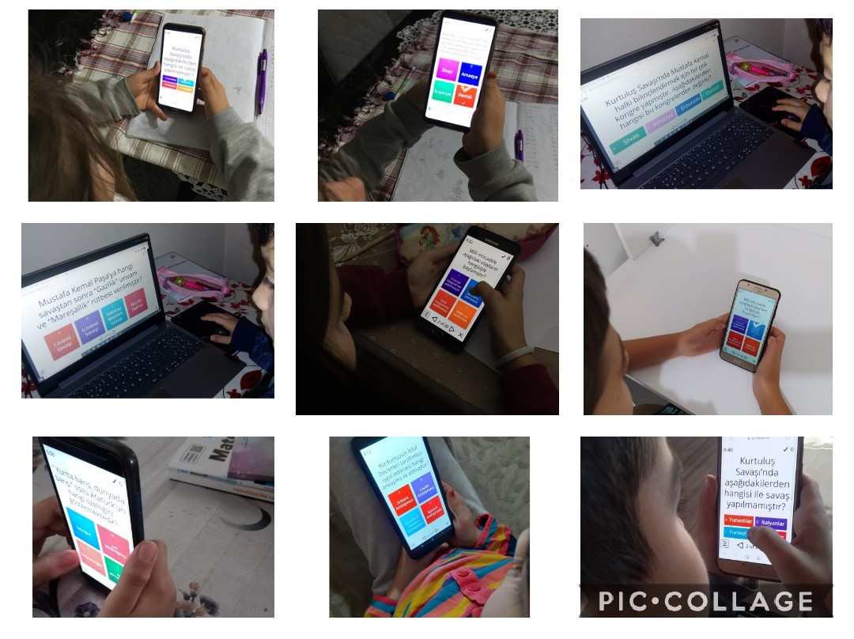
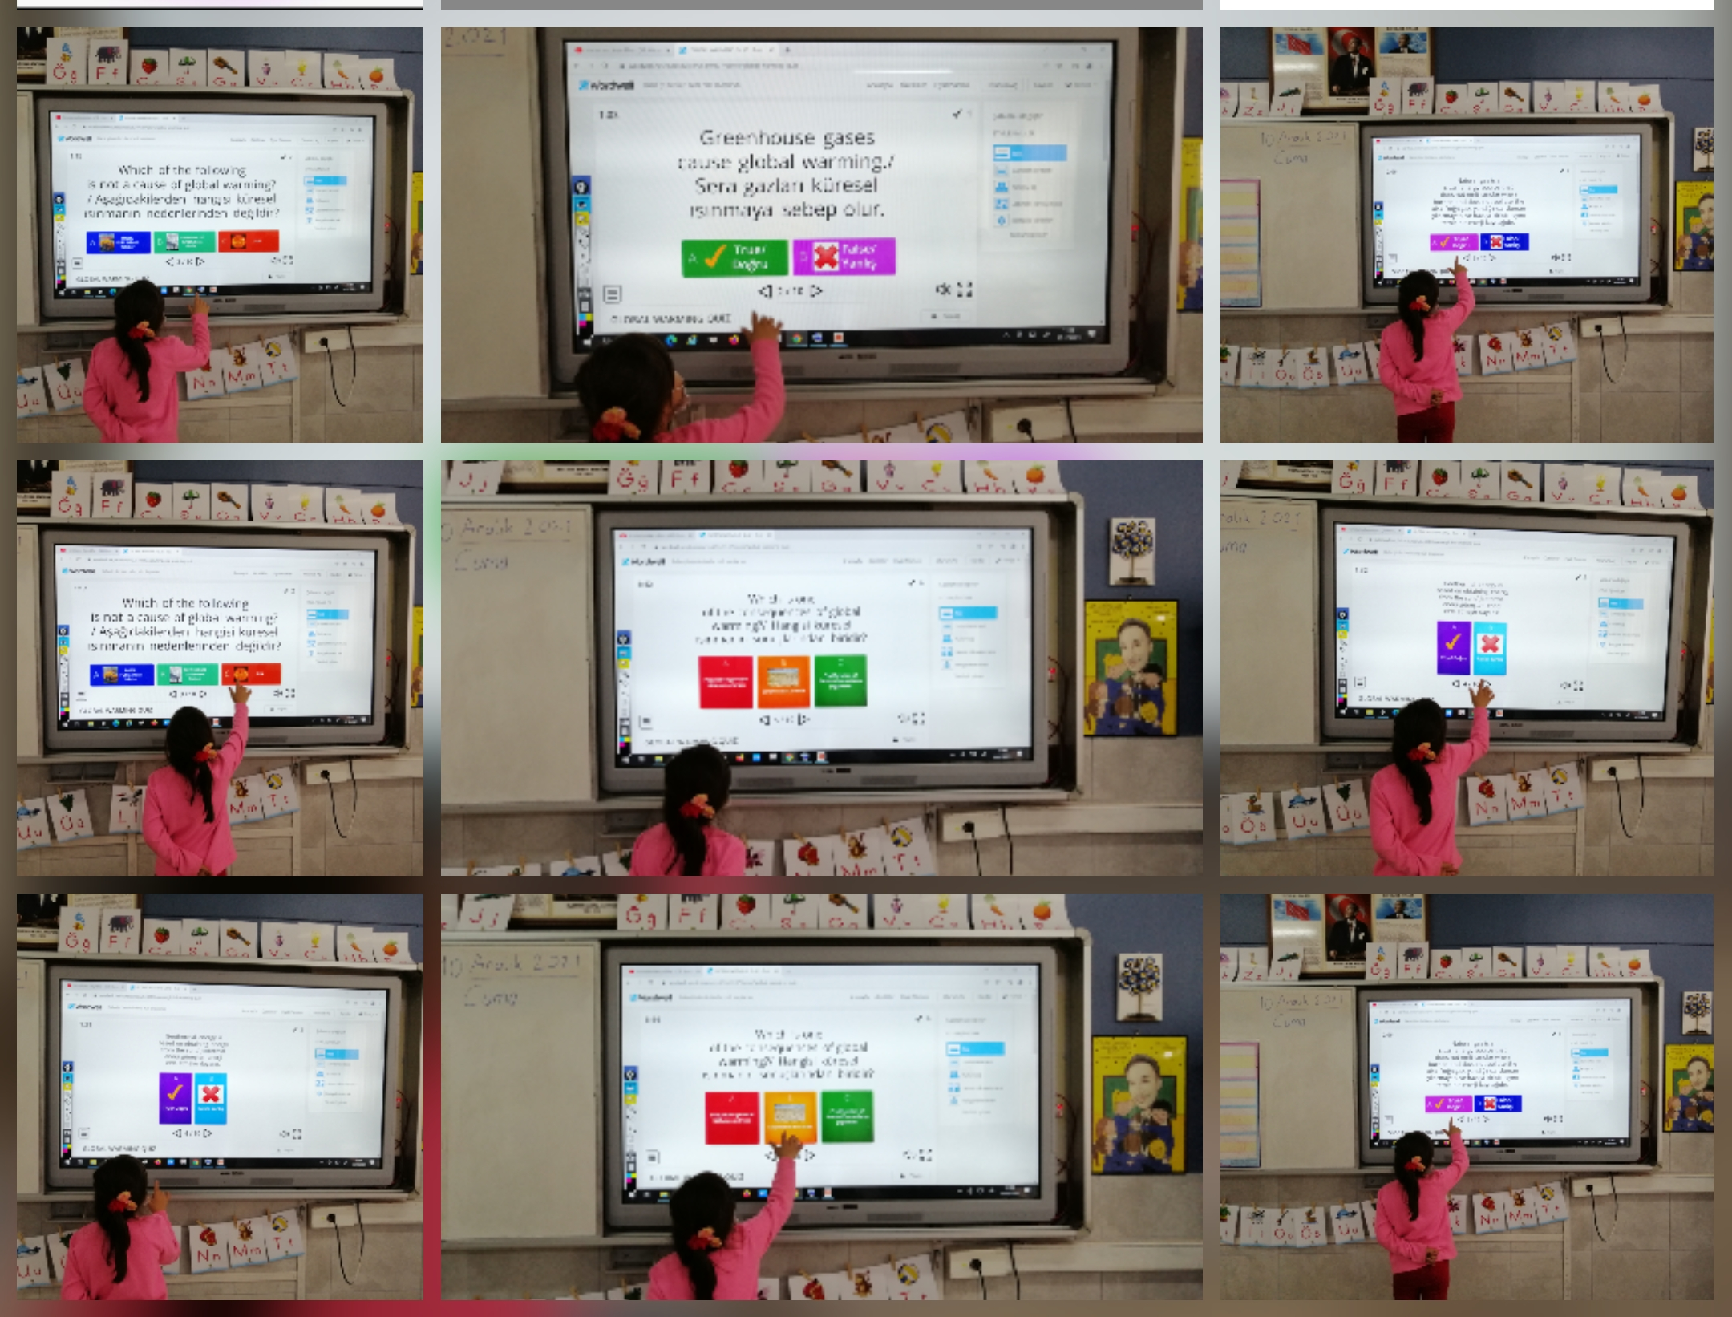
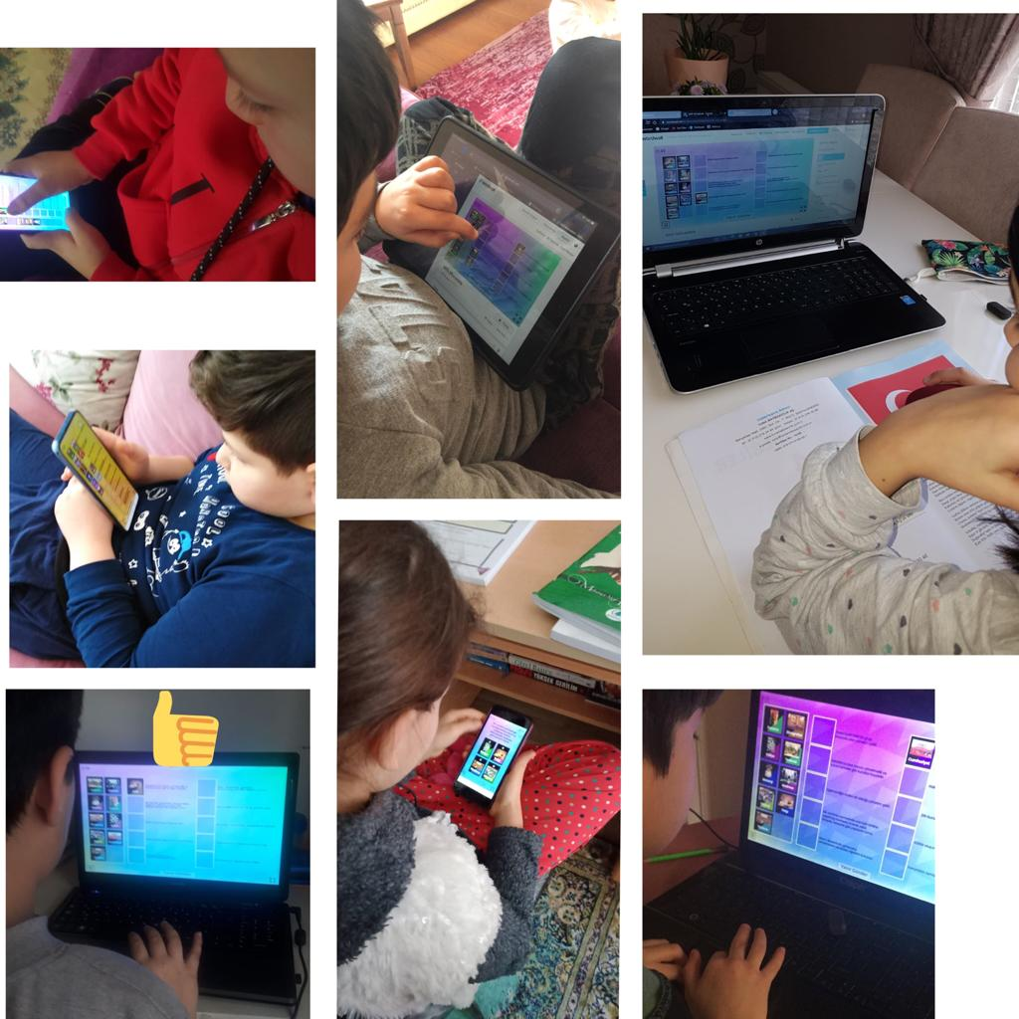
WORDWALL

Slide 11
QUIZIZZ

Slide 12
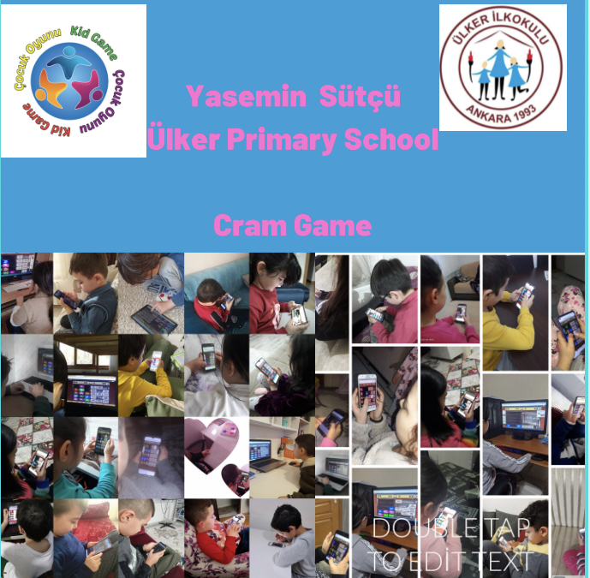
CRAM

Slide 13
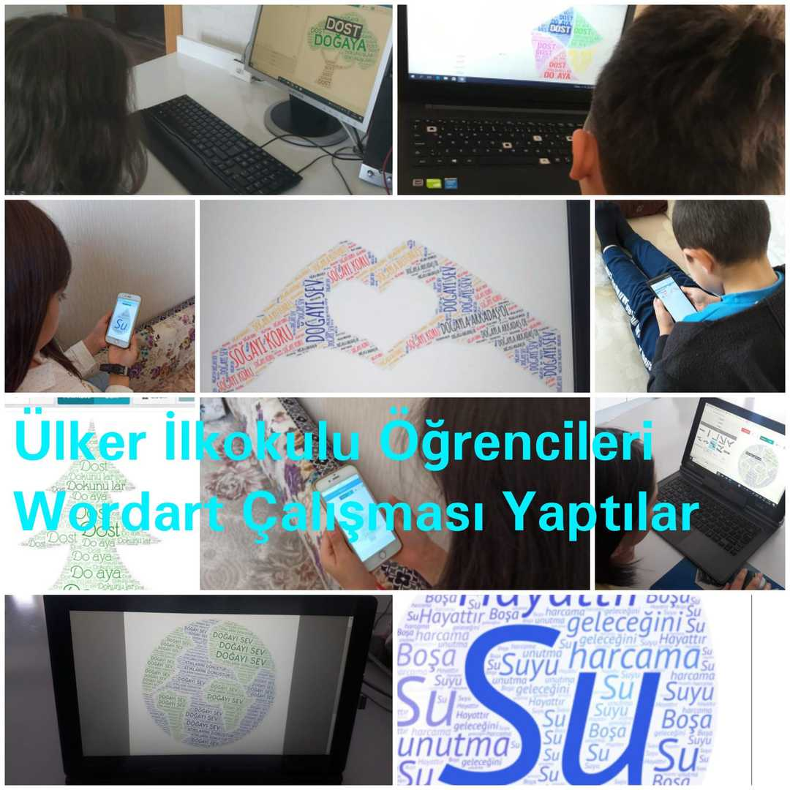
WORDART

Slide 14
MEETINGWORDS

Slide 15
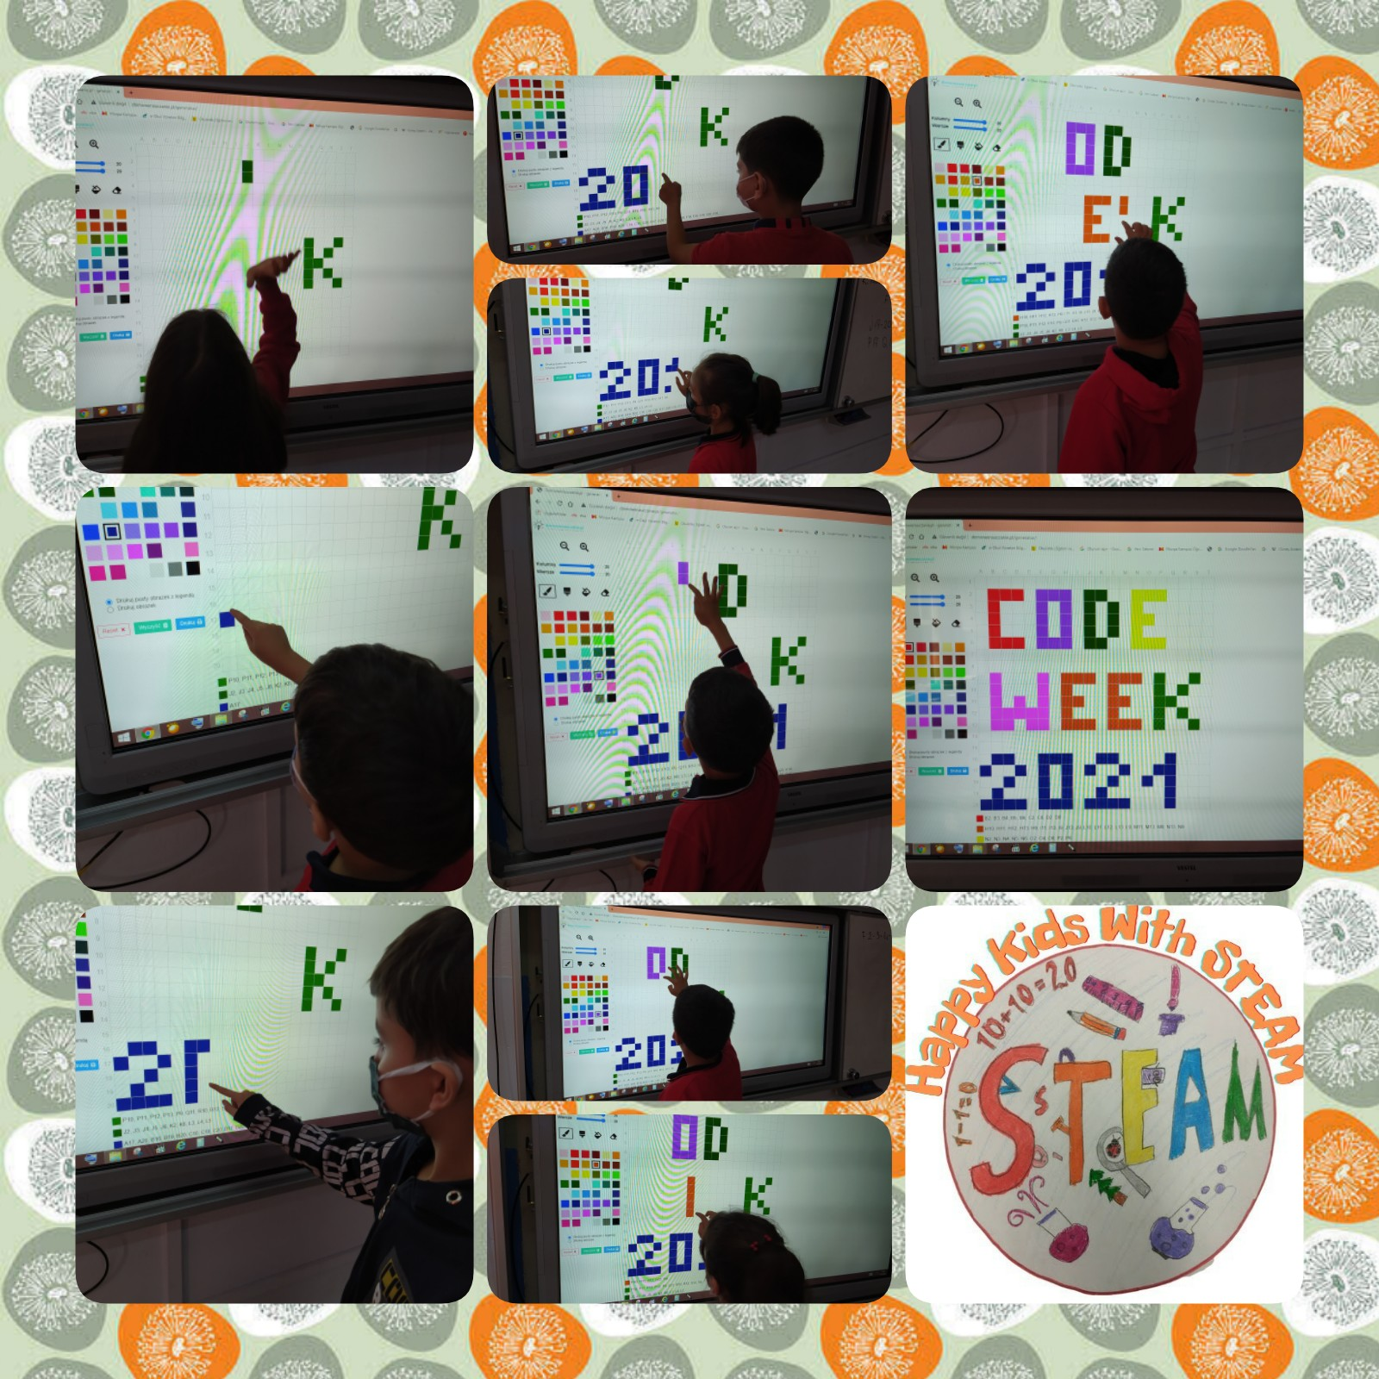
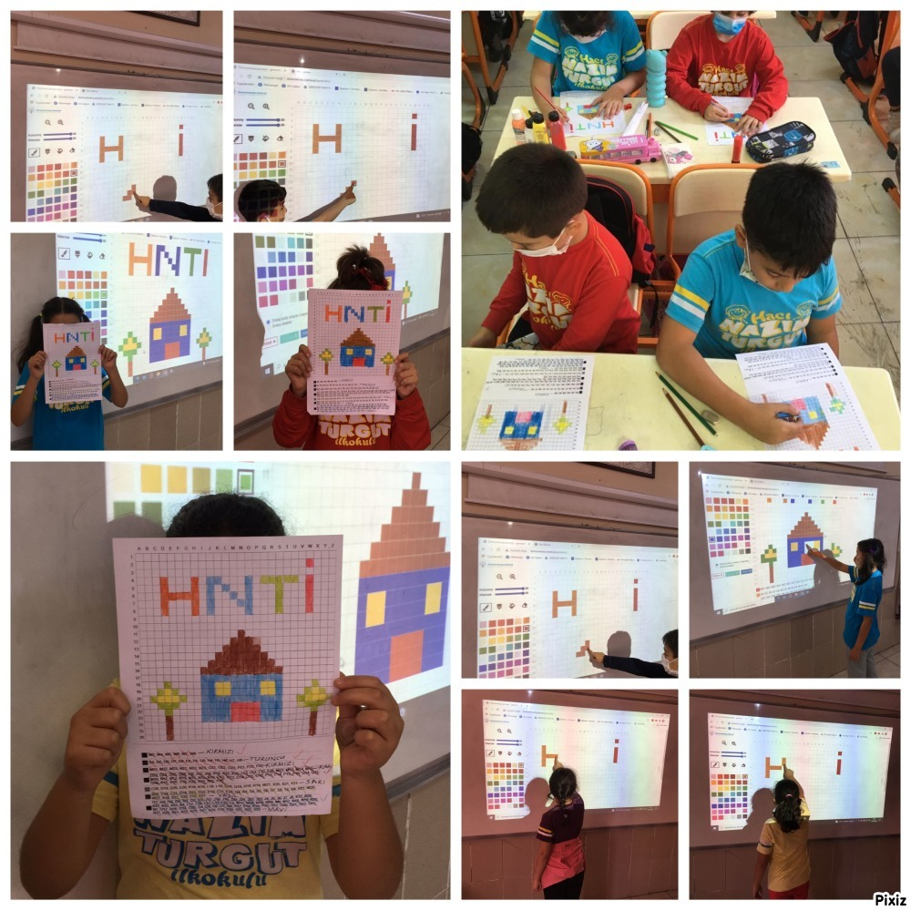
DOMOWENAUCZANIE PL GENERATOR

Slide 16
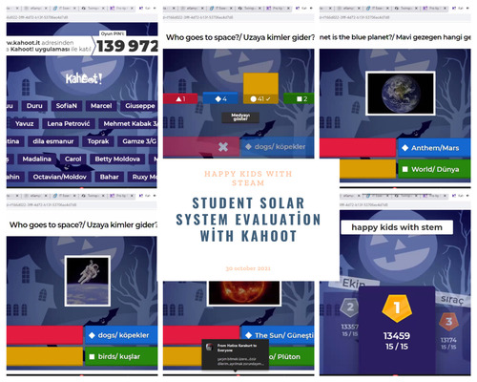
KAHOOT

Slide 17
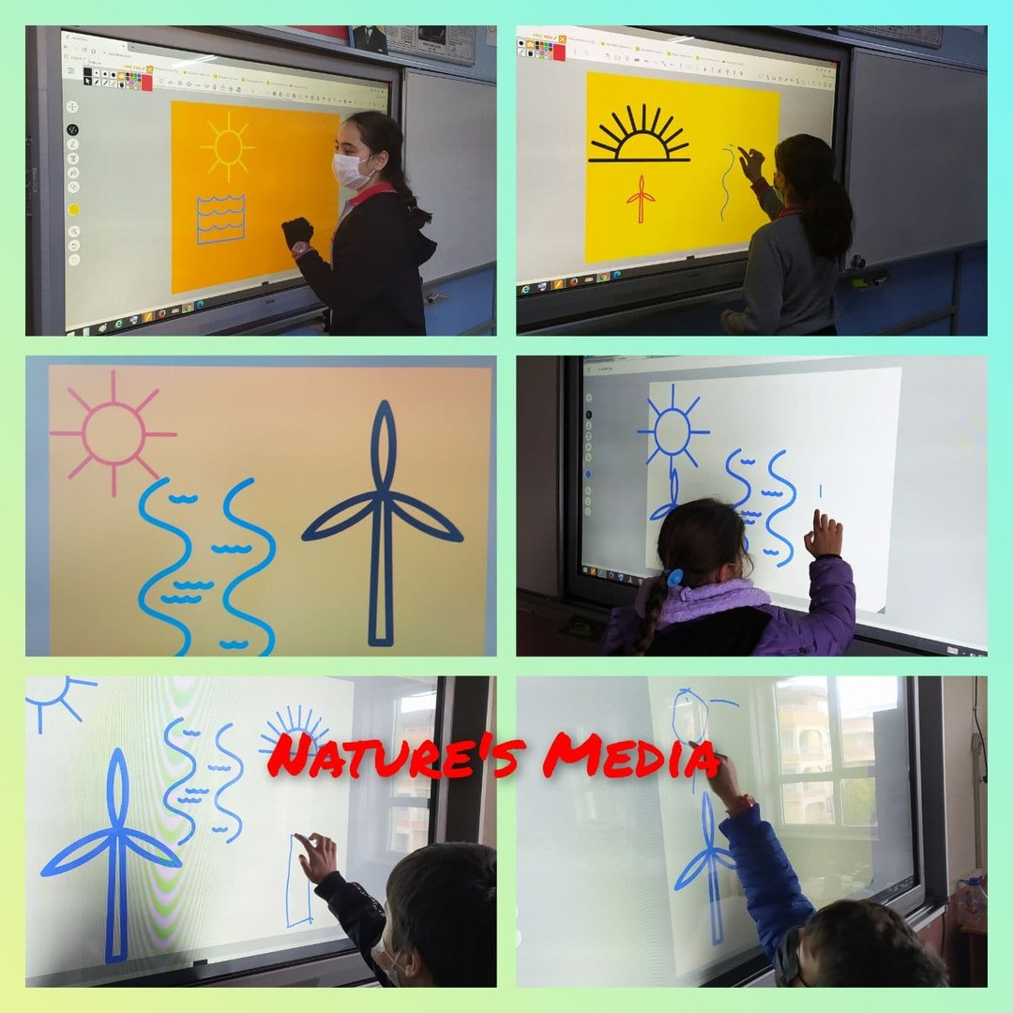
AUTODRAW

Slide 18
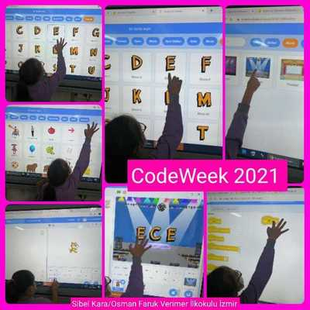
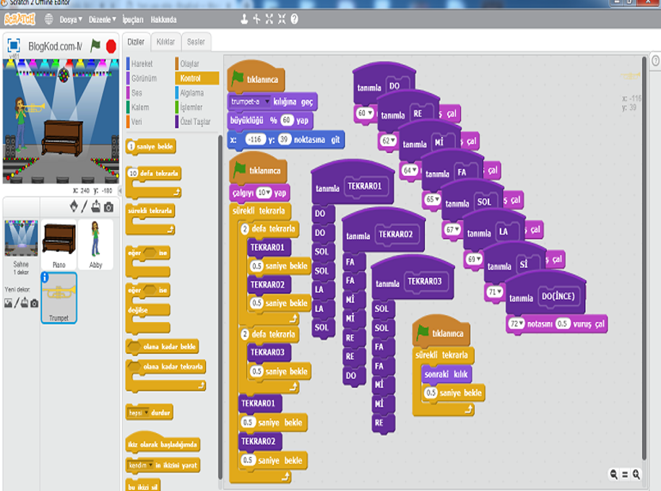
SCRATCH

Slide 19
QUIVER
The Quiver App makes learning fun by combining physical coloring with cool augmented reality technology to create an engaging, educational and magical experience.

Slide 20
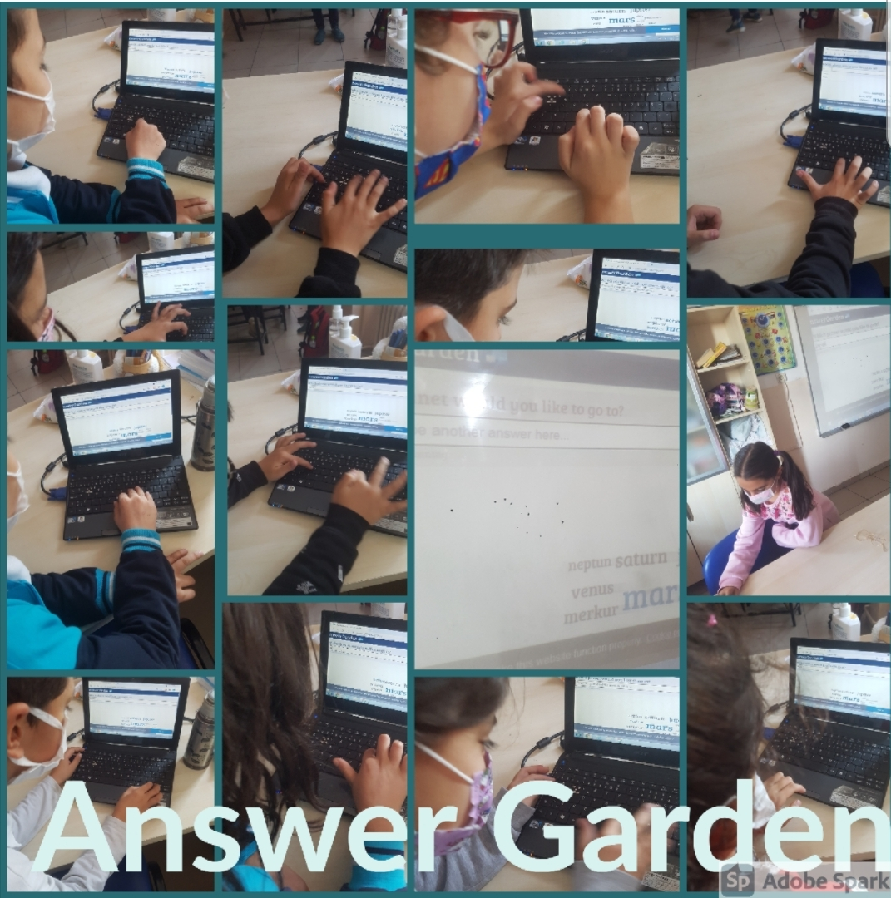
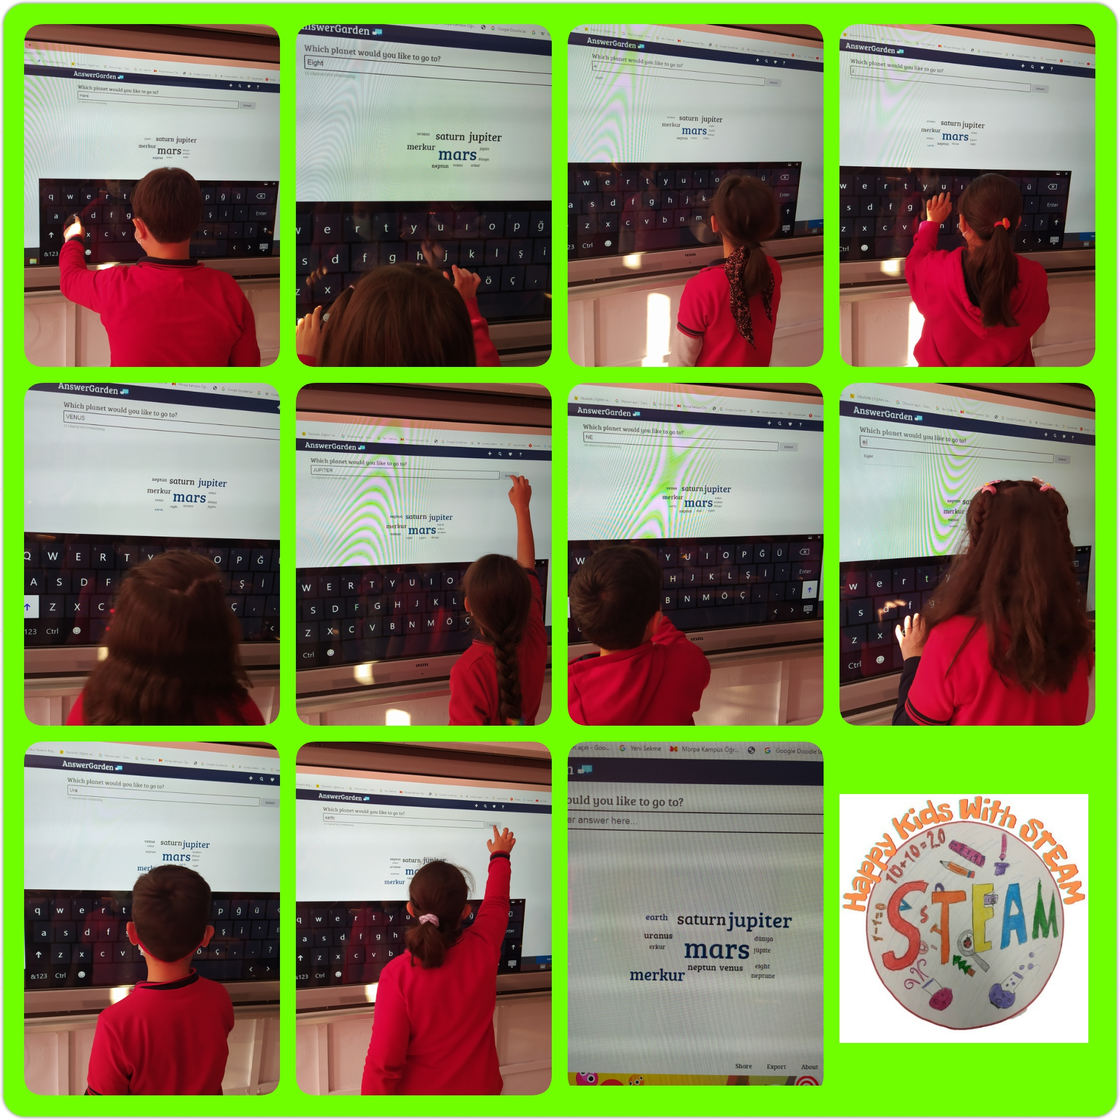
ANSWERGARDEN

Slide 21
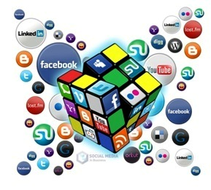
Within the scope of eTwinning Activity, teachers working with their students in their classrooms;
It enables them to have an idea about the educational practices in different schools or European countries, Encourages to use different learning methods in lessons, Increases their ability to use technology and enables them to use it effectively in their lessons,
Making the lessons more fun by making the students more motivated, Helps the development of foreign languages, Increases cooperation skills and work motivation, Provides him to update his knowledge about his field,
•It has been demonstrated that it encourages new and creative projects to be produced

Slide 22
The students involved in the eTwinning Activity; Attending classes more actively, Increased cooperation with peers,
Foreign languages are developed, Directed to different types of thinking such as critical thinking, creative thinking, argumentation-based thinking,
Recognize different cultures and have access to socialization opportunities, It has been observed that the tendency to use web technologies as a producer for educational purposes has increased.

Slide 23
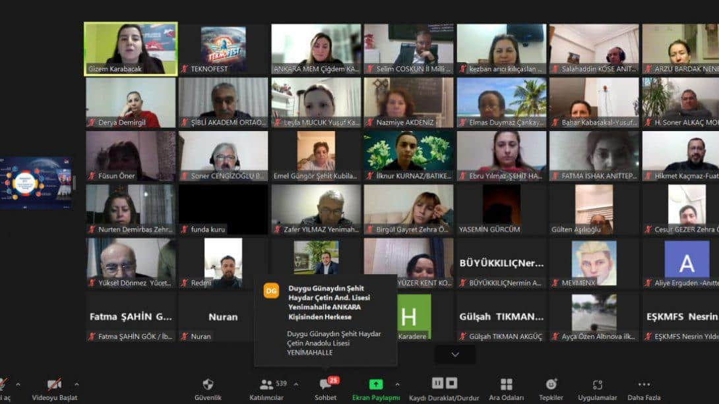
IN-SERVICE TRAINING
In our country and in our province, in-service trainings and skill acquisition courses are organized to improve the digital skills of adults. Teacher participants included in in-service training courses• Comprehension of Transformation in Education,• Learning Innovative Pedagogies in Education• It is aimed to make applications for the integration of Web Tools with Innovative Pedagogies.

Slide 24
ADVANTAGES
It creates a more active and participatory classroom environment.
Students in the educational environment realize positive attitudes towards each other.
Group Work, Effective Learning, High Level Thinking, Constructivist Learning, Individual Learning, Taking Responsibility etc.
Contributes to the Development of Skills.
Students become technology literated.

Slide 25
THANK YOU
YASEMİN SÜTÇÜ

