Slide 1
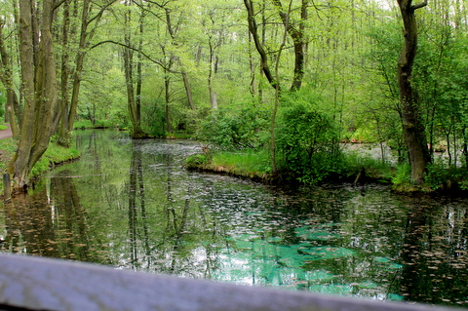
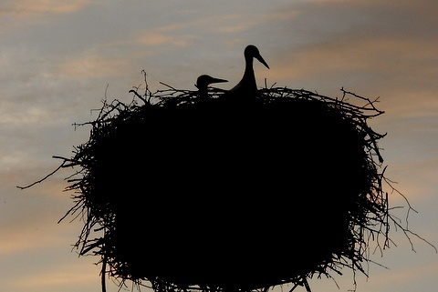
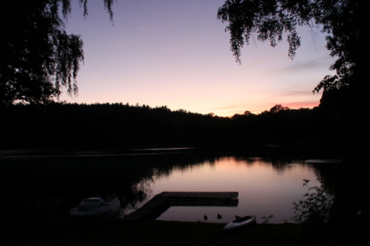
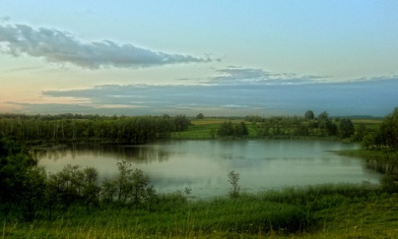
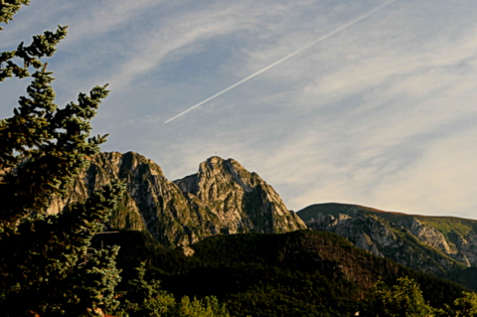
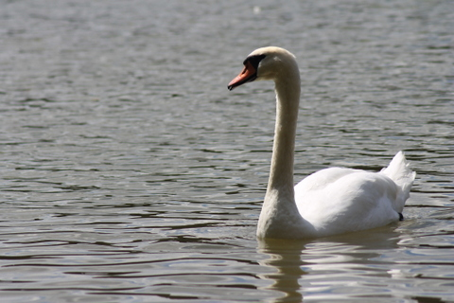
Spend your summer holidays…
In Poland !!!

Slide 2
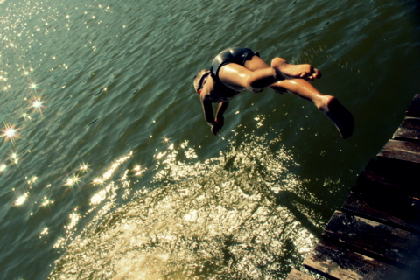
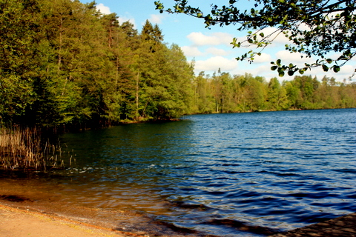
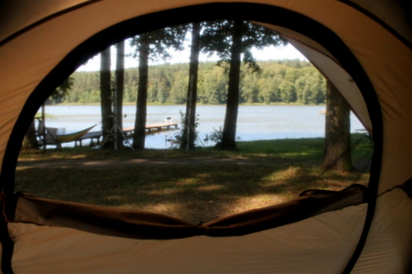
Mazuria
Although the most popular summer destination in Poland is the coast of the Baltic Sea with its beautiful wide sandy beaches, we invite you to less crowded places of Mazuria lakes. Only water, peace and quiet and wild nature around.

Slide 3
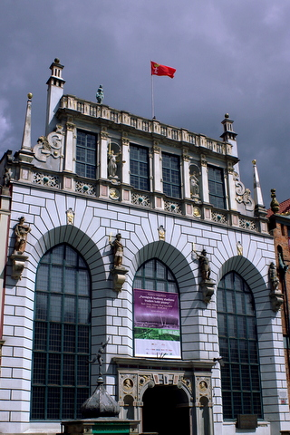
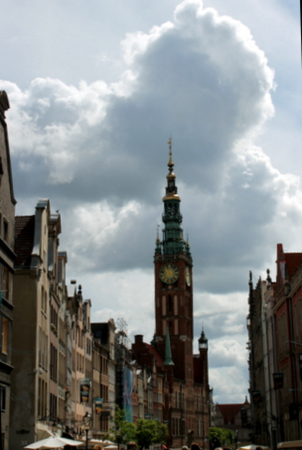
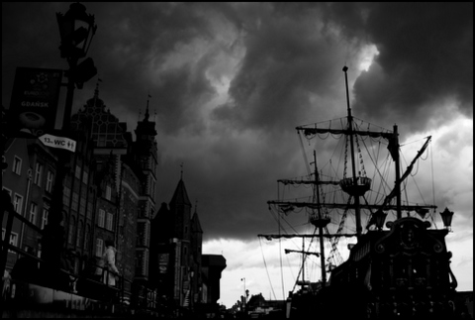
The city of Gdańsk
Situated at the coast of the Baltic Sea attracts with its rich history, beautiful monuments, charming little shops with amber and the smell of salty sea water.

Slide 4
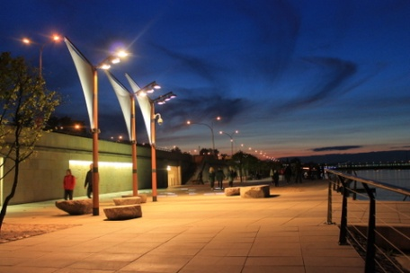
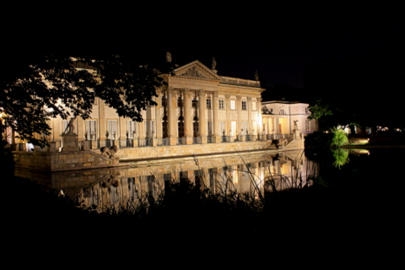
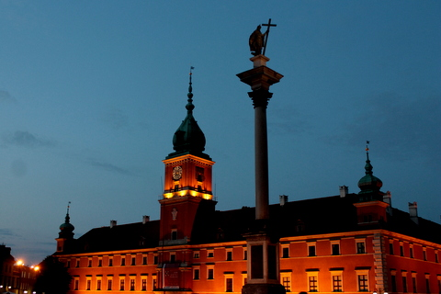
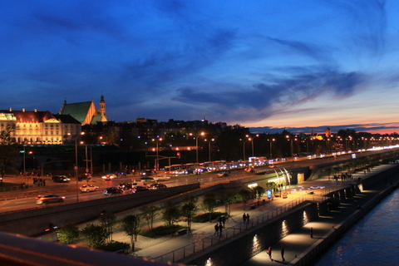
The capital city
Warsaw is worth visiting any time of the year. The Summertime is no exception. With its either historical or modern parts, welcomes you warmly.

Slide 5
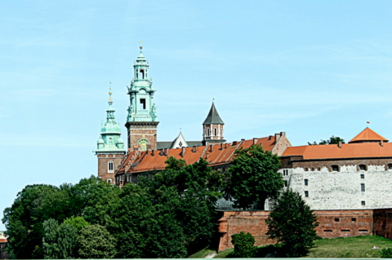
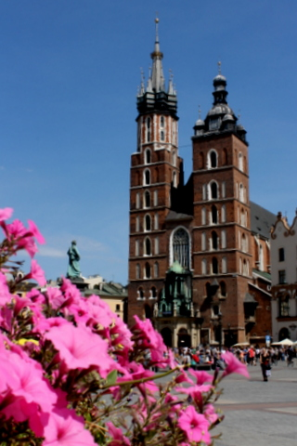
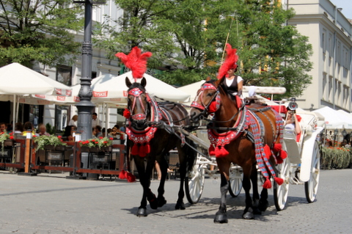
The city of Cracow
The cultural capital of Poland with the most beautiful Old Town can’t be missed. Cracow is a ‘must-see’.

Slide 6
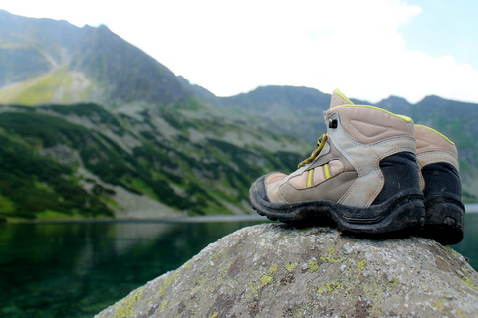
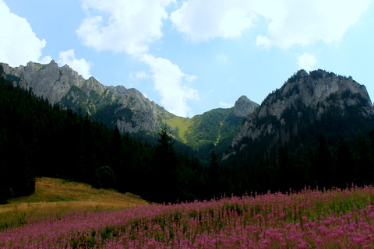
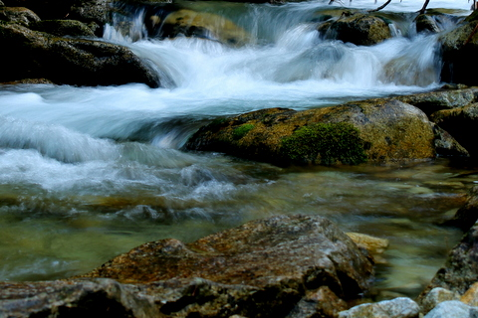
The Tatras
The highest and the most beautiful of Polish mountains located in the south of the country.
Breathtaking landscapes, cristal clear streams, dramatic rocks and spectacular views – everything you will find in the Tatra Mountains.

Slide 7
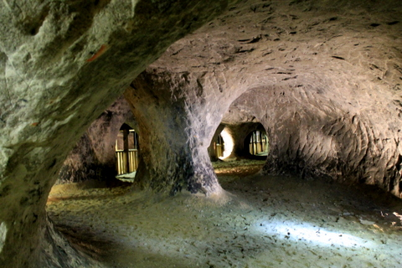
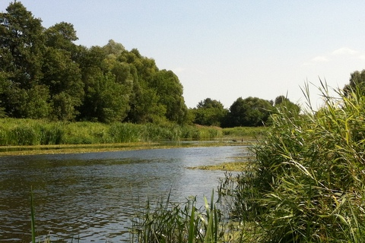
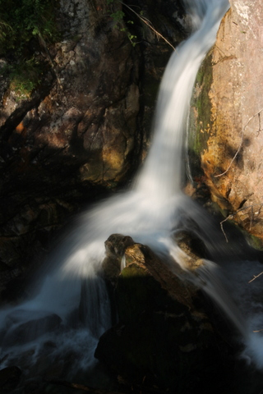
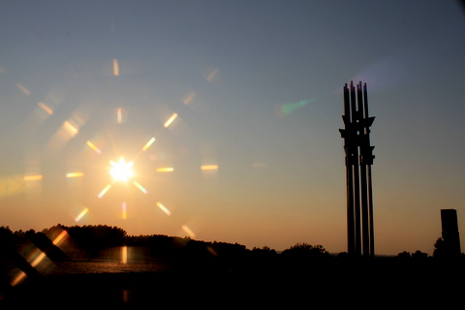
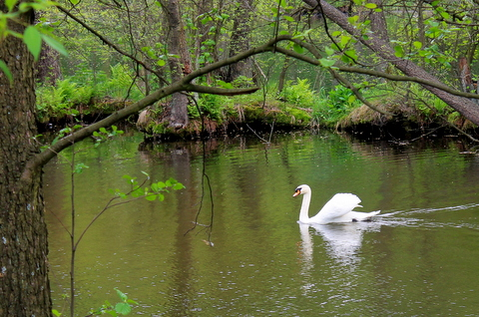
‘Thank you for your attention’ – Błażej.
… all the photos have been taken by the members of our family.

