Slide 1
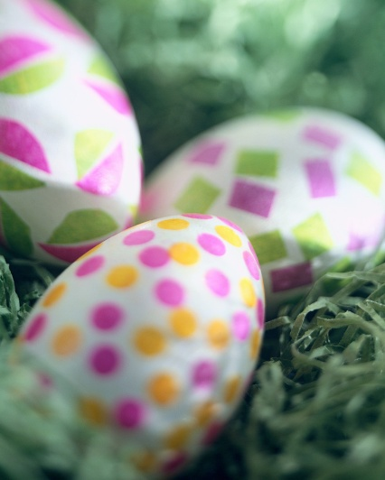
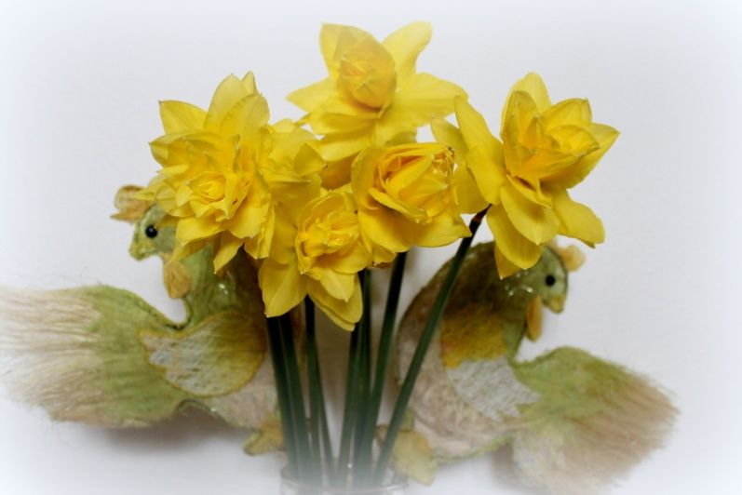
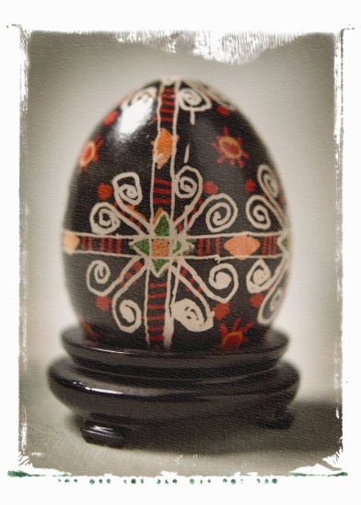
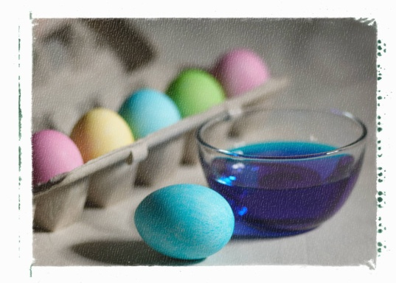
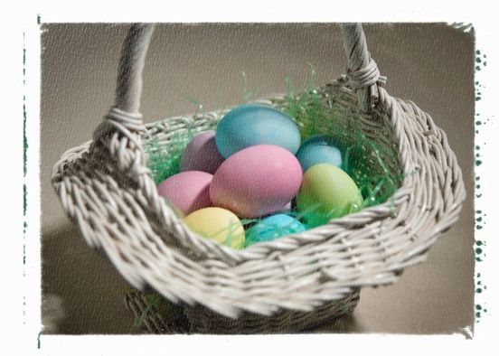
EASTER in POLAND
By Błażej DĄBROWSKI

Slide 2
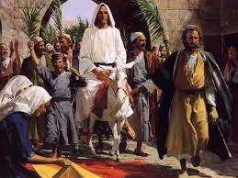
PALM SUNDAY
It is the beginning of the Holy Week. On this day we remind the moment when Jesus Christ entered Jerusalem on a donkey and the crowds were cheering and waving with palm leaves . In Poland our palms are extremely colourful and spectacular. Especially the folk ones, that take part in various contests: the longest one or the most beautiful.

Slide 3
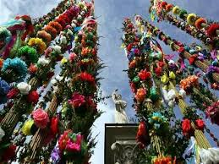
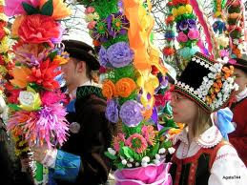
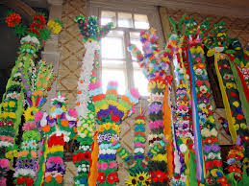
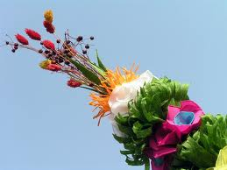
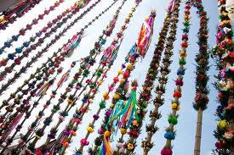
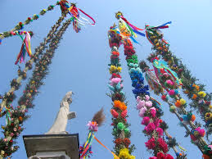
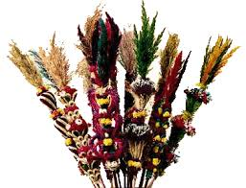
POLISH PALMS

Slide 4
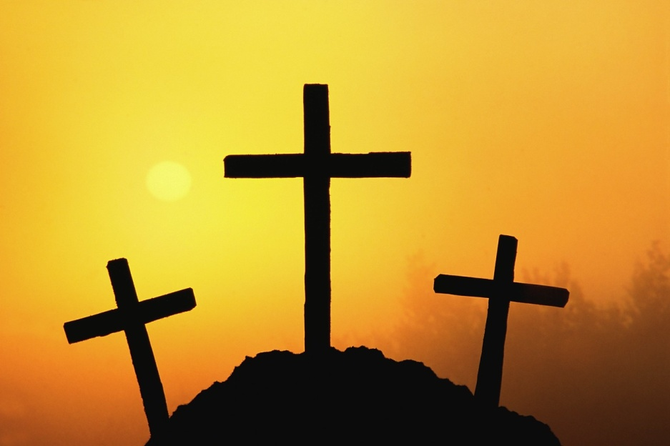
GOOD FRIDAY
Good Friday reminds us of the Crucifixion of Jesus Christ. On that day we don’t eat any meat, in the evening we attend services at church and during the day there is time to prepare ‘pisanki’ – coloured eggs that will be blessed on Saturday. Some of them are real pieces of art and need a lot of time to be made.

Slide 5
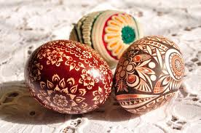
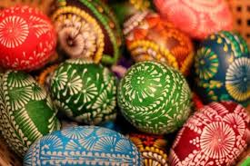
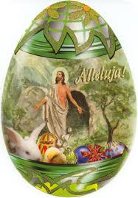
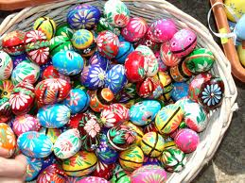
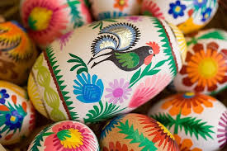
PISANKI – The Easter Eggs

Slide 6
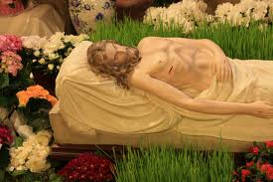
EASTER SATURDAY
Early in the morning we put food into small baskets and bring them to church to be blessed. This is called ‘święconka’ and includes: eggs, salt and pepper, a piece of sausage, a slice of bread and a piece of cake. We also visit the Christ’s tombs at churches and in the evening attend the most important Mass during the whole year, which can last even three hours.

Slide 7
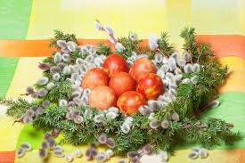
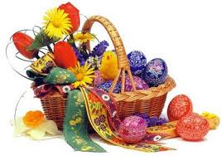
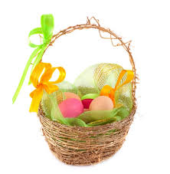
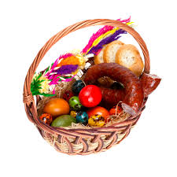
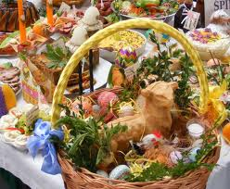
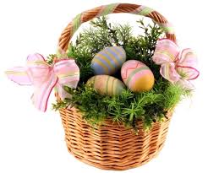
‘Święconka’ – the Easter Baskets

Slide 8
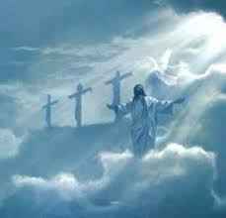
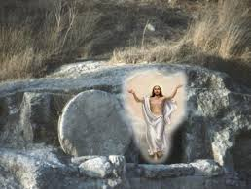
EASTER SUNDAY
Easter Sunday is the most important religious festival of the year, which reminds of the resurrection of Jesus Christ. Early in the morning we take part in the Ressurection Mass – at 6 a.m! and then, when we come back home, we have the most important meal during that day – The Easter Breakfast. It consists of boiled eggs – the symbol of new life, ham, bacon and sausage, vegetable salads and hot „żurek” – one of our national soups. And loads of cakes and sweets, because it is the time of celebrations, that Lent is over !

Slide 9
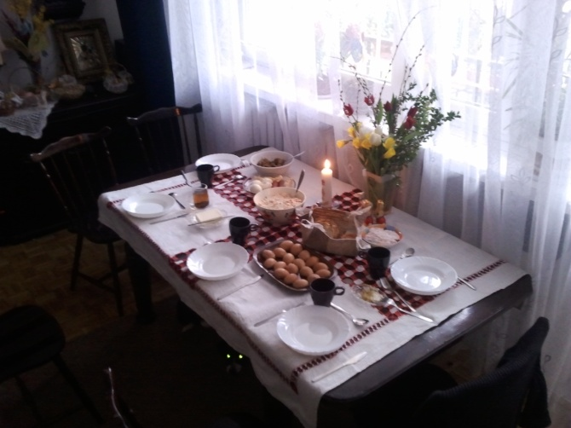
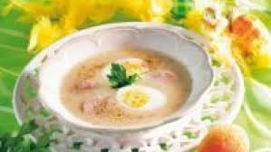
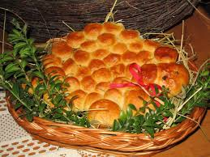
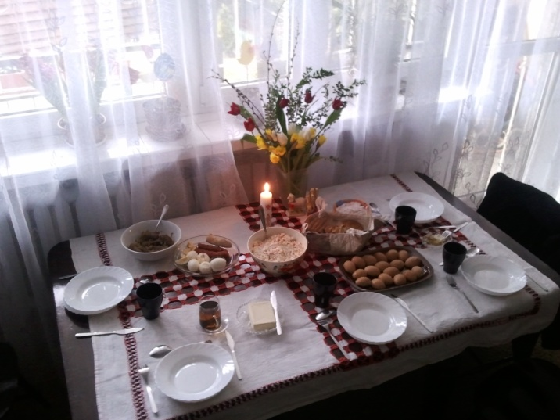
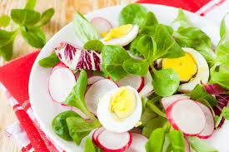
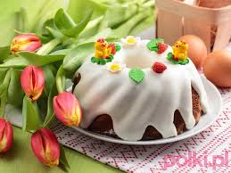
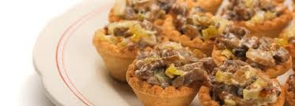
THE EASTER BREAKFAST

Slide 10

EASTER MONDAY
The day after Easter Sunday is called in Poland ‘the Pouring Monday’as on this day everyone should get soaking wet. The reason? There is a custom of spilling water onto one another, and this tradition is still present, both in towns and in the countryside. Boys with buckets full of water chase after girls and then … splash ;) It is the funniest day of the year and no one feels offended. (‘chlust’ in Polish means ‘splash’).

Slide 11
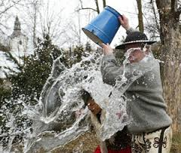
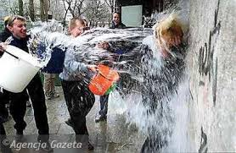
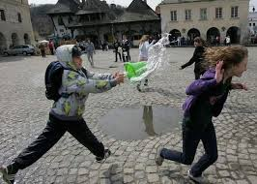
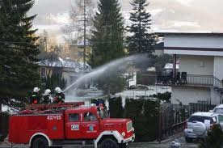
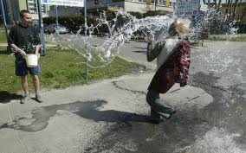
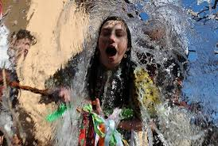
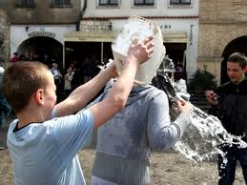
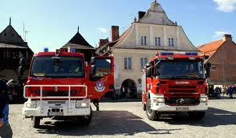
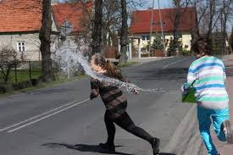
A LOT OF FUN ON MONDAY

Slide 12
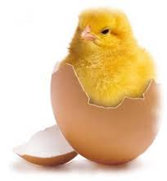
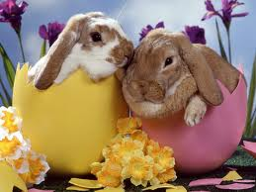
WE LOVE EASTER !
During Easter we spend a lot of time at church, and we do not get any presents, except for chocolate eggs, chicks or bunnies, but Easter is so colourful and joyful, that everyone loves it. And it is in Springtime :D

Slide 13
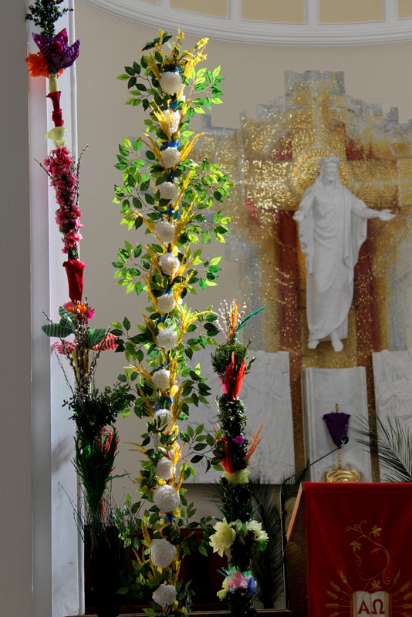
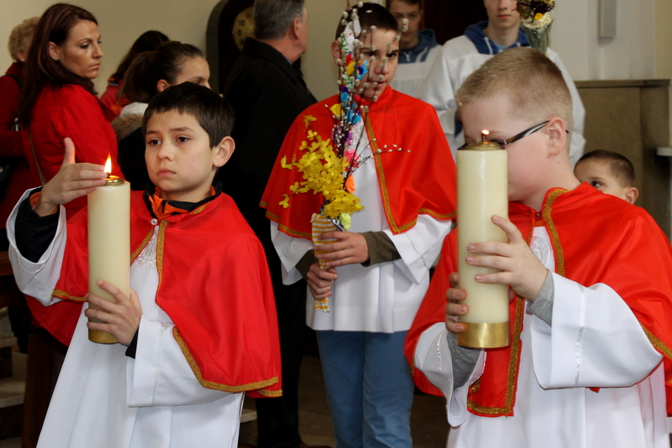
EASTER IN MY FAMILY
It’s me during last Palm Sunday
Hosannah ! Hosannah !

Slide 14
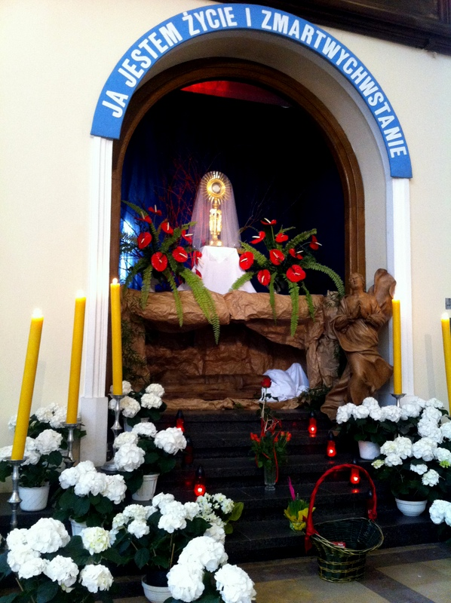
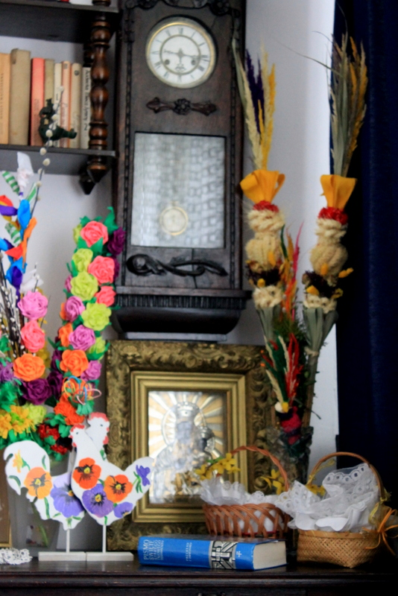

Saturday, called in Poland the Great
In the photos: our Easter baskets
Hallelujah !

Slide 15




Easter Sunday
I am reading the Holy Bible at church
And at home, before the breakfast

Slide 16






Easter Monday – the funniest day of a year ☺ Can you agree with me?

Slide 17





HAPPY EASTER EVERYONE !

