Slide 1
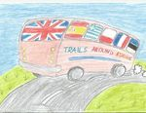
Trails Around Europe

Slide 2
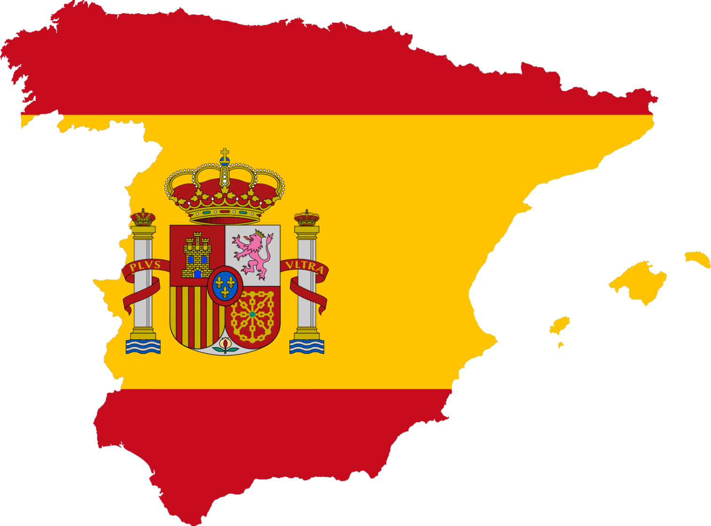
Spain
Capital: Madrid
Population: 46 million
Hello = Hola!

Slide 3
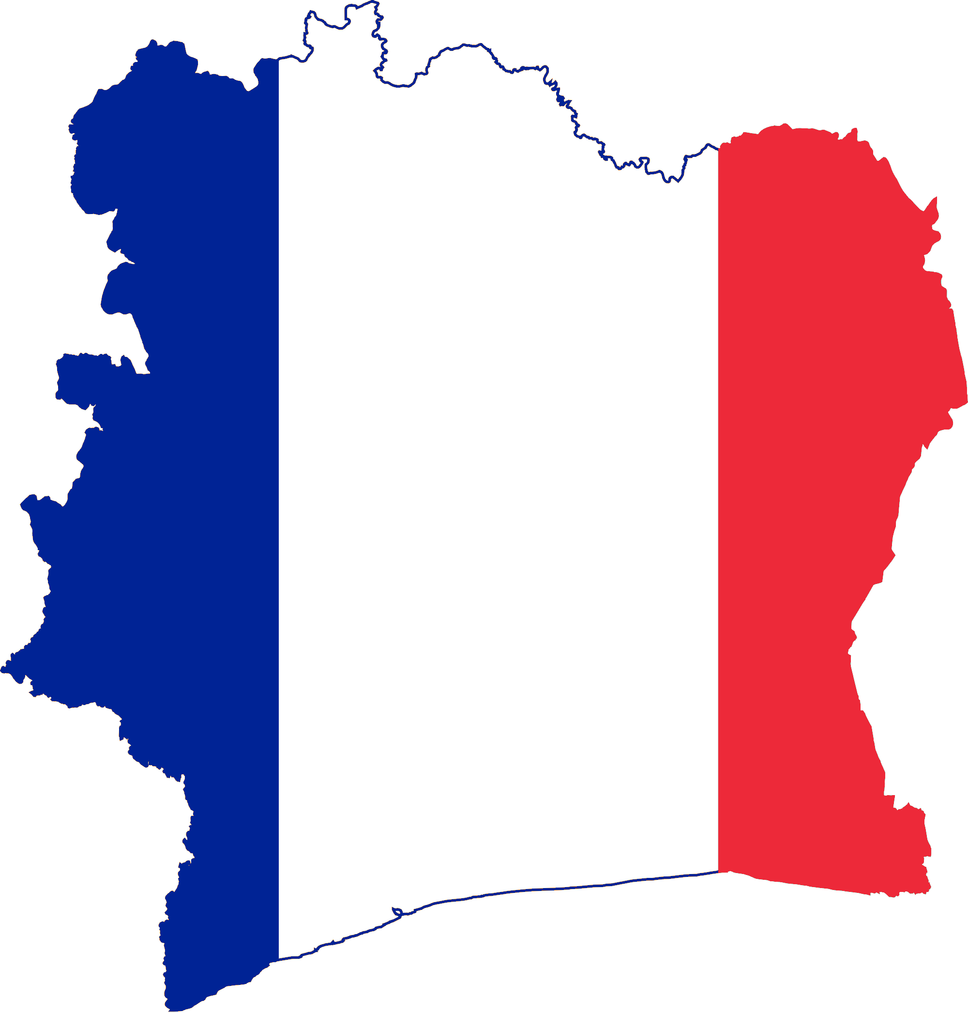
France
Capital: Paris
Population: 65 million
Hello = Bonjour

Slide 4
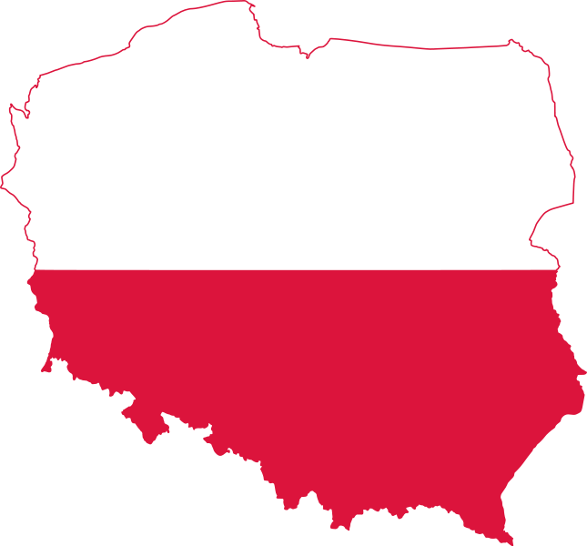
Poland
Capital: Warsaw
Population: 38 million
Hello = Cześć

Slide 5
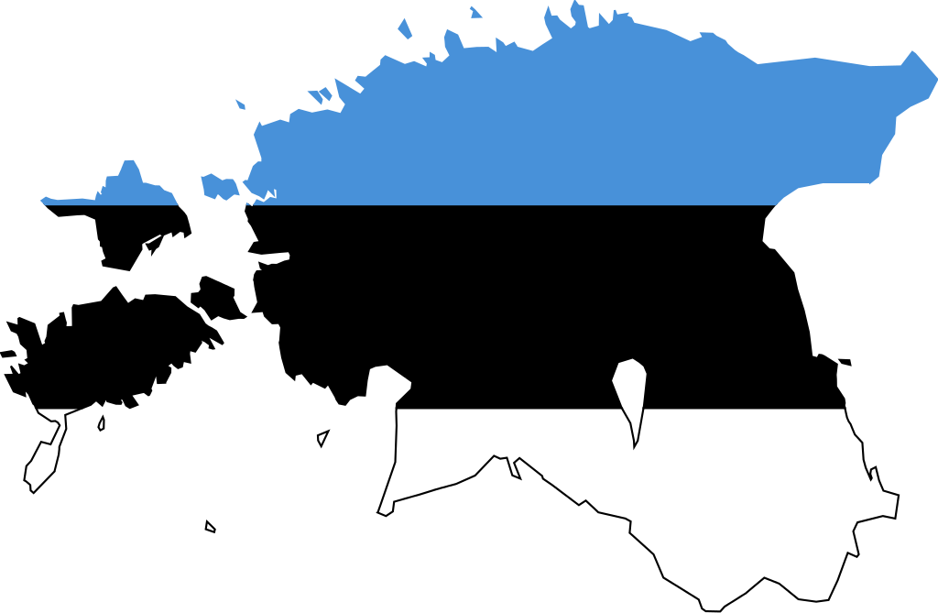
Estonia
Capital: Tallinn
Population: 1 million
Hello = Tere

Slide 6
Greece
Capital: Athens
Population: 46 million
Hello = Yassu!

Slide 7
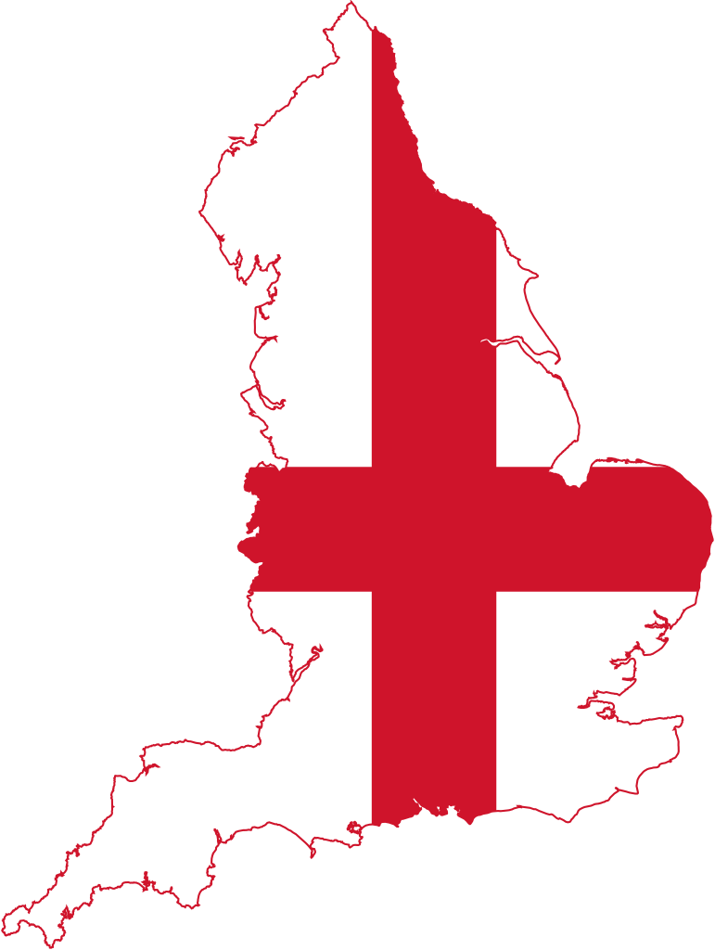
England
Capital: London
Population: 53 million
Hello!

Slide 8
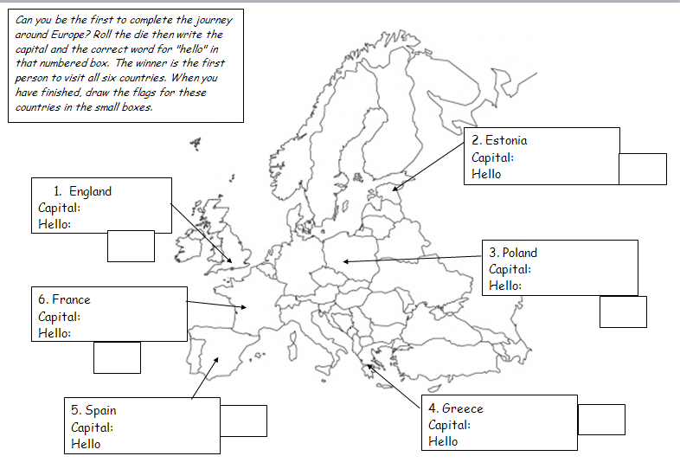

Slide 9
Country | Capital | Flag
England Hello | London
Estonia Tere | Tallinn
Poland Czesc | Warsaw
Greece Yassu | Athens
Spain Hola | Madrid
France Bonjour | Paris

