Slide 1
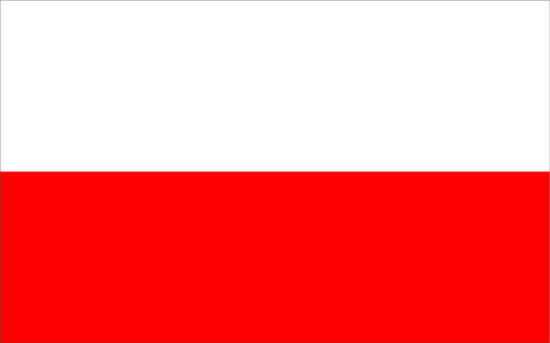
Dear Friends - Welcome to Poland !
… the heart-shaped country in the Middle-East Europe

Slide 2
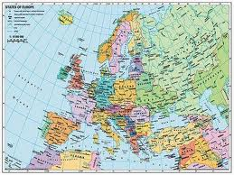
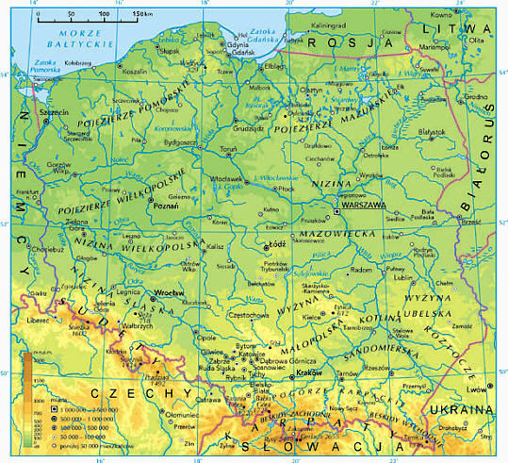
Some essential facts about our homeland
Poland is situated in the Central Europe, in its „heart”. It streches from the coast of the Baltic Sea in the north, through lake districts a „bit lower” and to the mountainous areas in the south. When you have a look at its map, you can easily see that Poland is heart-shaped.

Slide 3


Some basic information about our homeland
Our national symbols are:
The flag: two horizontal stripes: white and red,
The Coat of Arms: the White Eagle wearing a gold crown in the red field.
On the 1st of May 2004 Poland joined the European Union.

Slide 4
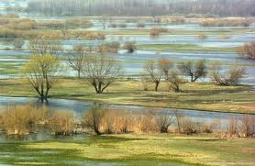
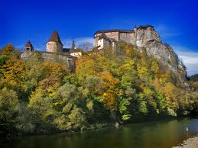
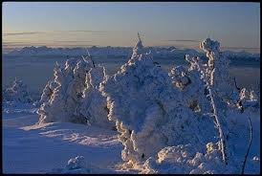
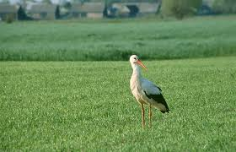
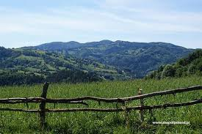
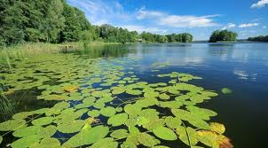
The most beautiful Polish landscapes
The highest point in Poland is Mount Rysy in the Tatras, with its 2499 metres above the sea level, and the deepest one is lake Hańcza, which is over 100 metres deep. Although you may say that most of our country is almost flat, the Polish landscape is varied: from the coastline of the Baltic Sea in the North, through lake areas to mountains in the south.

Slide 5
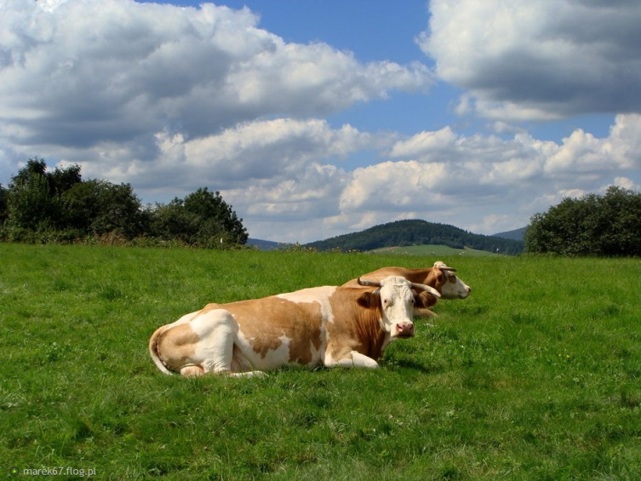
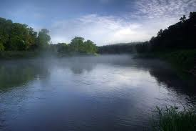
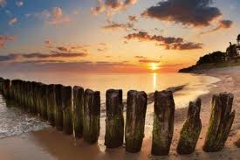
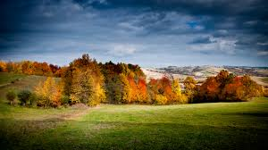
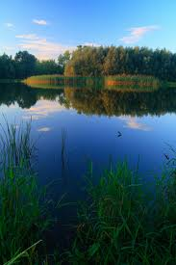
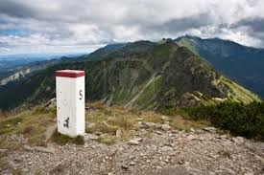
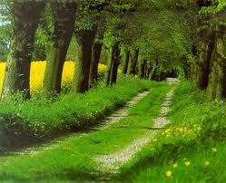
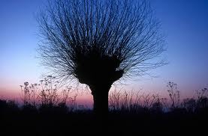
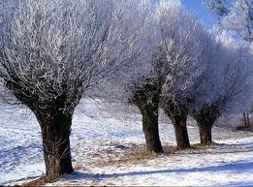
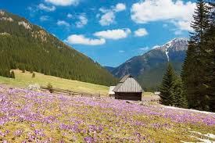
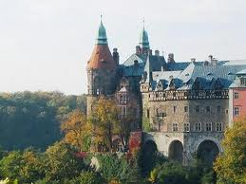

Slide 6
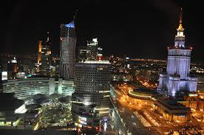
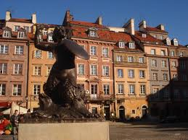
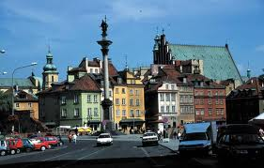
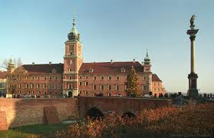
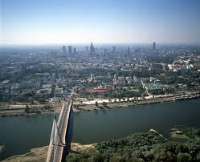
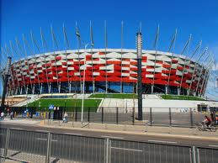
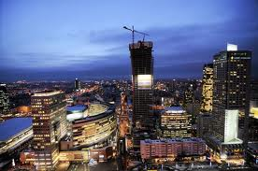
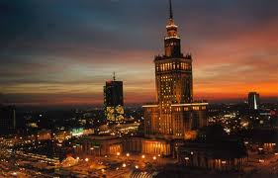
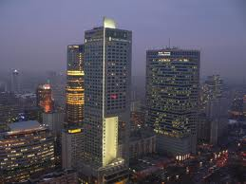
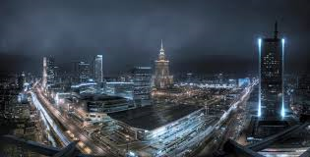
Some breathtaking views of Warsaw

Slide 7

LET’S FOCUS ON WARSAW
Warsaw, the capital city is located in the centre of Poland. With its over 1, 7 million inhabitants it stretches upon both banks of the Vistula River, which divides it into two halves: the left and the right side. The left one is older and rather “posh” – with the main Warsaw’s tourist attractions, such as The Old Town, The Łazienki Park and the Palace of Wilanów and the modern city centre with the Palace of Culture and Science and high-rise skyscrapers built with concrete, steel and glass. The right side, Praga, is not so „rich”, but has its own unique atmosphere and charm.
You have to pay attention to the fact, that Warsaw was destroyed during War World II by the Germans in more than 70%, but its residents managed to rebuild it shortly afterwards.

Slide 8
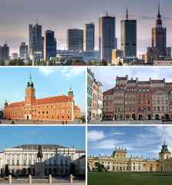
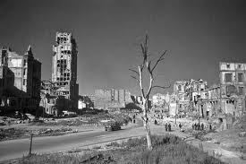
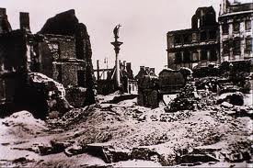
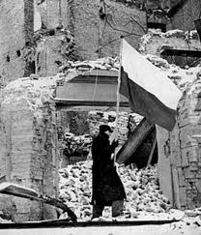
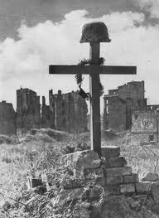
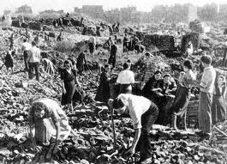
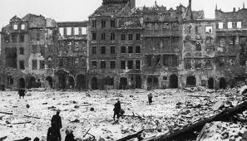
Like any other cities, Warsaw has its own symbols: the flag which is yellow and red, and the famous Warsaw’s Mermaid, that according to the legend, used to live in the depths of the Vistula River.
And our city is still changing: it’s growing and becoming more and more modern. It is trying to catch up with the rest of European cities.

Slide 9

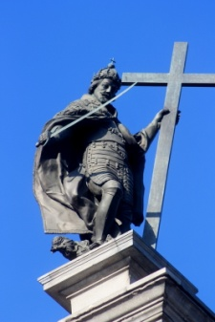
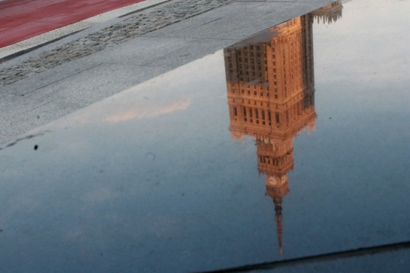
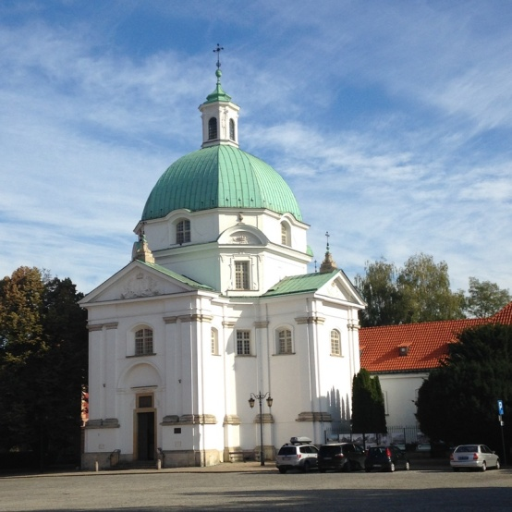
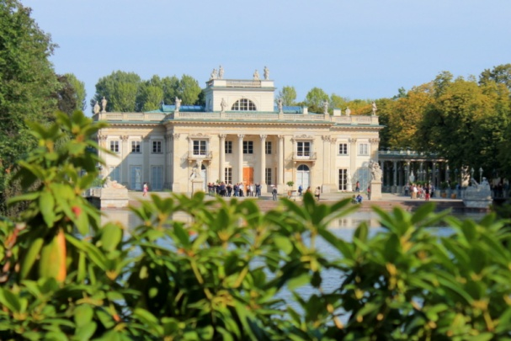
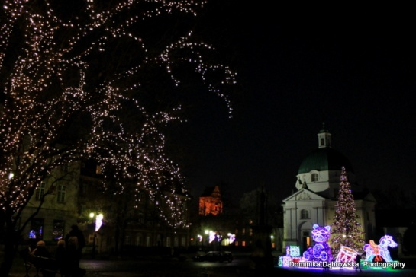
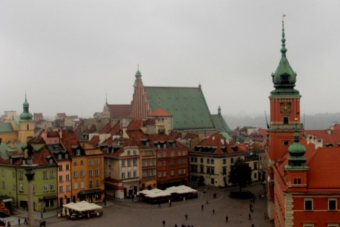
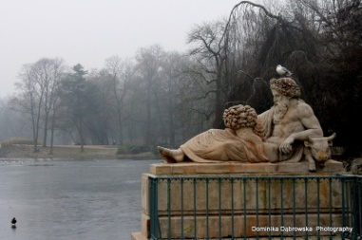
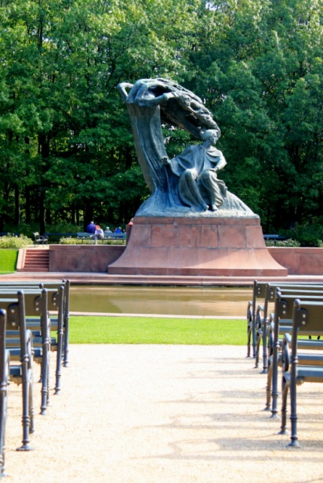
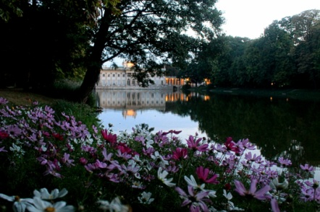
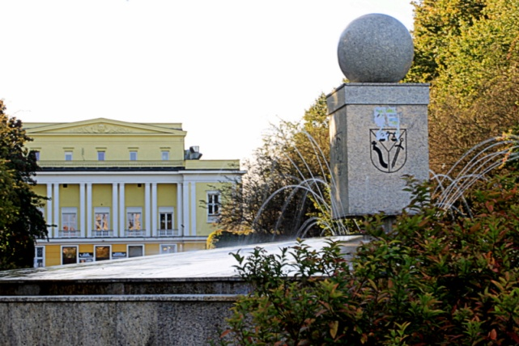
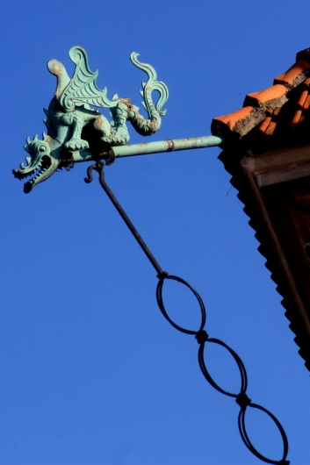
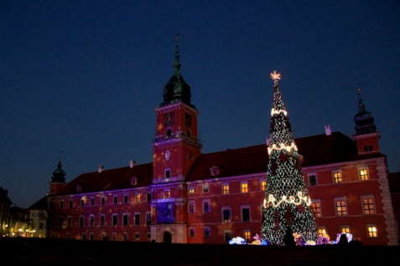
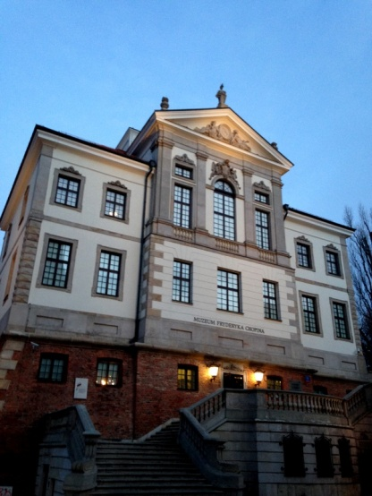



The other photos of Warsaw

Slide 10

Our school – The Primary School number 114 in Warsawa
Our school is located in a quiet neighbourhood in Targówek, which is part of Warsaw outside a city centre, next to a park. The school is over 90 years old, although its present building was built in the 1960’s. There is a lot of greenery around it.

Slide 11






In front of our school there is a modern huge yard with two pitches and a playground . There are also two gardens. Inside the classrooms there are a lot of modern devices, which make our lessons more attractive and more up-to-date.

