Slide 1
Quiz on England
BY Hannah Meyer and Victoria Gerighty

Slide 2
What is The Capital City of England?
a: Manchester
B: Norwich
C: London
D: Liverpool

Slide 3
What is the English Currency?
A: Euros
B: Pounds
c: Dollar
D: Rupees

Slide 4
What is the national English food?
A: Spaghetti bolognaise
B: Curry
C: Stir fry
D: Fish and chips

Slide 5
What is the English national animal?
A: Lion
B: Boar
C: Unicorn
D:DRagon

Slide 6
What is the longest river in England?
A: River ouse
B: victoria Falls
C: River thames
D: River tees

Slide 7
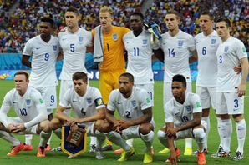
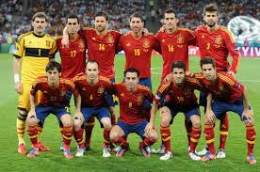
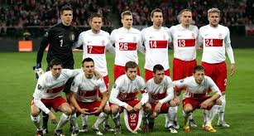
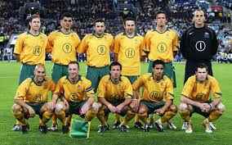
Which is the English football team?
A
B
c
D

Slide 8
Where does the queen live?
A: Big Ben
B: Buckingham palace
C: Houses of Parliament
D: London Eye

