Slide 1
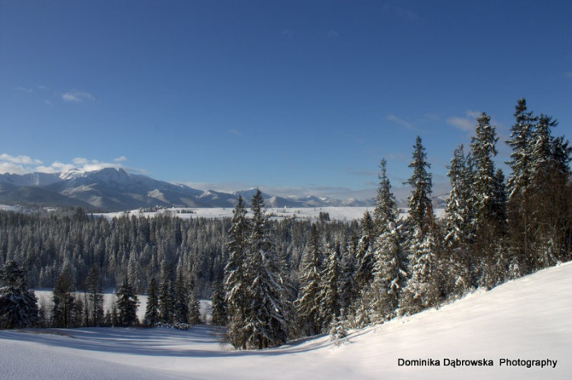
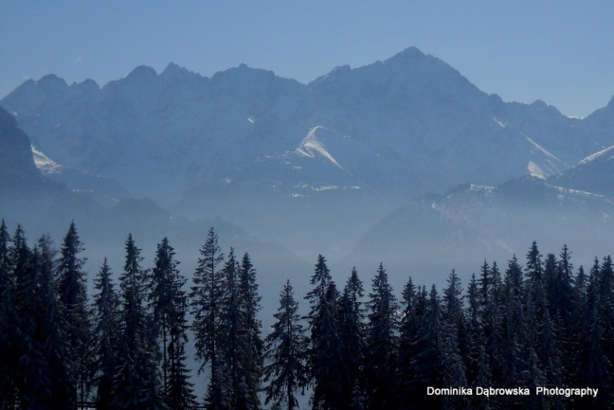
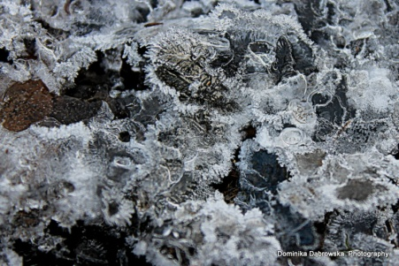
„Winter and winter sports in Poland”
by Błażej Dąbrowski
Pictures – by my mother.

Slide 2
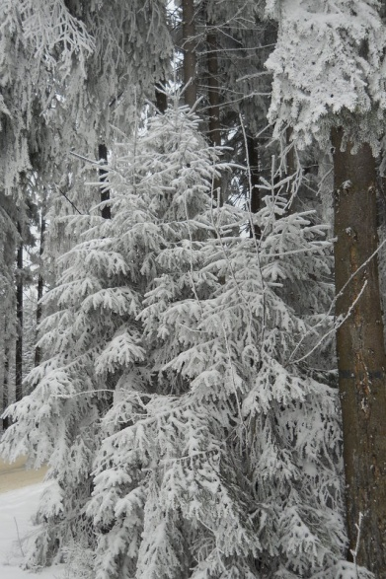
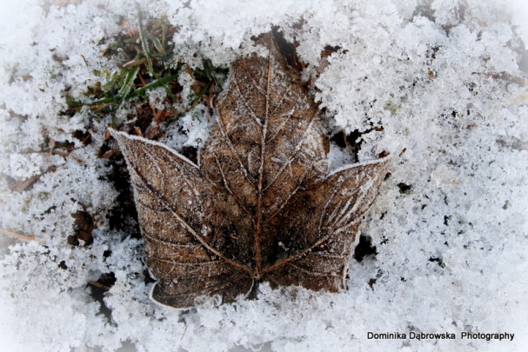
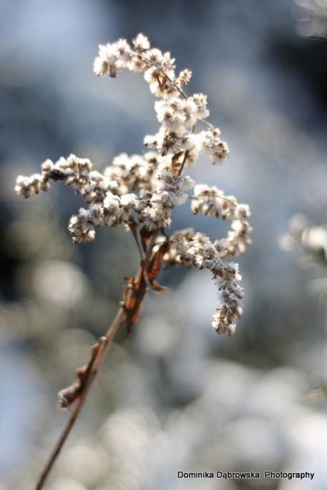
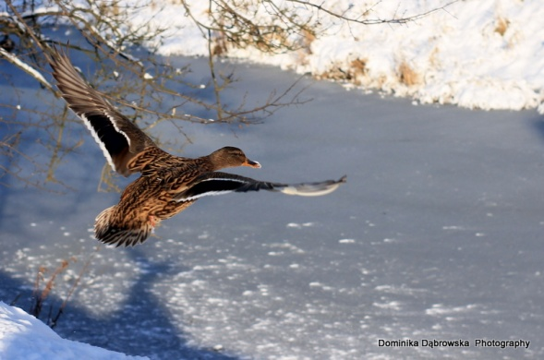
Winter in Poland
Winter in Poland may be either cold, snowy and frosty or mild, wet, without snow.
Everyone wants it to be snowy, especially during Winter Holidays – a two-week-long break in Januray or February (depending on the region of our country).

Slide 3
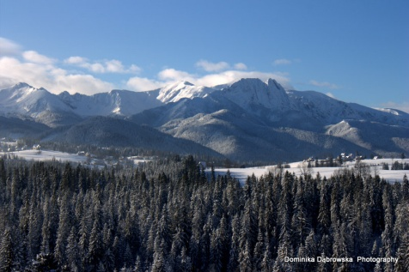
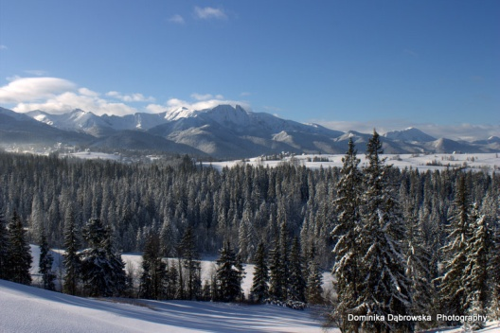
Winter sports and ski resorts.
When winter is snowy, people do winter sports. The most popular ones are: downhill skiing and cross country skiing, snowboarding and ice skating. Skiing is the most popular and there are a lot of ski resorts in Poland. Where? Most of them are located in the south, in the mountains. Examples? Szklarska Poręba and Karpacz in the Giant Mountains, Szczyrk and Ustroń in Silesian Beskid, Zakopane in The Tatras and Ustrzyki in Bieszczady. You can also go to Krynica, Muszyna or Wisła. The most popular and crowded is Zakopane, without a doubt, because the Tatras are the most beautiful Polish mountains.

Slide 4
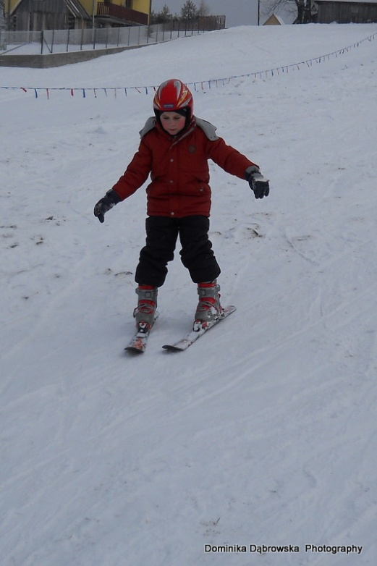
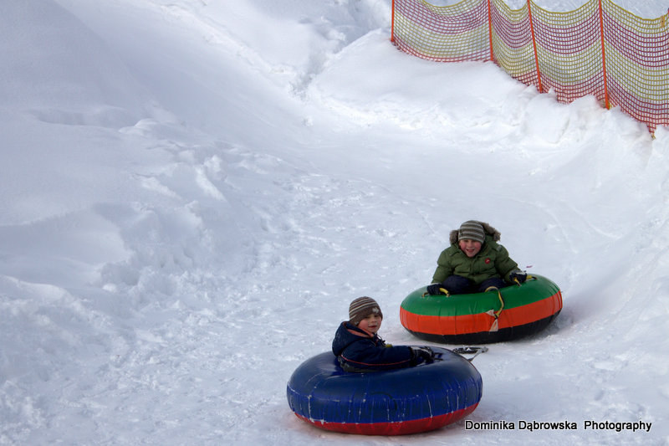
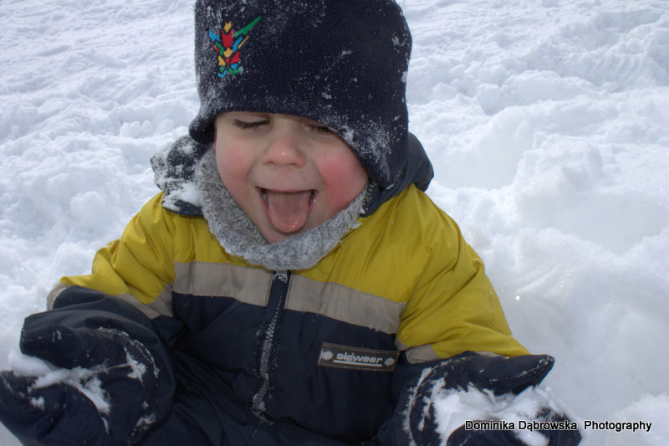
Keep Calm … and come to Poland in winter ☺

