Slide 1
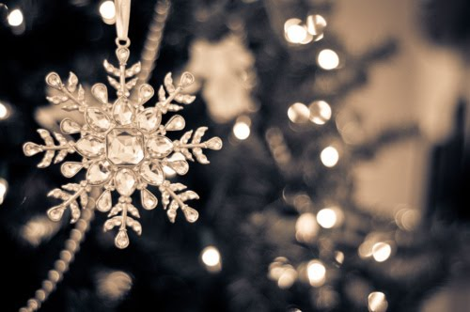
Polish Christmas

Slide 2
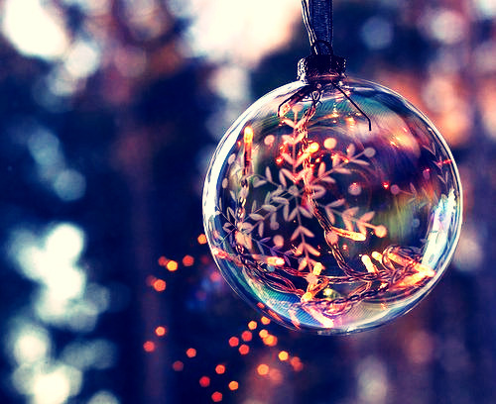
A few days before Christmas
we dress our Christmas trees.

Slide 3
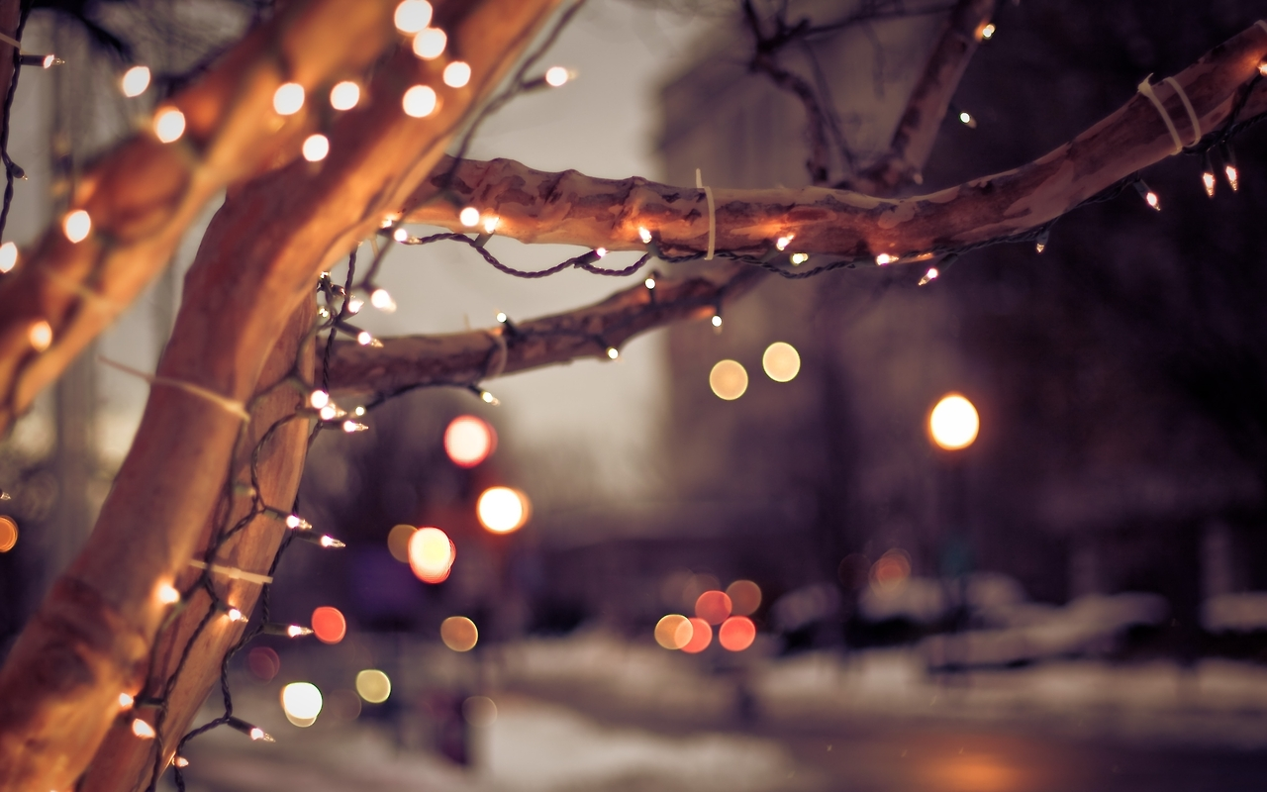
We meet with friends and family.

Slide 4
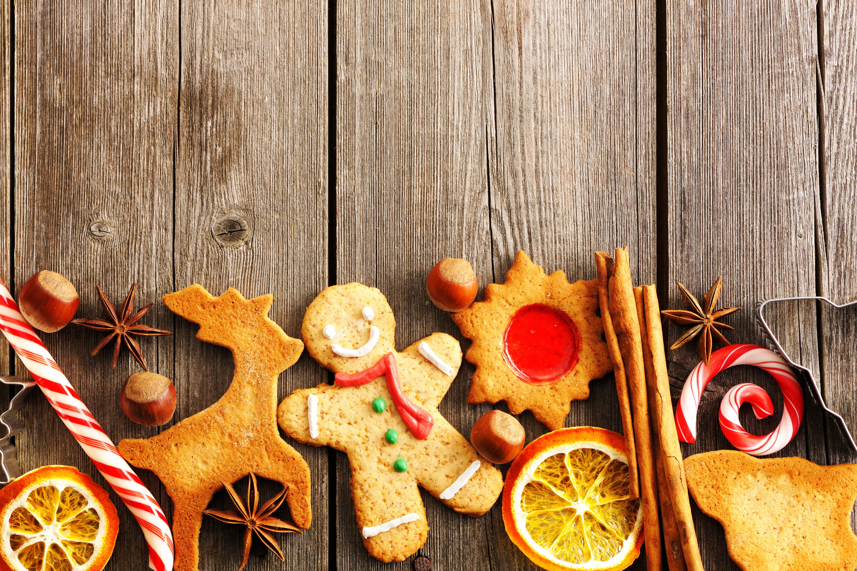
Food is the most important thing at Christmas.

Slide 5
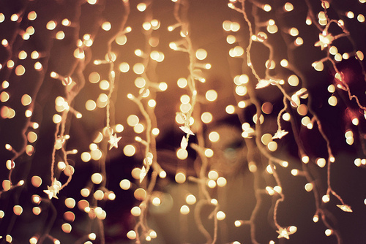
We sing carols
Christmas lights, Christmas bells,
Hanging on the tree.
I’ll send you a Christmas card,
If you send one to me.

Slide 6
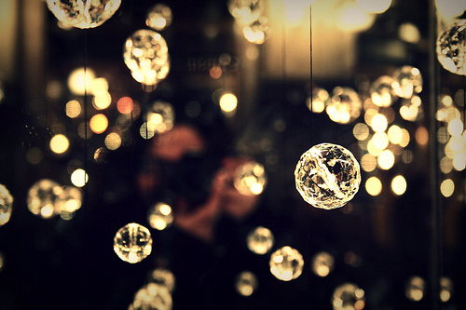
Oh, Christmas stocking, Christmas cake,
Christmas pudding too!
Please send me a Christmas card,
And I’ll send one to you.

Slide 7
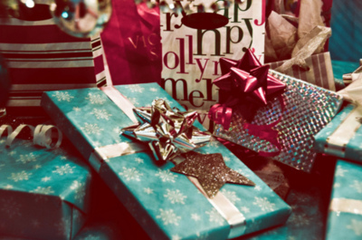
We give Christmas presents

Slide 8
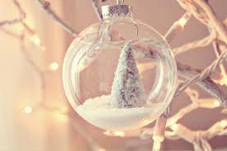
In Poland the most important day of Christmas is … the day before Christmas ! The favourite day of everyone. Early in the morning we decorate the Christmas Tree (some people do it a couple of days earlier) and there are a lot of preparations in the kitchen until the first star appears in the sky…

Slide 9
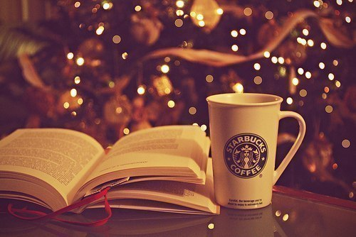
Christmas Eve
When the first star appears in the sky we start the Christmas Eve’s Dinner, which is the most important meal of the year. We start it with saying the prayer and reading the part of the Gospel, telling about the birth of Jesus Christ. Then we share the holy wafer with one another and say best wishes. After that we start eating. In the meantime children look for and open Christmas presents hidden under the Christmas Tree.
On this day we don’t eat any meat, so the Christmas Eve’s dishes consist of fish (mostly carp and herrings), mushrooms and cabbage. Traditionally there should be twelve dishes, which equals the number of Apostols, such as red borsh and mushroom soup, dumplings with cabbage and mushrooms, noodles with poppy seed and delicacies, vegetable salads, fish and cakes. And you should try each of them.
We always leave one empty seat for an unexpected guest, because no one can be lonely in that evening. And we put some hay under a tablecloth, that reminds of the stable, where Jesus Christ was born.
After the dinner we sing Christmas Carols.

Slide 10
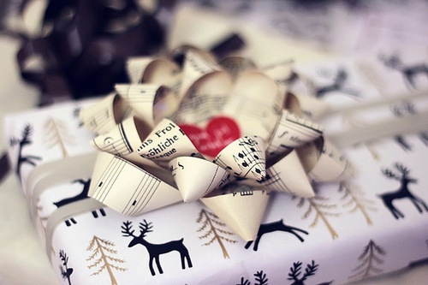
December the 25th
the so called „ The First Day” of Christmas
We are the Roman Catholics so we go to church and attend the services (if we don’t fall asleep, we go to the Midnight Mass). In the afternoon we meet our relatives and eat loads of food during the Christmas Dinner.

Slide 11
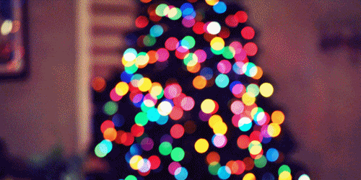
Thank you for your attention! ☺

