Slide 1
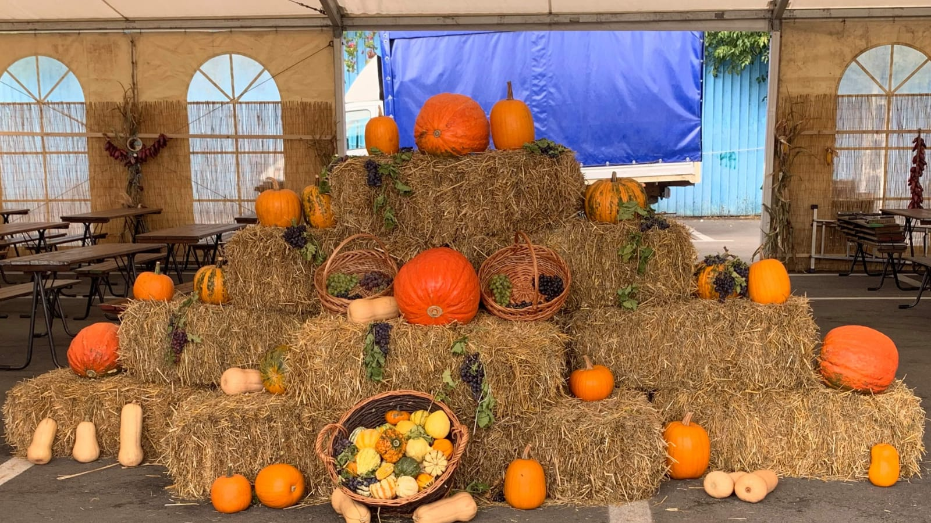
Traditional Romanian food
Project made by: Coman Andrei Mosorete Andrei

Slide 2
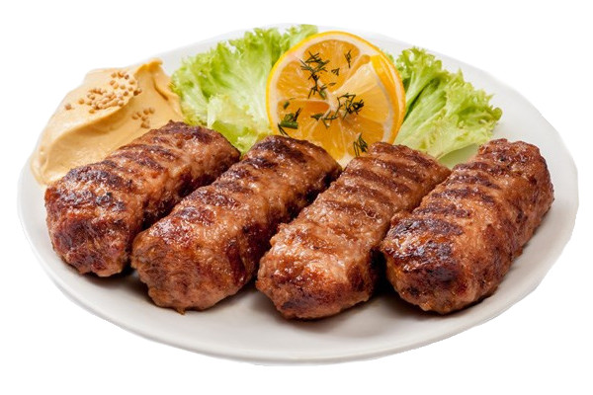
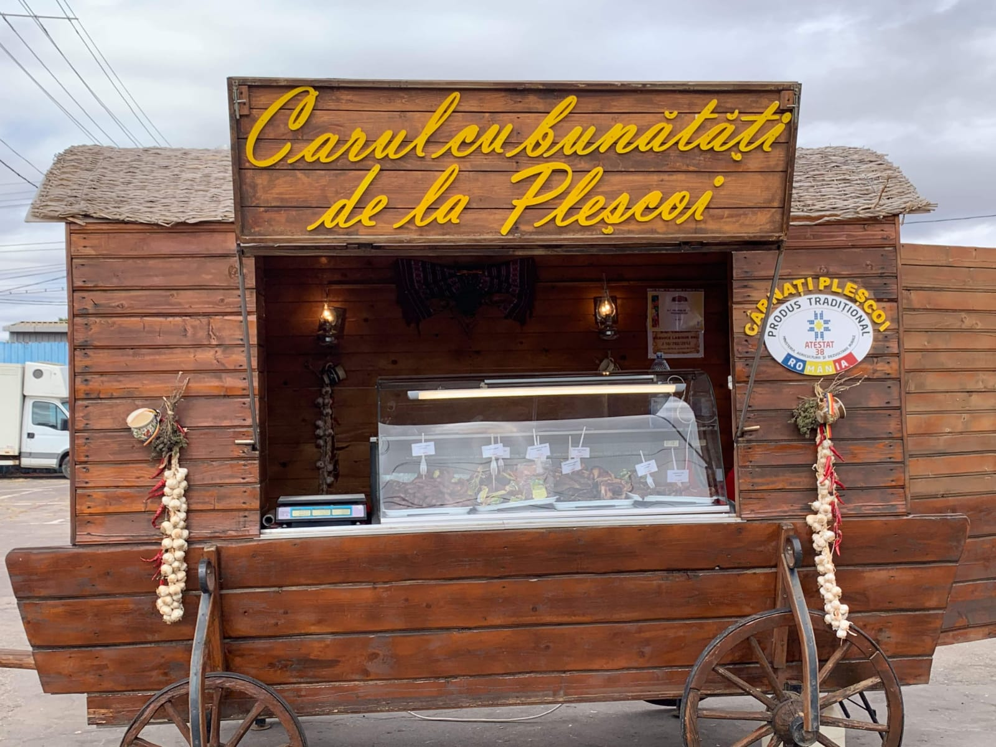
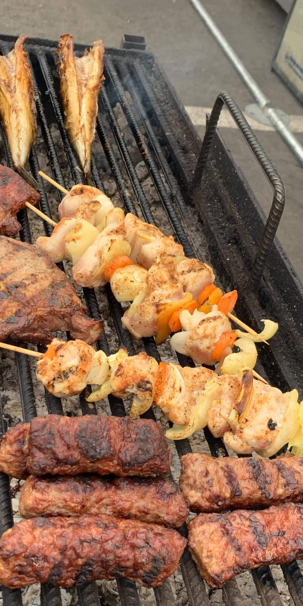
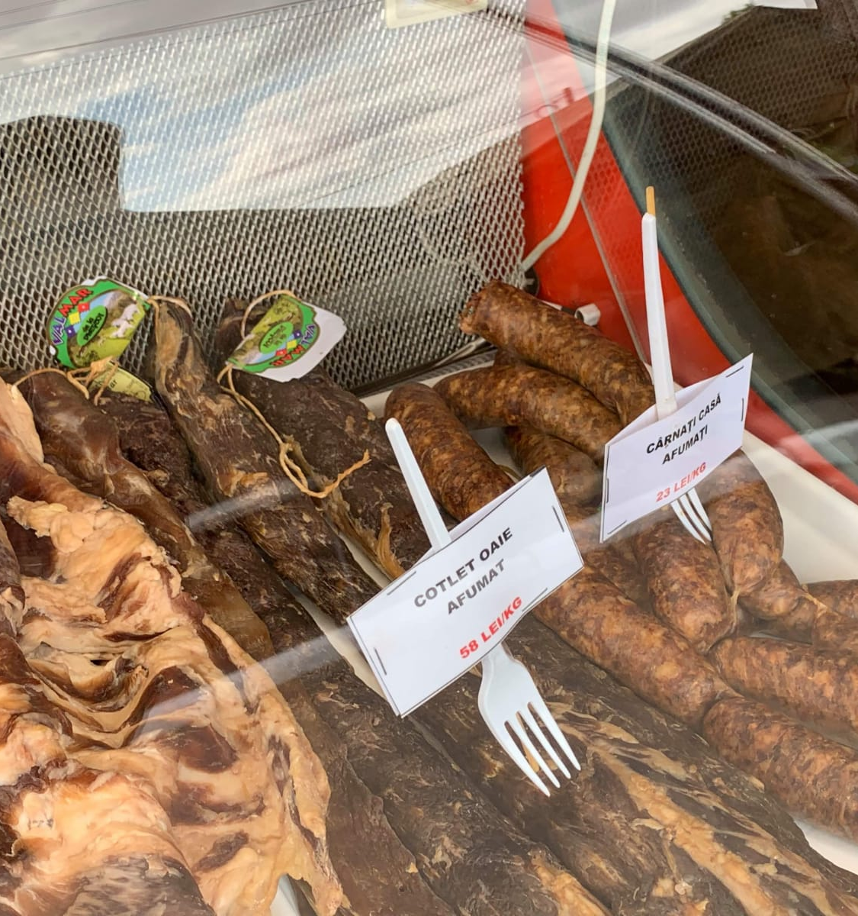
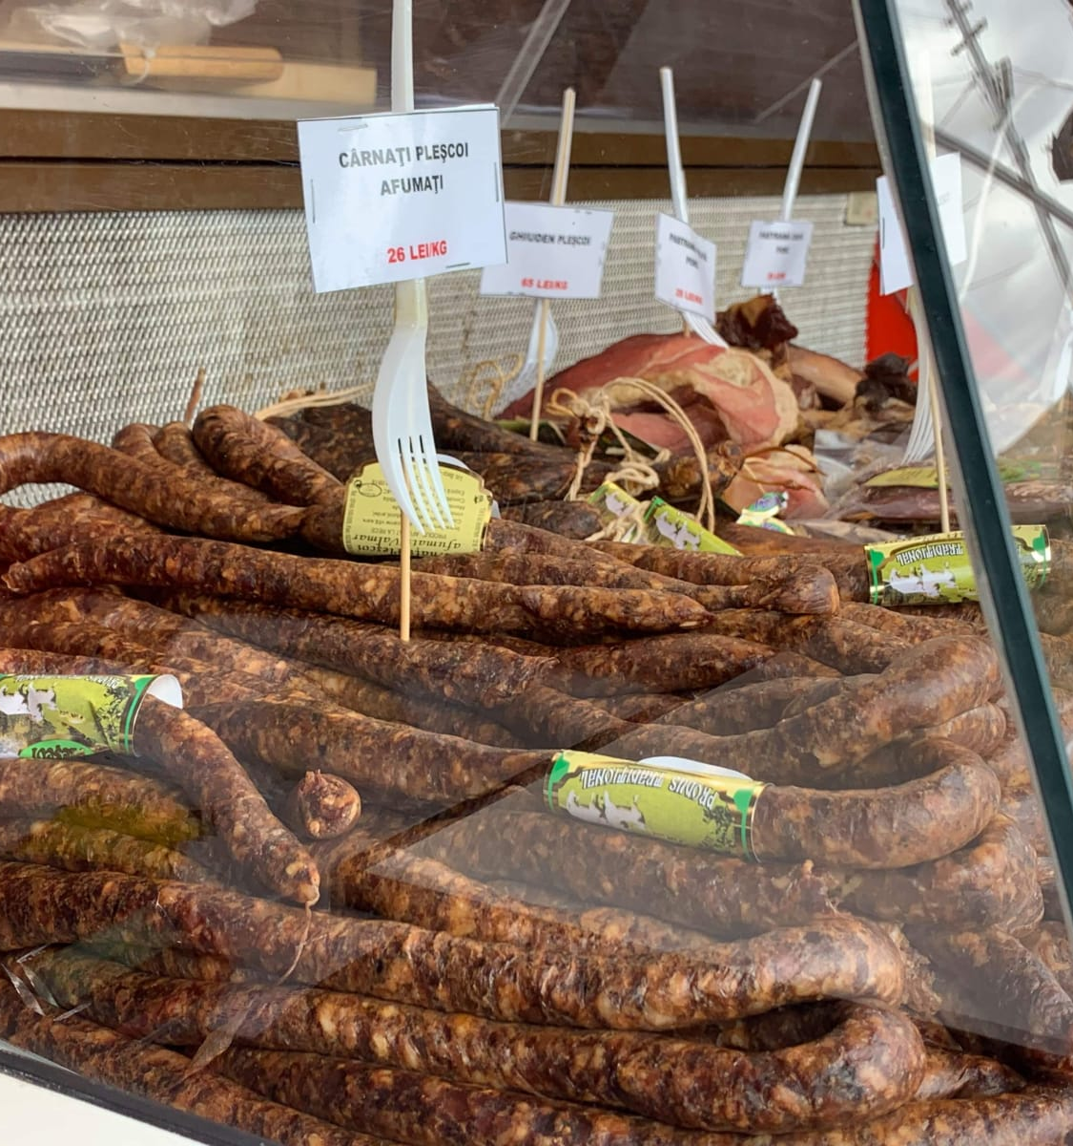
Meat:
Here in Romania, we love meat. So we have a lot of products made out of different kinds of meat, like smoked ham, sheep chops, smoked pastrami, and the famous sausages from Pleșcoi.

Slide 3
Belly Soup
Belly soup is another type of traditional Romanian food. It is prepared with boiled water, veal or beef belly, vegetables such as onion, carrots, celery, parsley, garlic and red pepper along with many other ingredients,sour cream, vinegar and egg yolk.

Slide 4
Salata de vinete
The eggplant salad is a Romanian culinary specialty prepared from baked eggplant, peeled and minced, mixed with oil, lemon or vinegar such as salt and pepper.

Slide 5
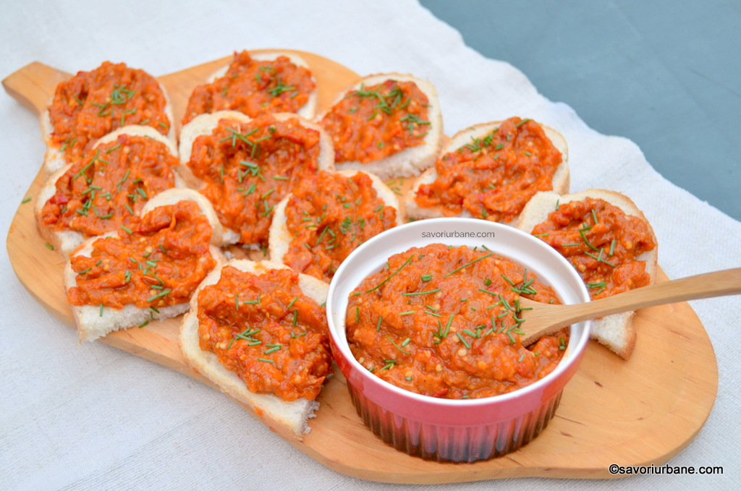
Zacusca
Zacusca is a food of fresh vegetables, baked or fried in oil. The main ingredients are baked eggplant, roasted peppers and chopped onion. You can also add tomatoes, mushrooms and carrots.

Slide 6
Micii
This is a traditional Romanian food, a kind of grilled meatballs, usually cylindrical in shape.

Slide 7
Tochitură tradițională
Tochitura is a traditional Romanian food, prepared from pork, veal, beef or chicken fried in a pan or a cauldron and served with mămăligă, fried eggs and cheese or telemea, along with pickles and garlic.

Slide 8
Mămăligă
Mămăliga is the name in the Romanian language of a dish prepared from corn flour Traditionally, mămăliga is cooked from boiled water, salt and cornmeal in a cauldron

Slide 9
Sarmale
Sarmaua is a culinary preparation of meat minced usually from pork, but also of beef, sheep, chicken or even fish, mixed with rice and other ingredients, wrapped in cabbage leaves. In Romania it is usually served with mămăligă and sour cream

Slide 10
Babicul românesc
The babic, is a Romanian sausage of Serbian origin as the name suggests, made from pork and smoked beef, dried and spicy

Slide 11
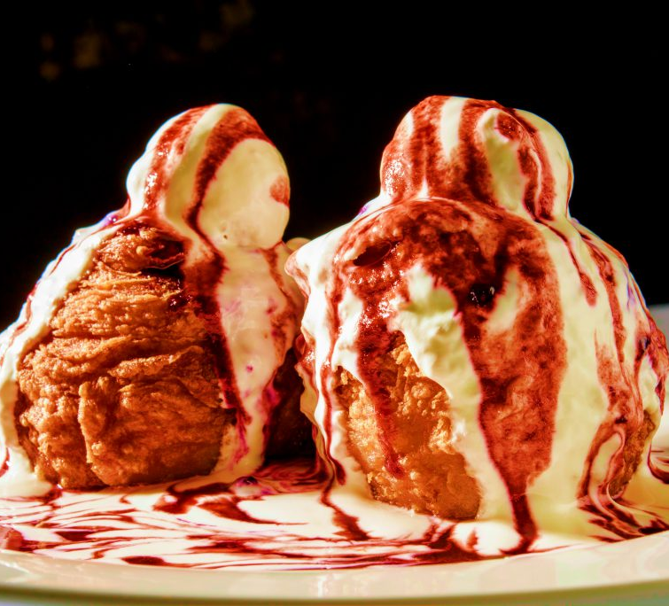
Papanaşi With sour cream
Papanași is a Romanian traditional fried or boiled pastry, doughnut shaped with a small sphere on top. They are usually filled with a soft cheese such as urda. Papanași are served covered in sour cream and with a sour jam topping.

Slide 12
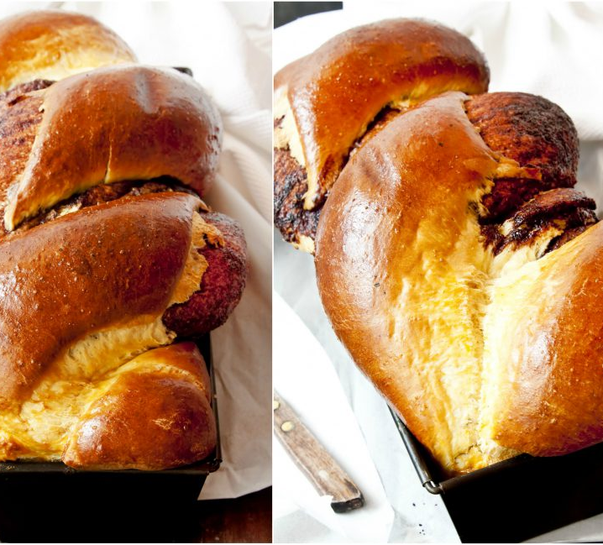
Cozonac
Cozonac is a classic, simple, sweetened yeast bread with origins in Romania. Traditionally made during Easter and Christmas, this citrus-scented sweet dough is twisted around a nutty filling, creating a spiral design when baked. The result is a festive loaf bread with a tender and soft crumb.

Slide 13
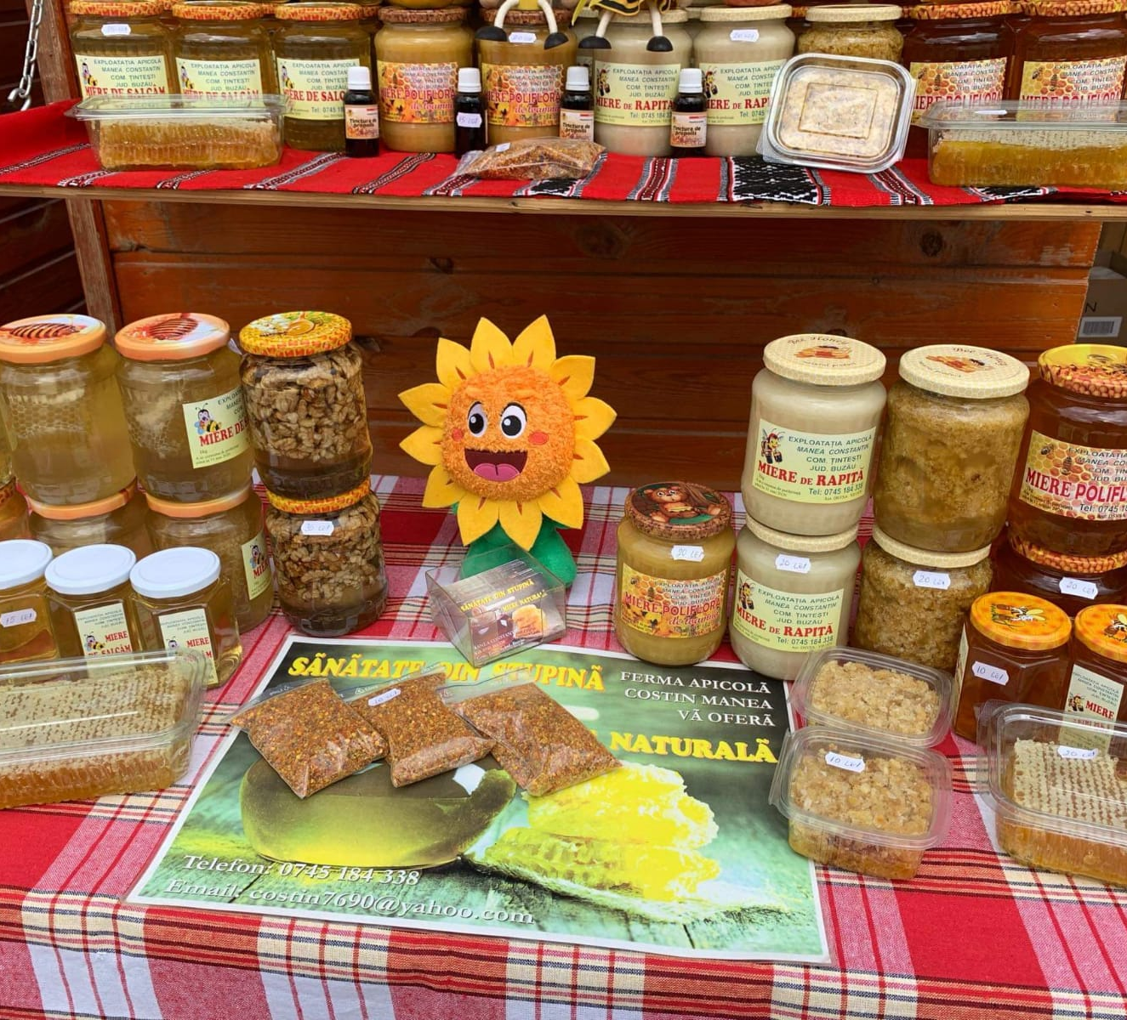
The honey from Romania is highly appreciated by the whole world, being certified as bio.
It's produced with great care and pleasure.
We can find our wonderful honey under various assortments, such as sunflower honey, polyphorous honey, lime honey and acacia honey .

Slide 14
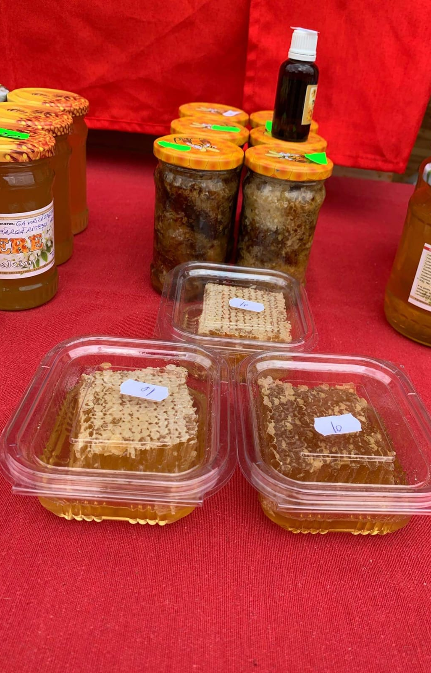
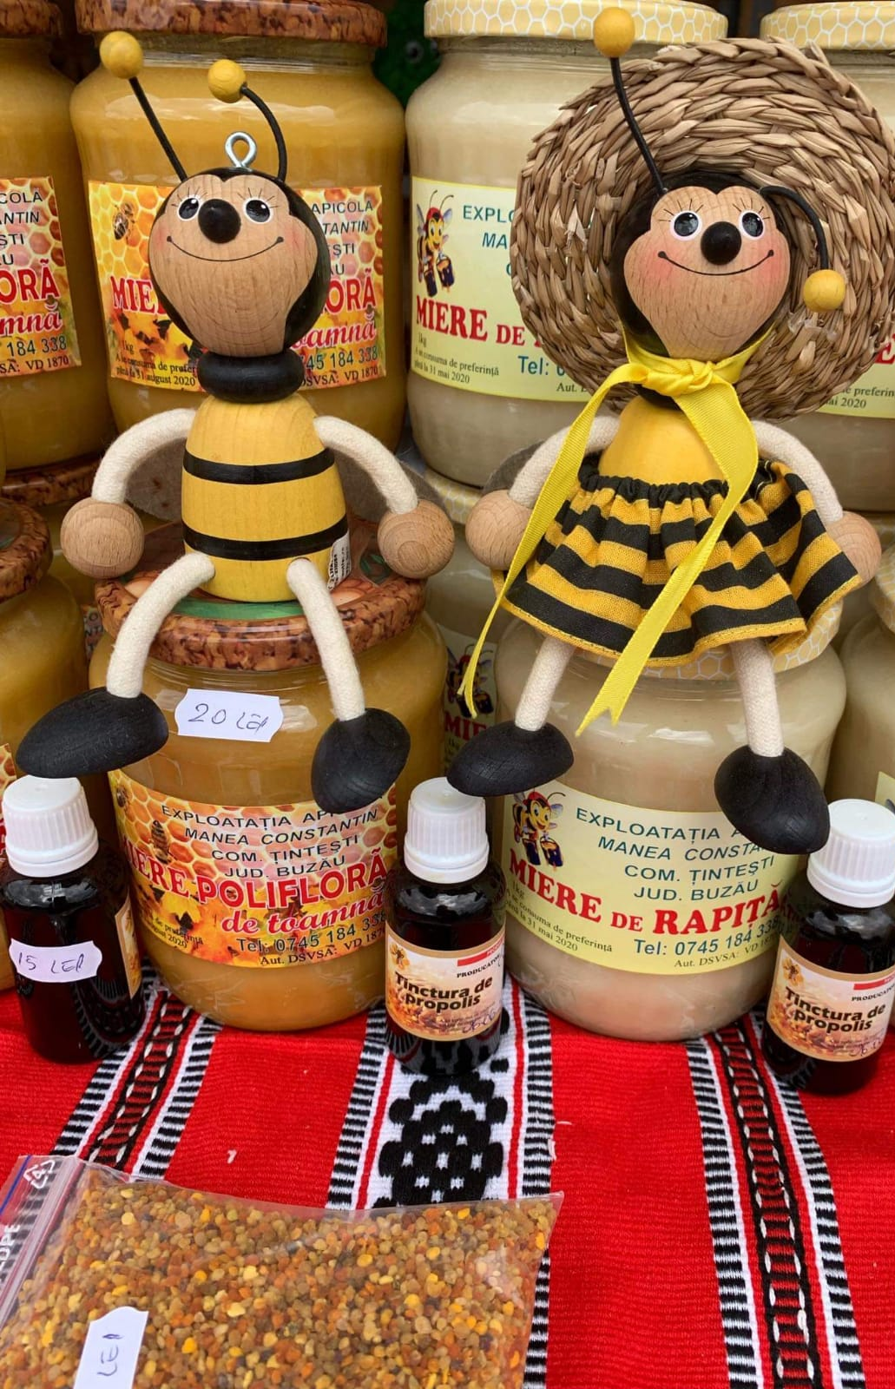
Natural Honey
Honeycomb: from local production

Slide 15
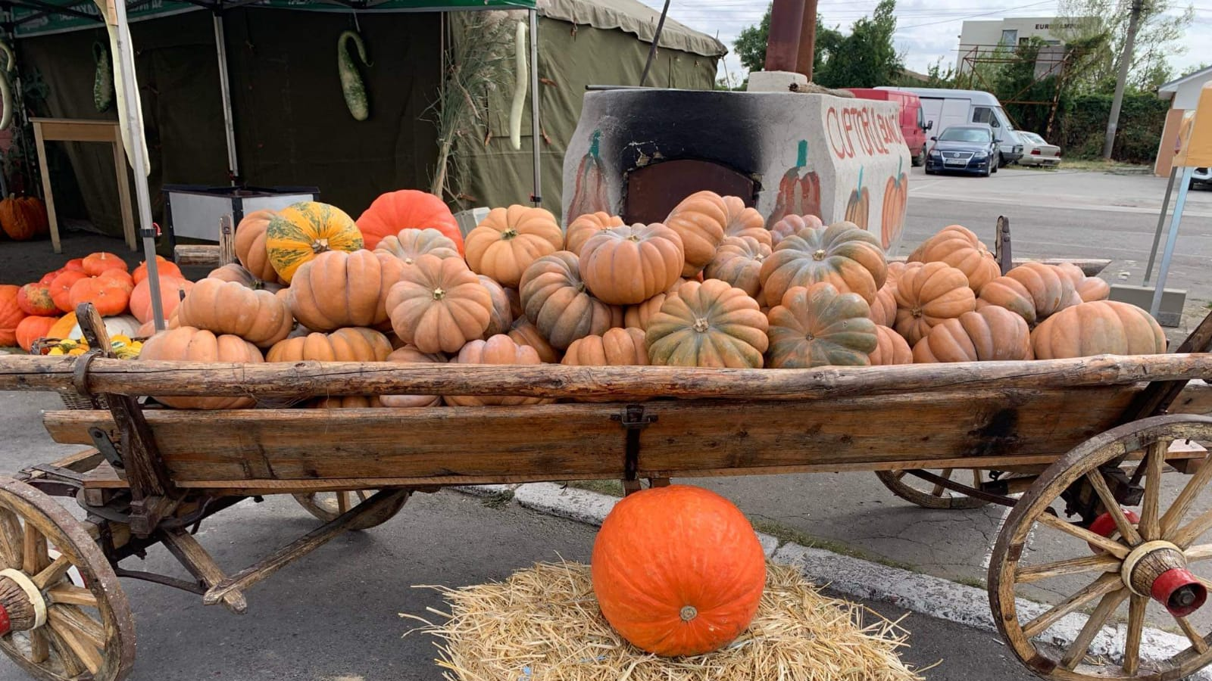
Thank you!

