Slide 1

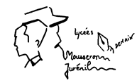


FOOD IN OUR LIVES
COLEGIUL ECONOMIC BUZAU

Slide 2
FOOD AND ECONOMY
RESEARCH

Slide 3
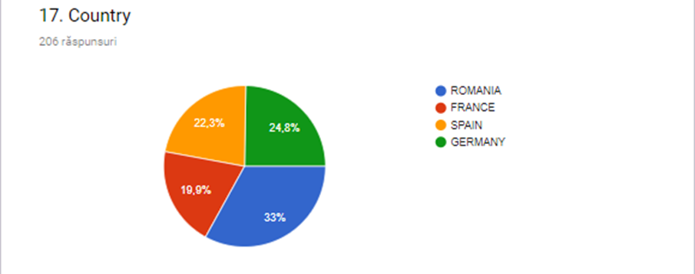
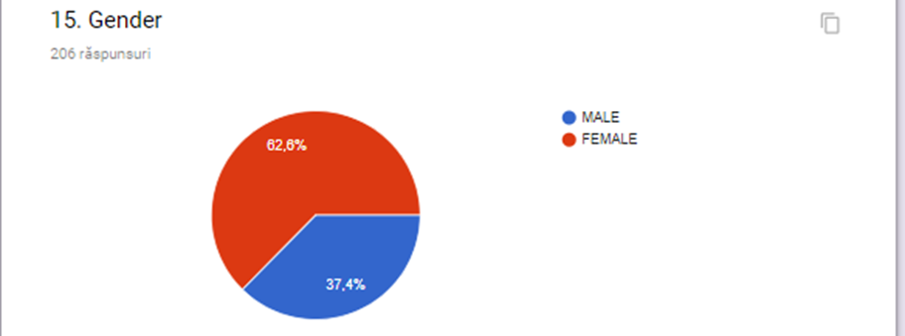
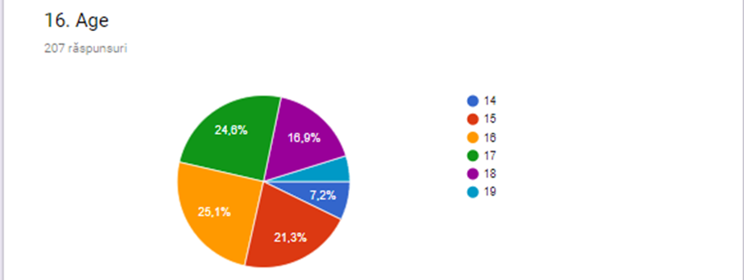
SOMETHING ABOUT STUDENTS WHO ANSWERED TO THIS QUESTIONNAIRE

Slide 4
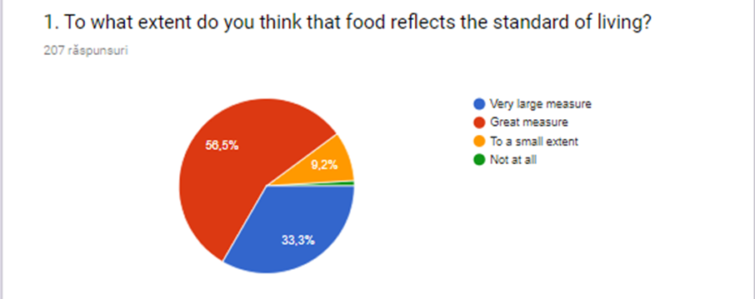
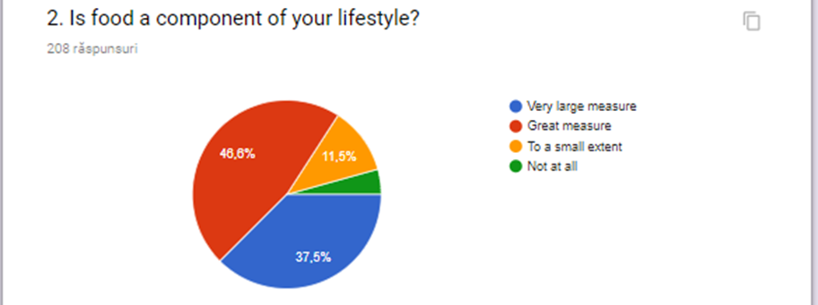
The distributions of the students’ answers to each of the 14 items are:

Slide 5
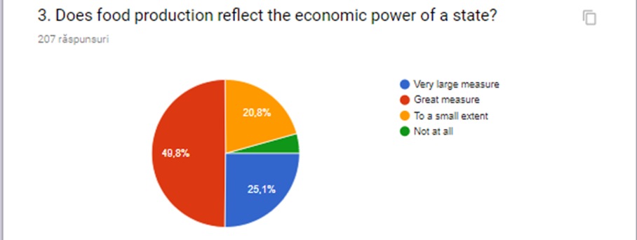
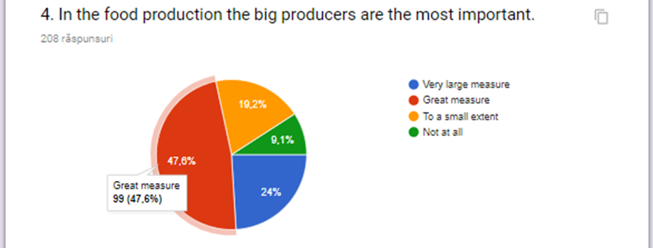

Slide 6
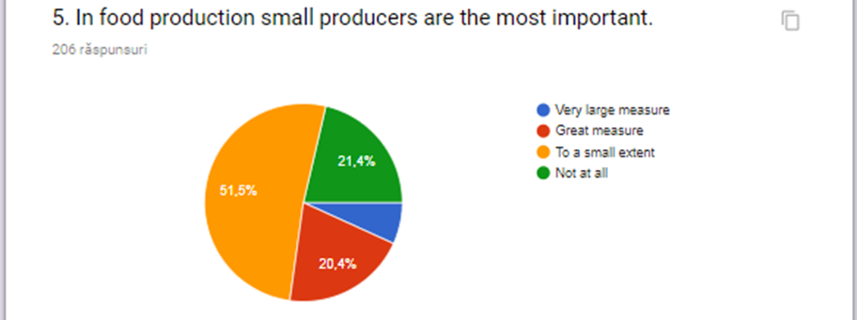
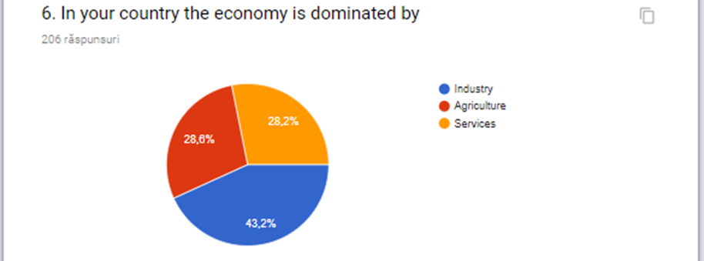

Slide 7
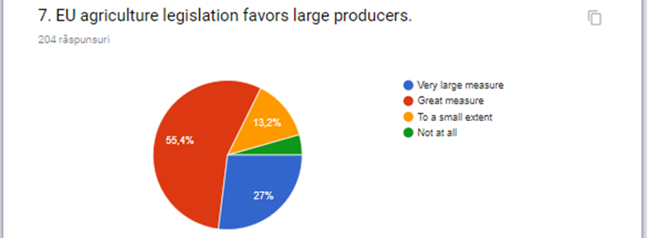
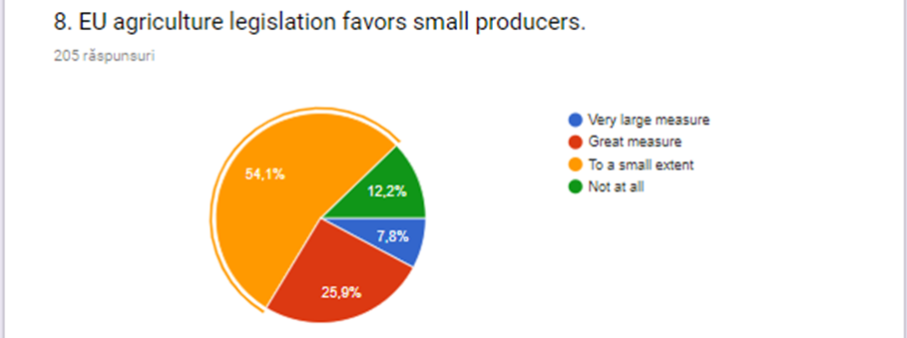

Slide 8
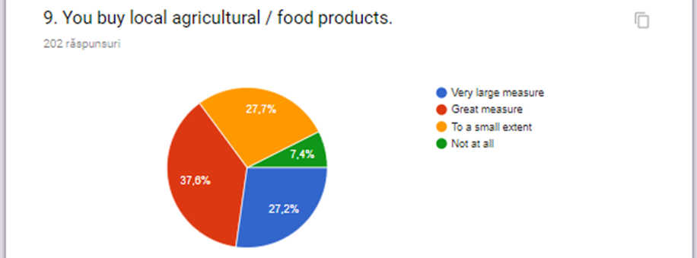
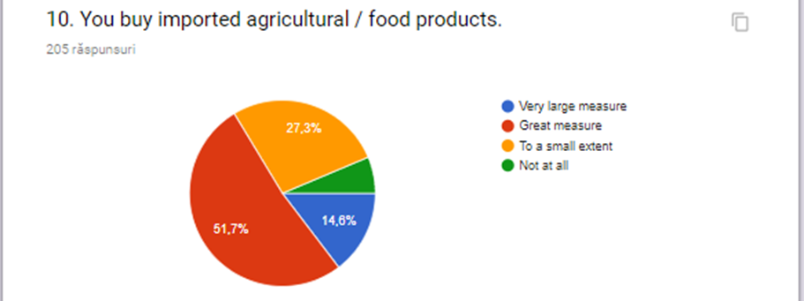

Slide 9
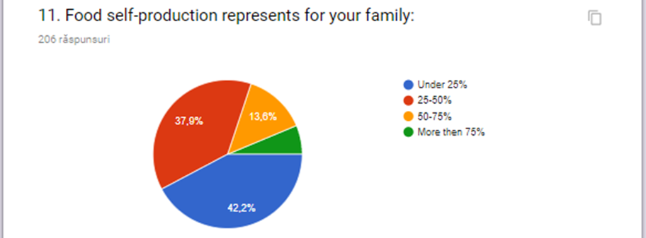
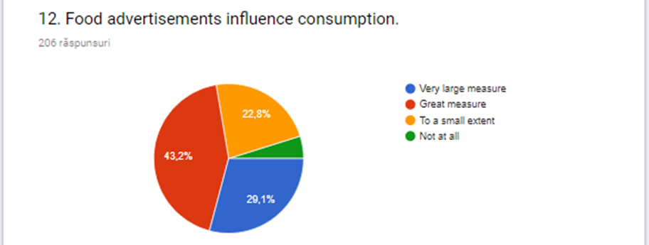

Slide 10
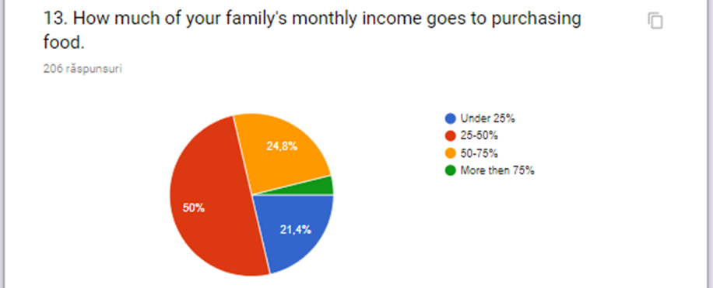
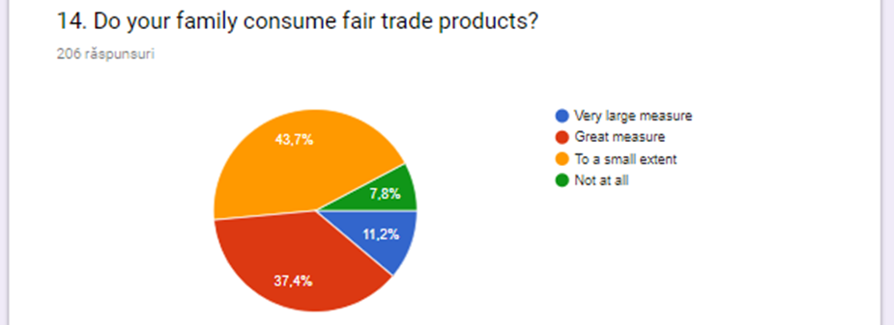

Slide 11
Thank you for your attention!
Questionnaire made by PHd Adina Enus and Presentation by Pascu Maria-Andreea and Serban Andrei

Slide 12
‘This project is financed with support from the European Commission. This material only reflects the views of the authors, and the Commission cannot be held responsible for any use which may be made of the information contained therein.’

