Slide 1
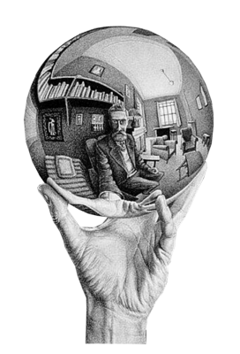
Escher
Tessellations

Slide 2
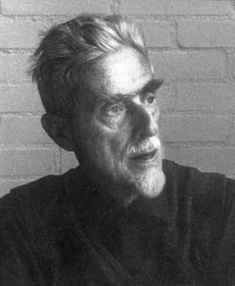
Maurits Cornelis Escher
(17 June 1898 – 27 March 1972), usually referred to as M. C. Escher, was a Dutch graphic artist. He is known for his often mathematically inspired woodcuts, lithographs, and mezzotints. These feature impossible constructions, explorations of infinity, architecture, and tessellations.

Slide 3
Tessellations
A tessellation of a flat surface is the tiling of a plane using one or more geometric shapes, called tiles, with no overlaps and no gaps. In mathematics, tessellations can be generalized to higher dimensions.
A periodic tiling has a repeating pattern. Some special kinds include regular tilings with regular polygonal tiles all of the same shape, and semi-regular tilings with regular tiles of more than one shape and with every corner identically arranged. The patterns formed by periodic tilings can be categorized into 17 wallpaper groups. A tiling that lacks a repeating pattern is called "non-periodic".

Slide 4
Types of tessellations
A regular tessellation is a highly symmetric, edge-to-edge tiling made up of regular polygons, all of the same shape. There are only three regular tessellations: those made up of equilateral triangles, squares, or regular hexagons. All three of these tilings are isogonal and monohedral.
A semi-regular tessellation uses more than one type of regular polygon in an isogonal arrangement. There are eight semi-regular tilings. These can be described by their vertex configuration4.8²; for example, a semi-regular tiling using squares and regular octagons has the vertex configuration.
Penrose tilings, which use two different quadrilaterals, are the best known example of tiles that forcibly create non-periodic patterns. They belong to a general class of aperiodic tilings, which use tiles that cannot tessellate periodically, though they have surprising self-replicating properties using the recursive process of substitution tiling.

Slide 5
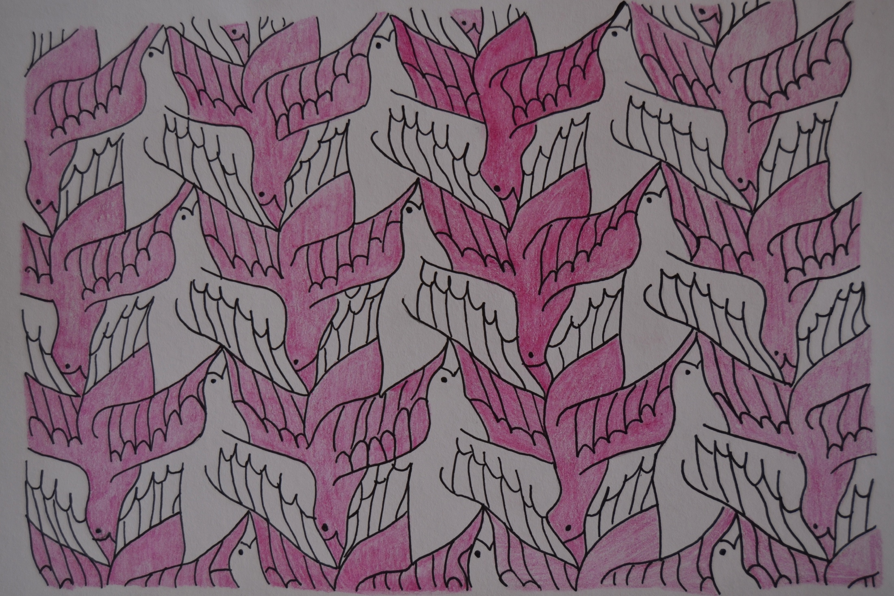
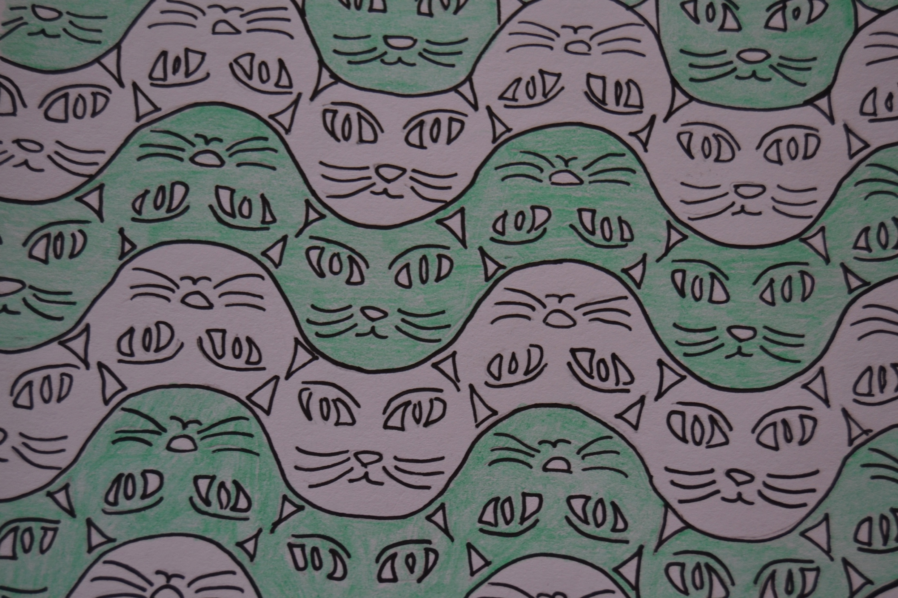
We did this two tessellations.

