Slide 1
Presentation of the Diary “Our First Days in Kindergarten”
Kindergarten ISKRICA
Zagreb, Croatia
Željka Horvatić

Slide 2
The process of adaptation to the kindergarten is a crucial step to us. We monitor the children’s progress and pay attention to the ways in which we shape their behavior.
The adjustment period serves for a child to adapt to a new daily environment, including other individuals and fellow classmates.
From age one, most of the children have been enrolled, finding themselves in an environment different from the one at home.

Slide 3
The adjustment period can be stressful because.....
A child has to accept their new teacher as an authority figure instead of the parent. A child also has to accept numerous children and a new sleeping schedule, hygiene and feeding schedule as well as playtime.

Slide 4
The fear of new people is present. A child can react by rejecting them or crying.
From age one, children need much more physical contact, hugging, hand holding, visual contact and non-verbal communication cues.

Slide 5
The process of starting preschool is gradual (no longer than half an hour on the first day, in their parents’ presence) and after two weeks, a child is able to spend the day (up to eight hours or more).

Slide 6
It is very important to understand the needs of a child, learn and be able to follow their gestures and emotions, give them plenty of patience and support, communicate with their parents and discuss the progress together.
Our goal is to ease a child into the kindergarten where their parents are absent.

Slide 7
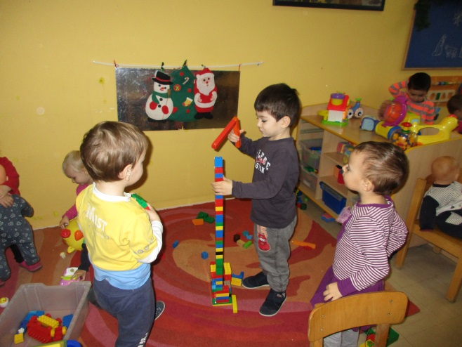
Gradually, a child forms independence, explores the environment and finds new stimulations.
We create the best transition from the family enviroment to the preschool way of life.

Slide 8
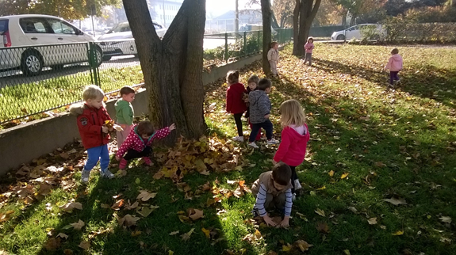
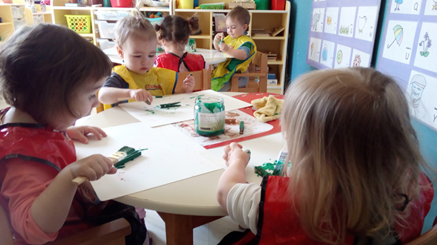
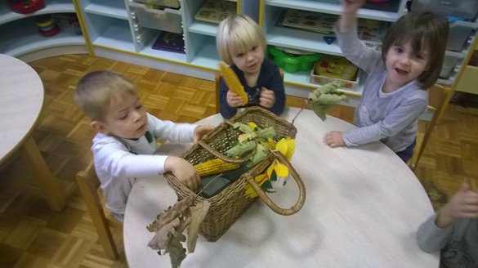
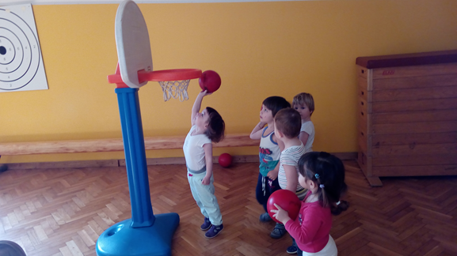

Slide 9
We follow a child’s adaptation to the kindergarten by keeping records of different phases of development. We record every change and stage of development which makes it easier for all of us to follow.
We also draw conclusions about a child’s progress which helps us create new stages of the education process.
This is one of many examples of monitoring a child’s adaptation, from social and emotional aspects in this case.

Slide 10
Elements of monitoring a child
Presence of extreme emotions and behavior (crying, anger, aggression, refusal of communication...)
Involvement during play (alone,initializes the game,plays independently, plays parallel games, interaction with others during play)
Communicates with peers (nonverbally , verbally)
Communicates with teachers (nonverbally , verbally)
Independency in every day life activities (still dependent, becoming independent with the help of a teacher independent)
Follows the rules of the group (partially, completely)
Teachers / observations, actions , feelings, new methodological approaches
Parents / actions, statements, feelings
Final observations (first month of adaptation , second...)

Slide 11
Example 1. From teachers diary...
The boy was enrolled in a kindergarted at the age of 4,9.
He was used to the home atmosphere surrounded by
adults only, so at the beginning it was hard to approach
him.
We gave him time and space to observe and explore the new surrounding. In the first 2 weeks the presence of a father and grandfather was an obstacle to get to know the boy better and to gain his trust.
By the end of the first month we started to build the confidence and emotional connection which is crucial in the first days of adaptation

Slide 12
From teachers diary...
The second week the boy`s grandfather was in the group with him. The boy is really close to his grandfather and again we couldn`t approach him properly.
We recommended that grandfather leaves the room for 2 hours and waits for a boy outside which he agreed to do.
The progress then was huge because the boy learned to ask the teacher when and if he needed anything.

Slide 13
By the end of the second month of adaptation, the boy is fully adapted and intergrated in the group. Mostly plays in a group of 3-4 children but doesn`t initializes the game ( follows ). He communicates with teachers and peers and expreses himself verbally

Slide 14
Example 2. From teachers diary...
Child M.V. girl (3,6) – 1. week
crying and calling for mother accompanied with dramatical verbal and nonverbal cues (drops on knees and yells "Please call mom!")
eats but asks to be fed because she smushes the food
communicates with teachers / not communicate with peers
Girl is emphatic, gentle and compassionate. Oriented on the teacher and adults. She needs encouragement to realise relationships with peers, to create intrest for others, to accept others and to create affiliation and sense of community.
After we shared our information with parents we found a common ground on further care. Parents are very content with our care and they are trying to help us how they can.
Final observations: ( third month ) Continuous involvement in all activities. Child is sometimes oriented towards the adults. Child feels safe towards adults and peers. Girl has succesfully adapted and aware of herself and enviroment
We are going to see an example of learning from the peers.
The little girl in the video is new...

Slide 15
Conclusion...
The most important factors to a child’s:
Up to age three, the most important person is the teacher.
Up to age four, the most important part are toys and playing with them.
Age five and older, interaction with peers is most important.
Everyone must get involved in the process of adjustment. Employees, peers, parents and extended families contribute to a successful adjustment period.

Slide 16
Thank you...

