Slide 1








FEARLESS CHILD MAKES
A CHEERFUL CHILD
ERASMUS +
2016-2018

Slide 2


Slide 3
THE AIMS OF THE PROJECT
Making preschool education more attractive and appealing;
Sharing the practices, which have been done on a country basis, to overcome school phobia;
Minimizing the problems of preschool adaptation, strengthening the cooperation of school and parents;
Improving early age children socialisation.

Slide 4
PROJECT OUTPUTS
1. Diary "Our first days in kindergarten".
2. Techniques and methodology of adaptation problem and school fear.
3. Activity „Working together“: institutions openness for family, parental involvement in the educational process.
4. Leaflet for project dissemination.
5. Blog includes traditional game's ideas, which will help facilitate children‘s adaptations.
6. E-book and booklet about techniques and methodology of adaptation problem and school fear
7. Video film about the project
8. Etwinning twinspace about our project theme, activities
9. "Happy School Day" educational weeks.
10. Skype video conferences.
11. Project exhibition.

Slide 5
LOGO
PRODUCTS OF OUR PROJECT
VIDEO
ETWINNING
WEBSITE
OUTCOMES OF OUR PROJECT
BLOG ABOUT THE GAMES
LEAFLETS
BOOKLET AND E-BOOK
EDUCATIONAL WEEK
EXHIBITION
DIARY
Notes:
This diagram illustrates a strategic approach to building, maintaining and concluding partnerships.
There are six steps, as you can see, and I will walk you through each of the steps so you can get a sense for what they entail. This diagram is not something TNC made up - it’s drawn from a few different models we found in the partner relations arena, and adapted to fit the best practices we’ve learned from experience working with partners around the world.
And just to note – what am proposing here is NOT a one-size fits all approach – you may jump directly from one step to the next, but in other circumstances you might skip a step, repeat a step and so on. There is no right way to work with partners, and all partnerships are different. But with that said, we think that this approach is general enough and robust enough to be applied – with adjustment – to almost any situation – from non-profit pt to govt’ to community-based partnerships.

Slide 6
DISSEMINATION PRODUCTS OF OUR PROJECT
YOUTUBE CHANNEL
FACEBOOK
BLOG ABOUT THE GAMES
TWITTER
TWINSPACE
(ETWINNIG)
INSTAGRAM
Notes:
This diagram illustrates a strategic approach to building, maintaining and concluding partnerships.
There are six steps, as you can see, and I will walk you through each of the steps so you can get a sense for what they entail. This diagram is not something TNC made up - it’s drawn from a few different models we found in the partner relations arena, and adapted to fit the best practices we’ve learned from experience working with partners around the world.
And just to note – what am proposing here is NOT a one-size fits all approach – you may jump directly from one step to the next, but in other circumstances you might skip a step, repeat a step and so on. There is no right way to work with partners, and all partnerships are different. But with that said, we think that this approach is general enough and robust enough to be applied – with adjustment – to almost any situation – from non-profit pt to govt’ to community-based partnerships.

Slide 7
TRANSNATIONAL PROJECT MEETINGS
1st TRANSNATIONAL MEETING – FRANCE
2nd TRANSNATIONAL MEETING – CROATIA
3rd TRANSNATIONAL MEETING – ROMANIA
4th TRANSNATIONAL MEETING – TURKEY
5th TRANSNATIONAL MEETING – BULGARIA

Slide 8
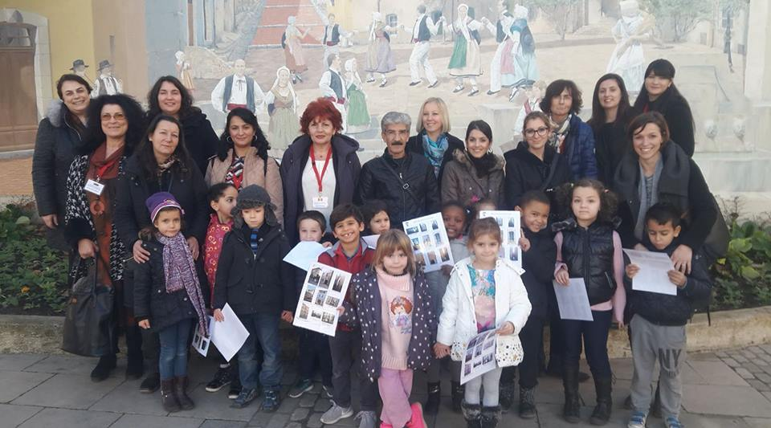
1st TRANSNATIONAL MEETING – FRANCE

Slide 9
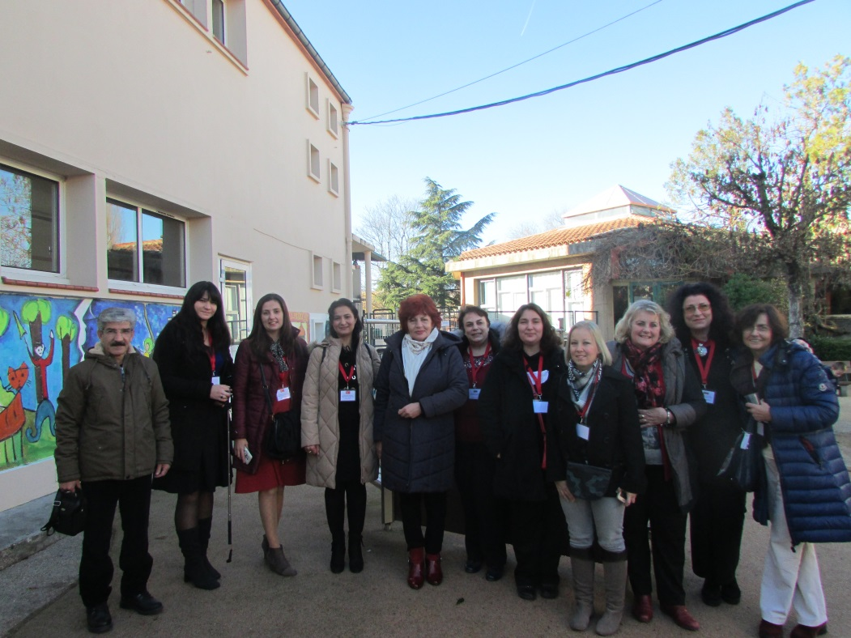
1st TRANSNATIONAL MEETING – FRANCE
From 6th till 10th of December 2016, Ecole Maternelle Jean Jaures Brignoles, France, hosted the first transnational meeting of the partners in the framework of Erasmus + Project "Fearless Child Makes a Cheerful Child".

Slide 10
1st TRANSNATIONAL MEETING – FRANCE
At the first meeting of our project we examined the pre-school education system in France and the activities to be carried out for the project: summary of the project and the tasks of the partners. We also discussed about the project Logo competition and agreed about dates and agenda of the 2nd meeting in Croatia and 3rd meeting in Romania. We exchanged ideas about the dissemination products to be prepared for the project.
A lecture on the eTwinning platform was held by Mrs. C. Avrand from the Rectorat de Nice to introduce us to the work and use of this platform.
During our stay in Brignoles we visited school and met children and teachers. We visited the “Middle Age city” of Brignoles with a class working on an artistic project about houses.
We also went on a one-day trip to Marseille where we saw the cultural sights of this city.

Slide 11
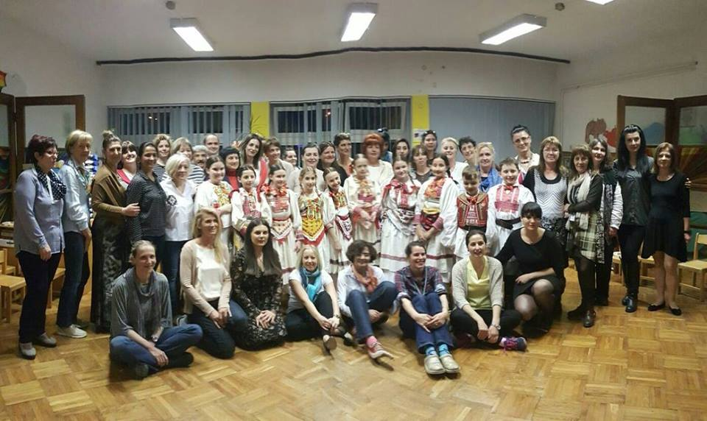
2nd TRANSNATIONAL MEETING – CROATIA

Slide 12
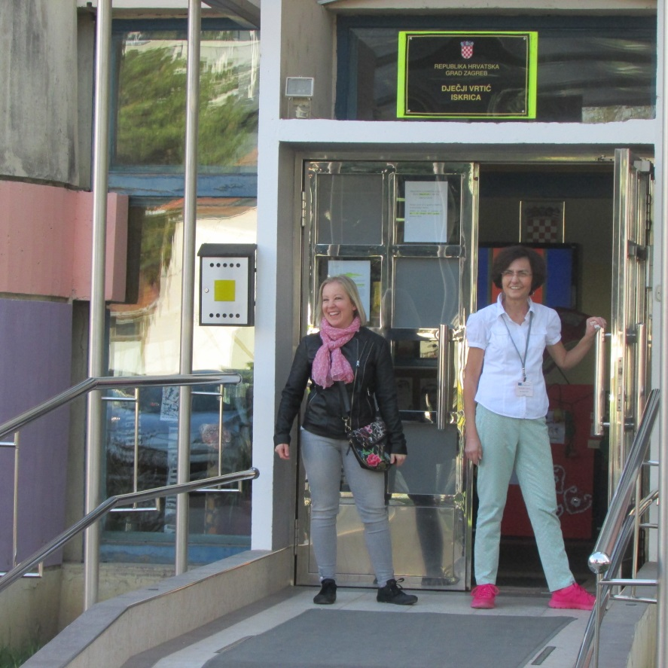
2nd TRANSNATIONAL MEETING – CROATIA
The second meeting of the project was held in Zagreb, Croatia, from 28th of March till 1st of April 2017.
Our hosts were teachers, children and staff of the kindergarten Iskrica from Zagreb.

Slide 13
2nd TRANSNATIONAL MEETING – CROATIA
At the meeting we discussed the tasks and activities to be carried out: updating of the activity plan, dates of the next project meeting in Romania and tasks for the next mobility (Working together activity; three methodology/techniques for decrease of early age school fear); an update of project eTwinning page; planning video conferences between partners. Presentation of the project blog held the French team. All the partners presented The Traditional games activities and The Diary – Our first days in kindergarten.
The Croatian Erasmus + team prepared a presentation about their institution, city and country, and a presentation about the Croatian Education System.
During our visit we had the opportunity to see the cultural heritage of Zagreb through sightseeing tour of Upper town and city center, the natural beauties of Croatia by visiting the Plitvice National Park and a part of the Croatian tradition through the cultural program of folklore ensemble.

Slide 14
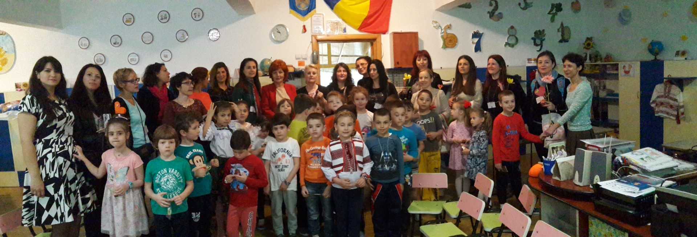
3rd TRANSNATIONAL MEETING – ROMANIA

Slide 15
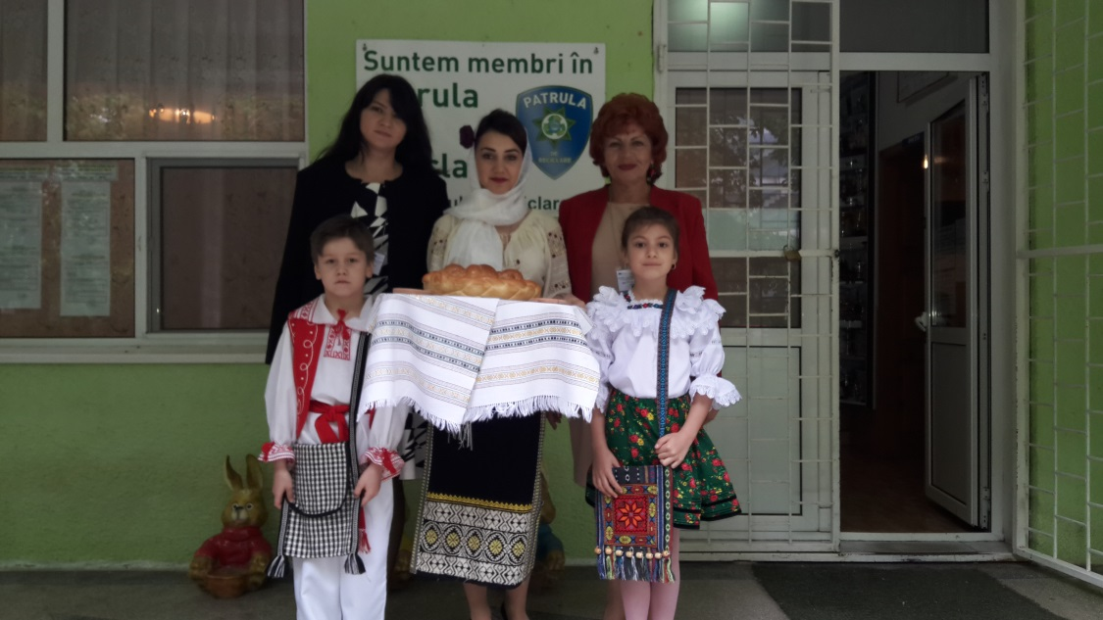
3rd TRANSNATIONAL MEETING – ROMANIA
The third meeting of the project was held from 8th till 12th of May 2017.
Our hosts were partners from The Gradinita N˚37, Braila, Romania.

Slide 16
3rd TRANSNATIONAL MEETING – ROMANIA
At the third transnational meeting Romanian partners presented their institution, city and country, and education system. We visited the classes in two facilities and enjoyed cultural program held by children. Our colleagues prepared a traditional dinner at school in cooperation with the parents. We updated project tasks and the activities to be carried out: “Happy School Days”- an open door days with specific activities for children, parents and teachers; The traditional games of our partner's countries (exchanging and making a video); eTwinning uploading; online meetings with children and teachers. Furthermore, we have determined the dates of the next meeting and discussed the midterm report. Each partner presented the parent involvement activities „Working Together“ and The Techniques and Methodology of Adaptation Problem and School Fear.
We visited the City Hall and had a tour of Braila with a guide. A trip to Bucharest (Visit to the Parliament House and Village) was also realized.

Slide 17
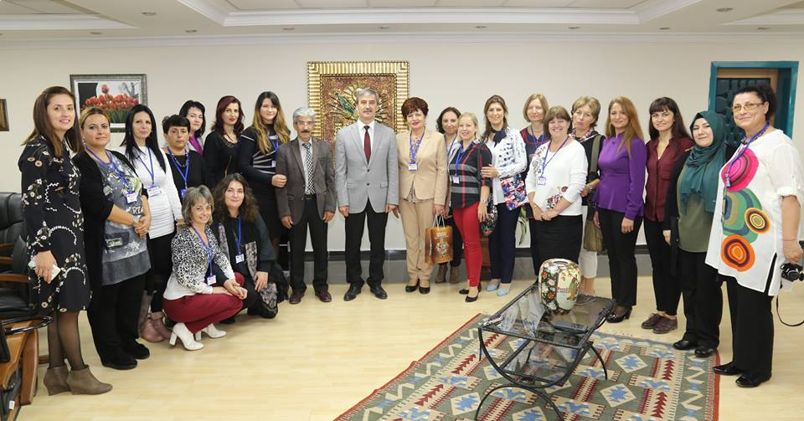
4th TRANSNATIONAL MEETING – TURKEY

Slide 18
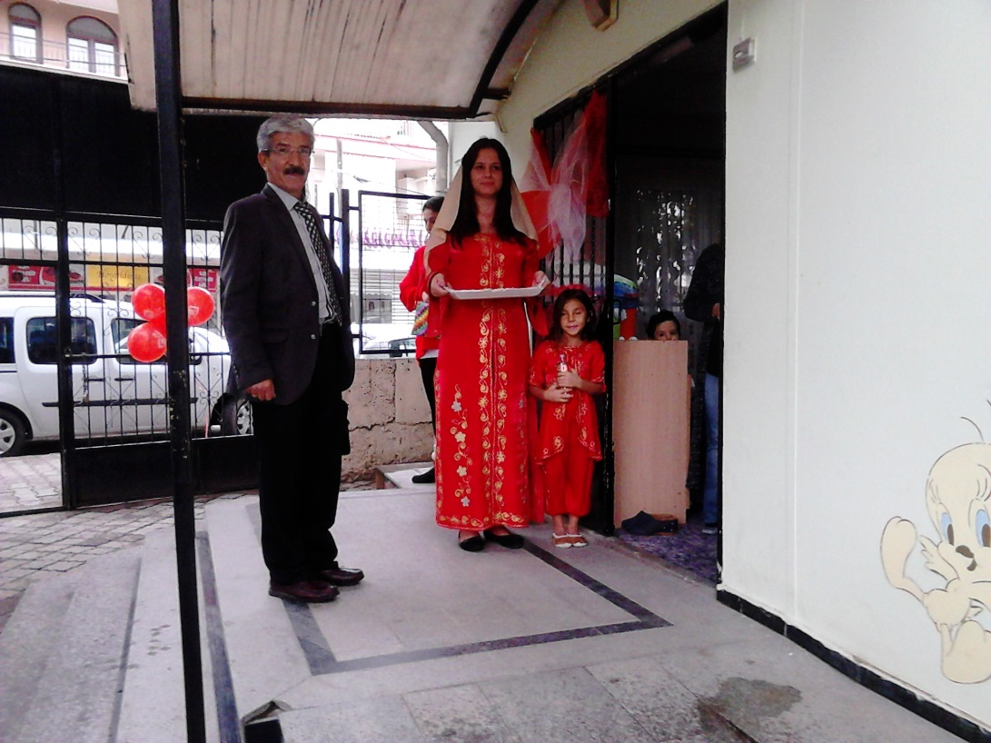
4th TRANSNATIONAL MEETING – TURKEY
The fourth meeting of the Erasmus + Project "Fearless Child Makes a Cheerful Child" was held in Turgutlu, Turkey, from 24th till 28th of October 2017.
Our hosts were Sadi Turgutlu Ortaokulu, Turgutlu, Manisa, Turkey – the project coordinator.

Slide 19
4th TRANSNATIONAL MEETING – TURKEY
At this meeting each country presented Happy School Days Events and Traditional Games. A draft for the project e-book and booklet was presented by the Croatian team. Bulgarian team presented the Project Exhibition Plan and The Turkish educational system was presented by the Turkish team. We agreed about the activities to be completed until last transnational meeting: finishing the e book and the booklet until the end of March, preparing 5 copies of the booklet for Bulgarian meeting; preparing materials made by children for the Project Exhibition in Bulgaria; making a DVD of the Traditional Games (Romanian team); sending impressions about the project for the e book.
For the purpose of dissemination we visited the representatives of the city authorities: The District Governor and The Mayor at the City Hall.
We also visited two kindergartens (Sadi Turgutlu Kindergarten and Mehmet Altan Kindergarten) and had an opportunity to see Turkish preschool methodology.
We visited places of the historical and cultural significance in Manisa and Izmir and enjoyed Turkish tradition and culture at the Turkish Night Event.

Slide 20
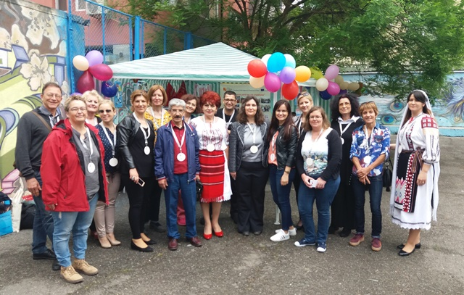
5th TRANSNATIONAL MEETING – BULGARIA

Slide 21
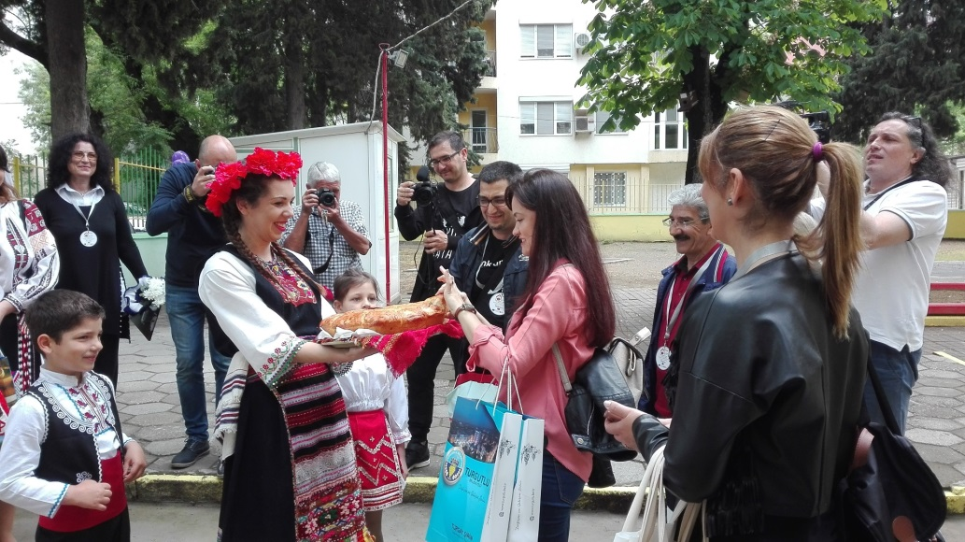
5th TRANSNATIONAL MEETING – BULGARIA
The fifth meeting of the Erasmus + Project "Fearless Child Makes a Cheerful Child" was held in Burgas, Bulgaria, from 8th till 12th of May 2018.
Our hosts were Radost Kindergarten with filial in Kraimorie.

Slide 22
5th TRANSNATIONAL MEETING – BULGARIA
The last transnational meeting of the Erasmus+ project „Fearless Child Makes a Cheerful Child“ was held in Burgas, Bulgaria from 8th till 12th of May 2018.
We visited the kindergarten Radost (main and second facility) and met with children and school staff who prepared a greeting program and educational activities. Bulgarian team had a presentation about town, country and Bulgarian educational system.
The exhibition of project results and outputs had been prepared at the kindergarten yard. Each partner had their own exhibition space for displaying the products made by children and teachers, presenting the country they came from. The event was accompanied by media.
The common exhibition space was arranged to present the project results: a stand with project products and photos, leaflets, compact discs - video of the traditional games, and the booklet.
Also there was an overall presentation of project activities, display of project meetings and activities – mainly photos, children's greetings and educational activities related to the project in the groups.
During our stay in Bulgaria, we had an opportunity to visit the Burgas Municipality and the District Administration.
For the purpose of presenting their country and cultural and social heritage, the Bulgarian team has prepared several trips and events (Trip to St. Anastasia, Trip to Kamchia and The Old Town of Nessebar-UNESCO and Bulgarian Night event)

