Slide 1
FEARLESS CHILD MAKES A CHEERFUL CHILD
2016-2018
FEARLESS CHILD MAKES A CHEERFUL CHILD
ERASMUS+
2016-2018
Diaries
“Our First Days In Kindergarten”

Slide 2
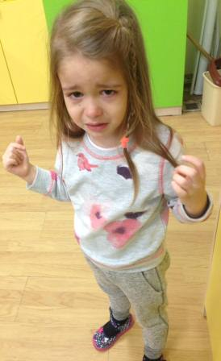
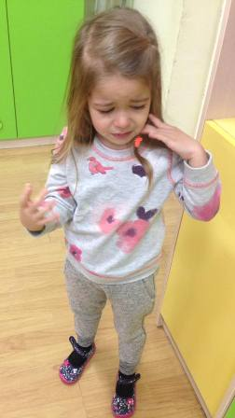
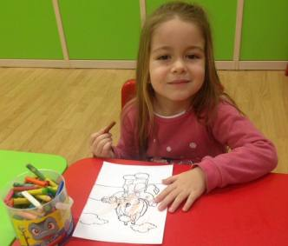
R. – 3 years old
SEPTEMBER
The child cries violently in the morning when been brought to the kindergarten. She holds her mother and in no way we are able to separate her. When we manage to separate her from her mother, the child fairly quickly calms down. She does not communicate with other children during the day. She does not eat and does not want to feed her. She does not use the toilet all day.
MARCH
The child is involved in pedagogical situations with desire. She demonstrates sustainability of attention, calmness, and shows deep interest. She plays in story and role playing games. She sings, she draws and is physically active.

Slide 3
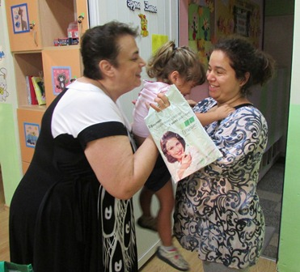
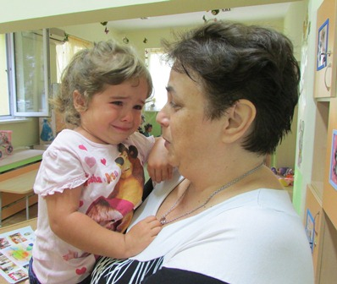
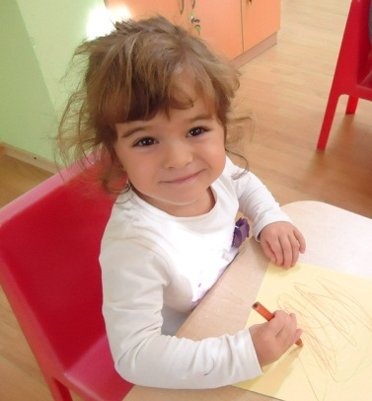
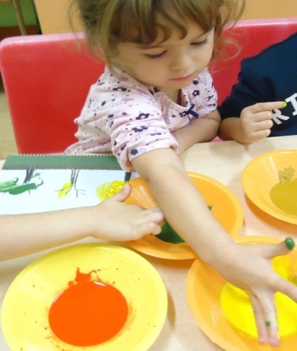
T. – 3 years old
SEPTEMBER
T. comes to the kindergarten with poor psychological readiness to join the kindergarten. From a single-parent family, she is emotionally unstable, mistrustful, with difficult adaptation and socialisation. She takes everything too close to her heart. She understands the instructions, but does not finish her work to the end. She rarely complies with group rules.
MARCH
Although the work on developing an emotional vocabulary continues and the anxiety process is over, the child continues to have her childhood fears.
T. is also included in games that involve creating a child community and building friendly relationships through physical contact and mutual sympathy.

Slide 4
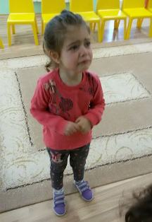
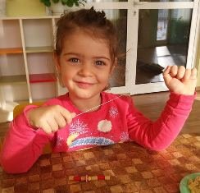
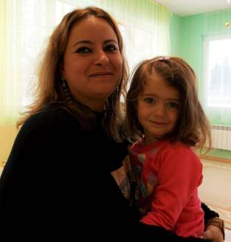
V. – 2 years old
SEPTEMBER
V. started kindergarten with great anxiety and uneasiness when parting with her mother.
They have a strong emotional connection with each other.
V. grows into a healthy family of two parents.
In the kindergarten she is hypersensitive to the interest of the other children in her. She spends a long time crying and only calms down for a short time.
MARCH
The child gradually overcomes stress and tension through group games. She willingly participates in the musical activities and together with the other children willingly performs: "Hello, what a wonderful day!”. She gets more confident by sitting with other children and drawing. V. still waits for the teachers’ directions .

Slide 5
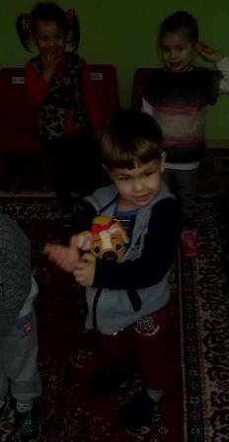
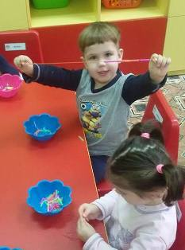
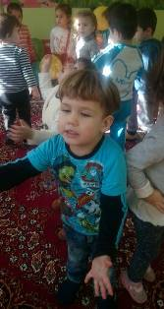
N. – 3 years old
SEPTEMBER
N. eats with an effort and support from adults, he hasn’t got any established hygiene habits. During afternoon sleep he is restless and often wakes up crying. The child doesn’t say about his natural needs, uses diapers during sleep. He almost never plays with other children, does not give his toys, do not comply with the rules of the games. N. is distracted, he holds his attention with persuasion.
Almost every morning he cries when separating from a parent. He exhibits aggressive behaviour towards his peers, which is expressed mainly in biting, stinging.
MARCH
N. begins increasingly to overcome tension and stress and show increasing willingness to be included in the games. A gradual shift from negative to positive psychological change is observed.
N. paints with more vivid colors in conducting art therapy.
He is very happy to be included in the game "Hello, what a wonderful day!”, to sing and dance with other children.

Slide 6
FEARLESS CHILD MAKES A CHEERFUL CHILD
2016-2018
FEARLESS CHILD MAKES A CHEERFUL CHILD
ERASMUS+
2016-2018
THANK YOU VERY MUCH!

