Slide 1




DIARIES / TURKEY
PART 1

Slide 2
CHILD'S NAME:F.A.E
TEACHER'S NAME:Alime SEZGİN
SEX AND AGE:Boy/5 DURATION:20 Minutes
PERIOD(MONTH):OCTOBER
ACTIVITIES: GREETING-MEETING

Slide 3
DETAILS:
He is shy about greeting and talking when he came to class.
His voice is barely heard while he is talking.He is avoiding eye contact while he is talking.
OBSERVATION REASON:
His shyness is the result of an accident from his little ages.
He fell and broke his teeth.Therefore, he doesn't want to talk or laugh.
COMMENTS AND SUGGESTION:
It can be told him that accidents like this about falling may happen to everyone.
A visit to a dentist can be made with his family.

Slide 4
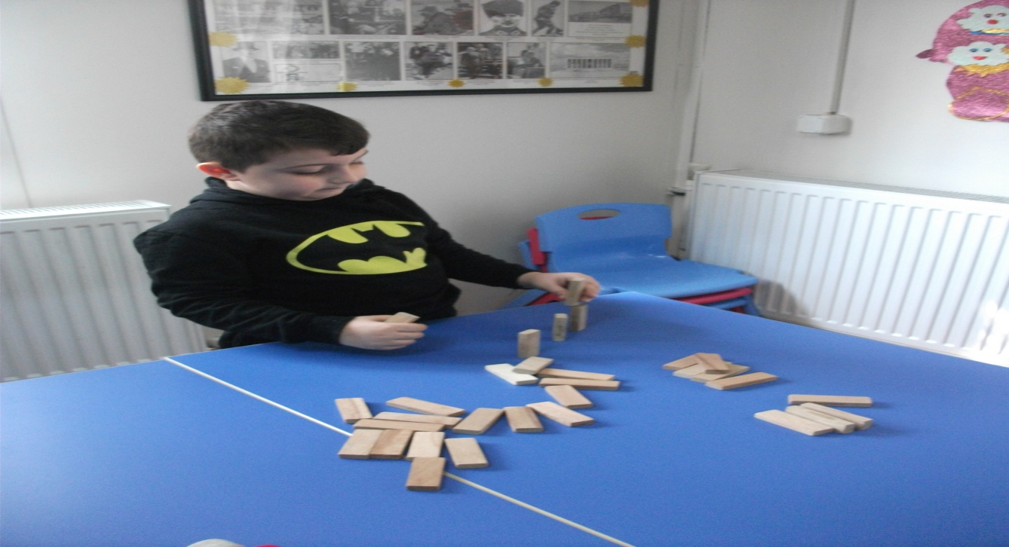
ACTIVITIES:LEISURE ACTIVITY(LEISURE GAME TIME)
PERIOD(MONTH):NOVEMBER
DETAILS
First,he looks at the toys and his friends,he observes them,
then he determines a playground for himself and starts to play there quietly.
When his friends invite him to their game,he says ''I made a very good game here''
and continues to play.

Slide 5
OBSERVATION REASON:
He prefers the games where he can play alone.He doesn't want to play games in groups.
COMMENTS AND SUGGESTION:
We enable him to socialize by telling him that the games in groups are funnier and more amusing.

Slide 6
PERIOD(MONTH):DECEMBER
DETAILS
He is hesitating about starting the art activity.He has thoughts like: ''What if I can't do it,what if I do it wrong.''This is why ,he can't continue or finish although he starts.We help him to finish with praises and encouraging sentences.
OBSERVATION REASON:
His lack of self-confidence about achieving something prevents him from starting and causes him not to start it.
COMMENTS AND SUGGESTION:
Simple and understable activities should be organized.Helping him in succeeding and little rewards can help him develop self-confidence.

Slide 7
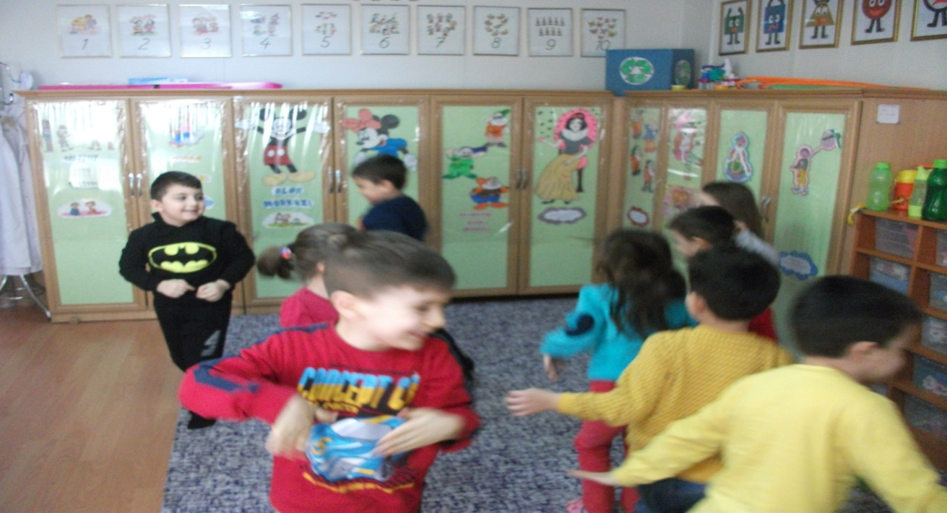
PERIOD(MONTH):JANUARY
ACTIVITIES: PLAY TIME

Slide 8
DETAILS
He is more active and comfortable in attending games.
He says ,he wants to play actively and he asks if they can play the games he loves like ''Let's play again, shall we play the ...... game?,
the ...... game was so fun.''
OBSERVATION REASON:
With playing actively in games,he is expressing himself in a better way.
COMMENTS AND SUGGESTION:
Attending games in groups and belonging to a group makes F Ali express himself and help him develop his self-confidence.
Games in groups should be diversified.

Slide 9
ACTIVITIES: MUSIC ACTIVITY
PERIOD(MONTH):FEBRUARY
DETAILS
We started with the songs which we learned. F.A said: ''My teacher,may I sing it on my own?'' and sang the song successfully.He became very happy and went back to his place jumping.The song contains imitations.F.A wanted to do imitations and did the imitations while having fun.

Slide 10
OBSERVATION REASON:
He wants to take part in all activities and he is having fun.
COMMENTS AND SUGGESTION:
Activies that are made in groups affect F.A's self-confidence positively

Slide 11
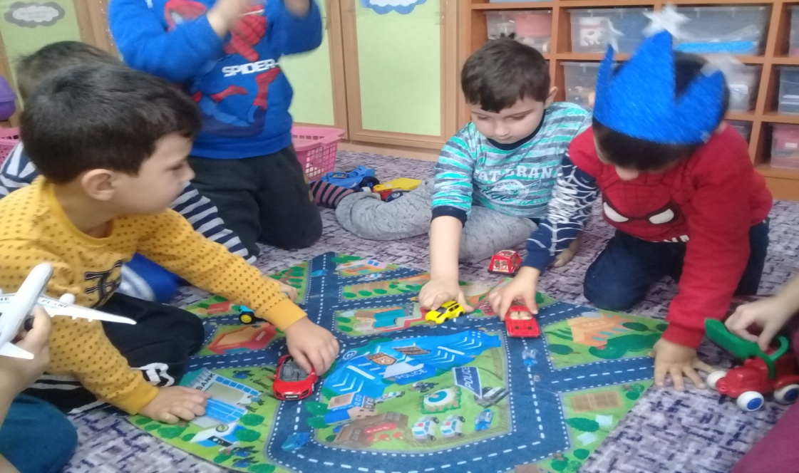
ACTIVITIES: FREE TIME ACTIVITIES
PERIOD(MONTH):MARCH
DETAILS
He attend the games more actively and he likes to share toys with his friends

Slide 12
OBSERVATION REASON:
He likes to involve the games actively and he gets fun
COMMENTS AND SUGGESTION:
With the help of the group activities he gets self confidence

Slide 13
DIARIES / TURKEY
PART 2

Slide 14
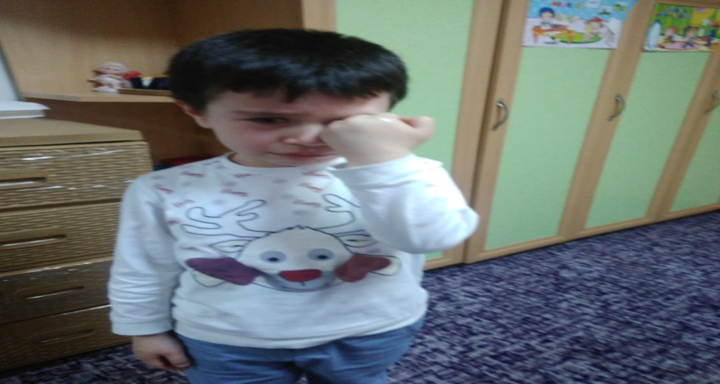
CHILD'S NAME:A.B.S
TEACHER'S NAME:AYSUN ÖCAL
SEX AND AGE:Boy/6 DURATION:20 Minutes
PERIOD(MONTH):SEPTEMBER
ACTIVITIES: FIRST DAYS OF SCHOOL
B. has only communicated with close relatives.
He hasn't communicated with stranger adults or his peers
He has no experience of crowd environments.
Therefore,he had a hard time adapting to the school.
Unsure attitudes of his family made him think
that his family won't return from wherever they go.

Slide 15
When they left him to the school, B. ,who had a sense like this,cried a lot
and behaved negatively.In the beginning of the school,
he showed negative reactions such as crying without a reason,nauseation.He has shown these reactions nonstop for a month.
When he came to school with his mother,he didn't leave his mother,didn't let her go,and cried.
Therefore,his mother was allowed to stay with him for a week.

Slide 16
OBSERVATION REASON:
Unhappiness, crying without a reason, unconfident
COMMENTS AND SUGGESTION:
Teacher indicated that his mother should let him individualize, and shouldn't be dependent to the child.
And also emphasized that a pressure and anxious environment shouldn't be formed at home.
I explained that the child should join social environment

Slide 17
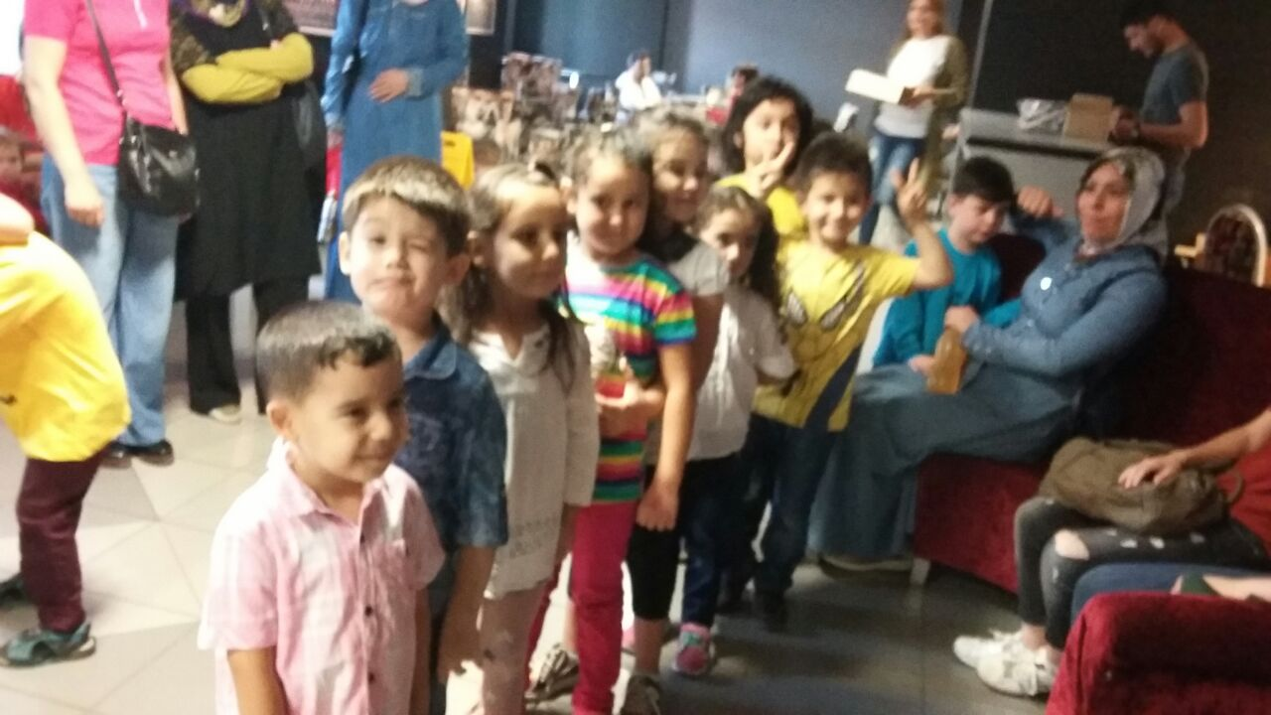
CHILD'S NAME:A.B.S
TEACHER'S NAME:AYSUN ÖCAL
SEX AND AGE:Boy/6 DURATION:20 Minutes
PERIOD(MONTH):OCTOBER
ACTIVITIES: SOCIAL ACTIVITY
B. continued to display similar behaviours in the second month
At the school he displayed behaviours such as sitting in a corner
without joining a group,
constantly asking when his family will come,
can't leaving the door, refusing to communicate.

Slide 18
Teacher showed him that he is not alone in this new environment introducing him to the other teachers and students ,by looking around the school
told him that he won't stay at the school all the time and his family will come to take him after a time
Teacher observed that his negative attitudes about the school reduced day by day.

Slide 19
OBSERVATION REASON:
He is having hard time about leaving his mother in Social-Cultural Activities.
He is crying when he is without his mother.
COMMENTS AND SUGGESTION:
Teacher warned his family that they should be determined,and show happy expression when they leave him to the school.
Teacher mention that in the face of difficulties they should not give up immediately.

Slide 20
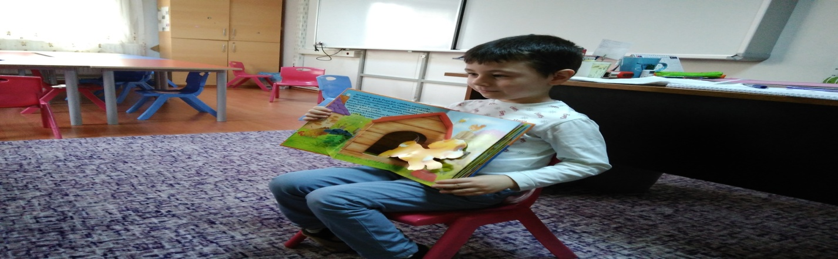
CHILD'S NAME:A. B. SABANCI
TEACHER'S NAME:AYSUN ÖCAL
SEX AND AGE:Boy/6 DURATION:20 Minutes
PERIOD(MONTH):NOVEMBER
ACTIVITIES: STORY TIME
Teacher observed that B.'s worries about the school are began to decrease
This happened thanks to the determined and consistent attitudes of teacher and his family.
B. ,now, spends his time with his friends,plays with them and enjoys it.
He began to attend in-class games and journal studies,however he still can't attend art activities.

Slide 21
OBSERVATION REASON:
He doesn't want to attend Story Activities.
COMMENTS AND SUGGESTION:
The troublesome attitude of B. about his adaptation to the school was reduced day by day.
However ,he still couldn't reach the intended level.
He continues to wait for his mother at the corridor from time to time.
Teacher emphasized that his family should continue to have a determined attitude.

Slide 22
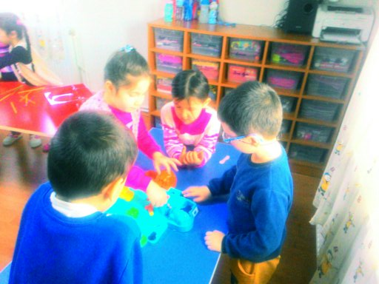
CHILD'S NAME:A. B. SABANCI
TEACHER'S NAME:AYSUN ÖCAL
SEX AND AGE:Boy/6 DURATION:20 Minutes
PERIOD(MONTH):DECEMBER
ACTIVITIES: GAME ACTIVITY
B. ,now,adopts his friends and teacher,and loves them
He doesn't have a problem about coming to or leaving school.
He wants his mother to wait for him ,if she comes to school early in order to take him.

Slide 23
OBSERVATION REASON:
His phobia about school is a getting less day by day
He becomes uncomfortable when he is the last one to leave the class
COMMENTS AND SUGGESTION:
This developments of B. makes teacher and his family happy.
The only problem that B. feels uncomfortable when he is last one to leave the class,when his mother comes late.
Teacher suggested his family that they must give him some time and help him about this situation.

Slide 24
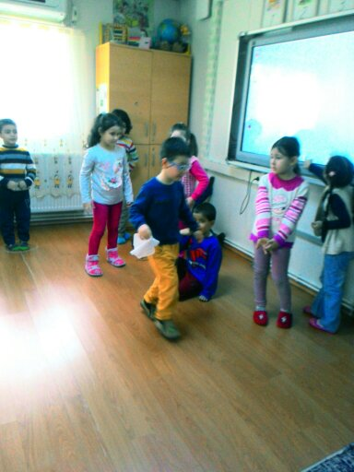
CHILD'S NAME:A. B. SABANCI
TEACHER'S NAME:AYSUN ÖCAL
SEX AND AGE:Boy/6 DURATION:20 Minutes
PERIOD(MONTH):JANUARY
ACTIVITIES: GAME ACTIVITY
At the of end of first term, B. overcame his fears and worries about the school and his teacher
He comes to the school happily and comfortably.
He attends all of the activities in the class,and completes them with success.
He plays with his friends,joins groups,sometimes becomes the leader,and sometimes watches the leader.
His attitude in the games is always a constructive one.
Due to this attitude,his friends love him,and want to play with him.

Slide 25
OBSERVATION REASON:
His negative attitudes and behaviours about friend relationships, and school rules became positive.
COMMENTS AND SUGGESTION:
His teacher think that B.'s fears and worries about the school are completely over.
Teacher interviewed with his parents about this.
She informed them that they should continue to display this behaviours and attitudes in the semester break.

Slide 26
CHILD'S NAME:A.B.S
TEACHER'S NAME:AYSUN ÖCAL
SEX AND AGE:Boy/6 DURATION:20 Minutes
PERIOD(MONTH):FEBRUARY
ACTIVITIES: BREAKFAST TIME
B. came to the school confortably after the semester break.
While his mother was leaving him to school, he said to his mother ''Don't take me early.''He said that he missed his friends and teacher.
His mother said that B. always asked when the school will start.
This development of B. shows that he overcame his fear of school completely.

Slide 27
OBSERVATION REASON:
His fear of school is completely over.He made improvements in friend relationships.
COMMENTS AND SUGGESTION:
Teacher stated that his family should keep their promises,if they don't he will lose confidence and get back to the very beginning.

Slide 28
CHILD'S NAME:A. B. SABANCI
TEACHER'S NAME:AYSUN ÖCAL
SEX AND AGE:Boy/6 DURATION:20 Minutes
PERIOD(MONTH):MARCH
ACTIVITIES: CULTURAL ACTIVITIES
After B. overcame his fear of school,his success in the class,his friend relationships,and his relationship with his teacher improved positively.
This shows that his fear of school affects his area of developments negatively.
B. now attends the social activities which he didn't attend before,and he enjoys it.

Slide 29
OBSERVATION REASON:
With the overcoming of fears and worries,making progress in all areas of development.
Providing him to attend art activities.
COMMENTS AND SUGGESTION:
Fears and worries affect us and our children negatively, and reduce our quality of life.
In this sense,necessary works are done by experts.
Thus,the fears and worries can be minimised.
Family factors are important here.This shows that we should care about the fears of our children,and we should make necessary works before it is too late.
B.'s family was informed about this.

Slide 30
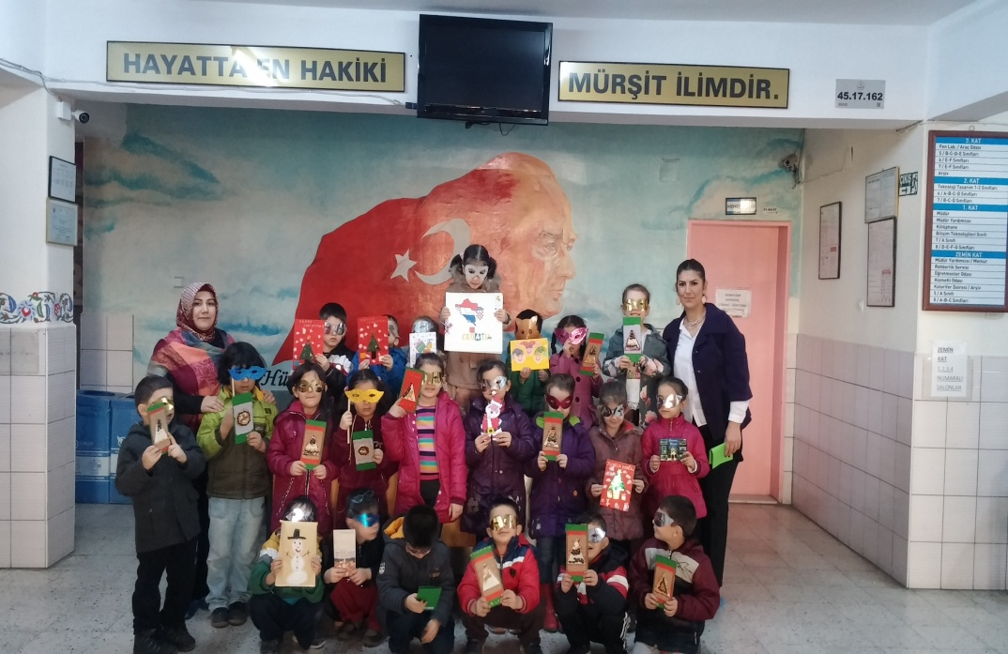

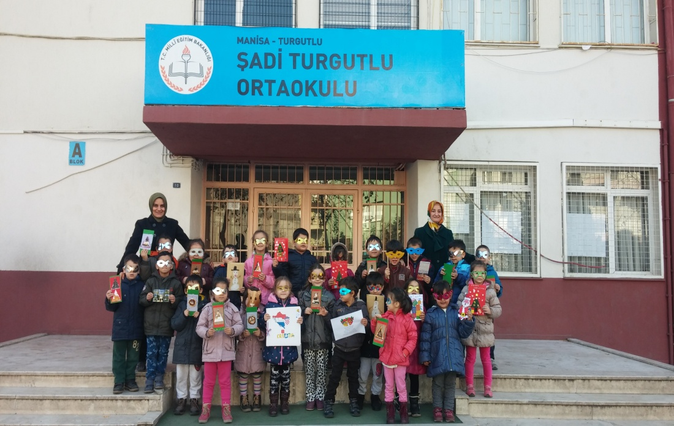

THANKS
FOR LISTENING

