Slide 1
WORKING TOGETHER I/ TURKEY

Slide 2
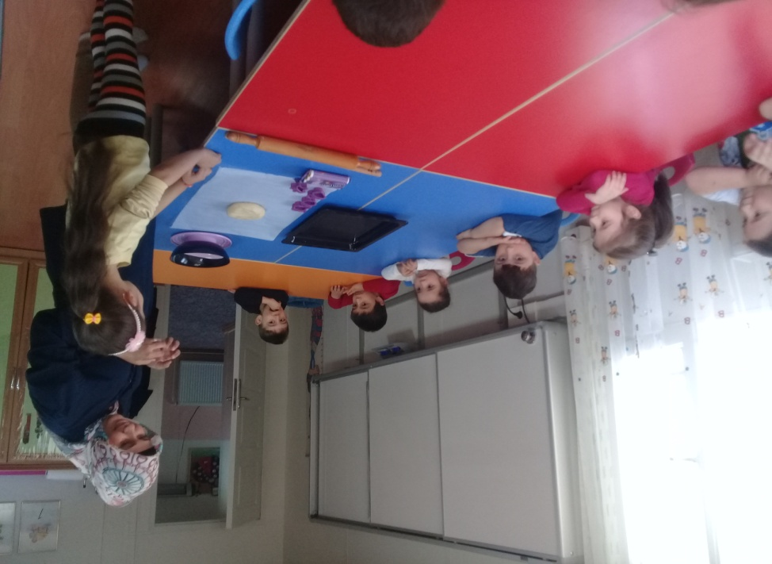
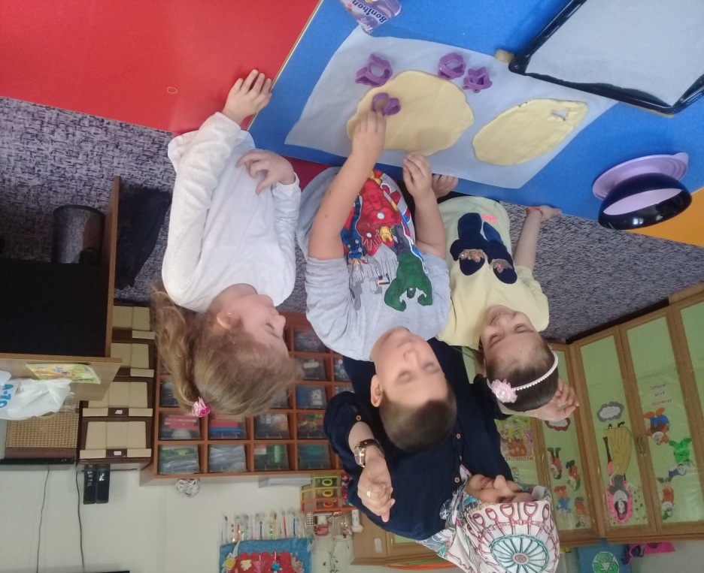
MAKING COOKIES

Slide 3
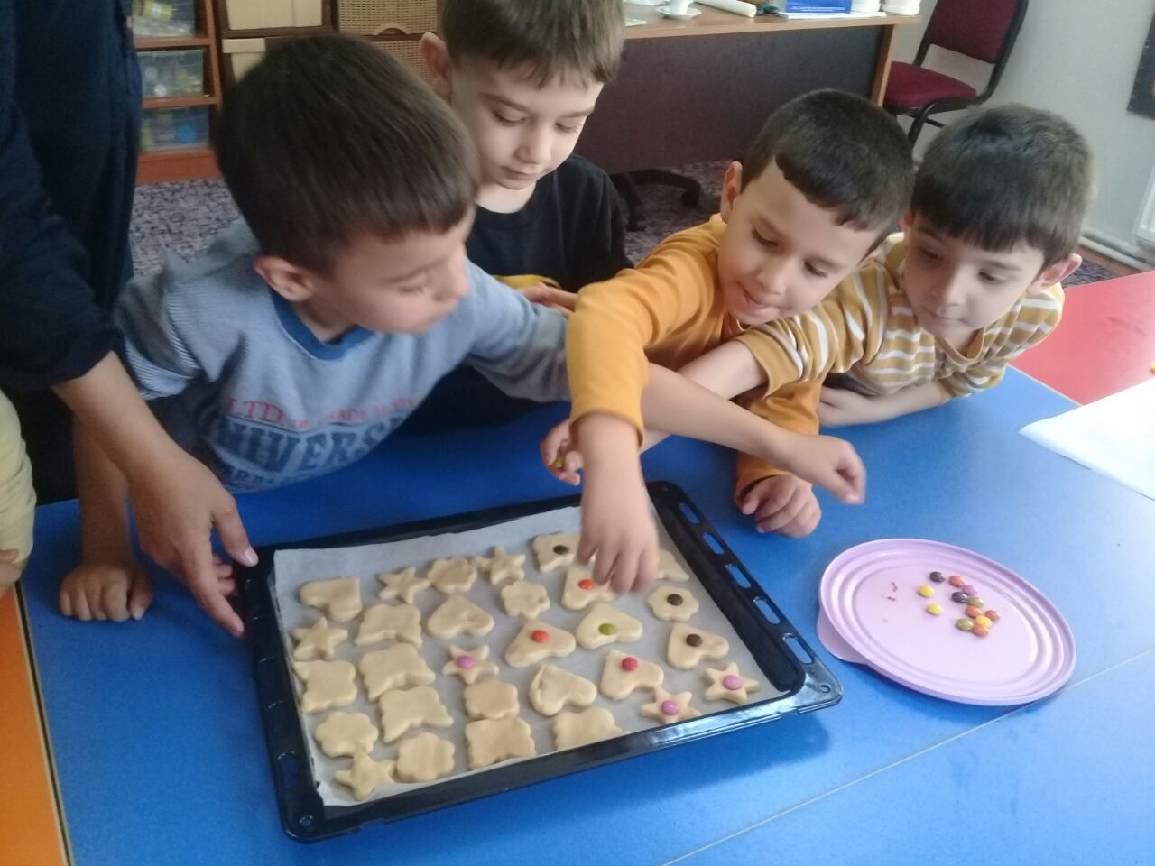
ACTIVITY NAME AND SUMMARY
Parent tells the materials needed for cookies and prepares the dough
Doughs are shaped and decorated with children
Cooked biscuits are eaten with children.

Slide 4
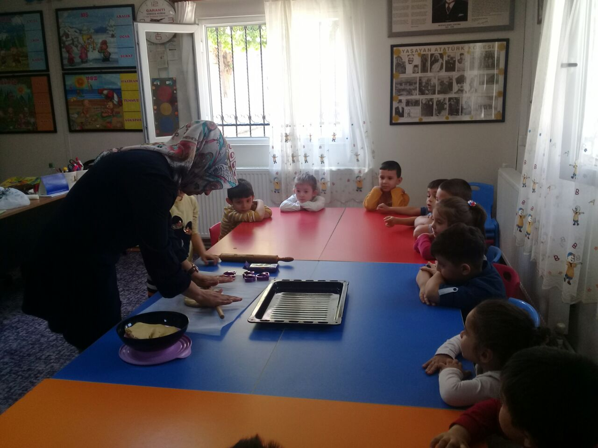
BENEFITS OF THIS ACTIVITY
It is very effective in strengthening the relationship between the child and the mother.

Slide 5
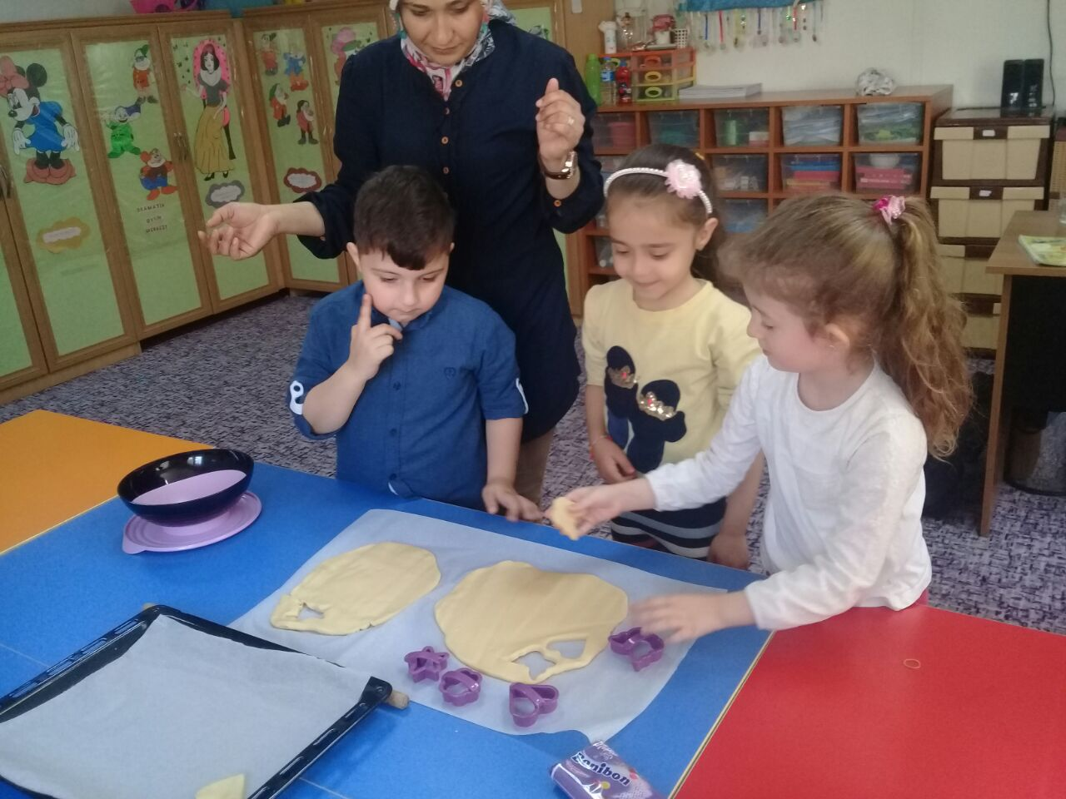
BENEFITS OF THIS ACTIVITY
This activity strengthens the dialogue between the child and the mother, making a presentation with her mother affects the child's sense of accomplishment, self-esteem positively

Slide 6
WORKING TOGETHER II/ TURKEY

Slide 7
MAKING OOBLECK DOUGH

Slide 8
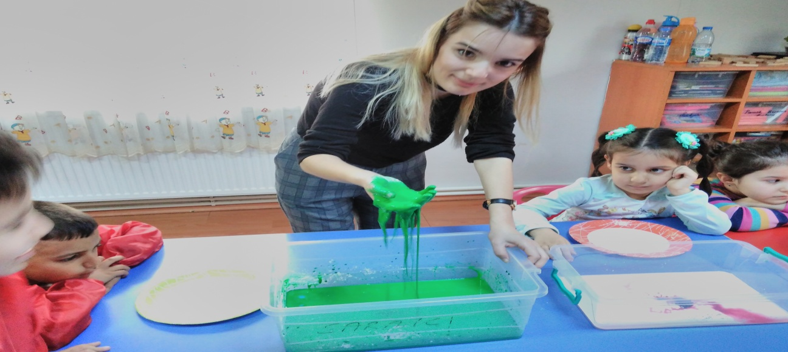
ACTIVITY NAME AND SUMMARY
A parent who is volunteered for the making Oobleck Dough is invited
Place 2 cups of corn starch in a vat.
Children touch this starch and mix it with their hands
Some food stain or finger stain is added.
1 cup of warm water is slowly added with the help of parent

Slide 9
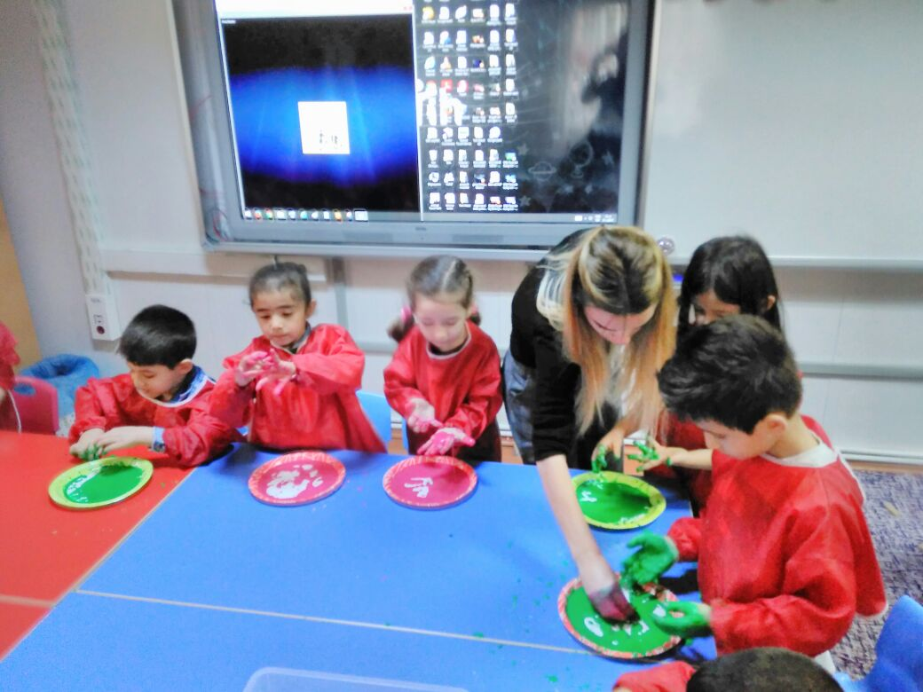
ACTIVITY NAME AND SUMMARY
When children mix these materials, a soft dough appeared
When they put it in their palms and they squeeze it, they will become a solid paste, open their fingers and liquid and will flow through their fingers
It will be like a stone when you hit the board quickly, but when you push your finger slowly, your finger will easily get into it.

Slide 10
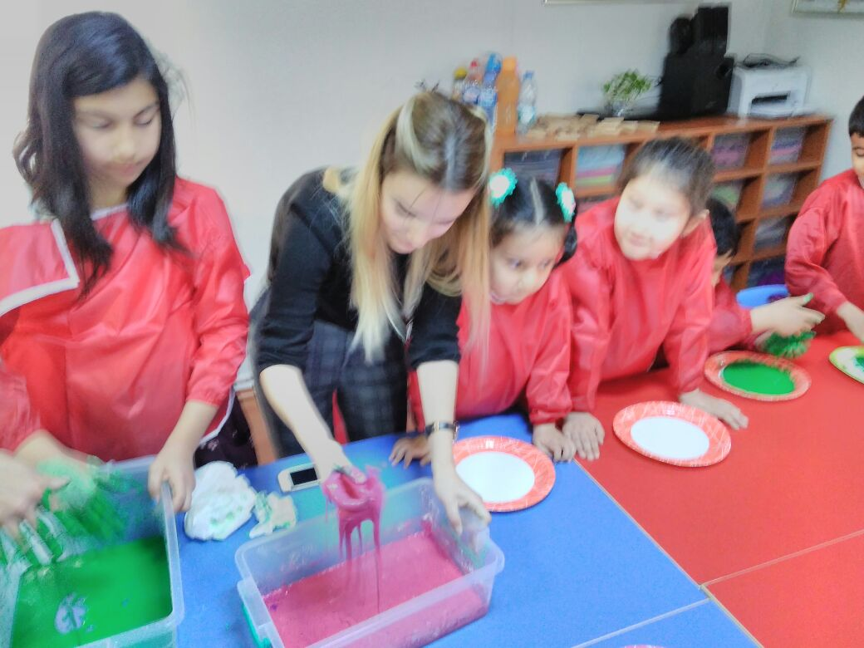
BENEFITS OF THIS ACTIVITY
Oobleck Dough is Affective game material
Made of only starch and water, the material is very cheap and easy to supply

Slide 11
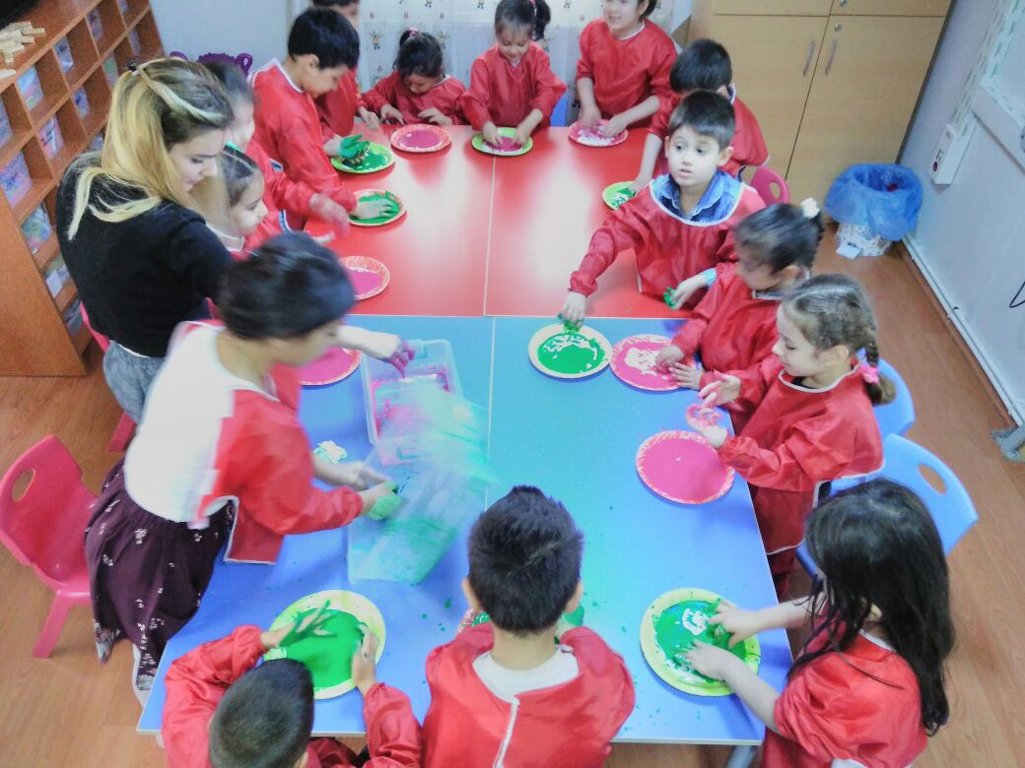
BENEFITS OF THIS ACTIVITY
The positive effects of this activity on the child
** Provides development of tactile senses
** Scientific curiosity
** Contributes to the development of small muscles

Slide 12
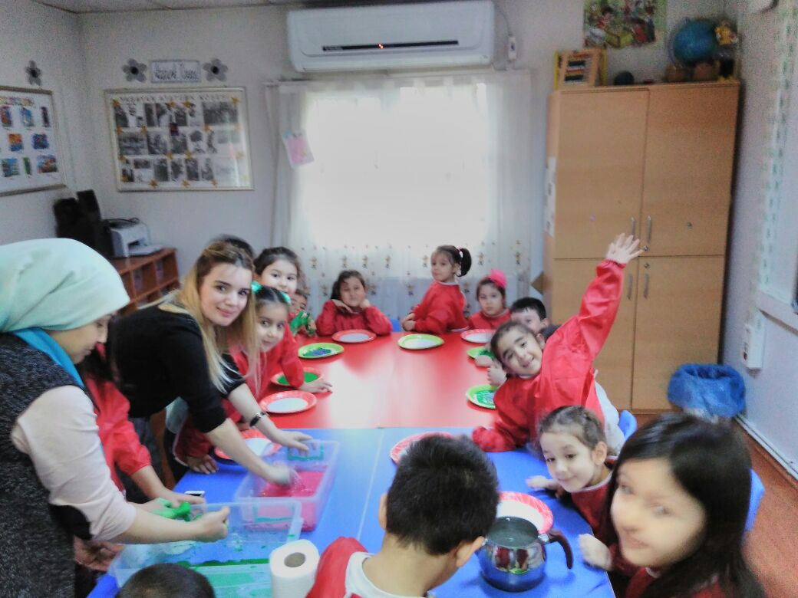
BENEFITS OF THIS ACTIVITY
**Development of Attention and concentration
** Pleasant and fun time
**With the participation of parents in the education, the feeling of trust develops in the child

