Slide 1
WORKING TOGETHER
PARENT INVOLVEMENT

Slide 2
WHY IS IT IMPORTANT?
A child’s teacher is the second most important person in a child’s life (after her/his parents, of course).
A positive parent-teacher relationship contributes to your child’s school success
This positive relationship makes a child feel like the important people in his life are working together.

Slide 3
Example 1 LONG TERM PARTNERSHIP WITH THE WHOLE FAMILY
Adaptation period in the group
Workshop within the Comenius project regarding the water pollution
Landscaping the back yard and gardening
Visting the grandparents farm ( with 2 groups )
Celebrations with the family at their home
Different workshops during the years

Slide 4
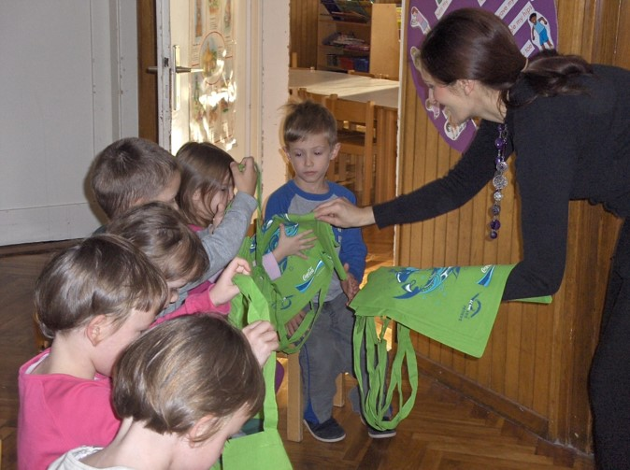
WORKSHOP WITHIN THE COMENIUS PROJECT ( MOTHER )

Slide 5
LANDSCAPING ( FATHER )
HOCKEY GAME ( WHOLE FAMILY )

Slide 6
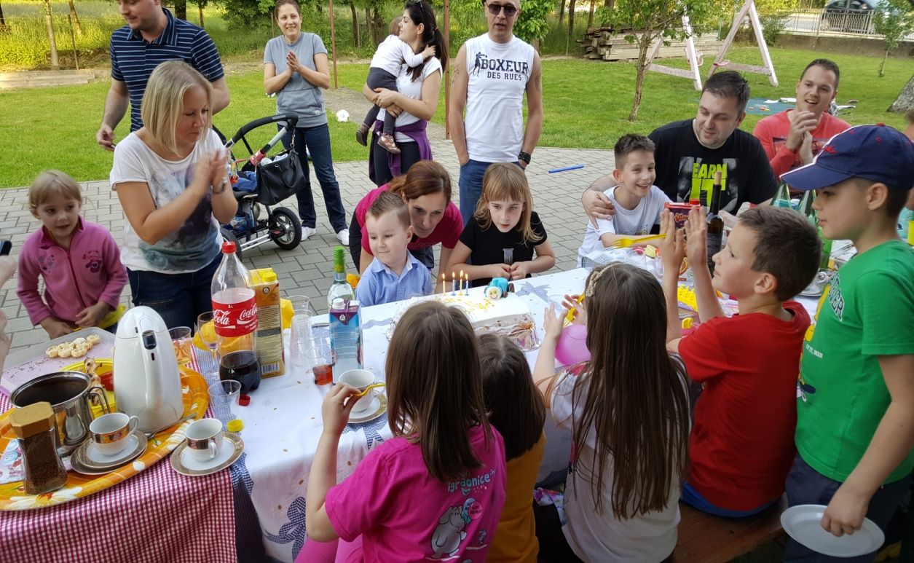
CELEBRATIONS WITH THE FAMILY AT THEIR HOME

Slide 8
BENEFITS
The whole family has been involved in the early age education throughout the years which resulted in a great cooperation between preschool and family and many great moments together.
Mother was in a group during the adaptation period ( both of her kids ) which went pretty smooth and the girl was well adapted into the group. In the years to come she held a workshop within the Comenius project regarding the water pollution and father was actively engaged in landscaping of our back yard and gardening. In that way parents actively participated in the process and shown their children the importance of education and partnership with school.
With their second child ( boy ) the adaptation wasn`t necessary because by that time he got to know both of the teachers as well as the group. Our partnership still continues through different activities such as visits to the grandparents farm with the whole group and also visit to the parents home for special occasions ( children birthdays and barbecues organized by the family Jurišević ).

Slide 9
EXAMPLE 2 WELCOME WEEK PARTY
Annual welcome party at the beginning of the school year
Main goals: getting to know each other, developing social emotional connection, bonding as a group, making the transition from home to kindergarten less stressful
Activities: competition games, group dance, different sports, work activities (wall painting), barbecue

Slide 10
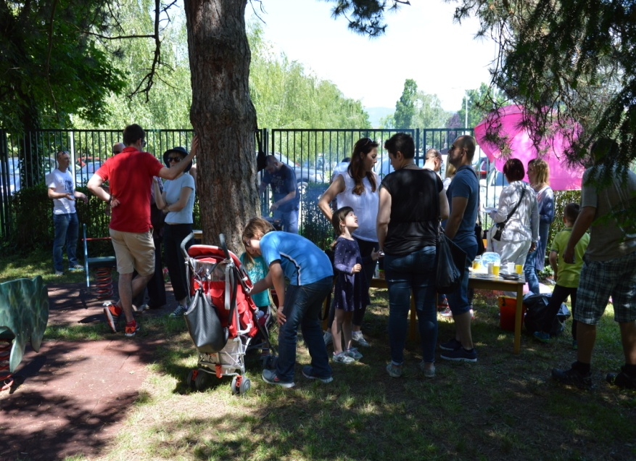
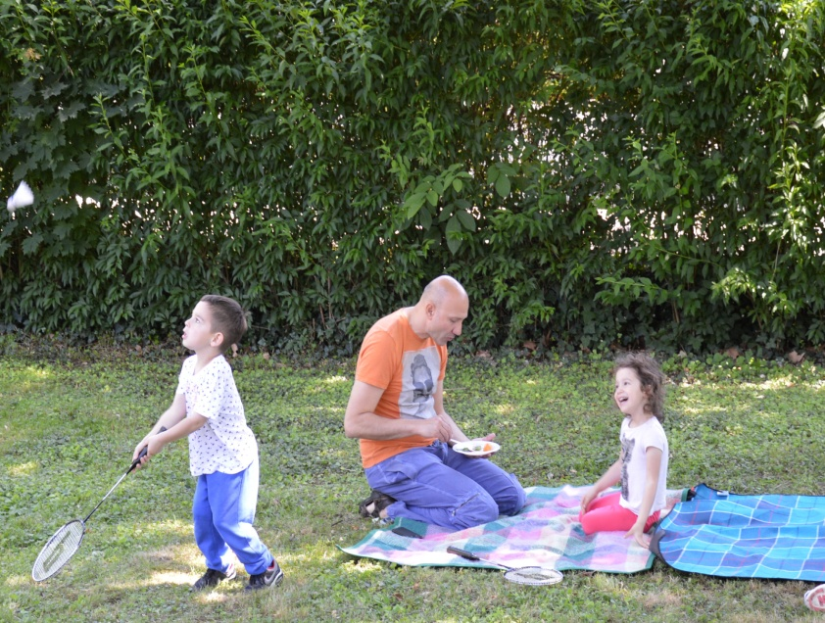
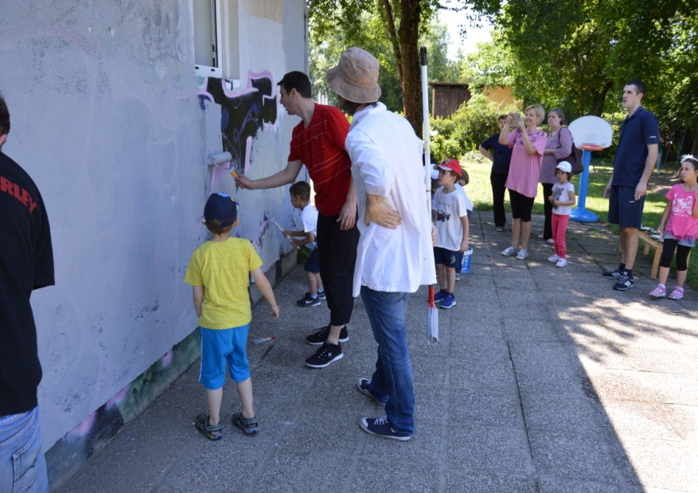

Slide 11
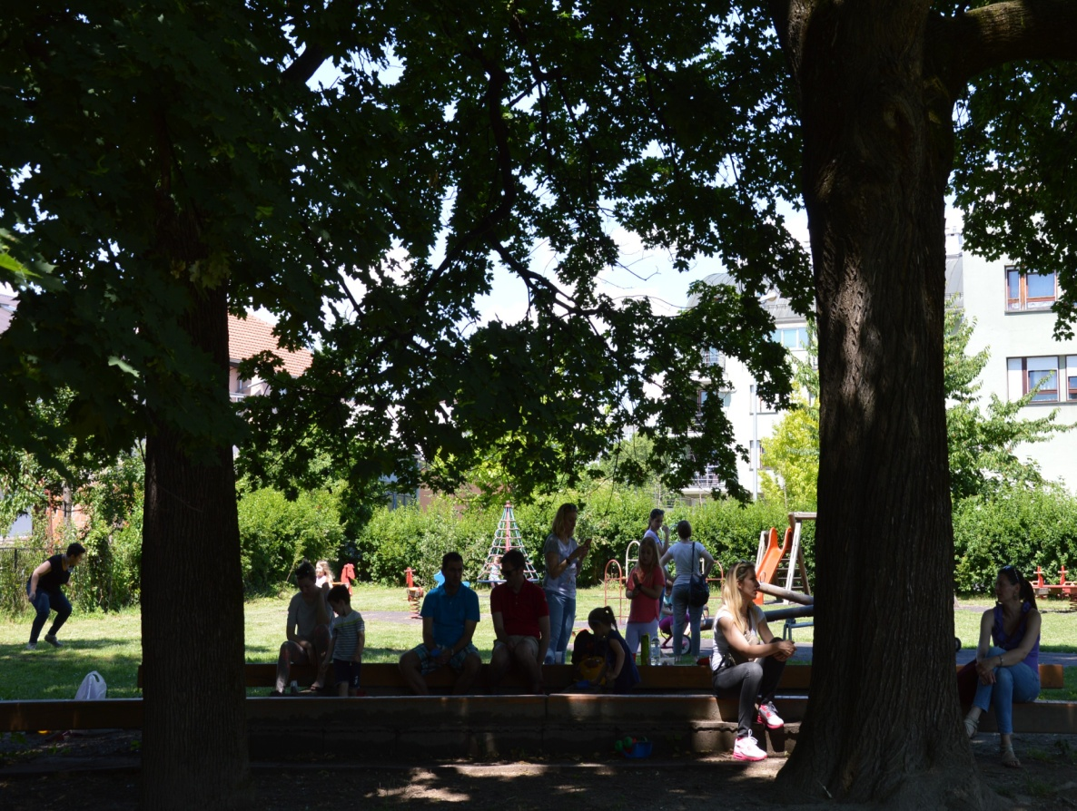

Slide 12
BENEFITS
Parents who are involved in their child's education create a connection between the home and school. Those who participate along with their child are privy to the many aspects of their child's day. At home, they are able to replicate and extend activities that their child experiences in school. Involved parents learn how their own child is getting along in the group.
On a deeper level, involvement in this capacity shows your child and your child's teacher that you view education as an important aspect of life - one worth participating in.
One of the benefit of parental involvement is establishing a social network. Parents of other children of similar age provide support and consolation, sources of information and family connections that can be lifelong. Social connections between children provide security when transitions, such as kindergarten, occur. A child may be more willing to join a group or activity if his parents are involved in this important transitional period of child’s life.

Slide 13
croatian erasmus+ team
THANK YOU FOR YOUR ATTENTION...

