Slide 1
WARSAW, POLAND
Points on the map

Slide 2
Our town is full of interesting places. Have a nice time watching.

Slide 3
The Palace of Culture

Slide 4
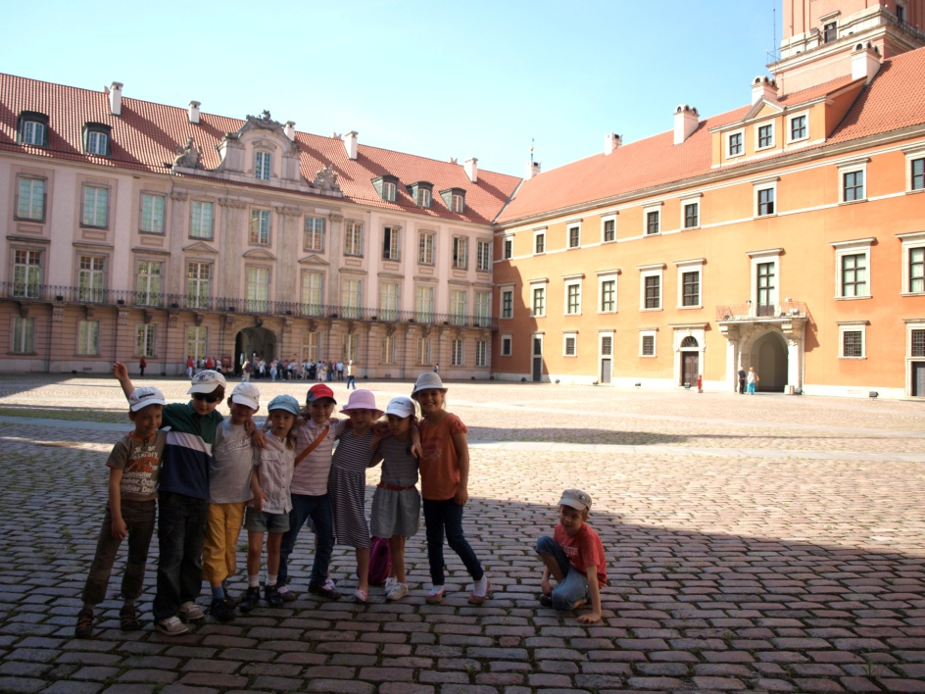
Old buildings

Slide 5
The monument of an unknown soldier

Slide 6
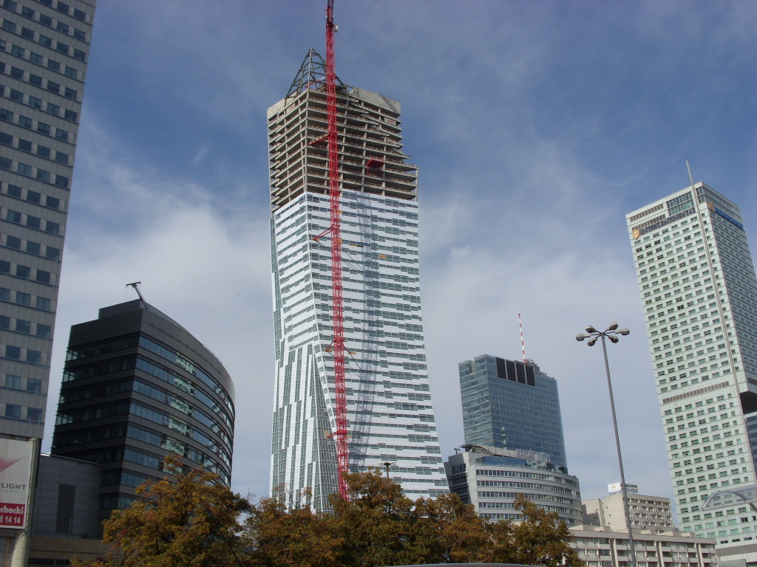
Modern buildings

Slide 7
The Warsaw Mermaid

Slide 8
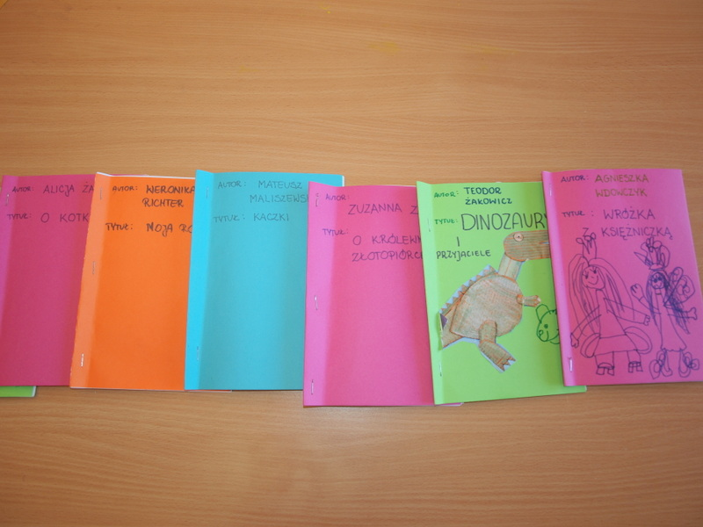
The university Library

Slide 9
The Zygmunt’s Column

Slide 10
The Chopin’s Monument

Slide 11
The Royal Castle

Slide 12
See you!!!

