Slide 1
Let's talk about ... numbers

Slide 2
What about numbers in the English language?

Slide 3
An idiom is
a) a phrase, saying or a group of words that has a metaphorical (not literal) meaning, which has become accepted in common usage in a given language
b) a short sentence, usually known by many people, stating something commonly experienced or giving advice
c) a well-known wise statement that often has a meaning that is different from the simple meanings of the words it contains
Idioms with numbers

Slide 4
one / two / three / four / five / six / sevens / nine / eleventh / forty
TRY TO COMPLETE THE IDIOMS WITH THESE SIMPLE NUMBERS
to be on cloud ?
? winks
in ? shakes
at the ? hour
the ? corners of the world
to be ? feet under
to have ? foot in the grave
to take ?
to be ? sheets to the wind
at sixes and ?

Slide 5
one / two / three / four / five / six / sevens / nine / eleventh / forty
TRY TO COMPLETE THE IDIOMS WITH THESE SIMPLE NUMBERS
to be on cloud nine
forty winks
in two shakes
at the eleventh hour
the four corners of the world
to be six feet under
to have one foot in the grave
to take five
to be three sheets to the wind
at sixes and sevens

Slide 6
So what do the idioms mean?
1. He usually has forty winks going home from work on the train.
2. The teacher was quite angry as I handed the project in at the eleventh hour.
3. Mike was on cloud nine about getting the job.
4. I am tired of climbing, let's take five.
5. There were people from the four corners of the world at the camp.
a. have a short break
b. extremely happy
c. from all over the world
d. at the latest moment
e. has a short nap

Slide 7
1. At the end of the party Tom was really three sheets to the wind, he could stand stright!
2. Wait for me! I'll be there in two shakes!
3. My granpa says he will be six feet under before I get married.
4. Having the coronavirus I felt so horrible that I thought I had one foot in the grave.
5. He has been at sixes and sevens since the death of his father.
a. dead and buried
b. was about to die
c. in a state of disarray and confusion
d. drunk
e. very soon / very quickly

Slide 8
Prepare your mobiles and learn a bit.
Join my QUIZLET RACE

Slide 9
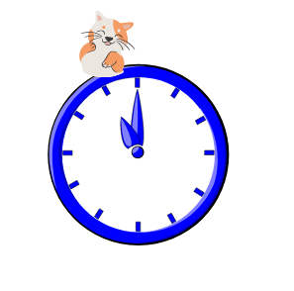
Guess the idiom!

Slide 10
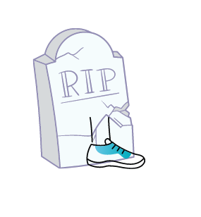

Slide 12
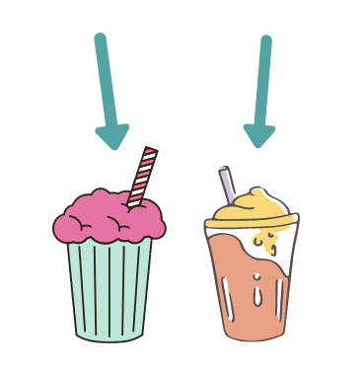

Slide 13
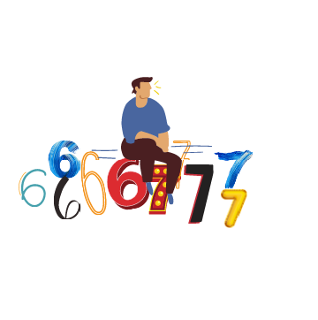

Slide 14
It's your turn.
Draw a picture showing one of the remaining idioms and let us guess what you mean.
to be on cloud nine
forty winks
the four corners of the world
to be six feet under
to be three sheets to the wind

Slide 15
Time for a test!
Prepare your mobiles again and join a quiz at
www.kahoot.it

Slide 16
To sum the meeting up we will practice your logical thinking.
Logical thinking is the act of analyzing a situation and coming up with a sensible solution. requires the use of reasoning skills to study a problem objectively, which will allow you to make a rational conclusion about how to proceed.
Absolutely essential skill in Mathematics!

Slide 17
Let's play a game of Baamboozle to check
how good you are at logical thinking!
Bulgaria - TEAM 1
Greece - TEAM 2
Poland - TEAM 3
Romania- TEAM 4
Each team choses a number. Under the number there is a question or ... a surprise.
The team with the biggest number of points wins!
https://www.baamboozle.com/bigclassic/239241/4

