Slide 1
Erasmus+ dan
Evaluation

Slide 2
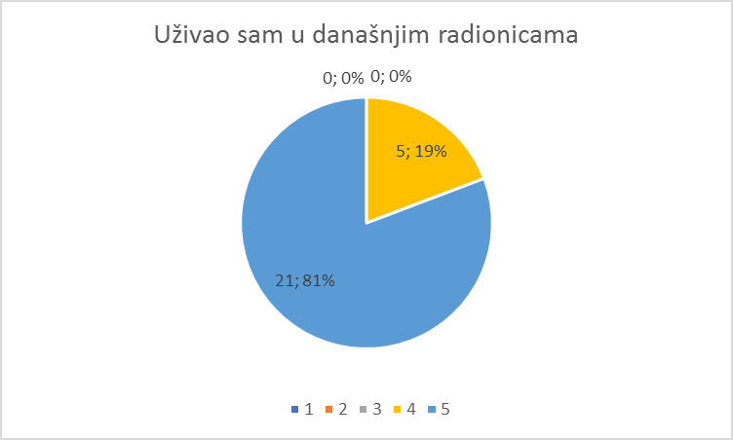
I enjoyed today's activities

Slide 3
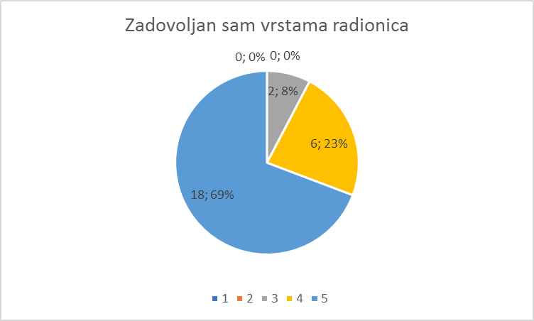
I liked the variety of workshops

Slide 4
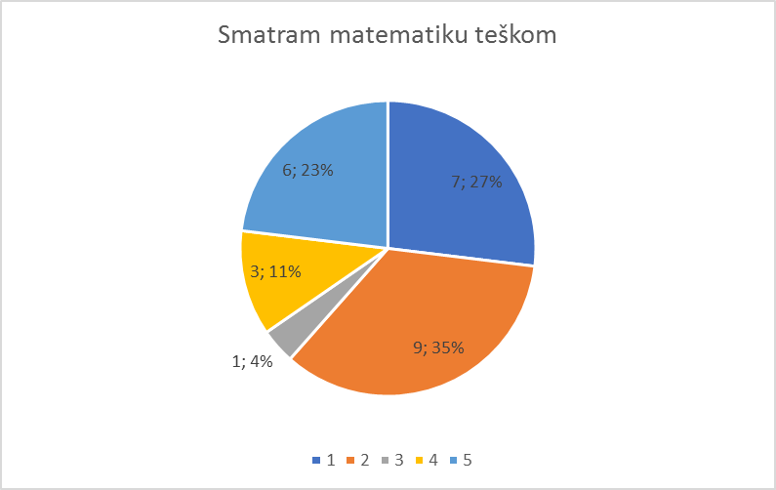
I find maths to be difficult

Slide 5
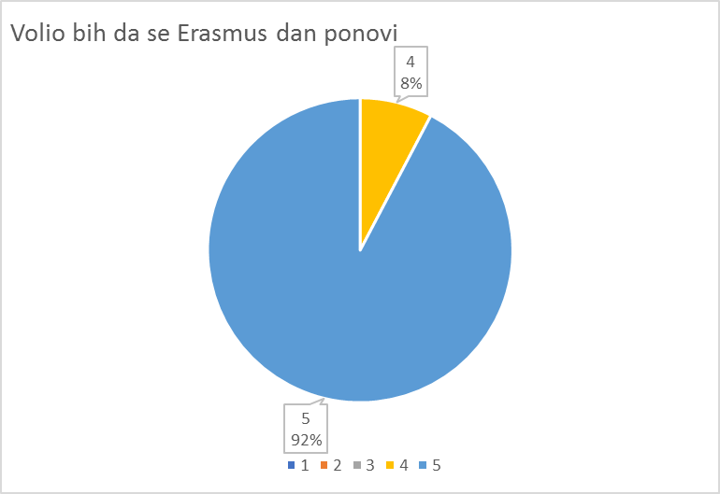
I would like to repeat Erasmus Day

