Slide 1
A.C MATHEMATICS
Turkish Famous Mathematicisians in the History

Slide 2
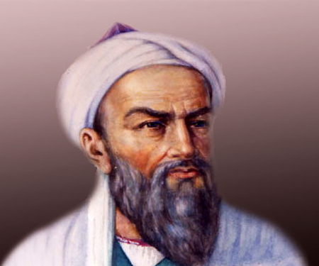
BİRUNİ
He was the first man who discovered rotation of the earth around its own axis . Also he was the first scientist who talked about the existence of America, Japan and Cape of Good Hope.

Slide 3
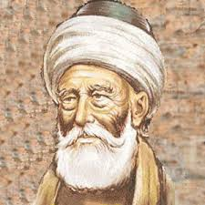
AKŞEMSETTİN
He discovered the germ before microscope was discovered. He explained germ “Ilnesses spreads person to person with very little living creatures which we can’t see” So he explained the “germ”.

Slide 4
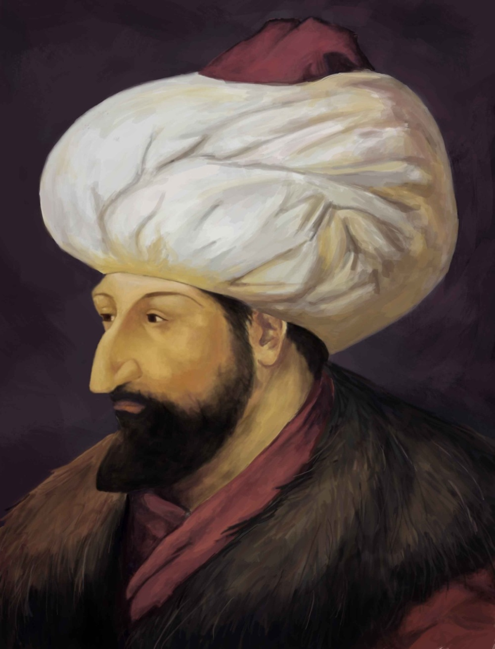
MEHMED
THE CONQUEROR
He was an inventor as well as a Sultan of Ottoman Empire. When he conquered Istanbul, he invented the mortar. The mortar called “Şahi” was the first mortar in the history.

Slide 5
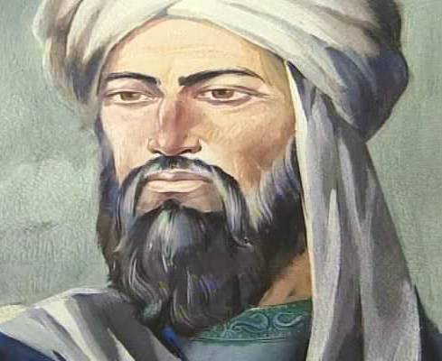
HAREZMİ
He was the founder of algebra. The word “algebra(cebir)” was used in his book at the first time. Also he was the first mathmatician who discovered “zero” and used
x unknown quantity. Today, programming language of the computers are written considering algorithmic method of Harezmi.

Slide 6
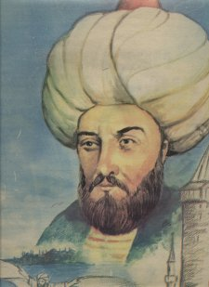
HEZARFEN AHMET ÇELEBİ
He was the first man who could fly with the wings which he improved. He lived in 17th century during Ottoman Age. He flew from Galata tower to Üsküdar. He flew over the Bosphorus. He was the pioneer of gliding.

Slide 7
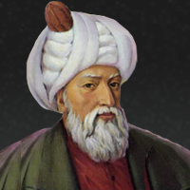
MİMAR SİNAN
He was the great architect who has architectural mystery which still can not be solved. He had a practical intelligent so he put the biggest cupolas on the four columns. He discovered the rail system which is used for buildings to make them steady. Selimiye Mosque is the mastership of Mimar Sinan.

Slide 8
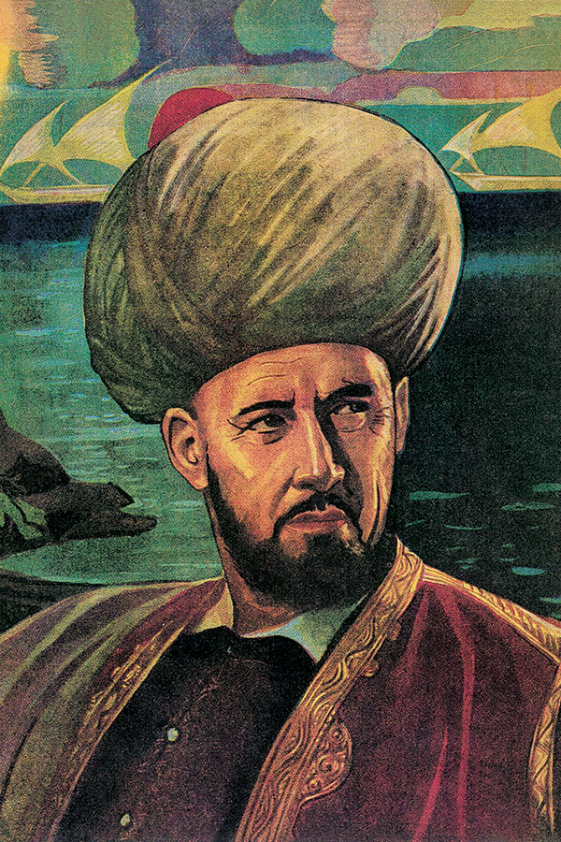
PİRİ REİS
He was the admiral of Ottoman Naval Force and world wide known geographer and cartographer. He drew the first world map which is nearly same as the maps nowadays. He was famous for the map which shows the America with details.

Slide 9
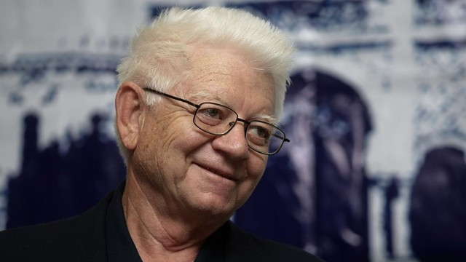
OKTAY SİNANOĞLU
He is a Turkish scientist of theoretical chemistry and molecular biology, Yale Professor Emeritus . He was the youngest person in the past century to attain a status of professor when he earned the status at the age of 28. Also, he has been nominated to Nobel award in chemistry twice.

Slide 11
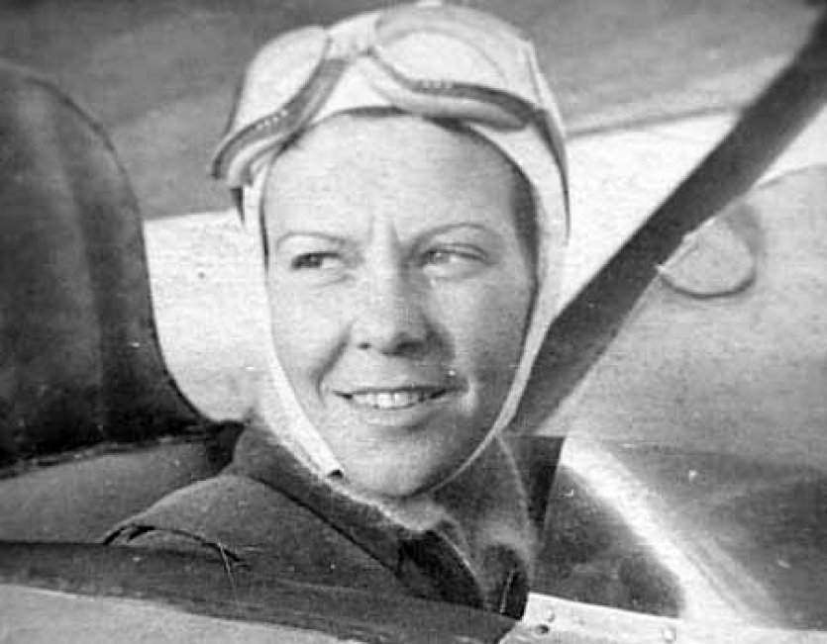
SABİHA GÖKÇEN
Turkish aviator Sabiha Gökçen was the first woman in her country to earn a pilot's license, and is believed to be the world's first female combat pilot. Gökçen was the adopted daughter of Turkey's first president, the eminent reformer Mustafa Kemal Atatürk.

Slide 12
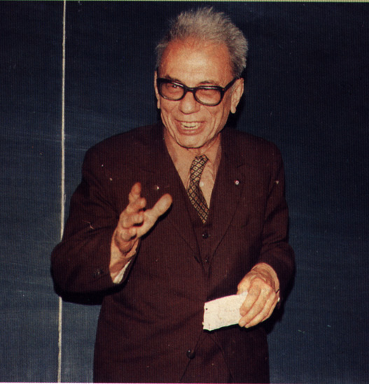
Cahit Arf 1910-1997
In the field of mathematics,
Cahit Arf is among the first names to come to mind, not only in our country but all over the world.

Slide 13
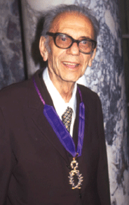
Cahit Arf 1910-1997
Arf’s work on the solvability of synthetic geometry problems with a ruler and compasses, and his work on the invariants that emerge in the classification of quadratic forms of objects resulting in the “Arf Invariant”, “Arf Closure” and “Arf Rings” brought him recognition in the world of mathematics.
Arf has made essential contributions to mathematics in various fields such as algebra, number theory, elasticity theory, analysis, geometry and engineering mathematics, resulting in structured and lasting work.
The “Hasse-Arf Theorem” is among his significant contributions to the literature of mathematics.

