Slide 1
ChrIstmas AND New Year’s EveN IN TURKEY

Slide 2
celebratIng ‘Noel’ on New Year’s Eve
Turkey is a Muslim country and Turkish people do not celebrate Christmas as such (except the christians living here), although the idea is not a throughly alien one.
Santa Claus (Father Christmas) was born in Turkey and is called Noel Baba in Turkish. It has long been the tradition that Noel Baba would bring gifts to kids on New Year’s Eve.

Slide 3
ChrIstmas DecoratIons
Many shops and garden centres stock Christmas trees and decorations. Every year there are more shops and restaurants festively decorated with Christmas trees and lights. You will even see signs saying ‘Merry Christmas’ in Turkish – ‘Mutlu Noeller’.
You may even spot a Santa or two.
Despite all that, however, December 24th and 25th are completely normal work days. No one celebrates or exchanges gifts. But all that changes on 31st December…

Slide 4
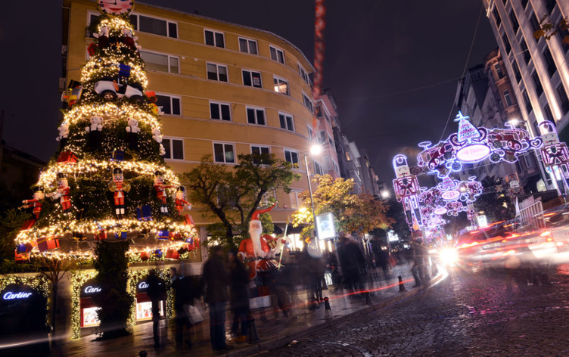
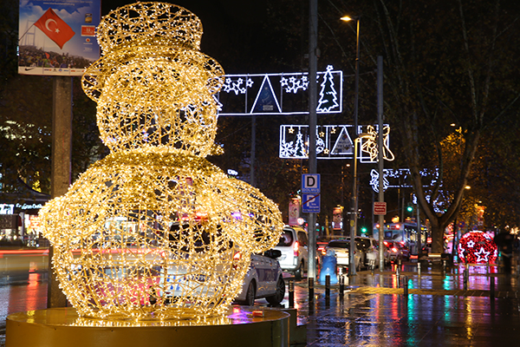
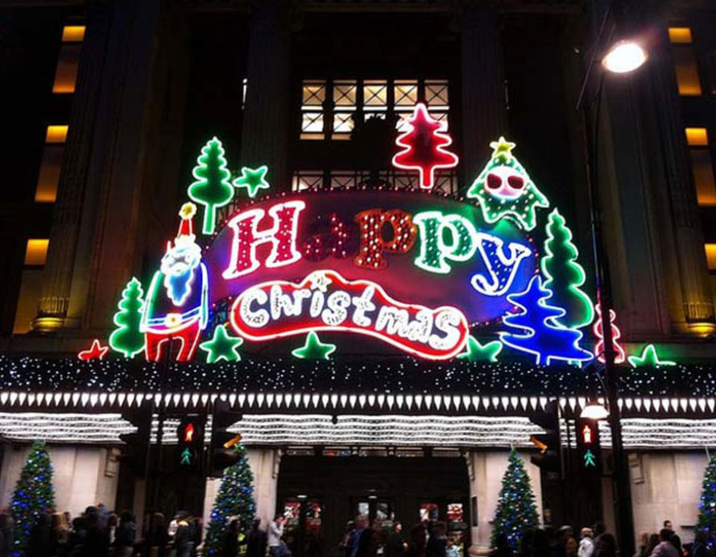
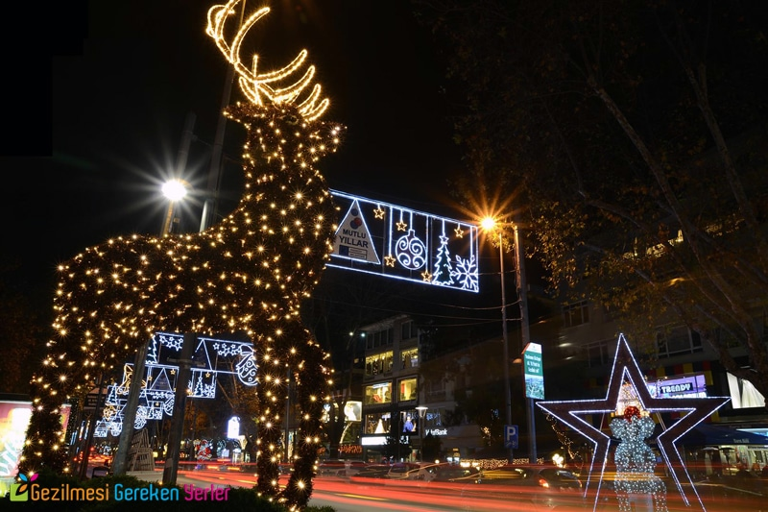
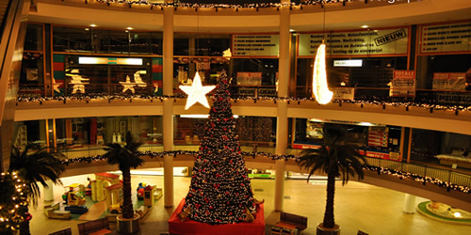
ChrIstmas DecoratIons

Slide 5
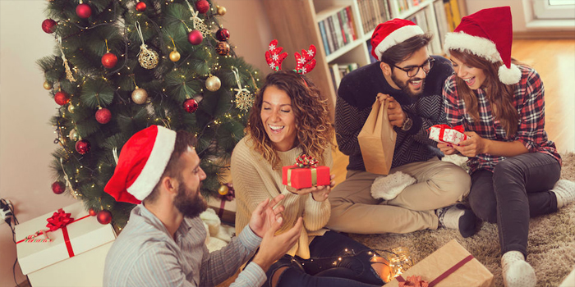
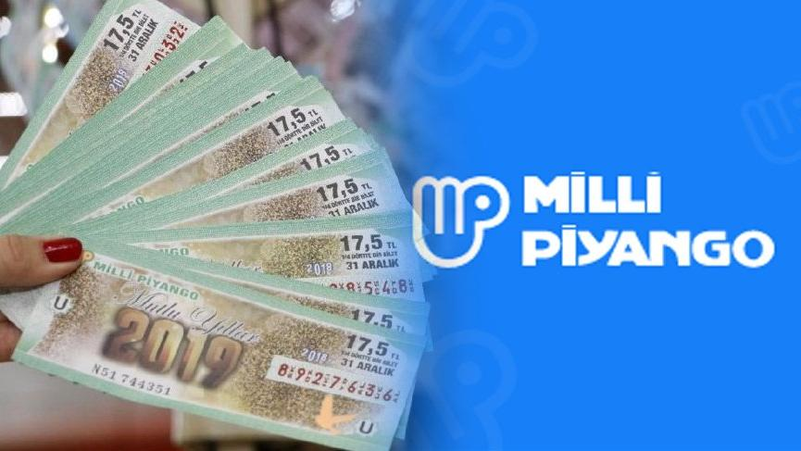
New Year’s Eve In Turkey
New Year’s Eve (Yılbaşı gecesi) is one of the most popular holidays in Turkey. The New Year’s Eve traditions in this country include a family dinner, a national lottery drawing and a countdown to midnight. Houses are also decorated and it is not unusual to see Santa Claus with a Happy New Year (Mutlu Yıllar) sign.

Slide 6
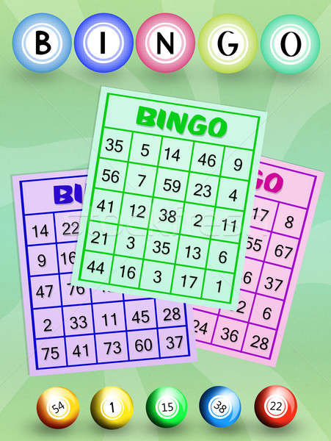
What Do People Do
Many people in Turkey start celebrating New Year’s Eve with a large family dinner. The main course is traditionally a roasted turkey. Variety shows on television begin in late afternoon and continue until early morning of the next day. Many people play games while waiting for the clock to strike midnight.
Older generations used to play bingo during New Year’s Eve gatherings, a tradition that partly continues today.

Slide 7
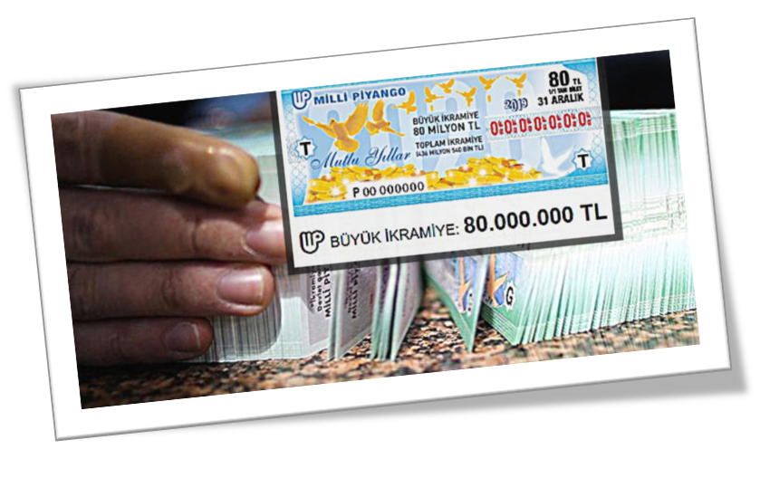
What Do People Do
State TV channels announce the winning numbers of a New Year’s national lottery just before midnight. Many people also congratulate each other, toast to a New Year and exchange small gifts at midnight between New Year’s Eve and New Year’s Day.

Slide 8
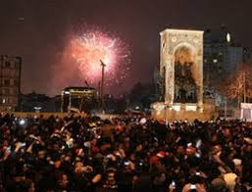
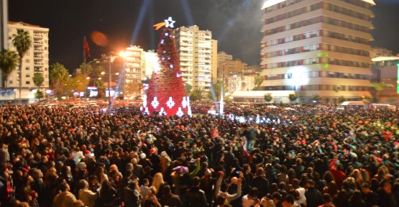
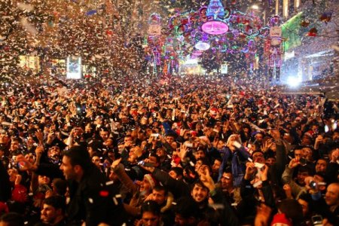
What Do People Do
In large cities, people gather in the town squares where they dance and watch fireworks.

Slide 9
TurkIsh TradItIons
It should come as no surprise that the Turks have their own special traditions for the night, marking the start of the New Year.
Do not be offended if you happen to receive a pair of red panties as a gift. It is considered good luck to don a pair of red underwear at the stroke of midnight for a fruitful and promising new year.
Another tradition involves smashing a pomegranate on your front door at the midnight mark. There is also the less messy option of sprinkling salt on your doorstep – all in an effort to usher in prosperity and good fortune for the year to follow.

Slide 10
TurkIsh TradItIons
Opening the tap at midnight and letting the water run is also believed to bring good abundance and good fortune.
To bring more money into your life, you are supposed to unlock a padlock at the stroke of midnight.
And if it is travel that you seek, take a short stroll at midnight, as it is believed this will bring journeys into your life.
Whatever the traditions or superstitions, whether you celebrate Christmas or New Year, it is a time for family and friends to gather together and share each others dreams for the coming year…

Slide 11
happy new year and mery chrIstmas

