Slide 1
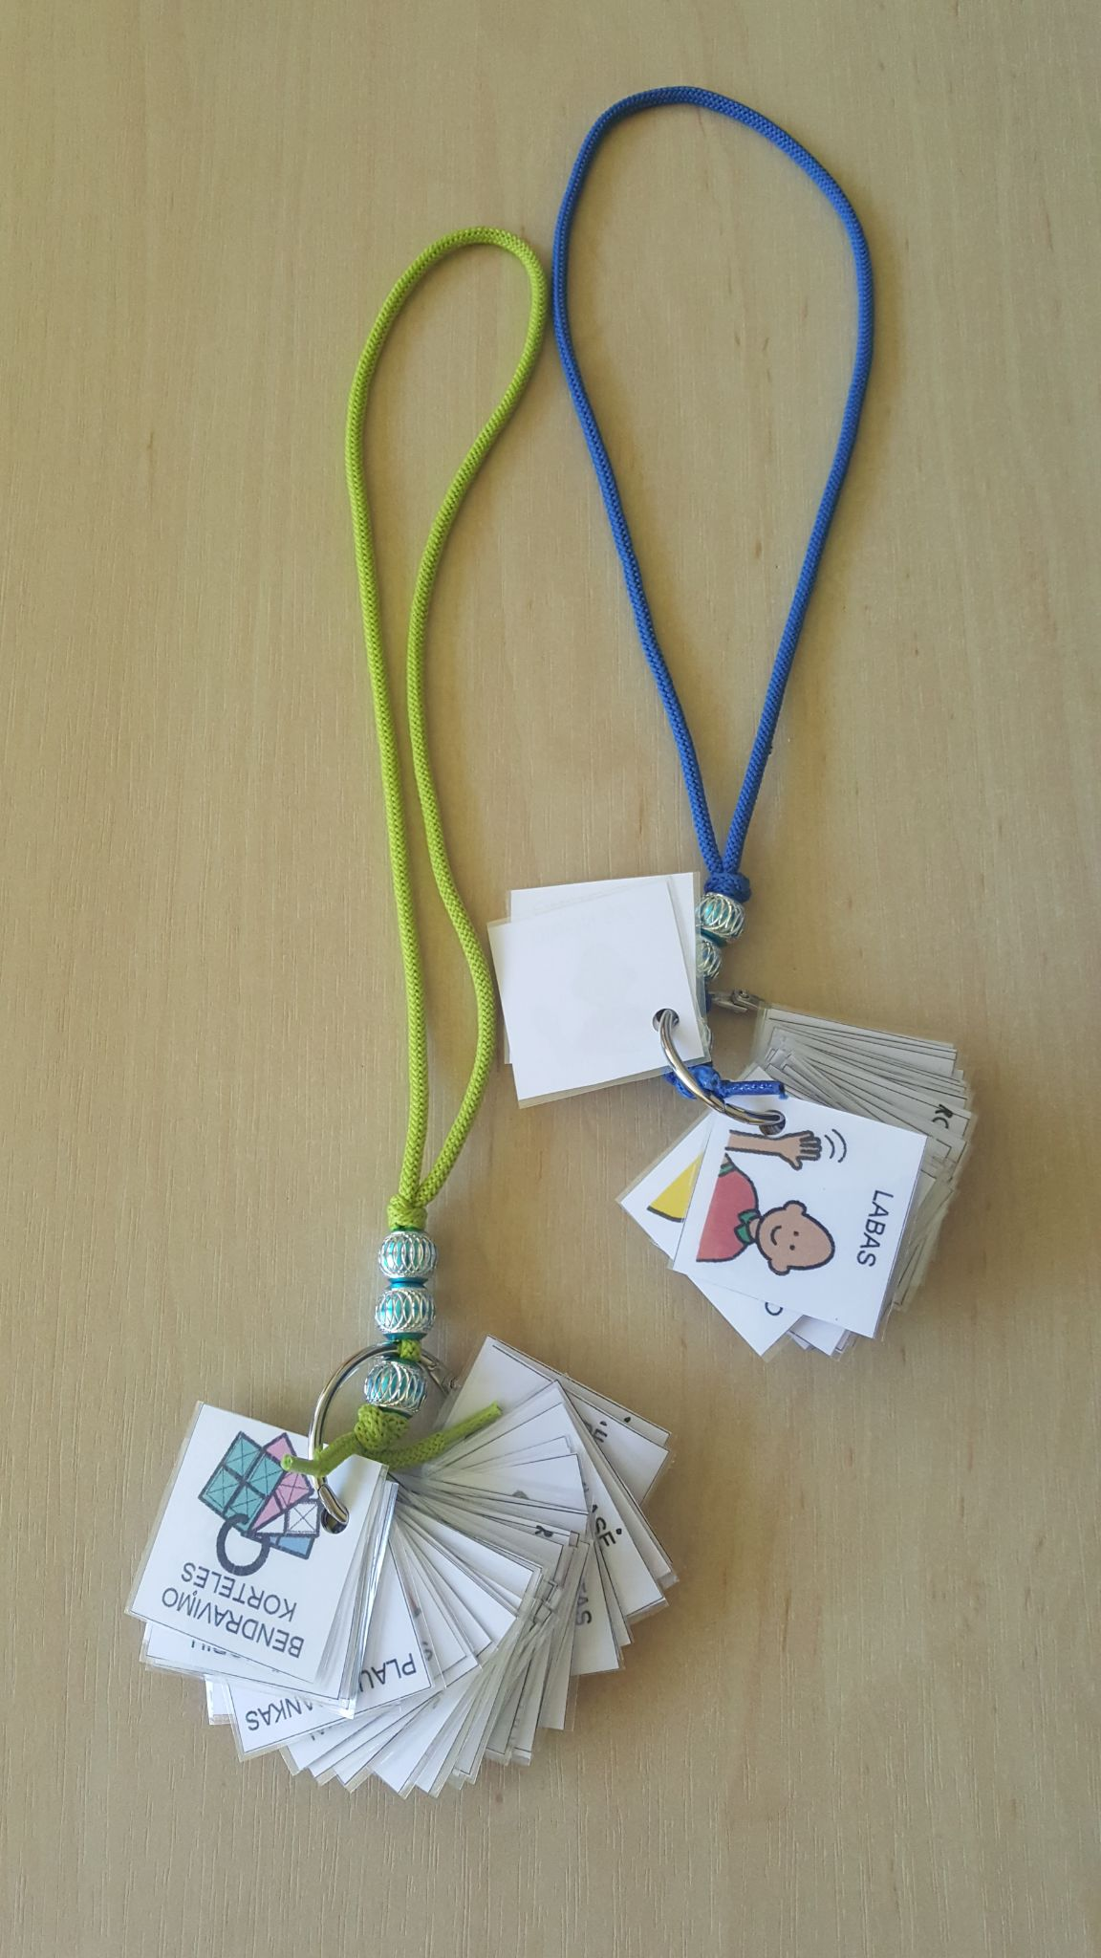
Pendent of pictures cards
Erasmus+ KA229 project ,, Collaboration to Have Abilities as New Goals of Education“ (C.H.A.N.G.E.)
2018-1-PL01-KA229-050641_5
Speech therapist Rita Kairienė
Kedainiai Special Education School, Lithuania
26th - 30th July, 2021

Slide 2
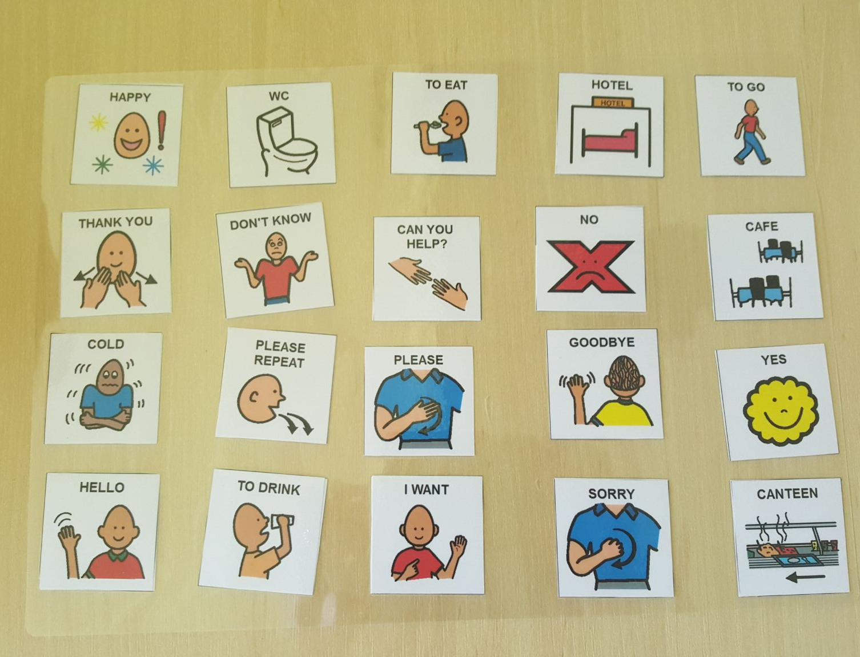
Tools:

Slide 3
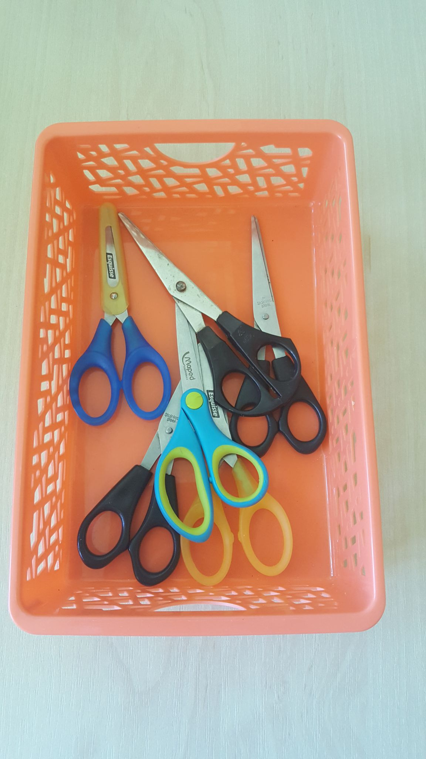
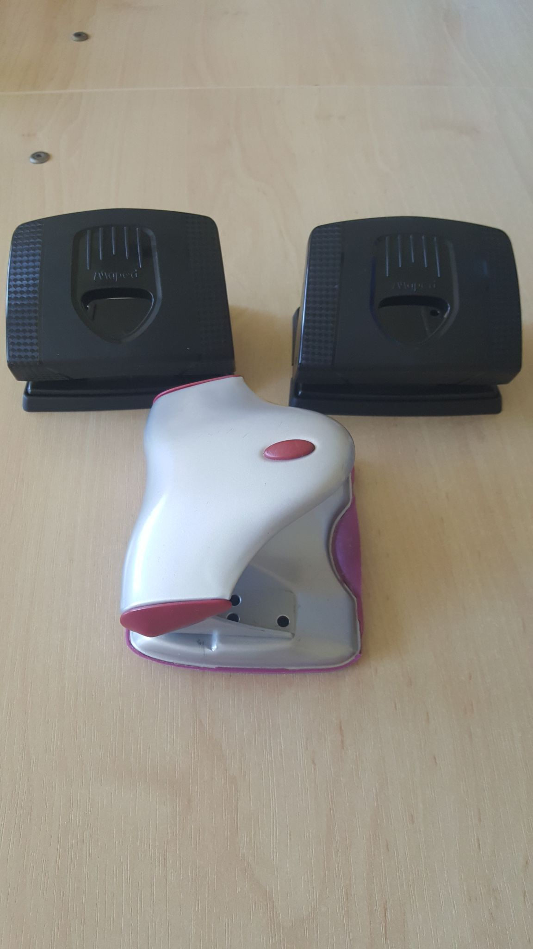

Slide 4
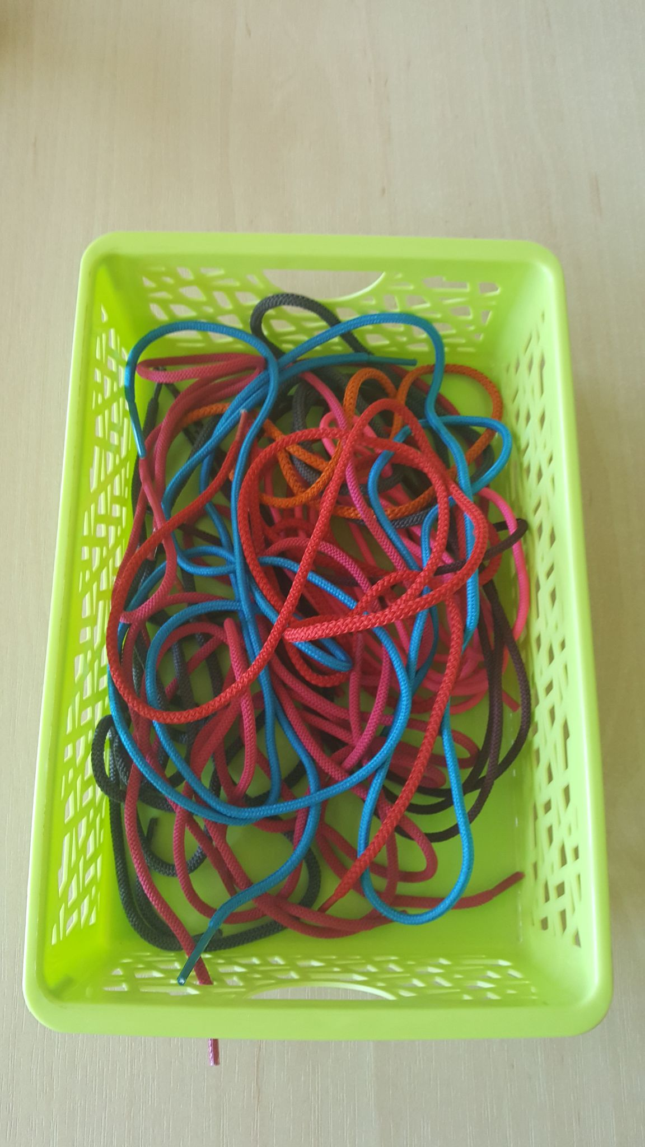
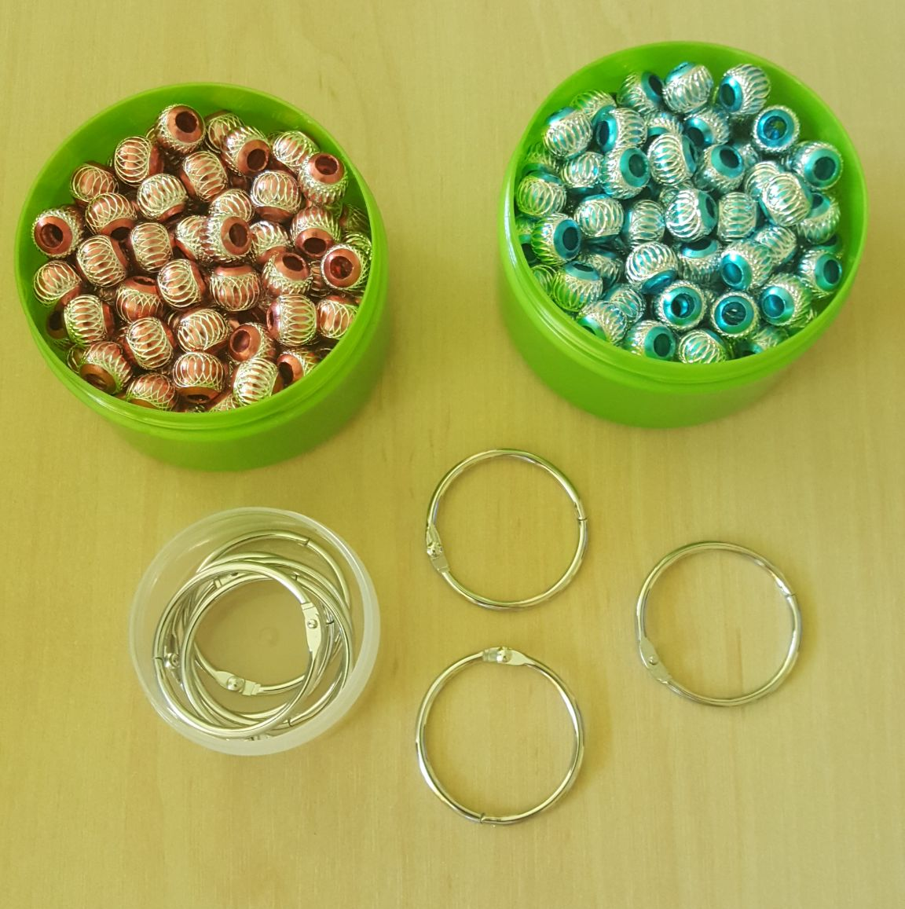

Slide 5
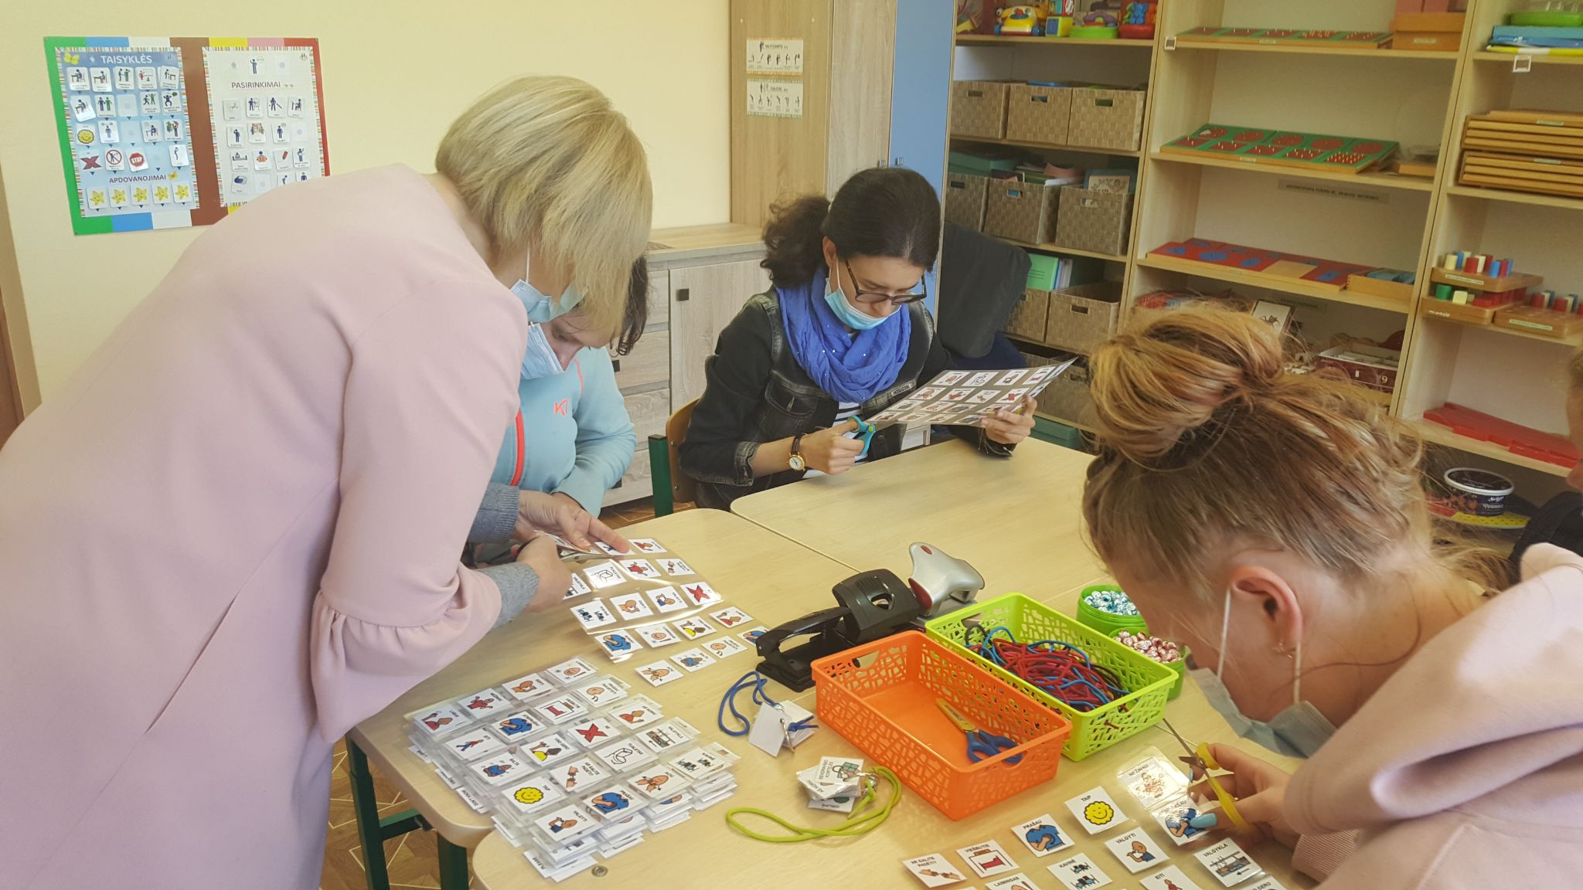
Cut pictures.

Slide 6
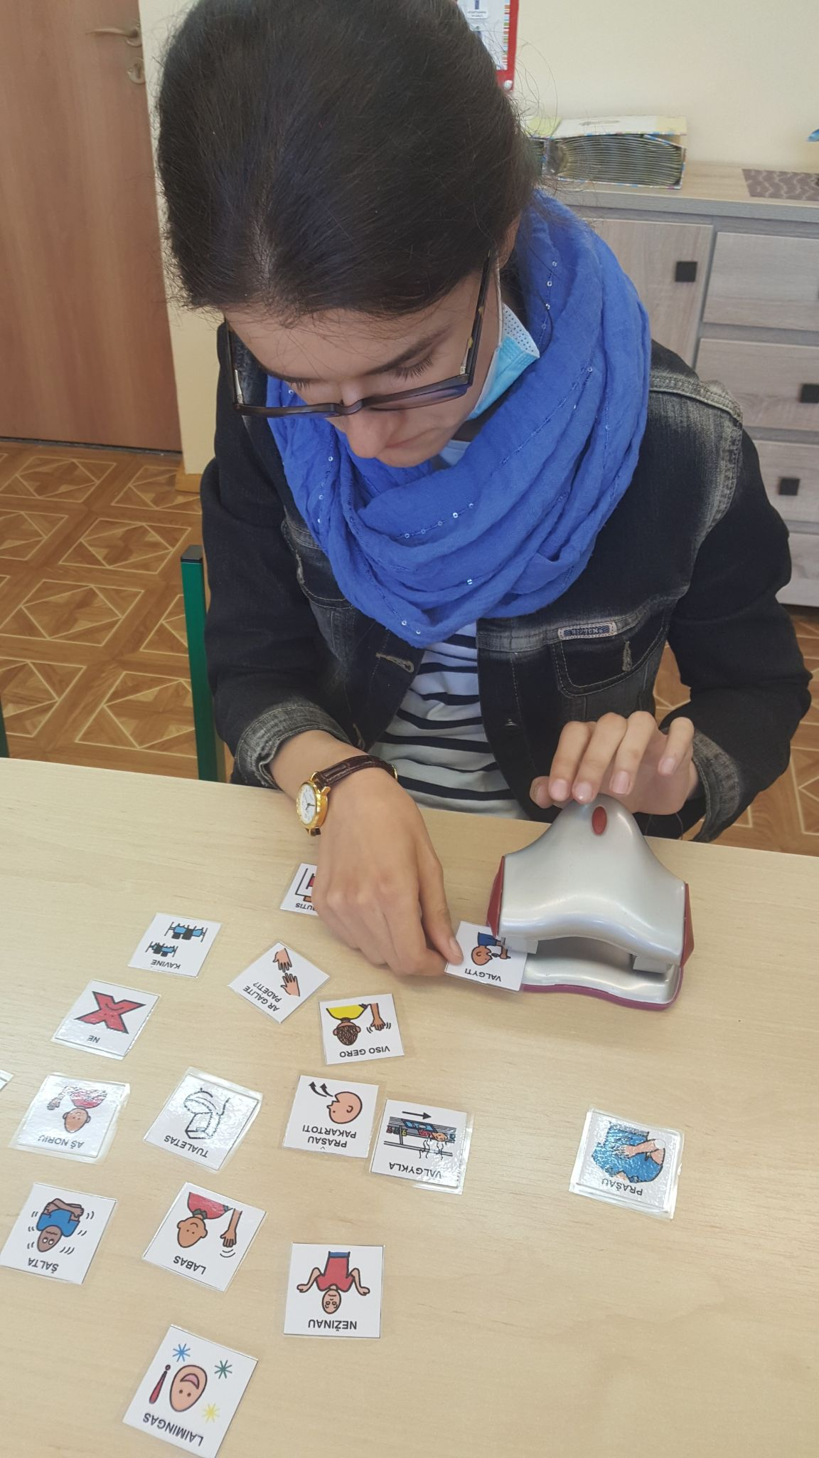
2. Punch holes
with a puncher

Slide 7
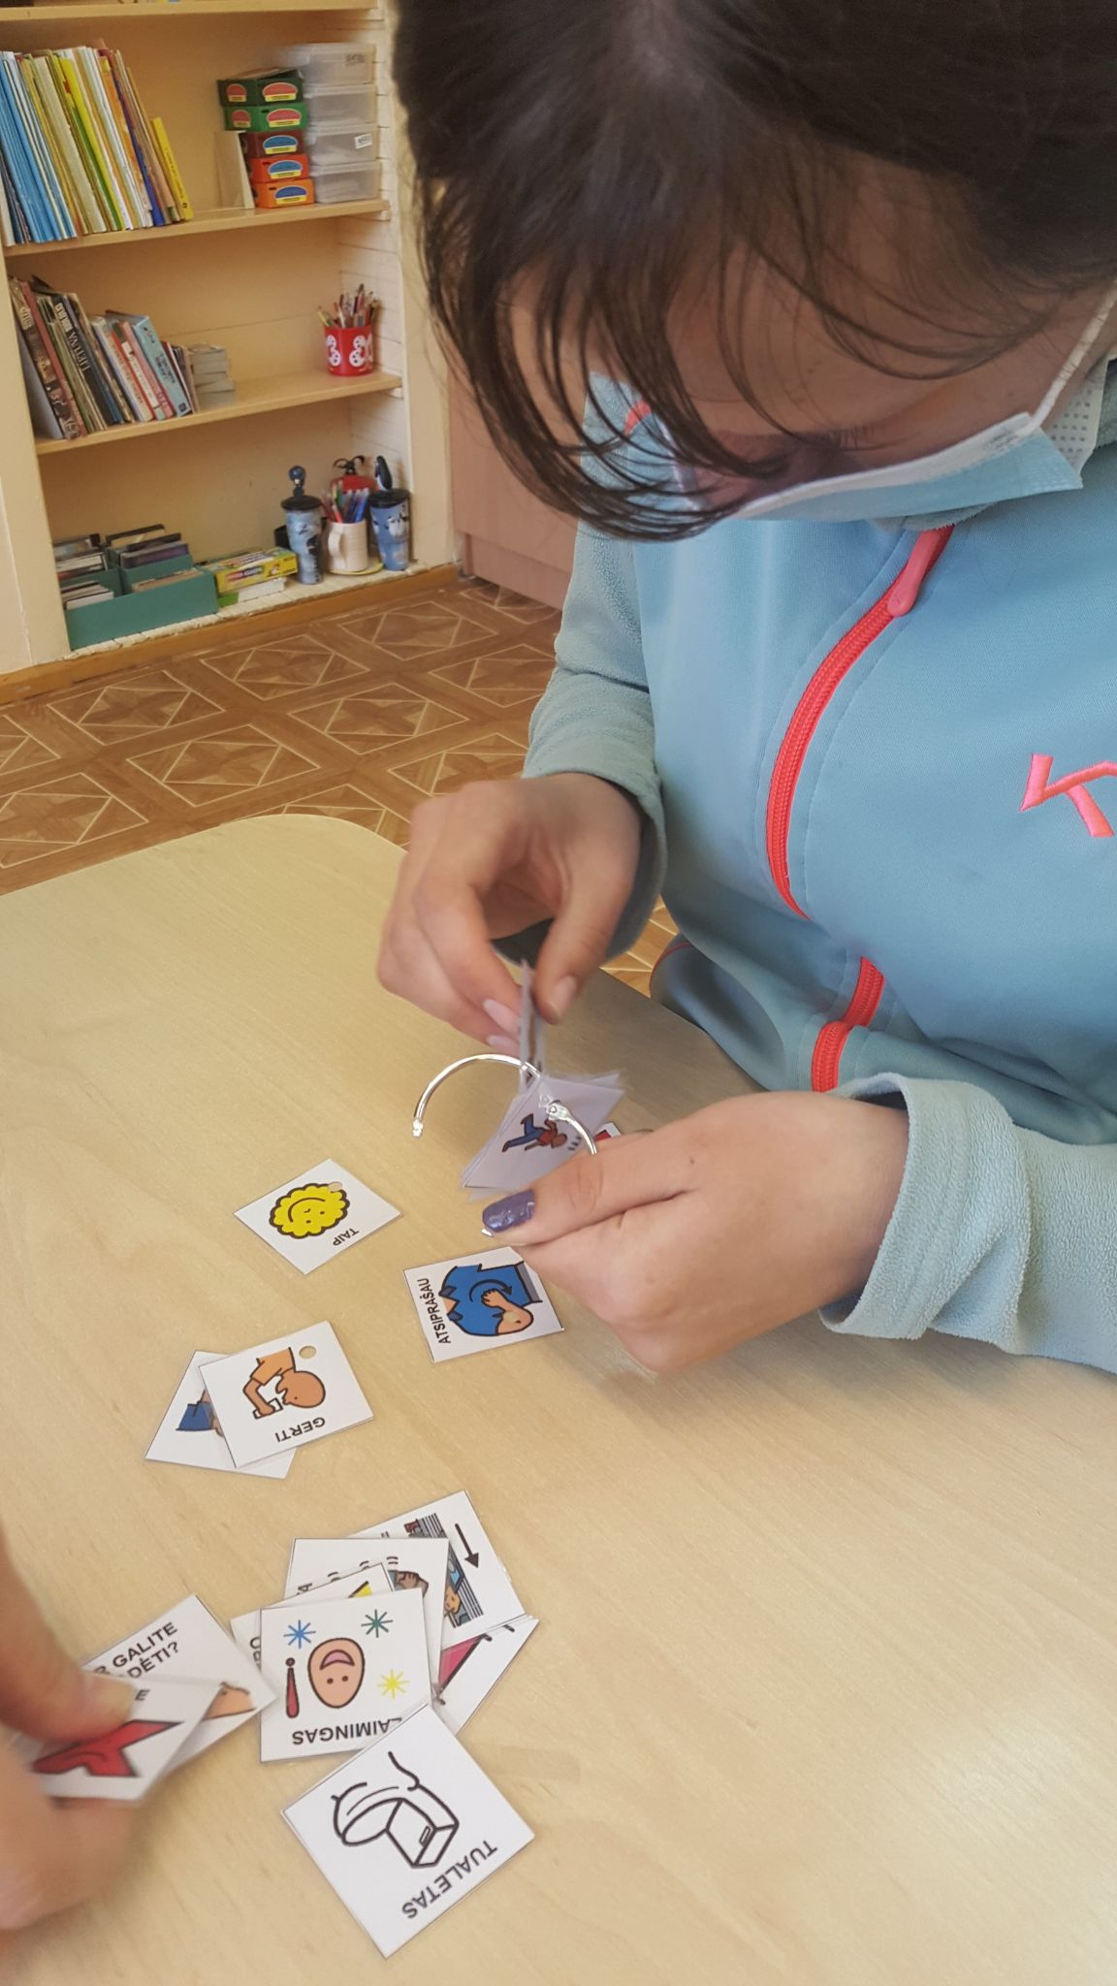
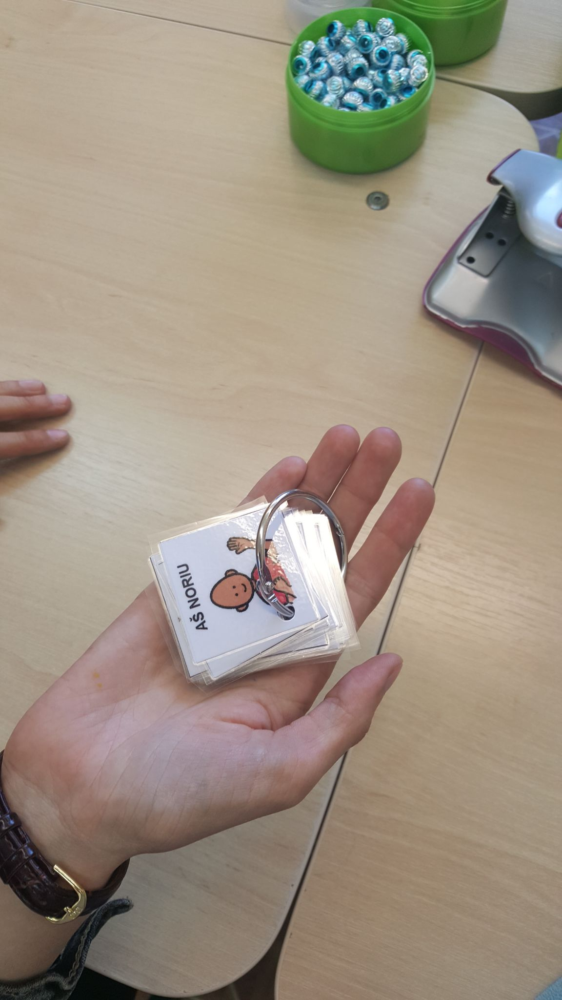
3. Bead the cards onto the ring.

Slide 8
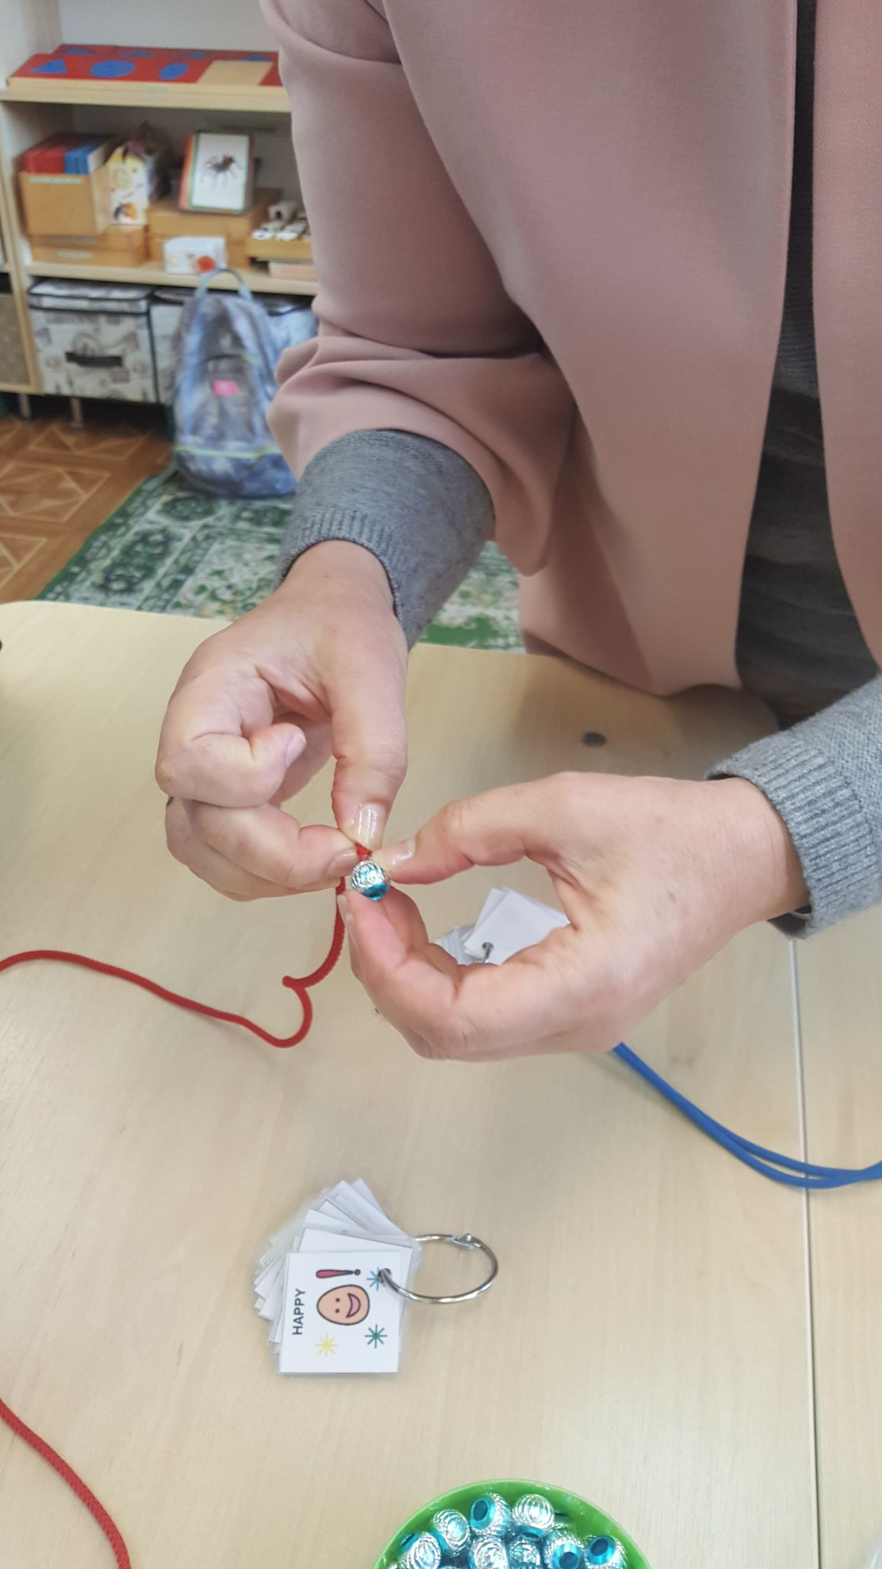
4. Pierce the rope through the bead

Slide 9
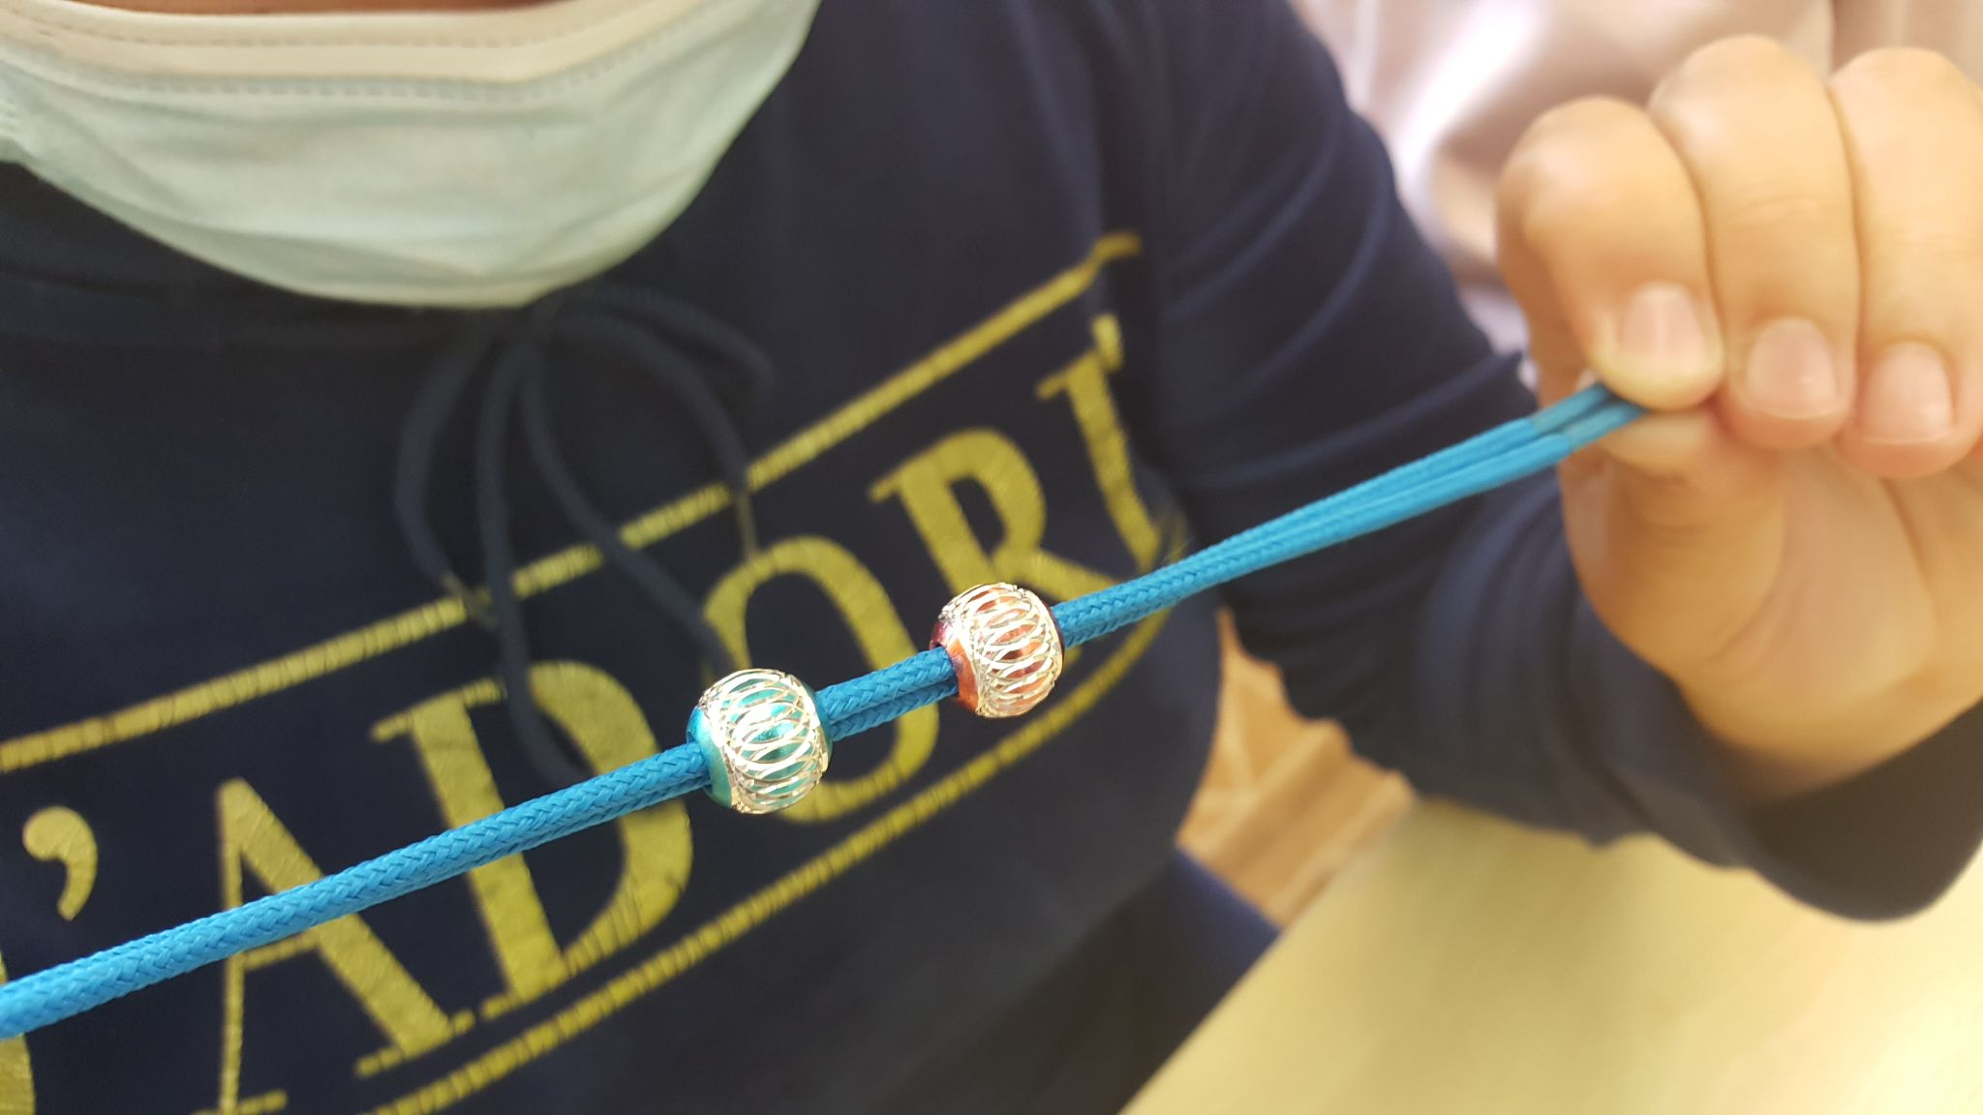

Slide 10
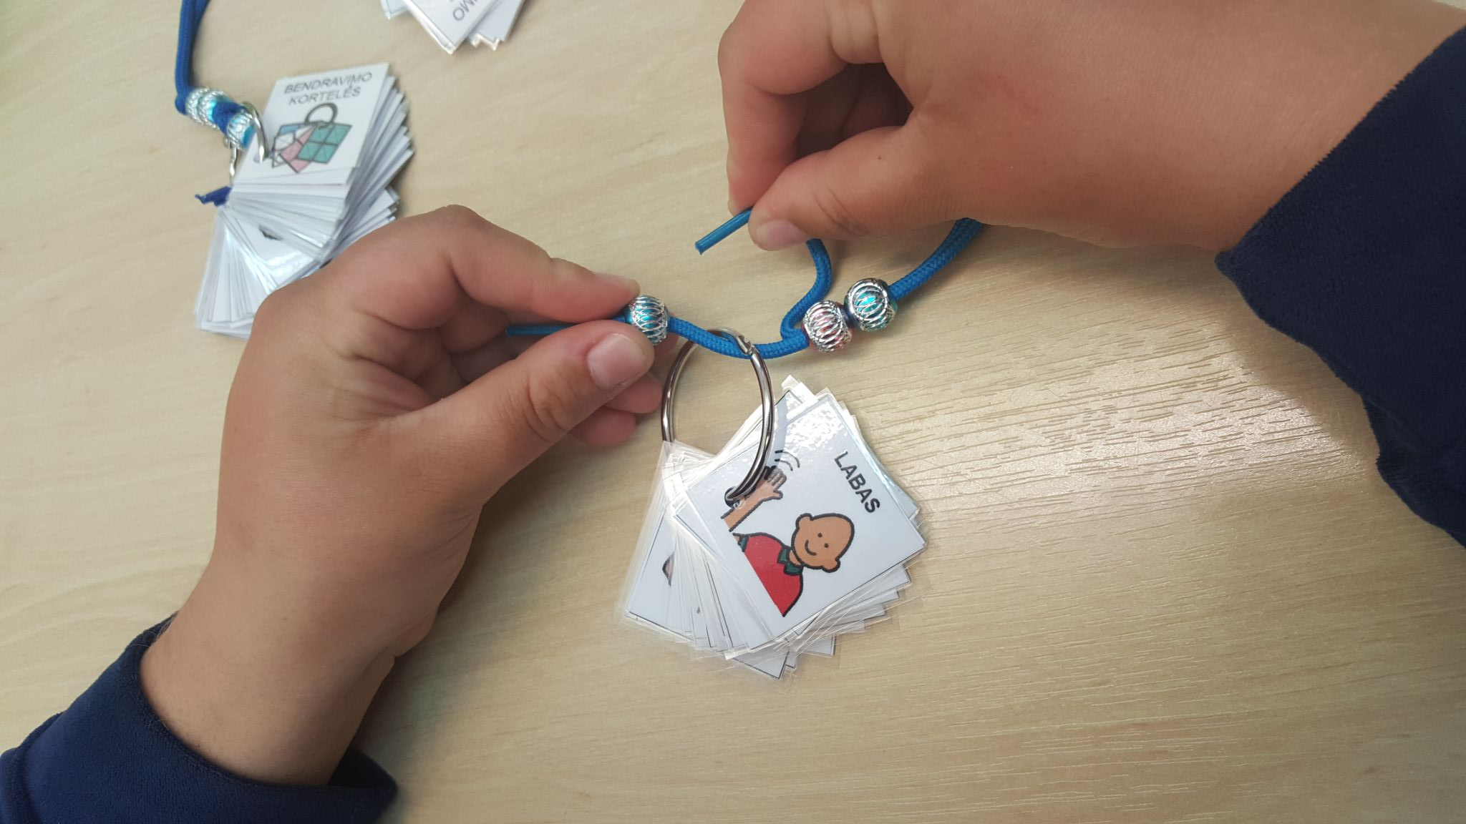

Slide 11
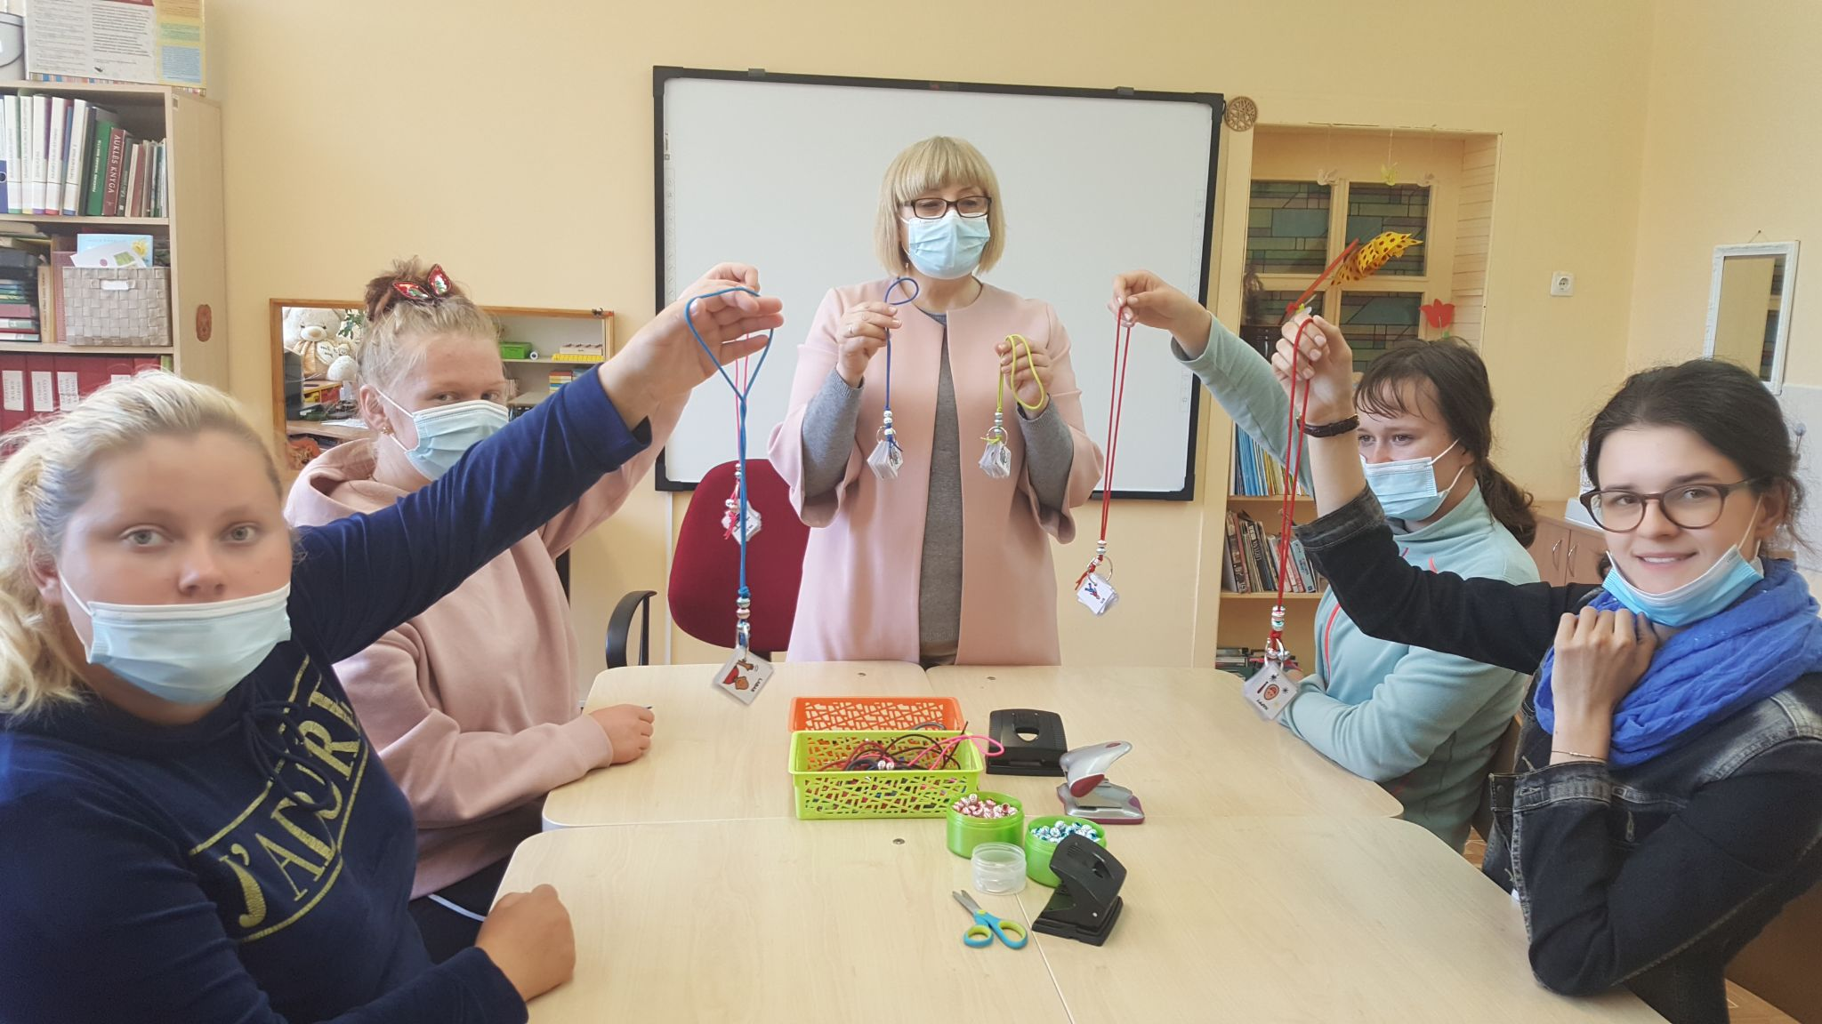
Our works

Slide 12
