Slide 1
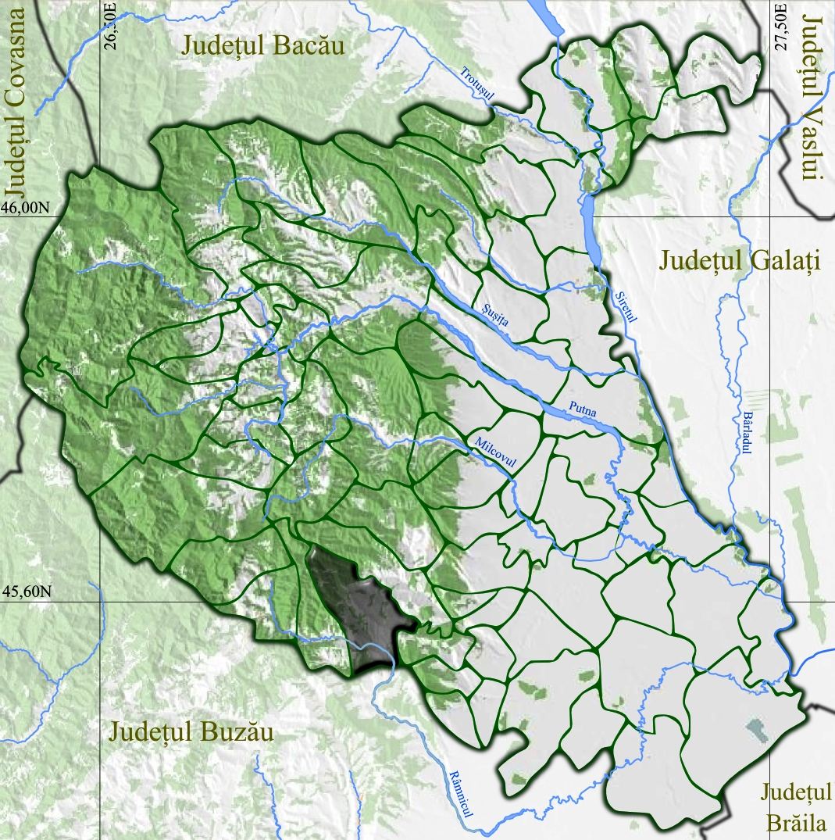
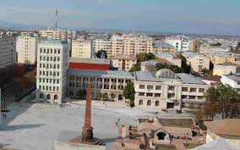
Welcome to focsani
Focsani is located in the county vrancea,ROmania

Slide 2
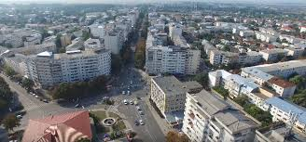
Here, have a look at our city from above

Slide 3
This is the union square
Here, the union between Moldova and the Romanian Country took place. Here , as you can see, is an Obelisc that represents the historical fact that took place on 5th of January, 1859.
This Photo by Unknown Author is licensed under CC BY-SA

Slide 4
This is the mausoleum of mărășești
The Mausoleum of Mărășești is a memorial site in Romania containing remains of 5,073 Romanian soldiers and officers killed in the First World War and dedicated to the commemoration of the Battle of Mărășești and Romanian Army members who were killed during World War I.

Slide 5
The municial theatre “Maior gheorghe pastia”
The Municipal Theatre “Maior Gheorghe Pastia” from Focsani is a historical monument. It was started in 1909 and finished in 1913. It is an important cultural building .
This Photo by Unknown Author is licensed under CC BY-SA

Slide 6
Last but not least, the church
The church “St. New Nicholas” is an orthodox church in Focsani. It was built in the year 1732.

Slide 7
And for the last slide, i’ll present the food
The Moldovan cuisine is a style of cooking related to the people of Moldovan and its breakaway region of Transnistria. It consists mainly of traditional European foods, such as beef, pork, potatoes, cabbage, and a variety of cereal grains.

Slide 8
Thanks for watching!
SEE you next time!

