Slide 1
Food
Here are some foods from Yorkshire.

Slide 2
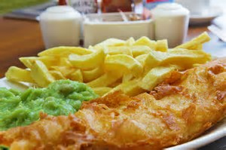
Fish and chips
Here in Wetherby we are home to a great English delicacy fish and chips there is a restaurant called the Wetherby whaler

Slide 3
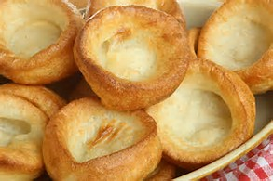
Yorkshire puddings
Here is the recipe
1. Heat oven to 230C/fan 210C/gas 8. Drizzle a little sunflower oil evenly into 2 x 4-hole Yorkshire pudding tins or a 12-hole non-stick muffin tin and place in the oven to heat through.
2. To make the batter, tip 140g plain flour into a bowl and beat in four eggs until smooth. Gradually add 200ml milk and carry on beating until the mix is completely lump-free. Season with salt and pepper. Pour the batter into a jug, then remove the hot tins from the oven. Carefully and evenly pour the batter into the holes. Place the tins back in the oven and leave undisturbed for 20-25 mins until the puddings have puffed up and browned. Serve immediately. You can now cool them and freeze for up to 1 month.

