Slide 1
Tuesday

Slide 2
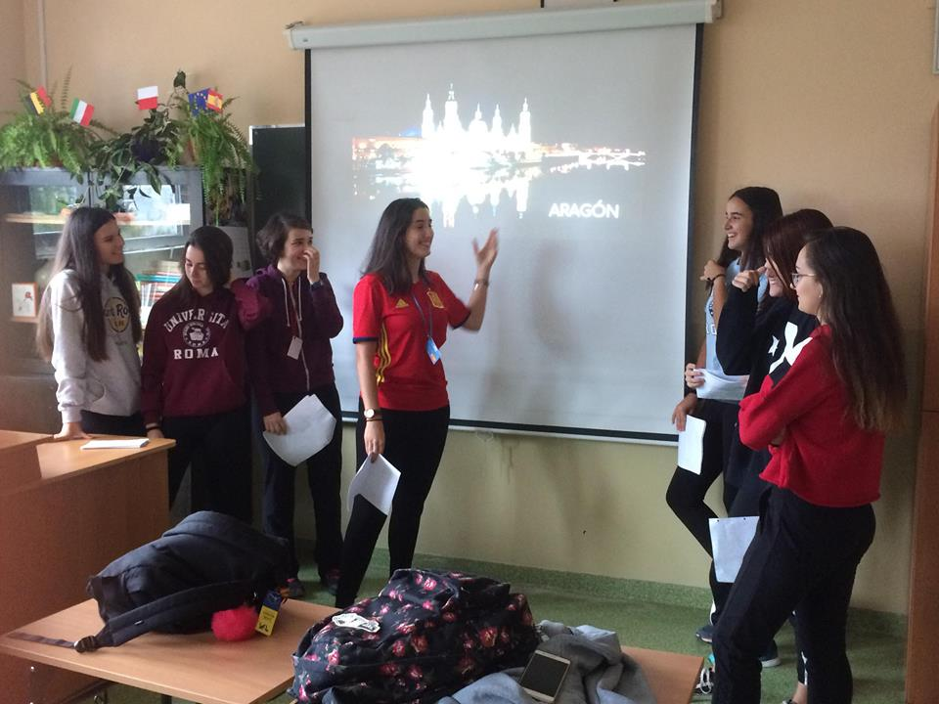
Guests present their region to Polish students.

Slide 3
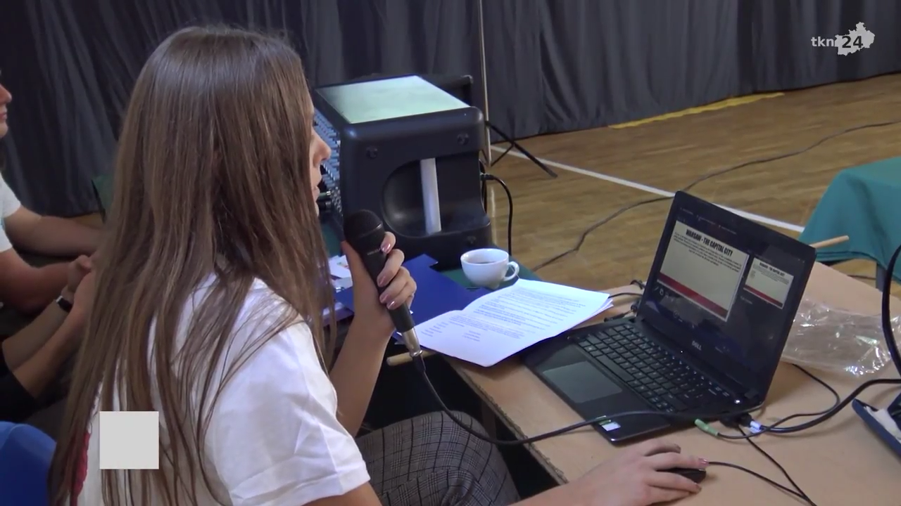
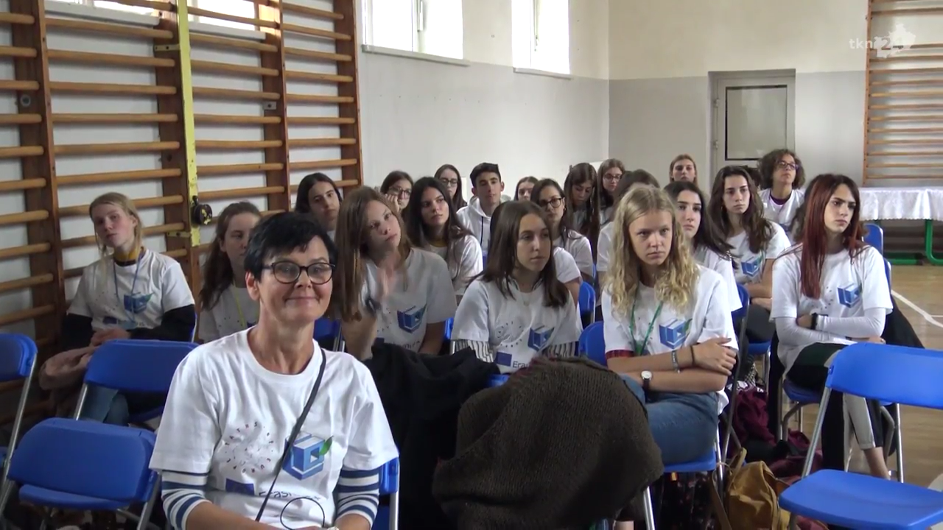
Official Opening of the project, welcoming by the headmistress and invited authorities.
Power Point Presentation about Poland

Slide 4
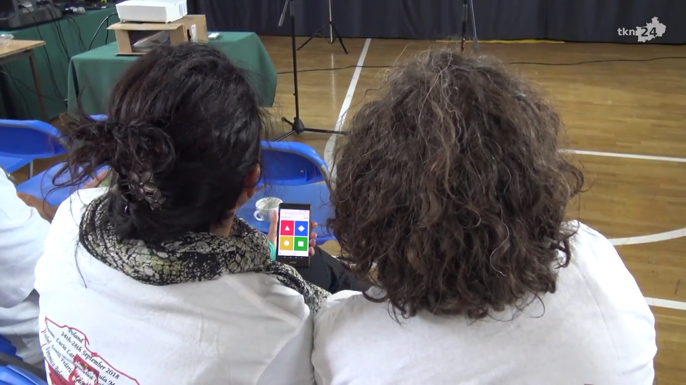
Quiz about Poland (smartphone app.)

Slide 5
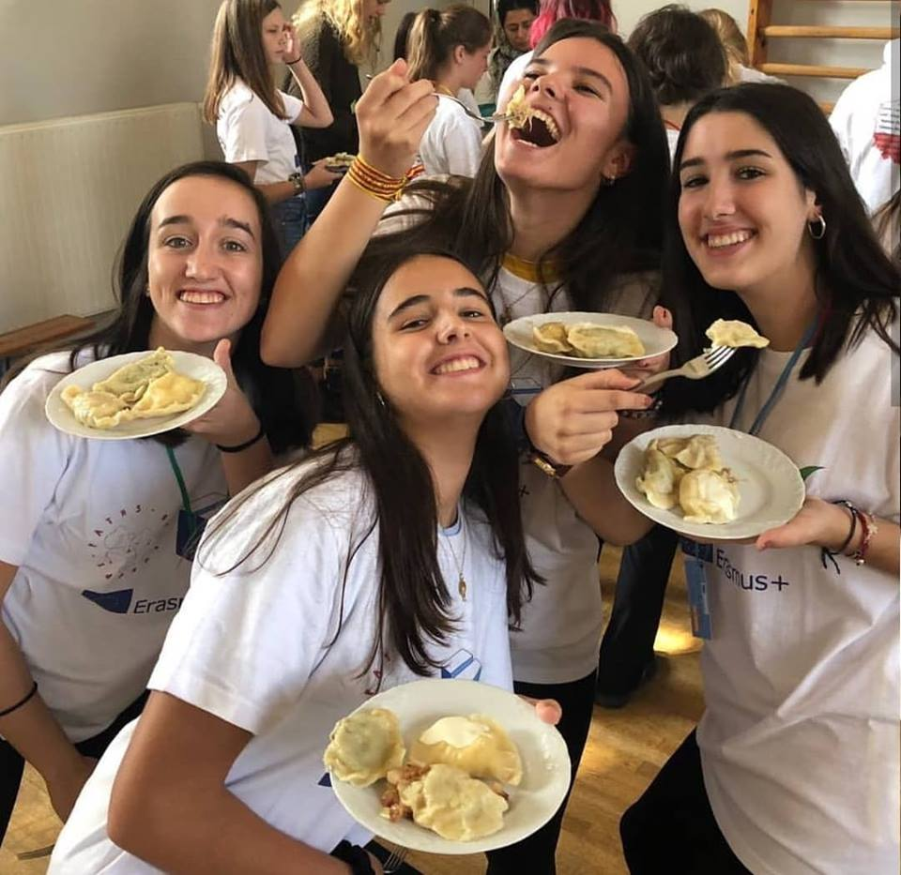
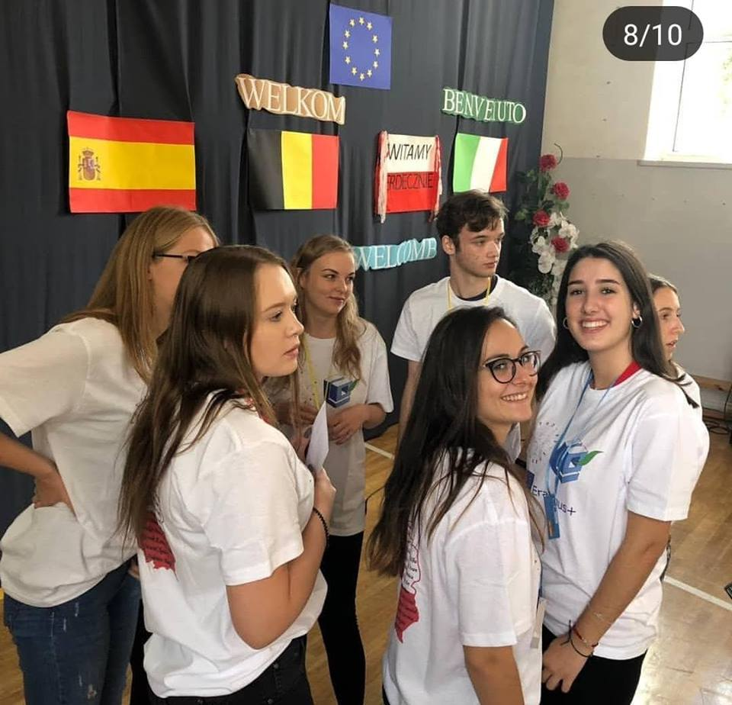
Lunch at school

Slide 6
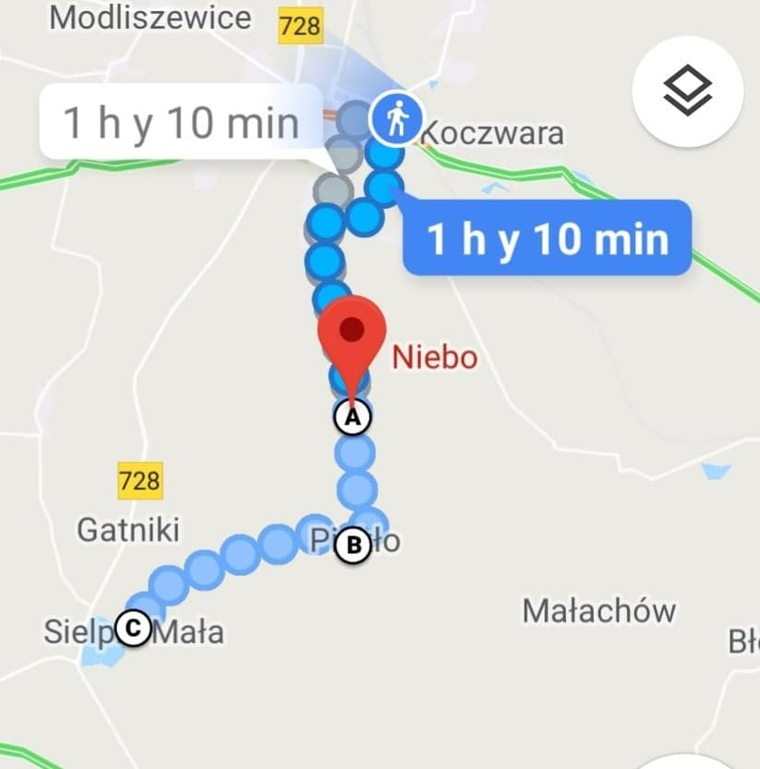
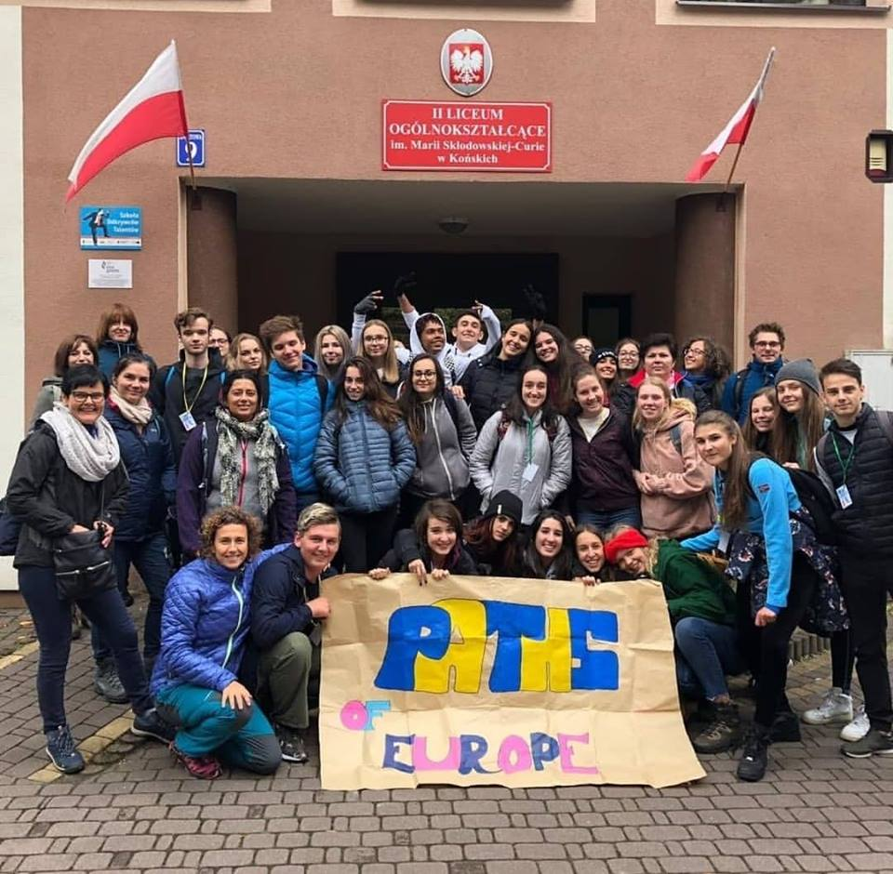
Hiking trip: Końskie-Niebo-Skałki Piekło-Gatniki-Sielpia (about 14km).

Slide 7
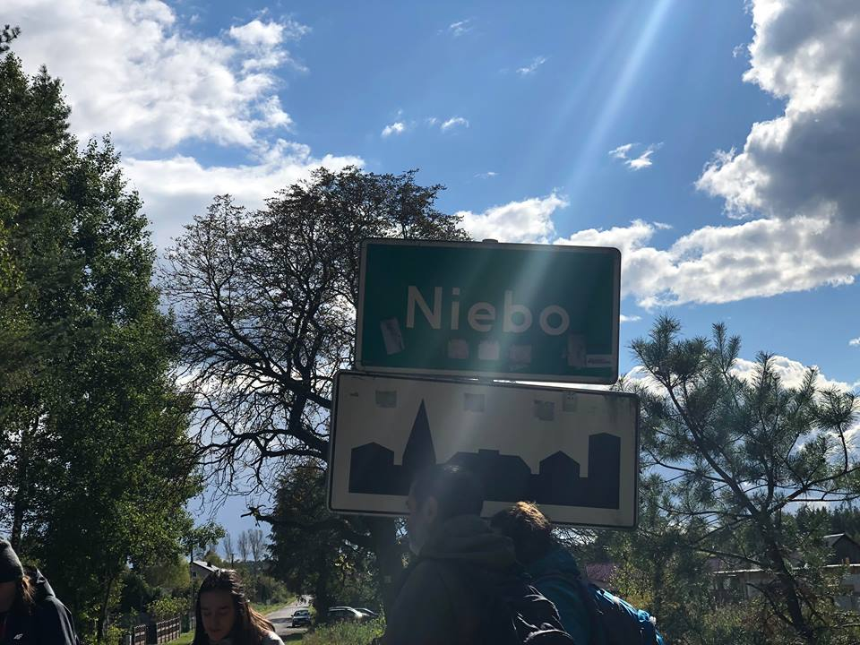
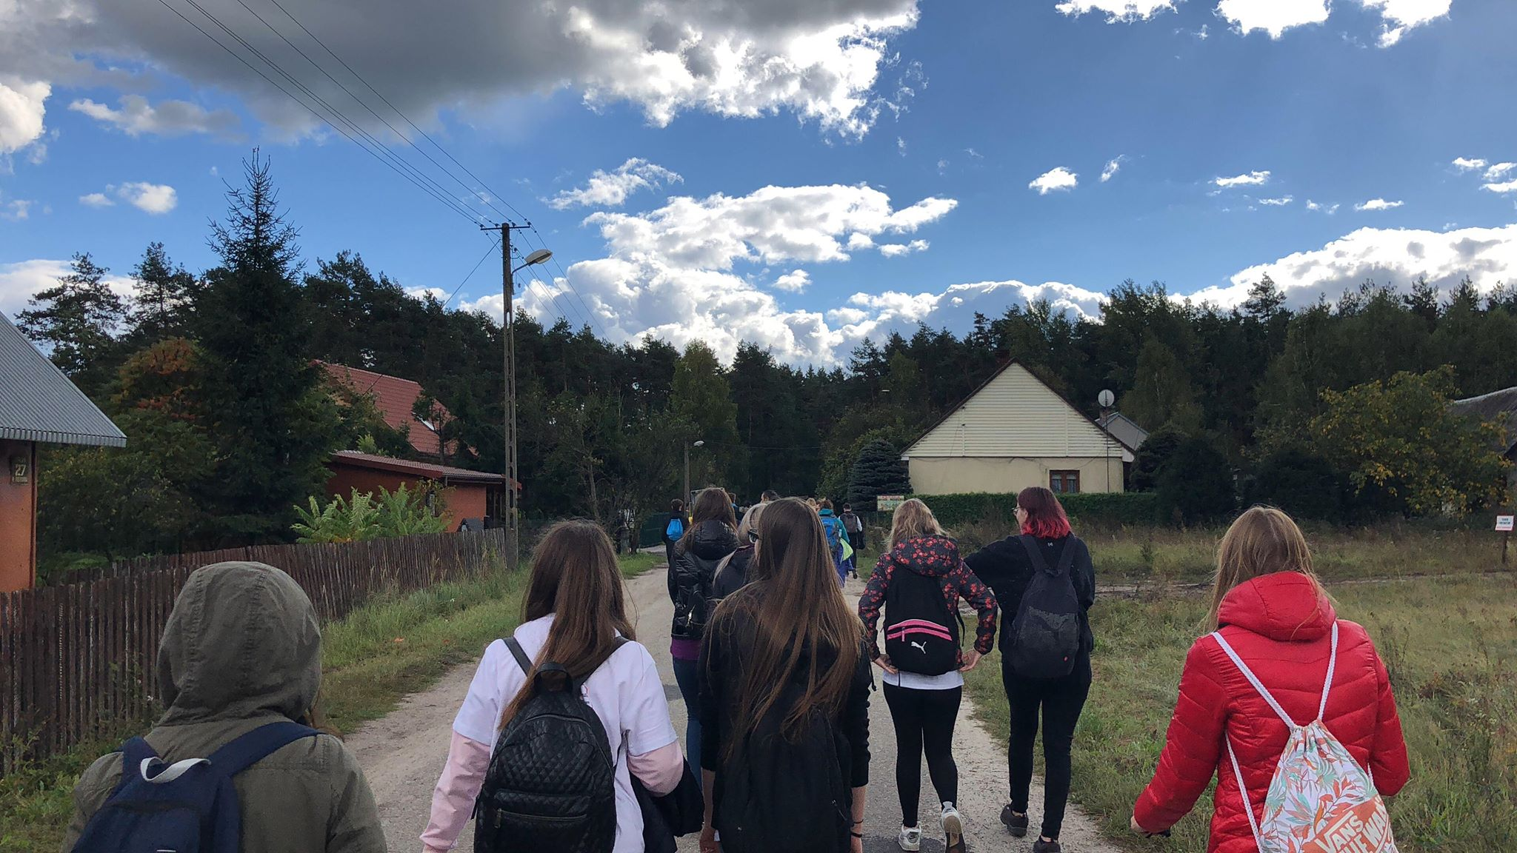
Niebo

Slide 8
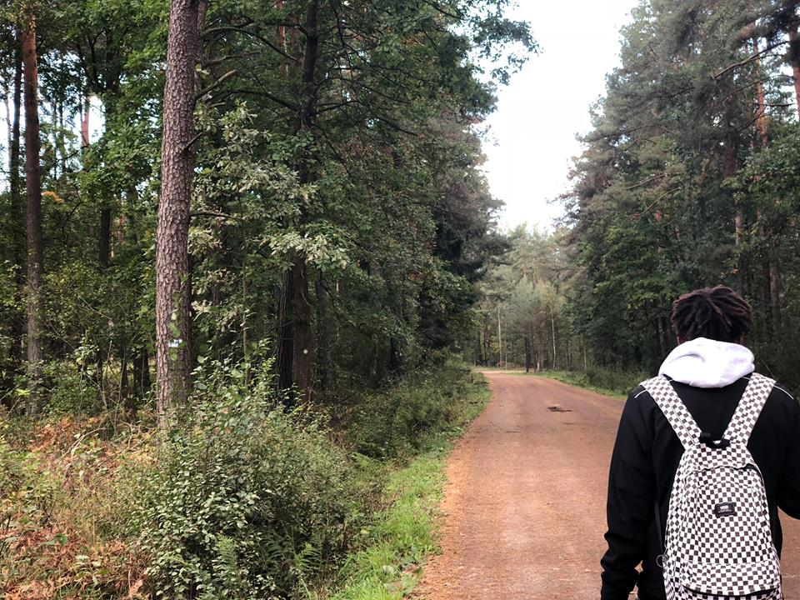
Meeting with horses

Slide 9
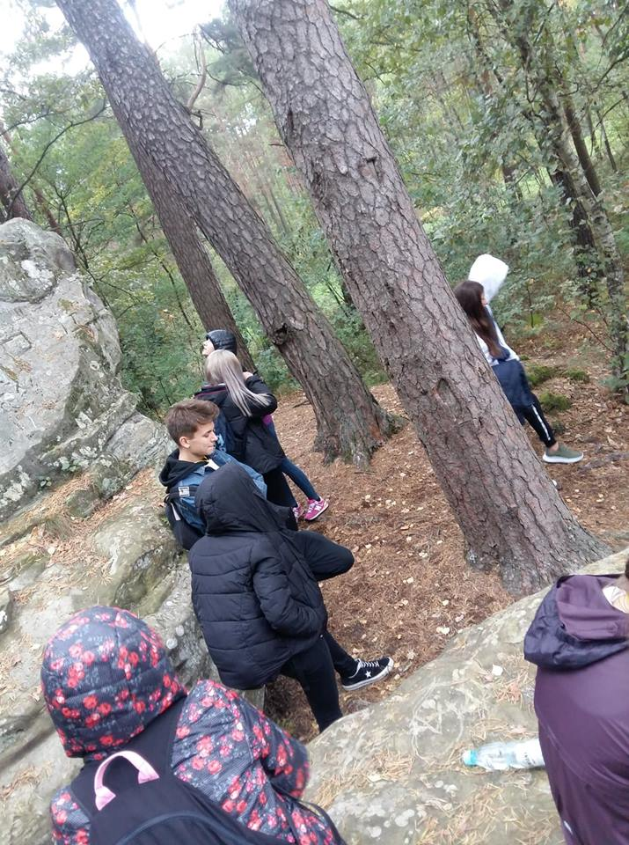
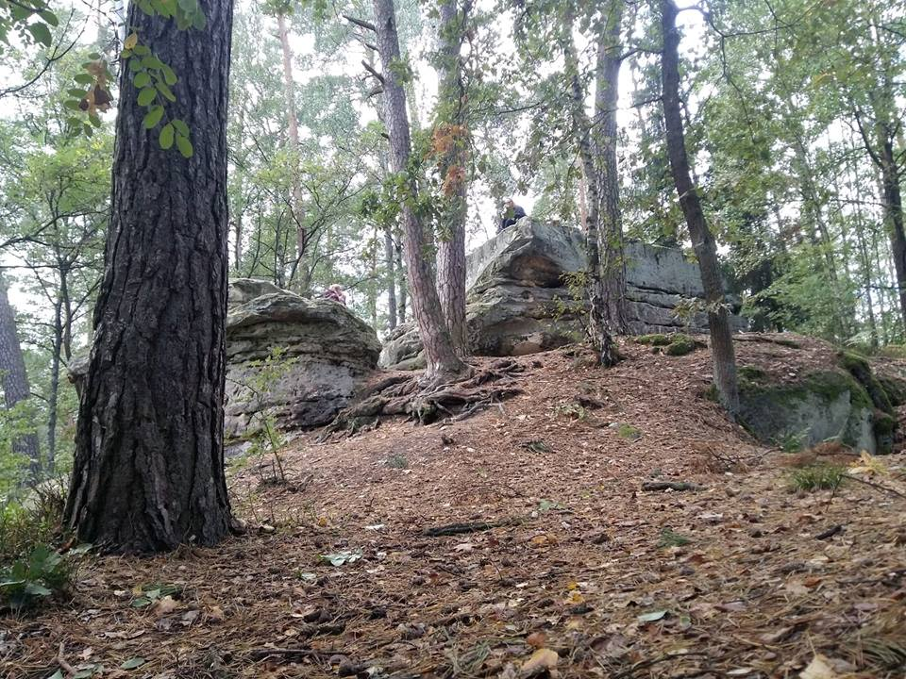
Skałki Piekło

Slide 10
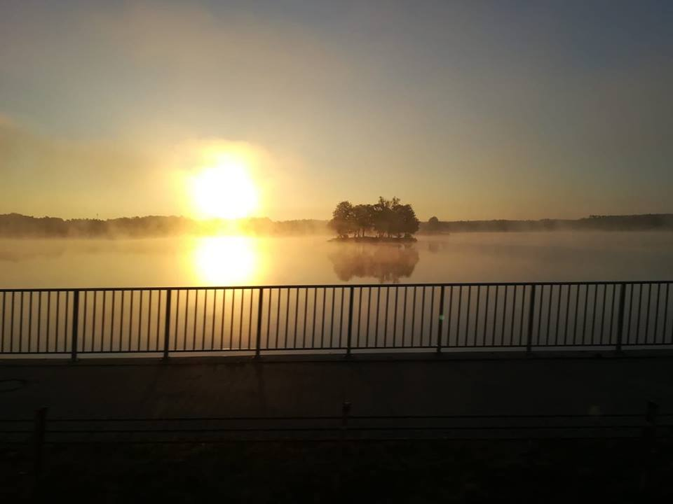
Sielpia

Slide 11
Travelling back to Końskie by bus.

