Slide 1
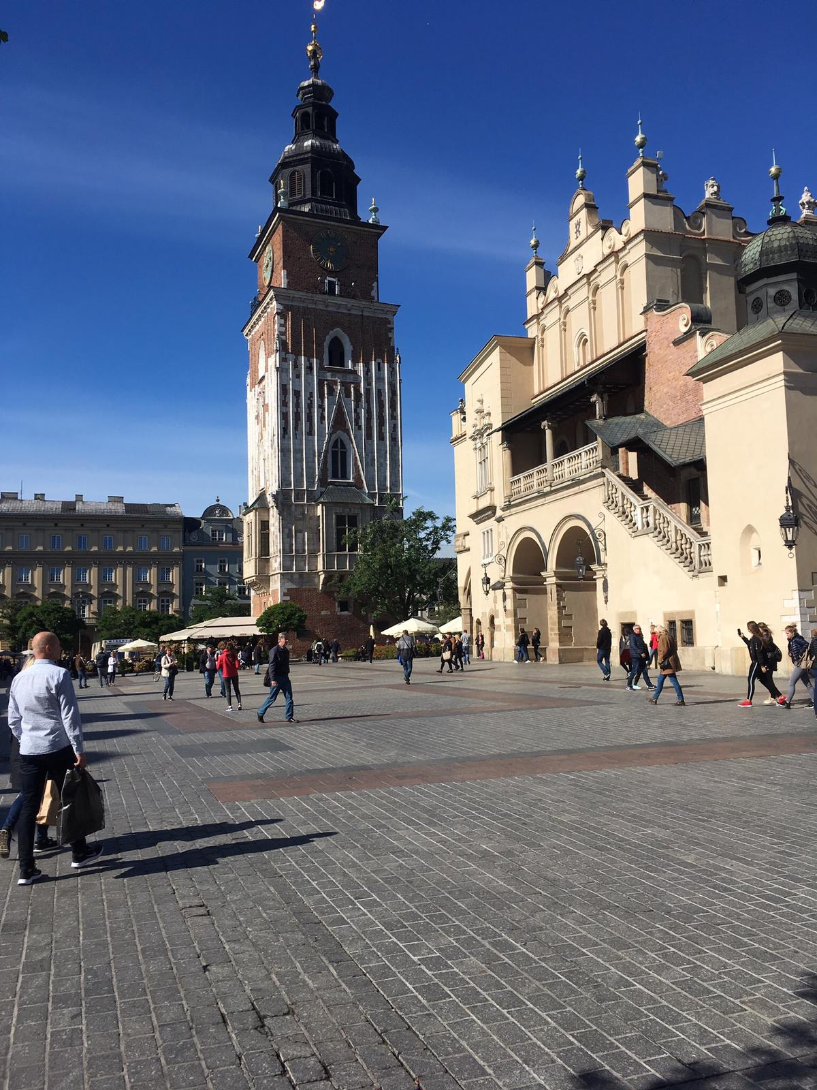
Cracow - Erasmus
26.09.2018.

Slide 2
What were we doing in Cracow?
On the 26th of September we came to Cracow. We first introduced the legend about Wawel Dragon to our guests and then we went to visit the Wawel Castle with the guide. We also had some free time to take pictures together and some time for sightseeing by ourselves. Then we went to the marketplace at the Old Town where we had free time to buy souvenirs. The last part of our trip was a city game in Kazimierz and the subject of this game was the history of Jews. In the evening we came back to Końskie.

Slide 3
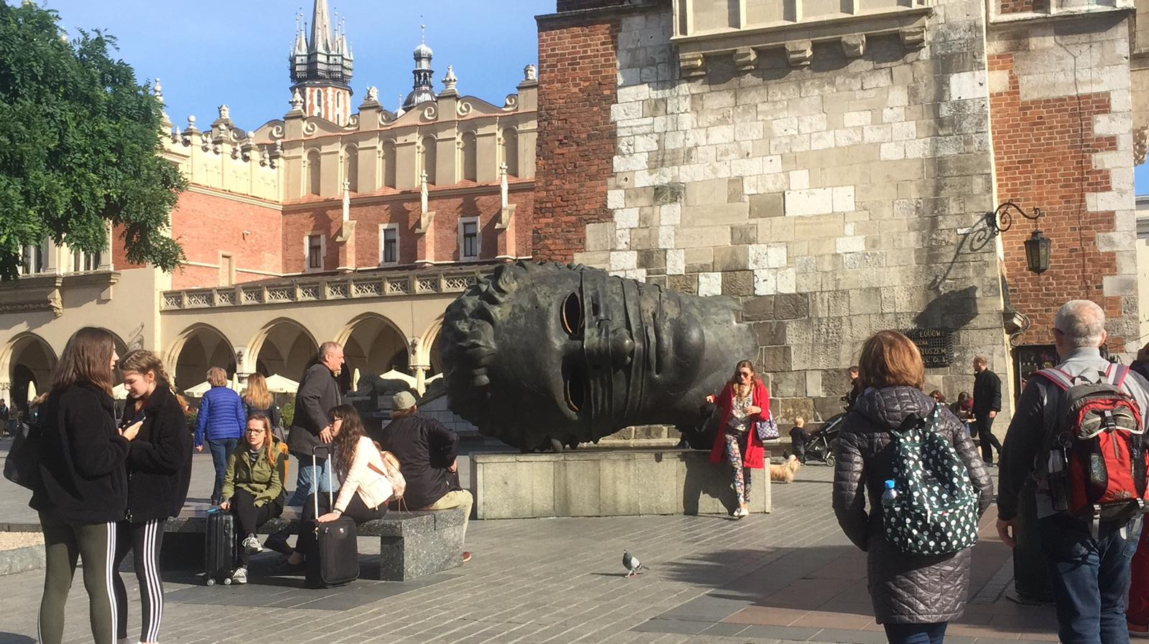
Eros Bendato on the main market square in Cracow

Slide 4
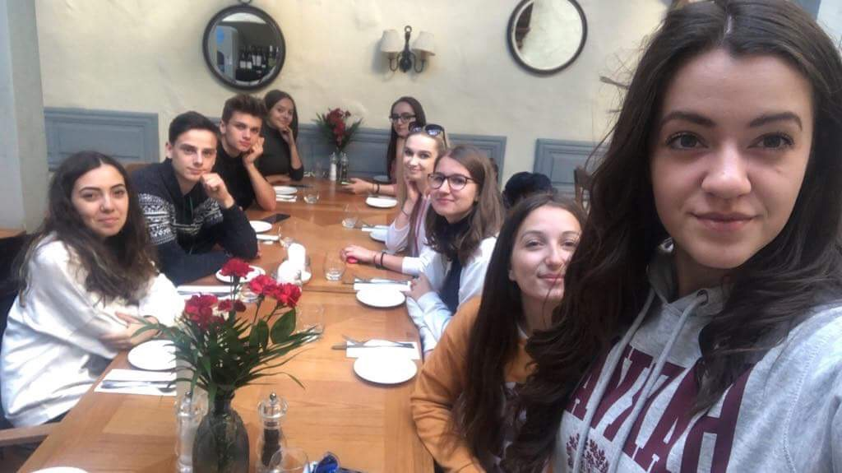
Friends at the restaurant

Slide 5
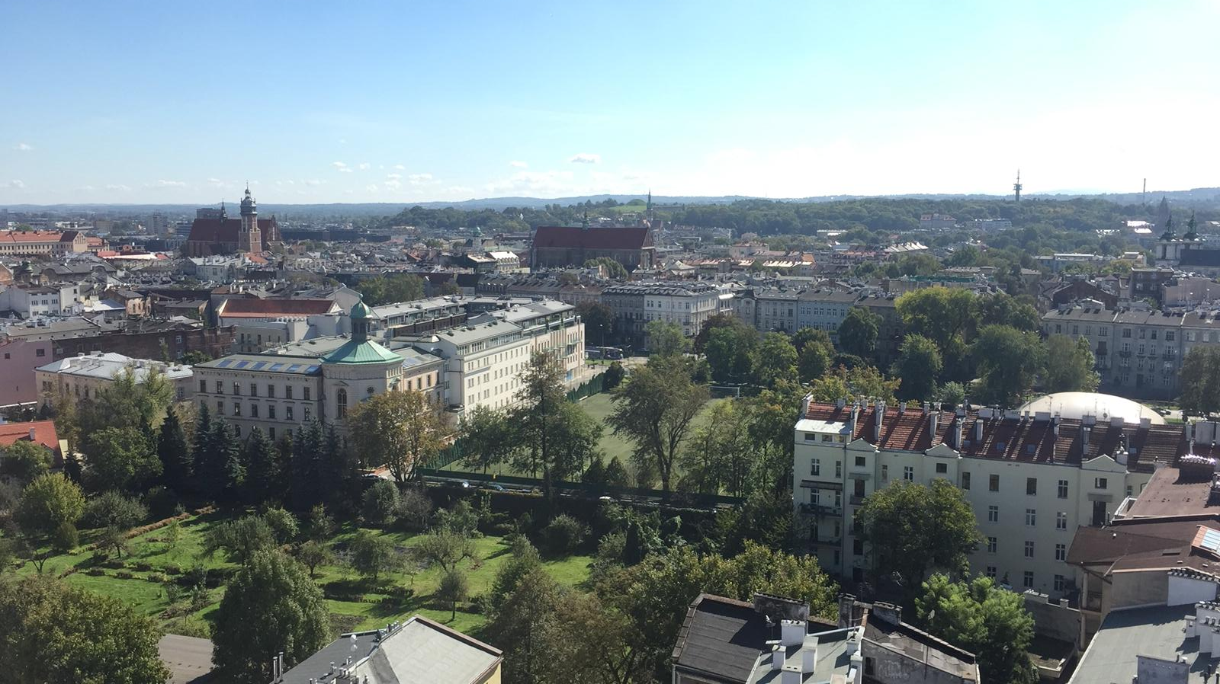
Sightseeing in Cracow

Slide 6
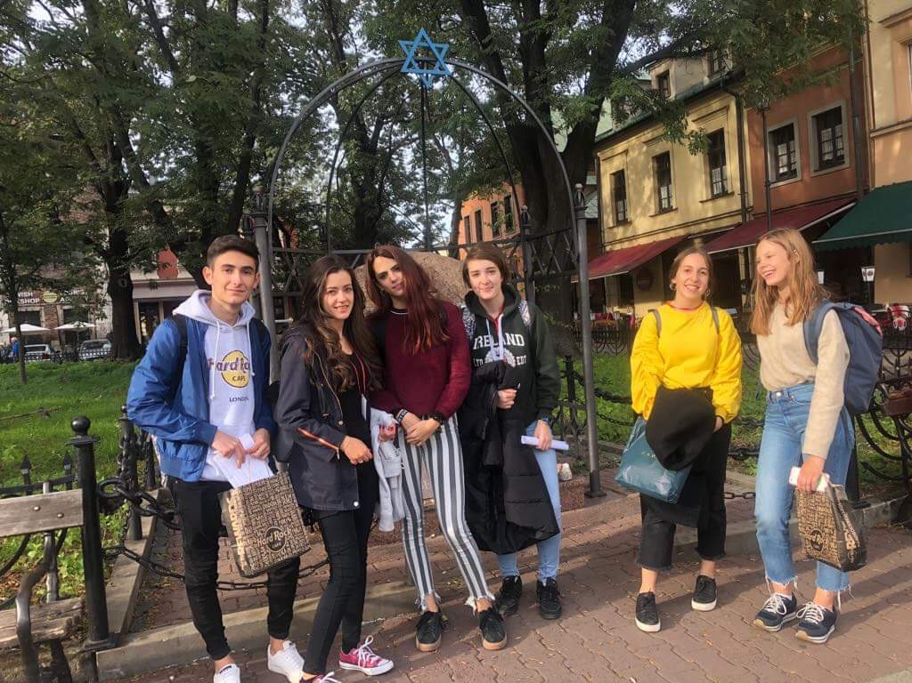
City game

Slide 7
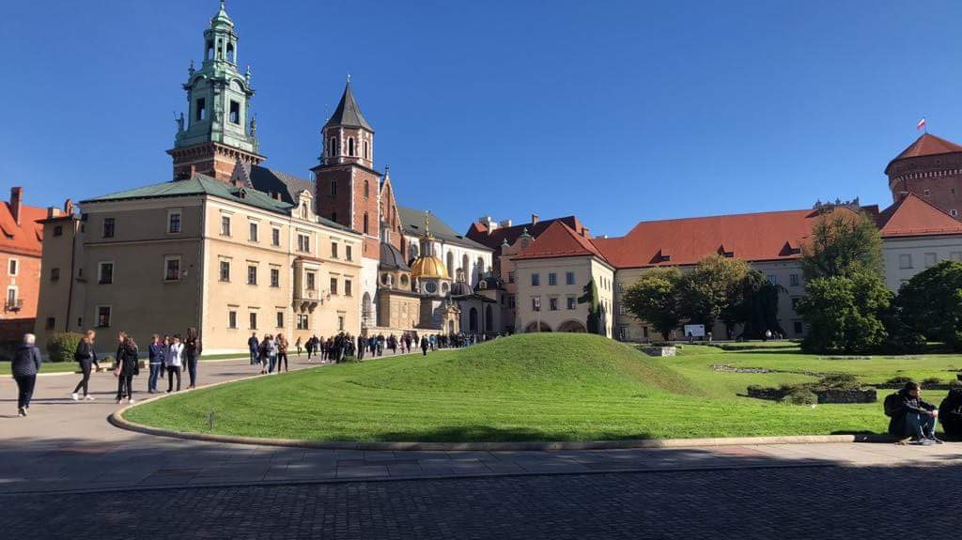
Beautiful Wawel

Slide 8
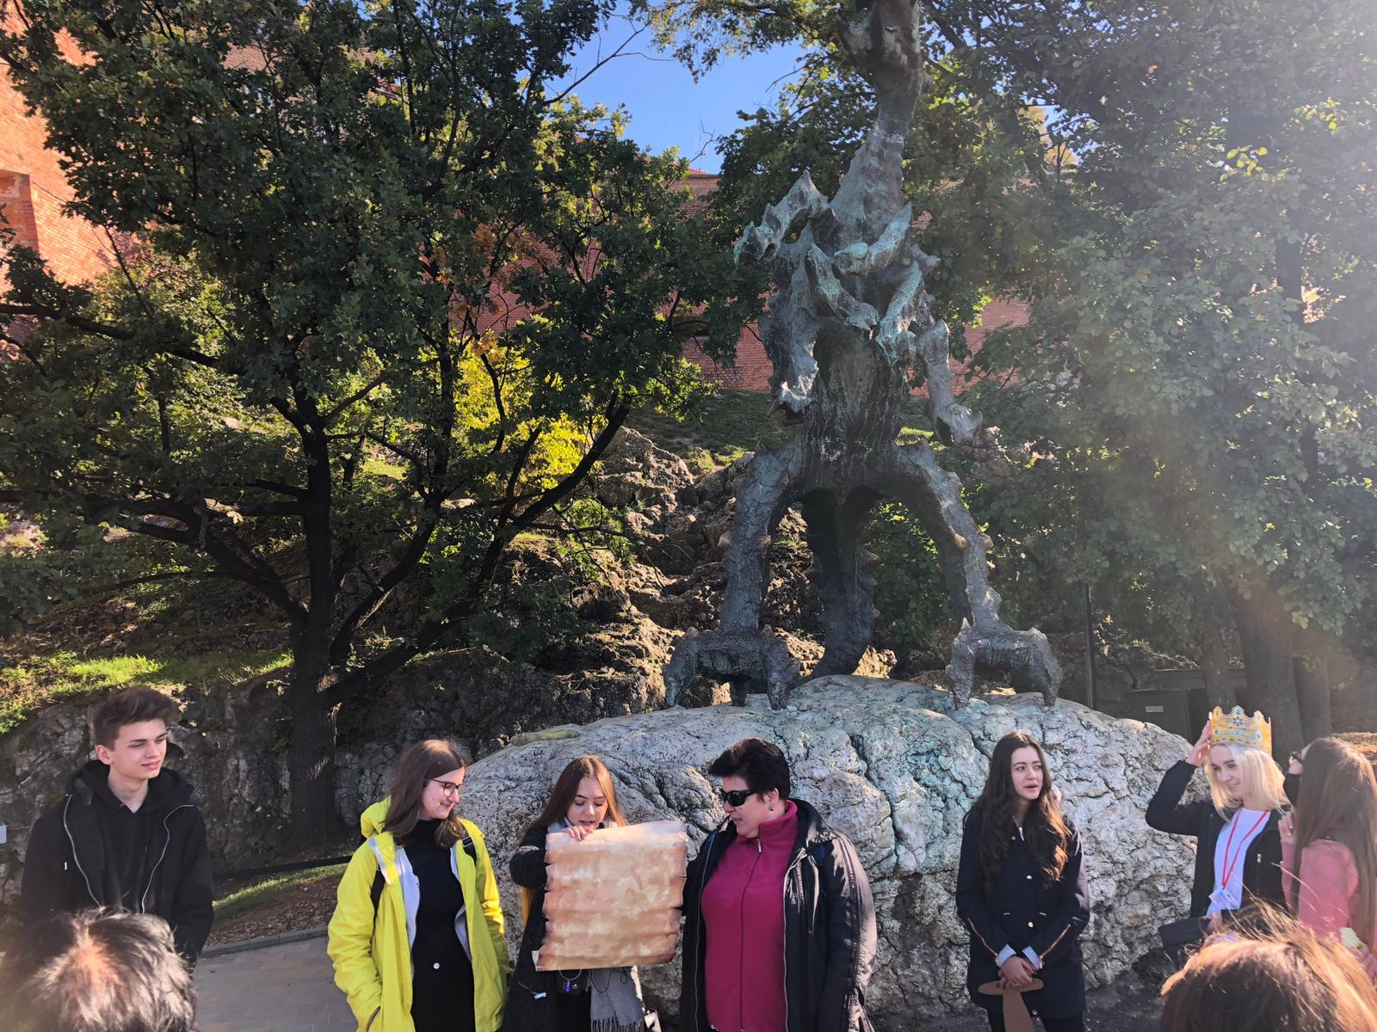
Legend about Wawel Dragon

Slide 9
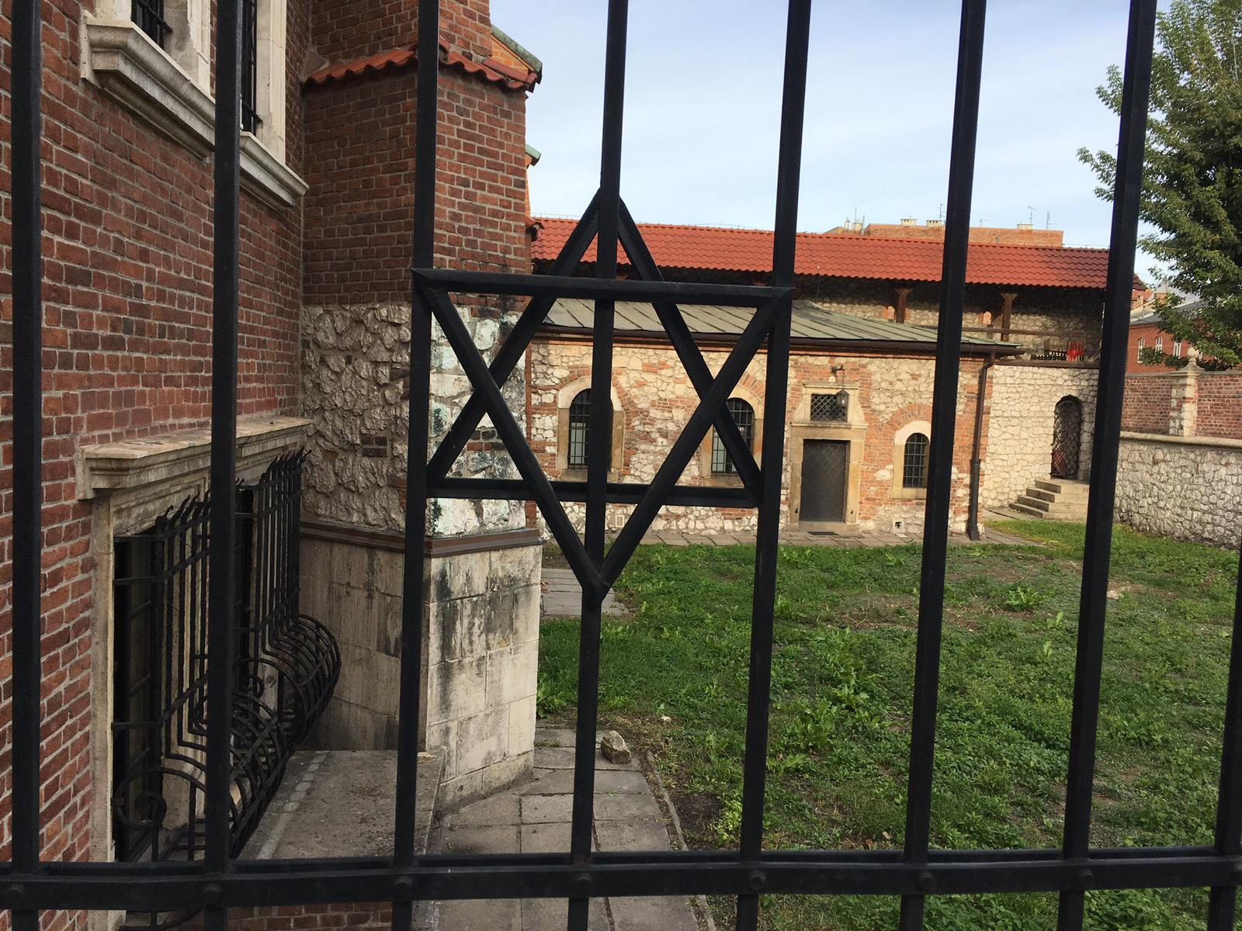
Dawid’s Star

Slide 10
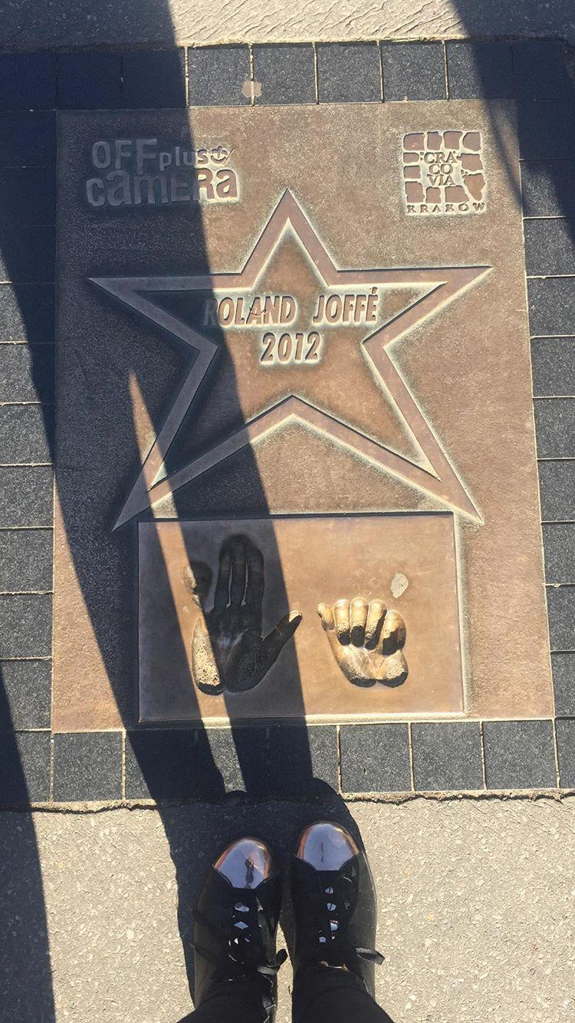
Roland Joffe’s Star

Slide 11
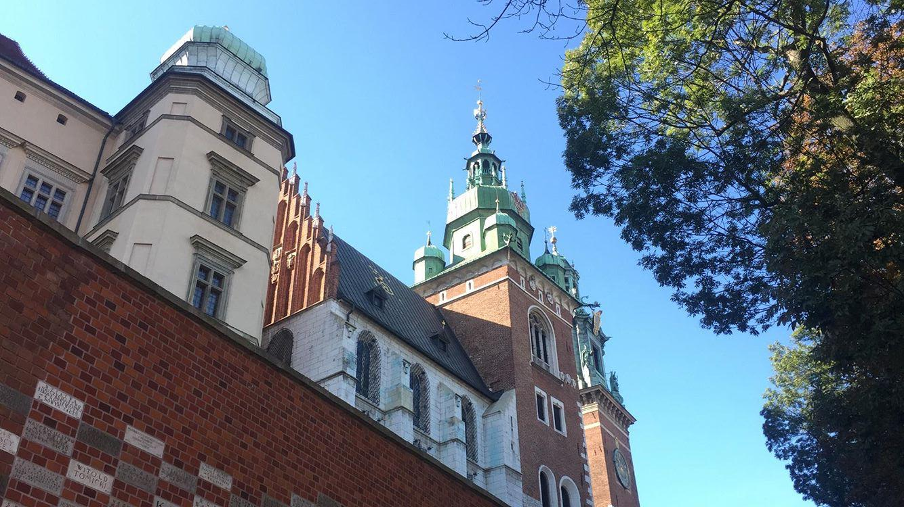
Cracow Cathedral

Slide 12
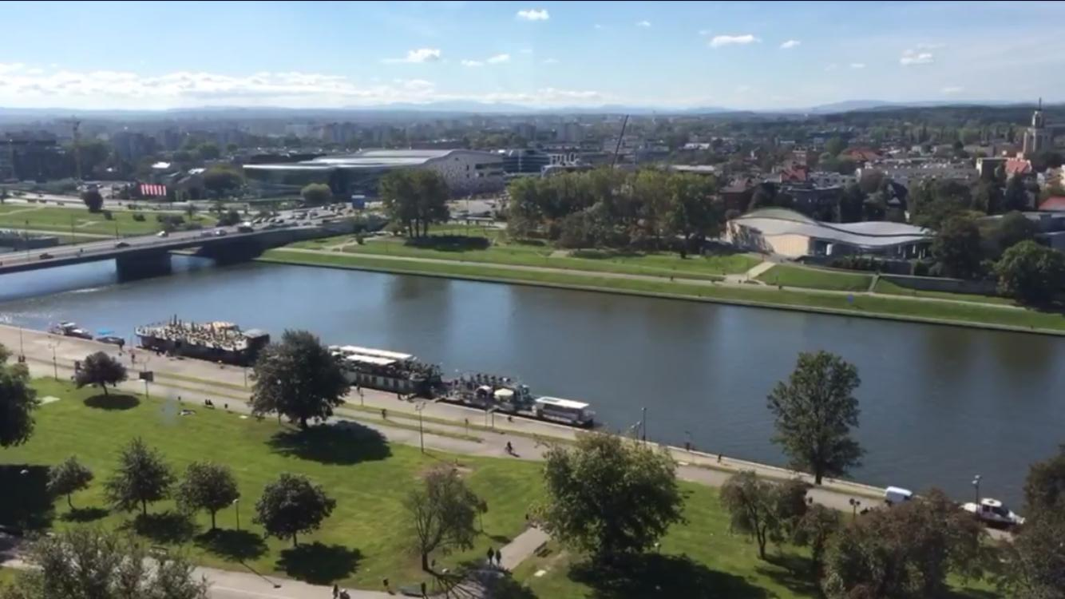
The Vistula river in Cracow

Slide 13
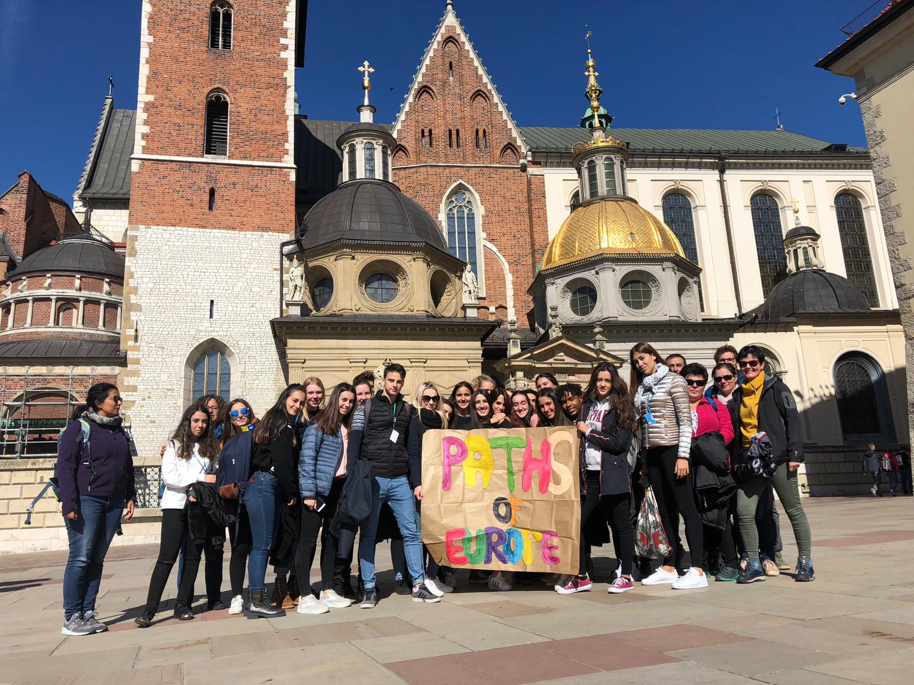
PATHS OF EUROPE!

Slide 14
THE END

