Slide 1
Jewish cemetery

Slide 2
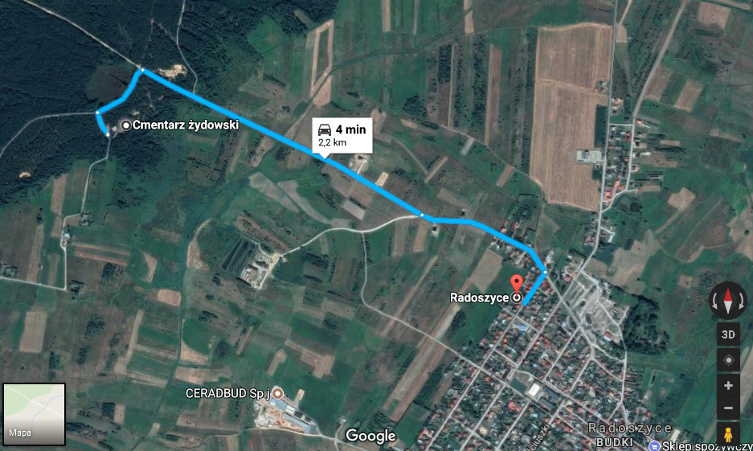
The Jewish cemetary is located on the scenic hill on the edge of the forest near Radoszyce.

Slide 3
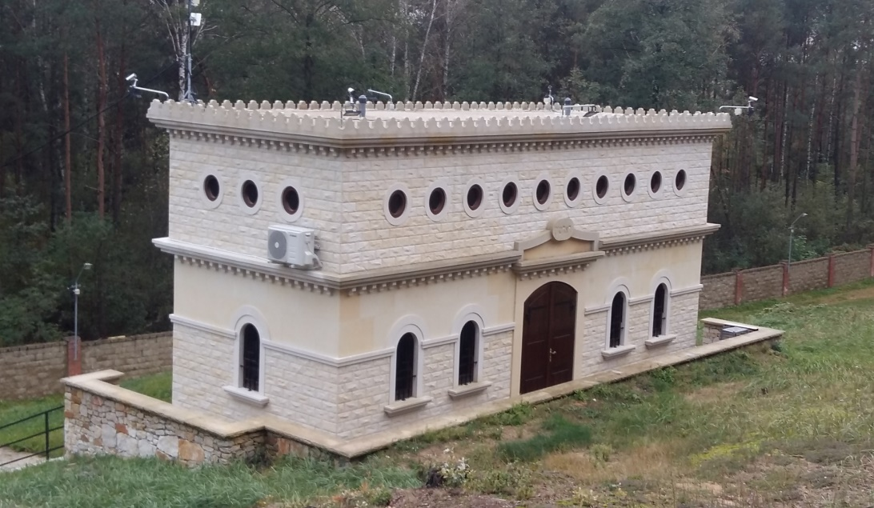
The date of its establishment is unknown, it is known that it existed before 1789. In the early 20th century its area was expanded. In the 18th century the Jews constituted 49% of the community and Radoszyce became another center of Chassidism.

Slide 4
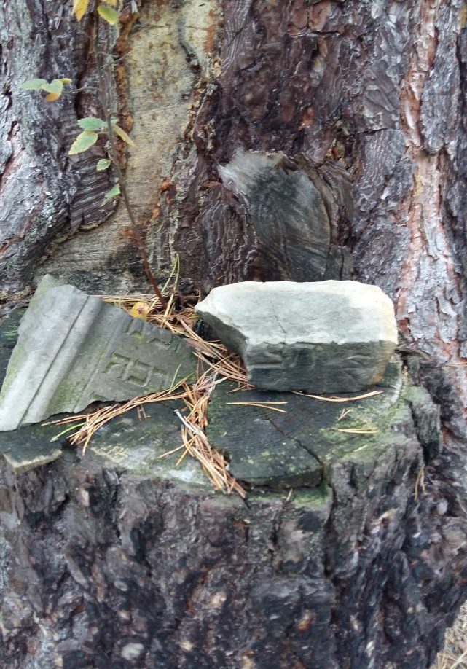
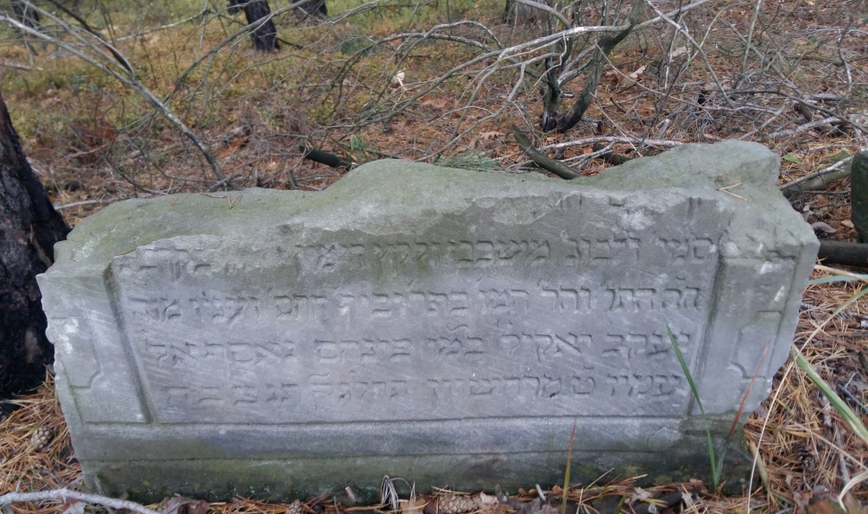
The necropolis was destroyed during the Second World War, and the process of destruction continued after the liberation. For many years the descendants of the Jews from Radoszyce sought to stop the devastation

Slide 5
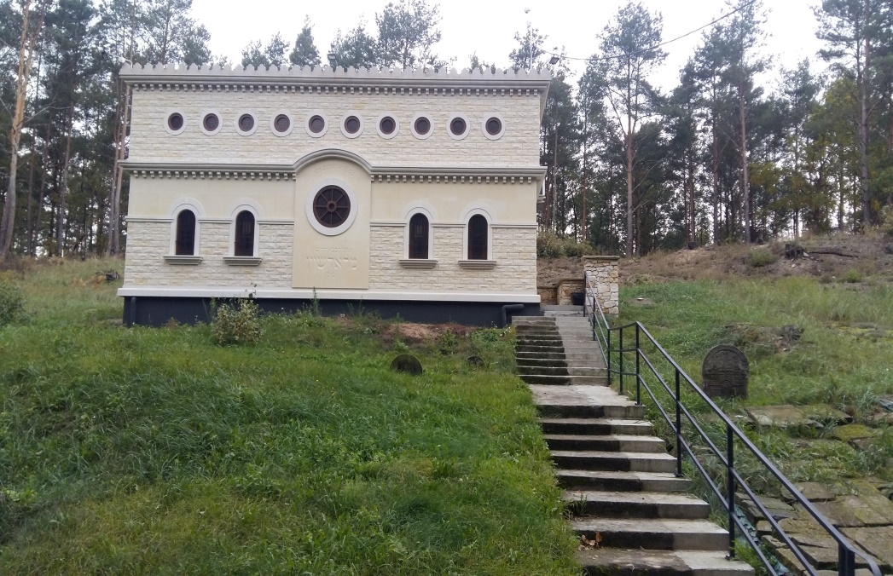
Few years ago, Ohel has been renovated. Ohel is a building upraised over the tzadik's grave. The tzadik is a kind of spiritual leader. In the cemetary tzadik Isachar Dow Ber was buried, who lived in Radoszyce in the 18th and 19th centuries. By the Jews he is considered a holy person and a world-famous miracle-maker.
Opis budynku, wspomnij że został
wyremontowany

Slide 6
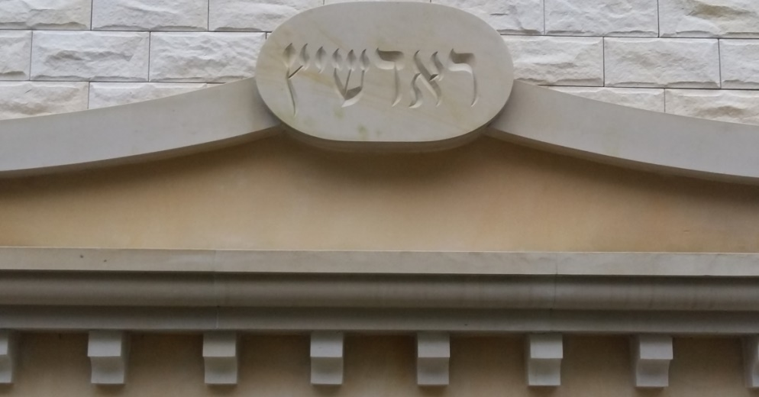
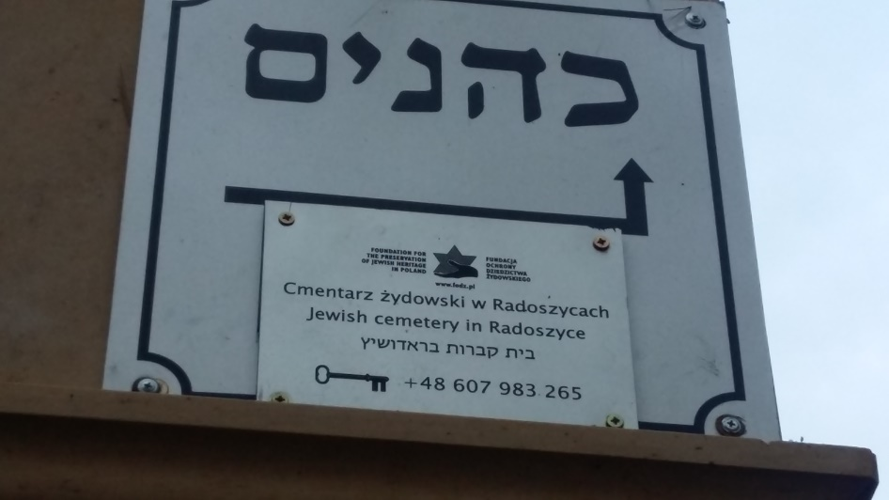
„Radoszyce”
„Ohel of the saint Hassid from Radoszyce”

Slide 7
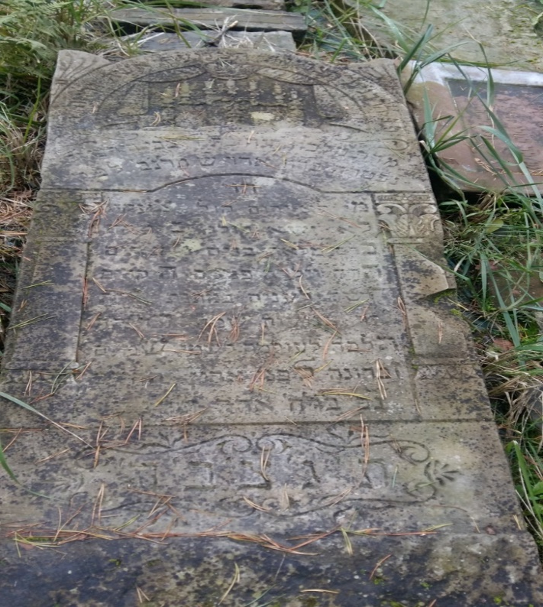
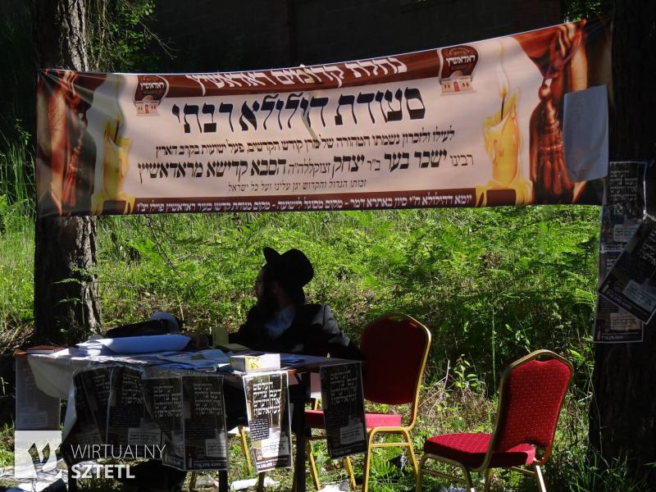
Every year, hundreds of Jews from all over the world come to Radoszyce to celebrate the „Jorcajt” festival. „Jorcajt” takes place on the tzadik’s death anniversary and Hasidim pray by his grave, because they belive that during the festival he takes their prayers, and they soon come true.

Slide 8
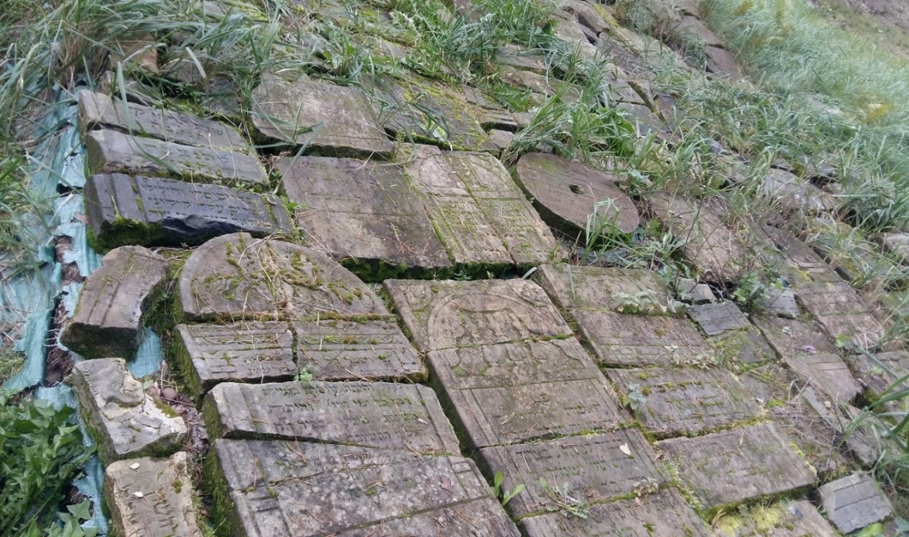
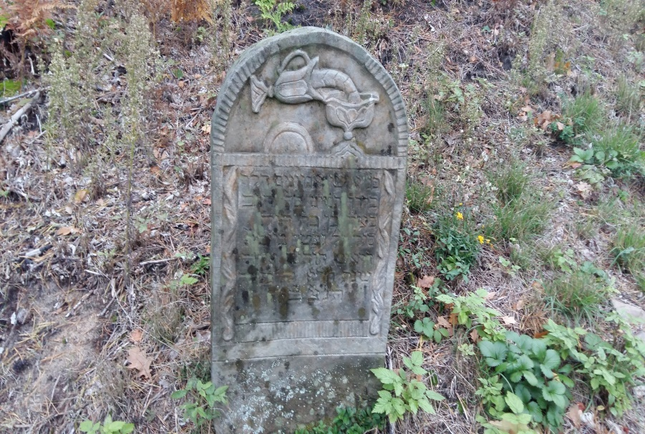

Slide 9
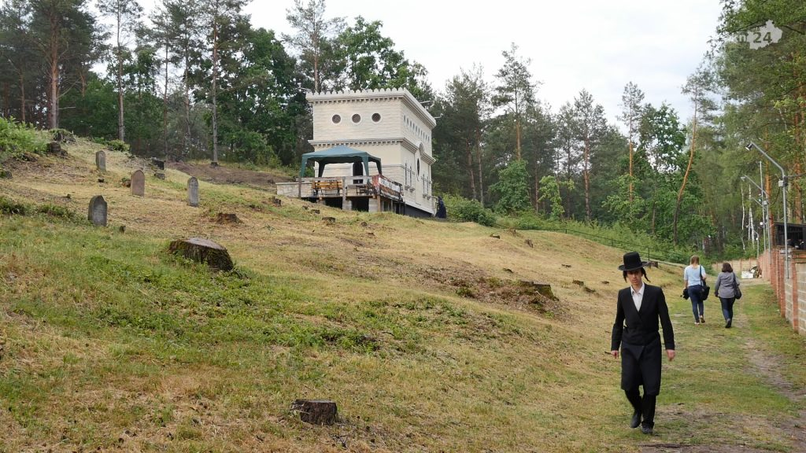
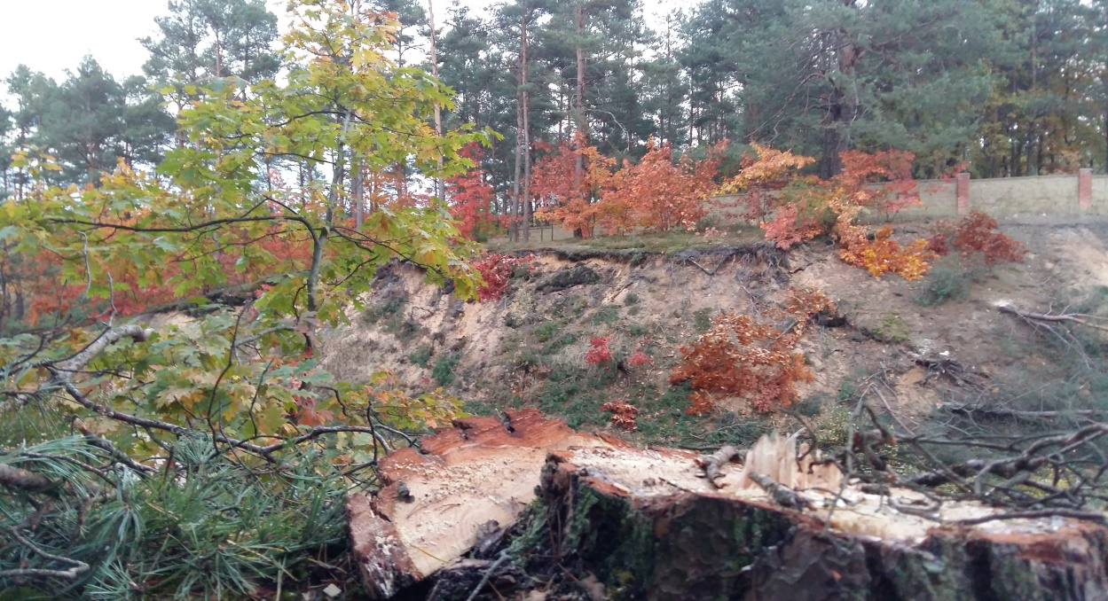
Representatives of the Jewish community in New York announced that in the area of the cemetery they will want to invest - in the hotel or a synagogue with accommodation places.

Slide 10
Project „Paths of Europe”- co-funded under the European Union Erasmus program
The publication reflects only the views of its authors and the European Commission and the National Agency of the Erasmus + Program are not responsible for its content.
Made by
Adam Pietrusiewicz

