Slide 1
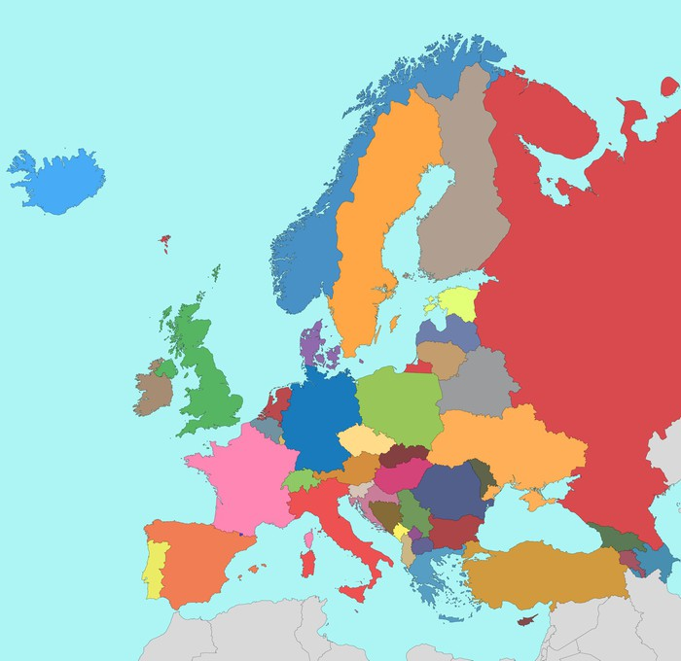
Cultural
routes
Of
europe
„Paths of Europe”

Slide 2
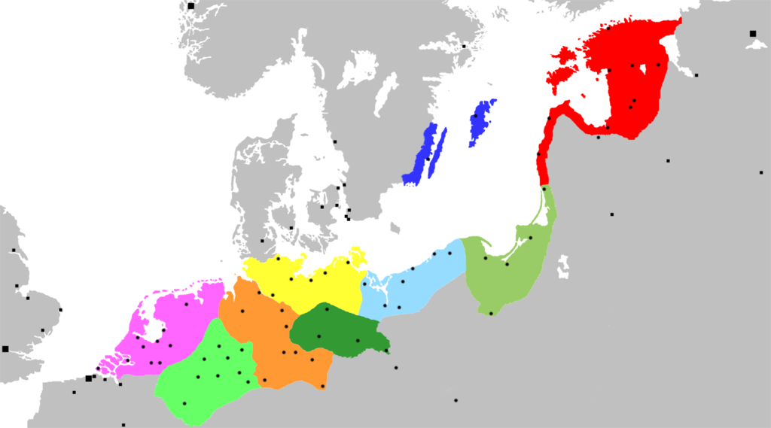
hanza
the Hanseatic League, the Hanseatic League (with the St.-Hans-Hans-German group) - solving contemporary problems. Cities belonging to this network that run a business can not run a business.

Slide 3
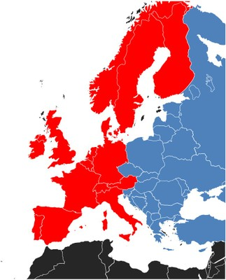
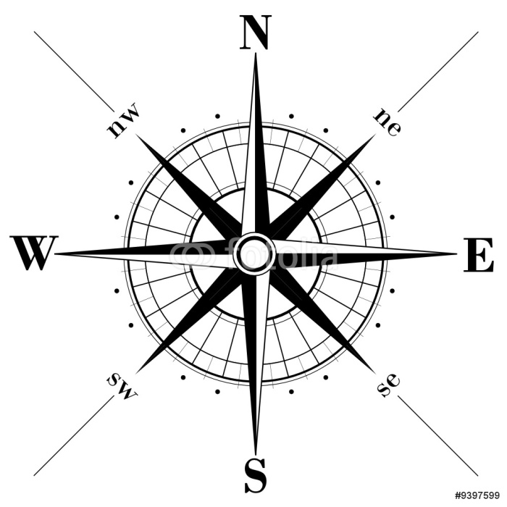
Hanza, as a bridge connecting the markets of western and eastern Europe,
excluded the extra-union competition in the region of the Baltic and North Sea.
Trading among others Flemish cloth, salt, fish, grain, wood, wax, wine.
Merchants wanting to stand out from the others, formed
social groups of patrician families.

Slide 4
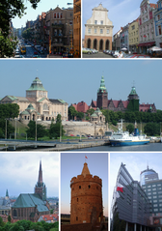
The largest economic union –
up to the time of the European Union - also united the common language,
Christian religion, legal system
and culture. Staying away from their home pages, the merchants spent their evenings talking fairy tales
(the protagonist of which was the merry and jester Sowizdrzał)
or reading poetry (often coarse),
liked the performances and songs of sailing.
Turzyn, Rynek Sienny, Wały Chrobrego, Archcathedral Basilica of St. Jacob, Baszta Panieńska, Pazim

Slide 5
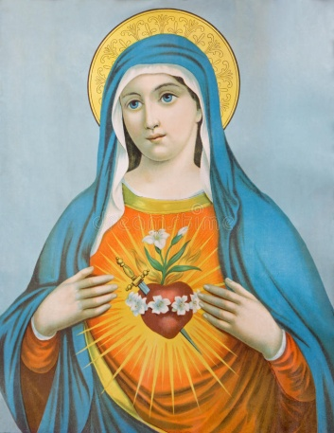
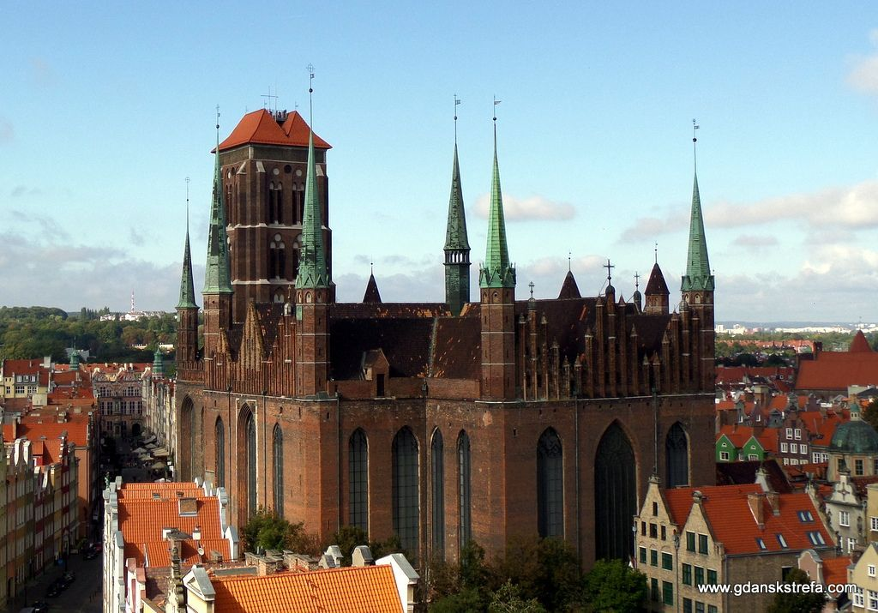
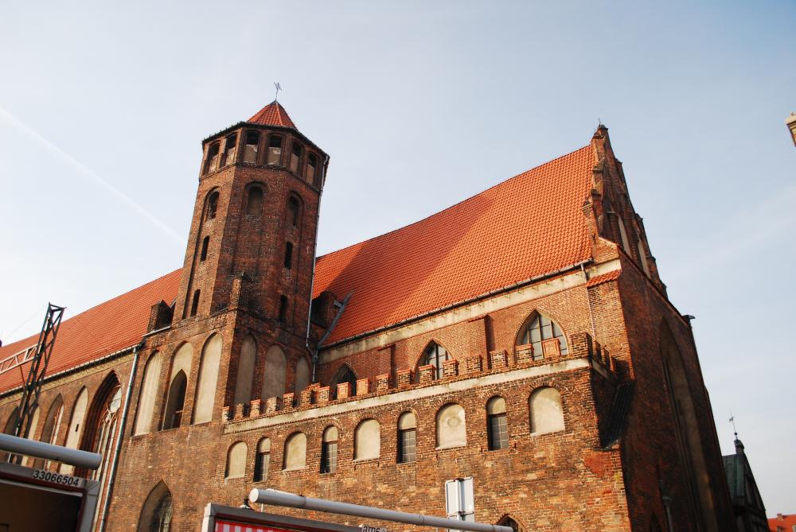
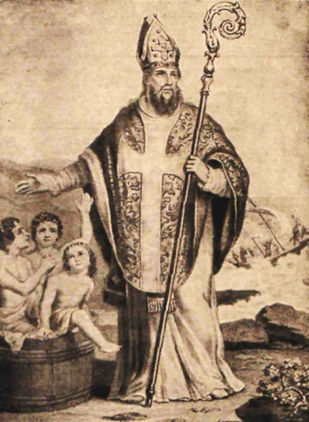
Cities located on the Hanseatic Trail can be recognized
from afar through the high towers of gothic cathedrals,
proving their rank.
Many temples have identical patrons:
the Virgin Mary (Marian churches)
St. Nicholas - the protector of merchants

Slide 6
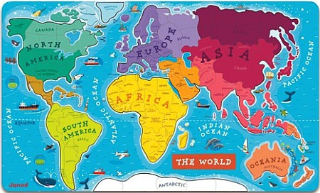
With time, however, the importance of this organization began to decline. The cities became more dependent on their monarchs, there were discrepancies between the interests of individual members, consumer reluctance
to high prices dictated by the league, and finally competition of
independent Dutch merchants led to the collapse of the organization.
In 1494, Hanseatic merchants were expelled from Novgorod. Ultimately, Hanza lost its position as a result of great geographical discoveries and the establishment of sea routes connecting Europe with America and India.

Slide 7
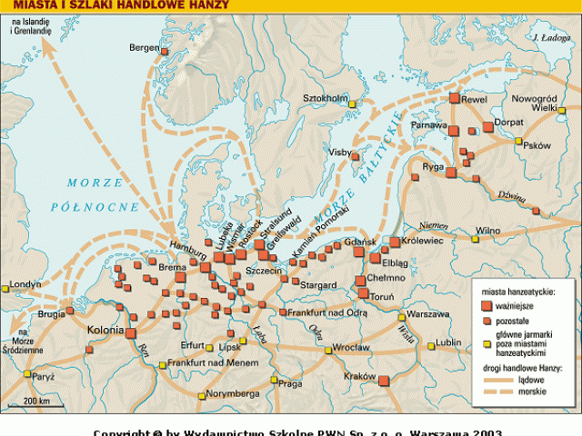
NEW HANZA
looking for twin cities in Northern Europe. Founder in 1980 in Dutch Zwolle. The New Hanza business goal has taken over the traditions of the medieval Hansa.

Slide 8
The New Hanza organizes annual conventions in one of the cities - members (Hansa Days). The most important organ of the Union is the Congress of Hanseatic Cities, in which delegates from each member city take part. Delegates have the right, among others to make changes to the statute, to exclude and accept members and to choose the Presidium. The Presidium of the Union includes: the president (always the mayor of Lübeck) and four members from at least three countries. Another organ of the Union is the Hansa Commission. It consists of representatives of 5 German cities and one representative from each Member State (currently, SŁupsk represents Polish cities).

Slide 9
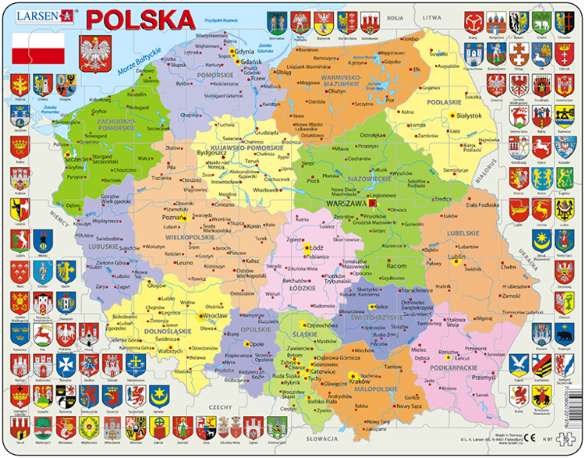
BIAŁOGRAD
BRANIEWO
CHEŁMNO
DARŁOWO
ELBLĄG
FROMBORK
GDAŃSK
GOLENIÓW
KOŁOBRZEG
KOSZALIN
KRAKÓW
KWIDZYN

Slide 10
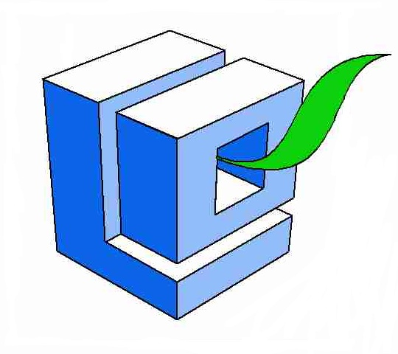
THANK YOU
FOR YOUR ATTENTION!
Natalia Krakowiak
and
Katarzyna Prasał

