Slide 1
„An interesting place
in our region”

Slide 2
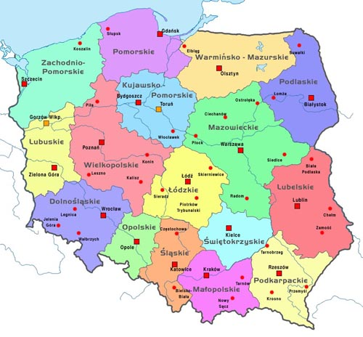
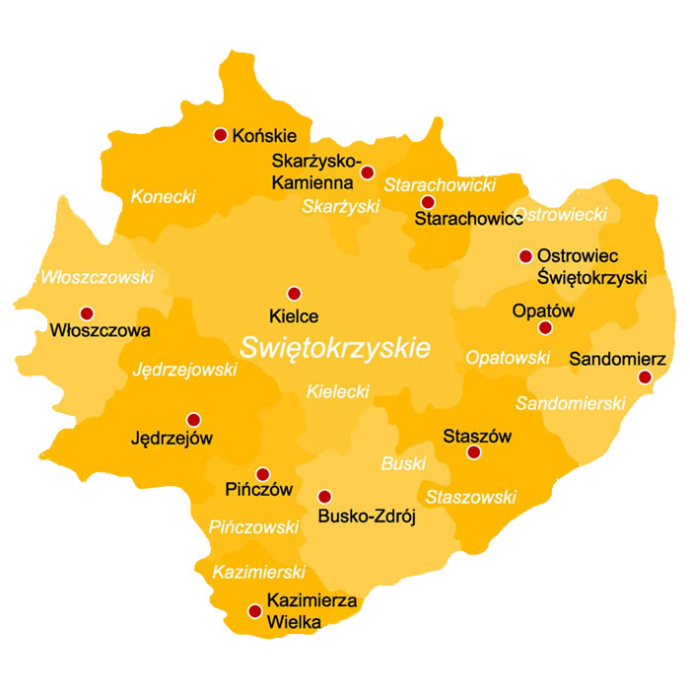
The symbol of our region is
A witch
We are
here!
Poland consists of 16 voivodeship.
Our region called
„Świętokrzyskie”
is one of them. It is located in the
middle-south of Poland. The capital of „Świętokrzyskie” is Kielce city.
We live in Końskie
near the Świętokrzyskie Moutains.
Although our region is small, in our opinion, there are many beautiful places.

Slide 3
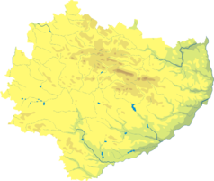
Jaskinia Raj
which is translated as “Paradise Cave” in English
is one of the most popular attraction
of Świętokrzyskie and it is also one of the most beautiful caves in our country.
Paradise Cave is located in Świętokrzystkie Moutains in the interior of a small Malik hill about
270 m high. It was explored in 1963
by Józef Kopeć and Feliks Wawrzeńczyk
Jaskinia Raj

Slide 4
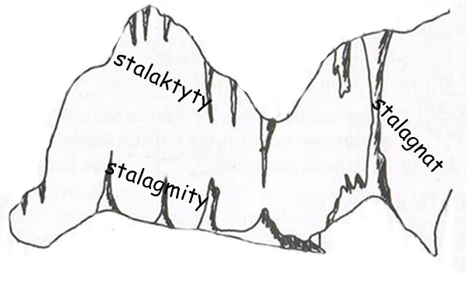
Paradise Cave is a typical cave developed in linestone.
It is quite small, but it has got impressive and well-preserved rosette.
The corridors of the cave was created over 360 millions years ago
at the bottom of the shallow sea, which was then there.
The development of the cave occurred in several stages,
mainly at the end of the Tertiary and Quaternary.
stalactites
stalagnates
stalagnites

Slide 5
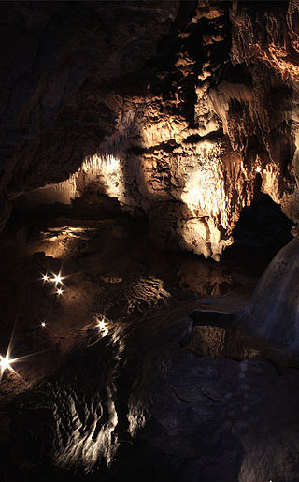
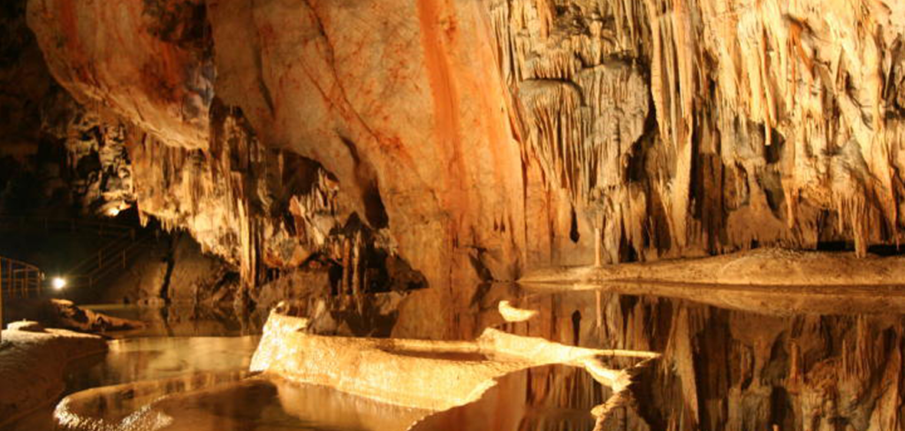
GOOD TO KNOW!
Since 1972 it has been available for tourists, but only under the guidance of a guide. The cave has got the horizontal development and you can visit it without any special abilities. The interior of the cave is electrically illuminated and completely adapted to group tours. The cave become an inanimate nature reserve and an archaeological site. Delights in the richness and variety of calcite stalactite forms. There are clusters of stalactites with a unique global density.

Slide 6
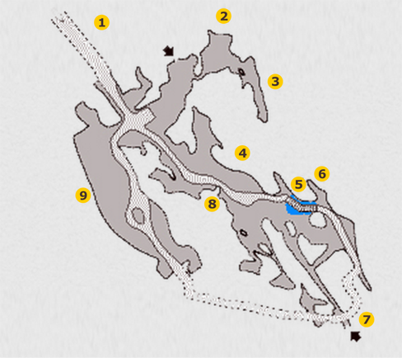
Way trough the cave
From the pavilion there is a large Preliminary Chamber 1 connecting three strings of cave passages.
At the top of the chamber there was an opening
where the explorers entered the cave.
Another - The Chamber of the Scrap 9 - is the largest chamber in the cave. There are enormous boulders that break away from the ceiling and later are covered with infiltration.
Next is an artificial tunnel, which is 40m long and goes to the Column Hall 6, where there are full of stalactites numerous fossilized corals in the walls, and the bottom covers lakes, nets and rice fields. A bridge leads to the Stalactite Hall 4 . There are hundreds of stalactites in various stages of development. Their number reaches over 200 pcs / m2. Another section of the cave is the High Hall 8 with a ceiling above the level of the pavement. As we proceed again, we get to the Preliminary Chamber 1 , closing the loop of the tourist route.

Slide 8
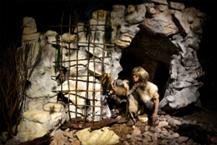
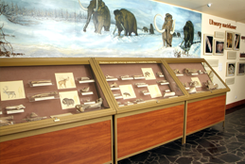
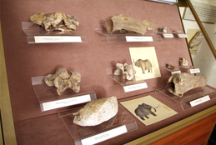
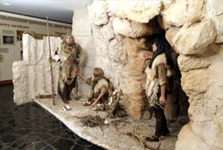
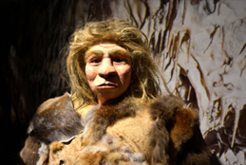
The length of the tourist route is 180 meters and starts in the pavilion, where a museum exhibition is organized which introduces tourists to karst. You can see the Neanthertal tool in the cave, which were used over 50,000 years ago as well as the remains of prehistoric animals. The Neanderthal camp has been reconstructed in three museums with three natural-sized figures.

Slide 9
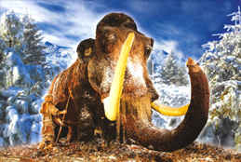
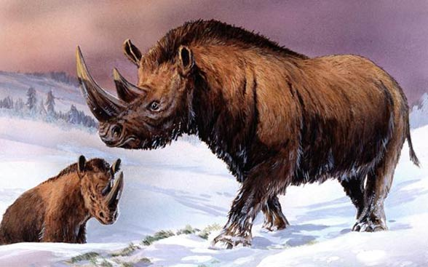
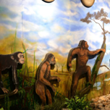
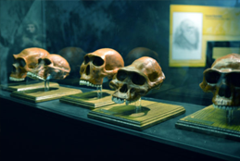
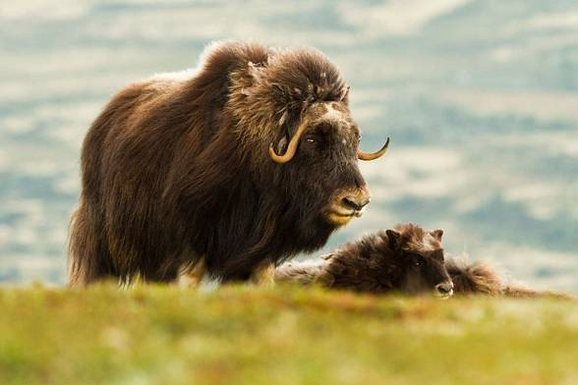
Who lived in
a cave?
There are no human remains found in cave deposits,
but the presence of large mammals such as :
cave and brown bear
mammoth
cave hyena
hairy rhino
muskrat
primitive bison
reindeer
horse
polar fox
There were also numerous remains of small vertebrates,
mainly rodents.

Slide 10
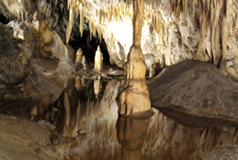
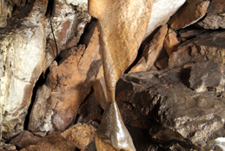
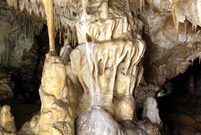
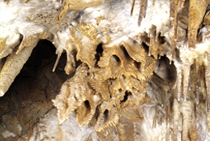
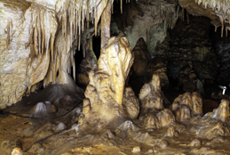
Interesting facts
The cave was discovered accidentally

Slide 11
Temperature inside the cave 8-10 ◦c
Humidity: over 95%
In the winter season,
Paradise Cave is a place of hibernation of bats,
mainly a “Large Bat”. In total there are 9 species
of those flying mammals.

Slide 12
„The cave paradise”
is the opposite of the poorer cave which is located near by and is called
„hell”

Slide 13
Cave in figures
Length of
natural cave corridors: 240m
Length of
the artificial pavement: 40m
Length of
the tour in the interior of the cave: 180m

Slide 14
THANK YOU
FOR YOUR ATTENTION!
Natalia Krakowiak
and
Katarzyna Prasał

