Slide 1
CAVE PARADISE

Slide 2
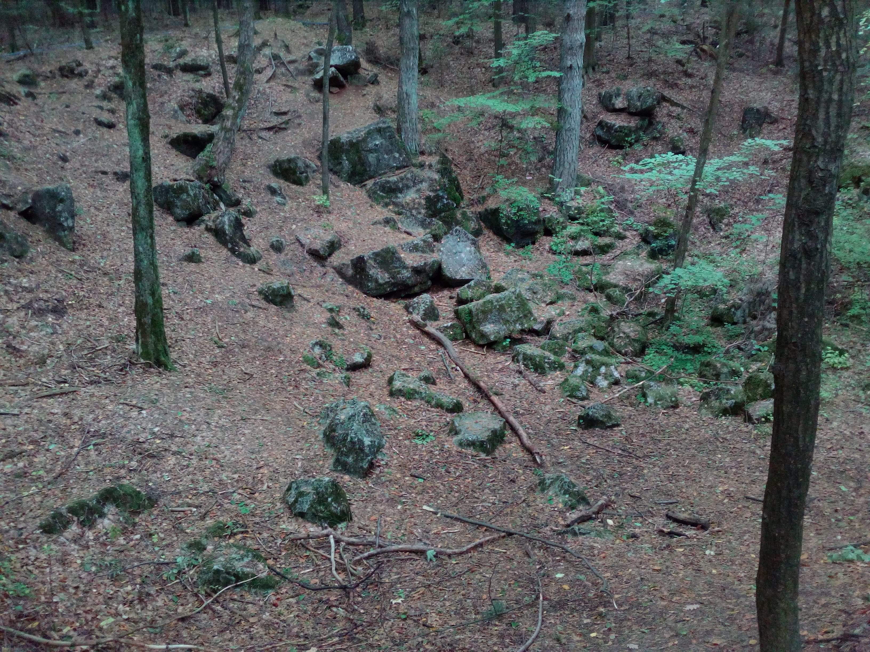
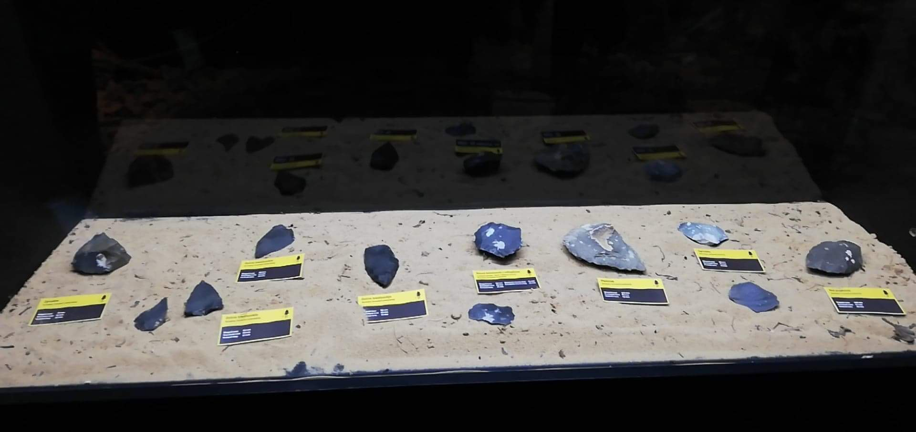
Driving by bus we could listen to
information about the
Paradise Cave
prepared by Agata and
Jessica.

Slide 3
CAVE PARADISE
We started by visiting the Paradise Cave. We divided into two groups . In the first group the guide's interpreter was Mrs. Jola, while in the second group Jacob translated. We found out a lot of interesting things about the cave for example that one centimetre of stalactite is formed over 100 years or we saw mosquitoes, flies, and spiders living in the cave. The guide also showed us many interesting forms shaped from stone. It was cold and dark in the cave, we also saw interesting exhibitions.

Slide 4
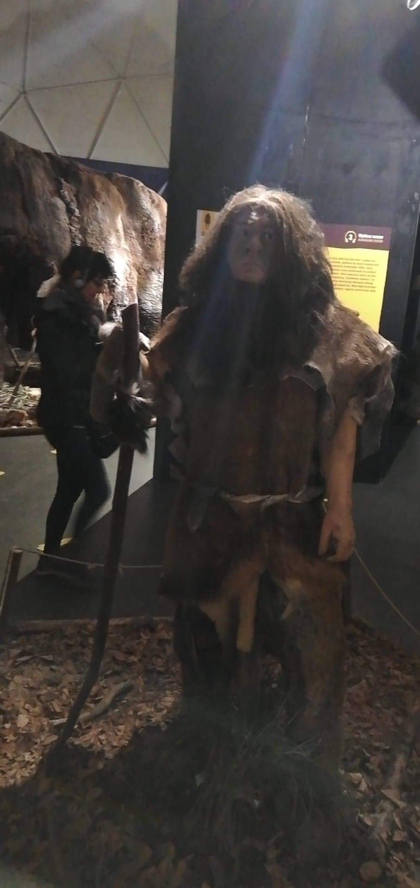
THE NEANDERTHAL CENTRE
After leaving the cave we went to visit the Neanderthal Centre. We received headphones and audio guide. There we could learn interesting information about our ancestors and first people.

Slide 5
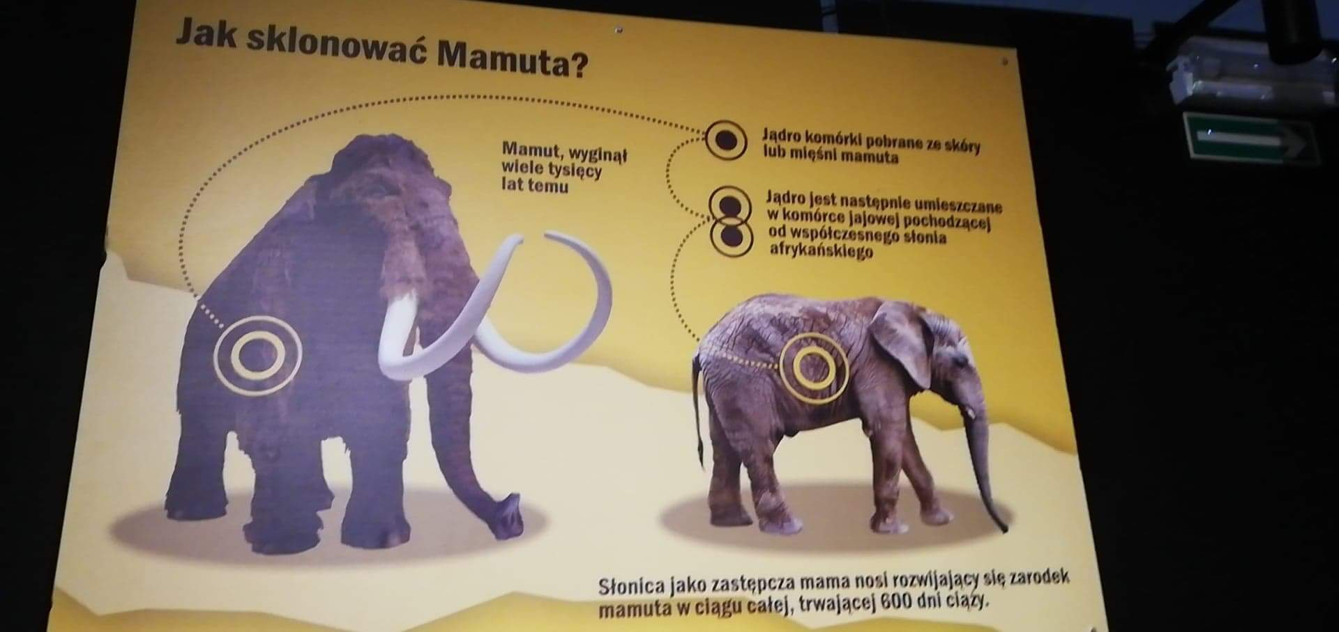
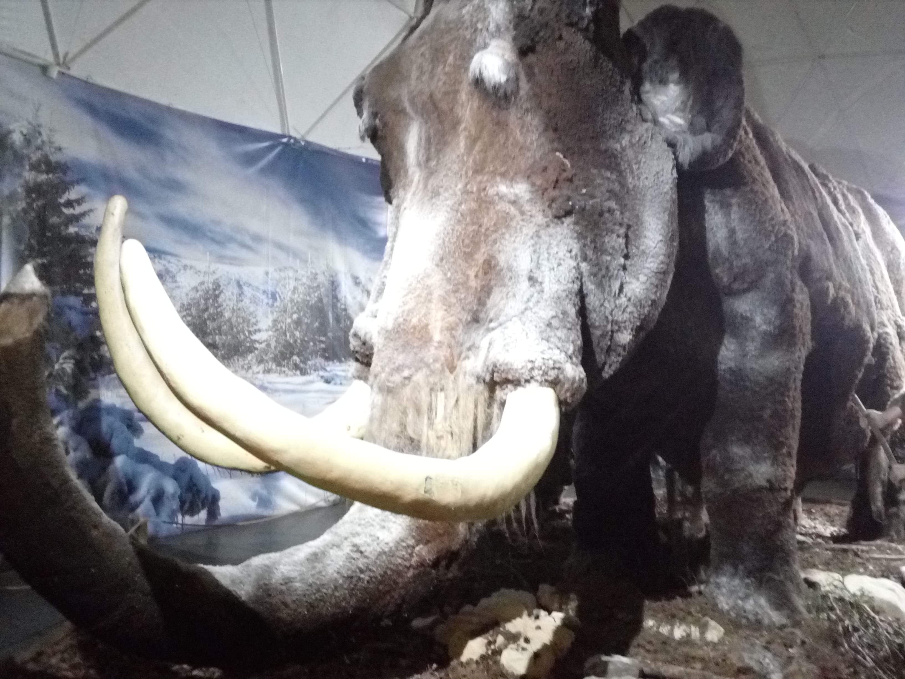
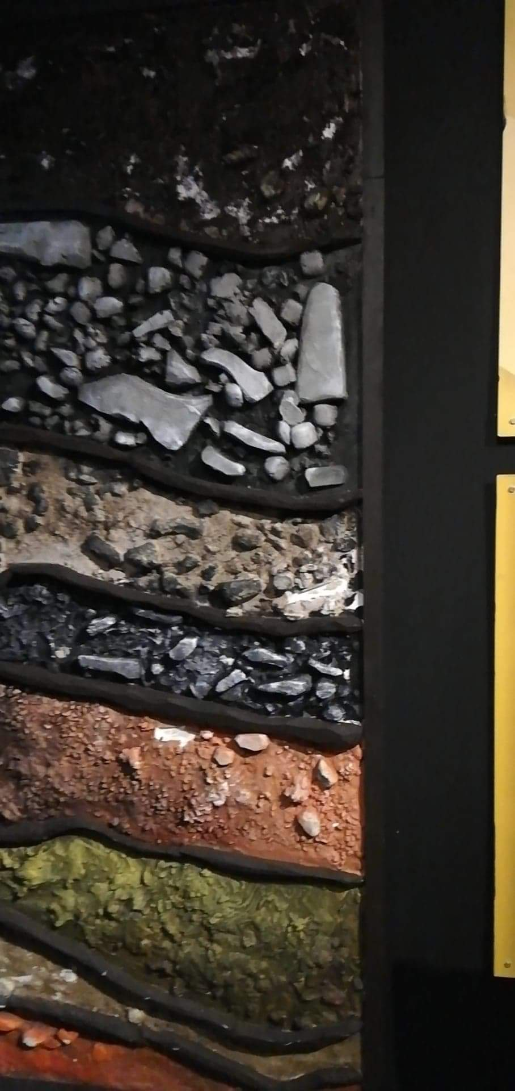
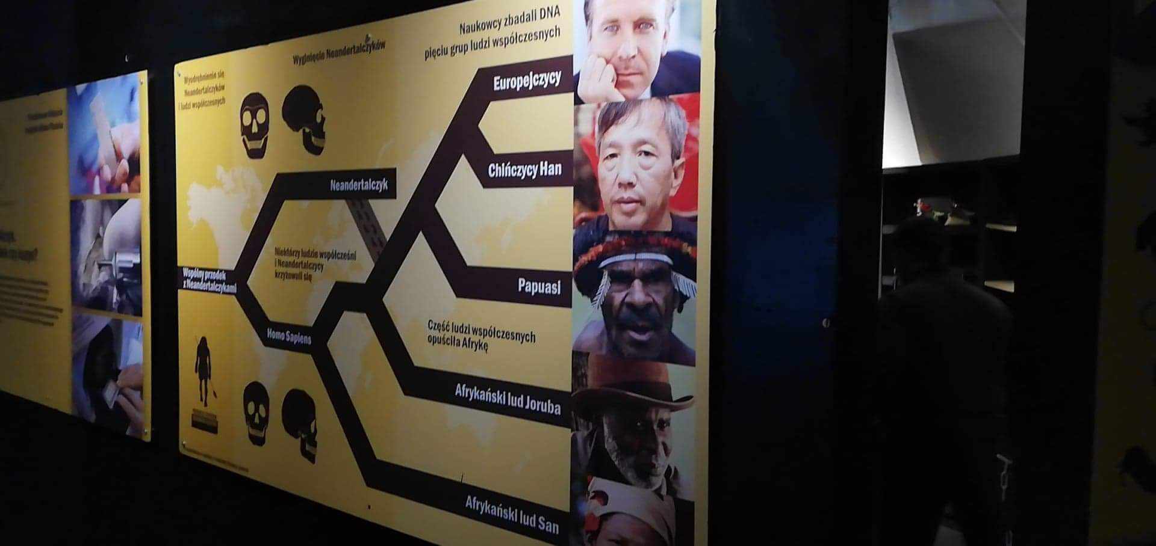

Slide 6
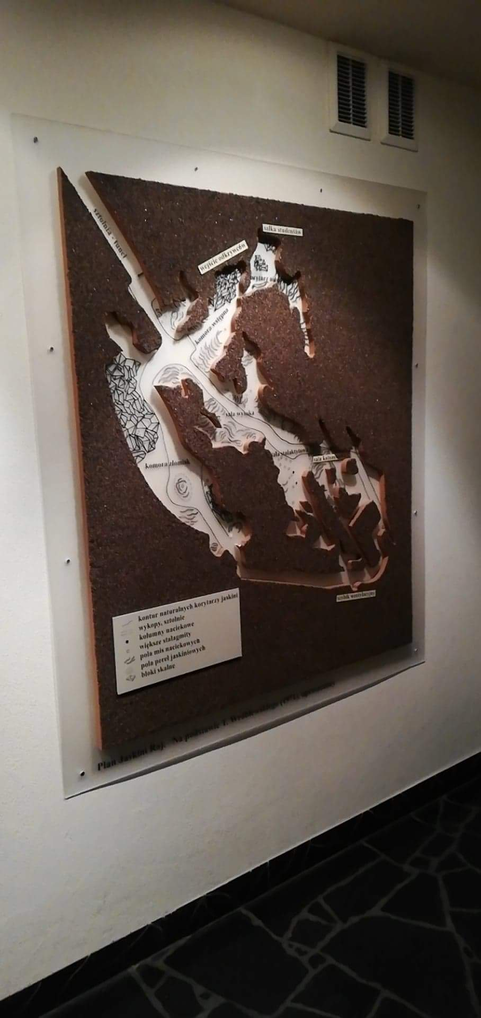
During the return to
Konskie we could hear interesting
information about the Swietokrzyskie Mountains prepared by Oliwia and Sandra and about Kielce prepared by Filip and Cuba.

