Slide 1
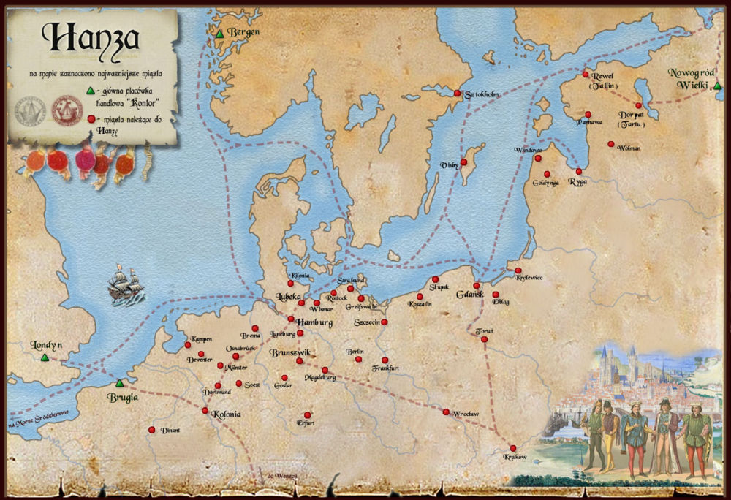
HANZA
HANZA is a union of northern European trade cities from the Middle Ages and the beginning of the modern era. Cities belonging to the union supported in the economic field, hindering the work of merchants from cities that were not part of the union, while at the same time creating real political and sometimes military force

Slide 2
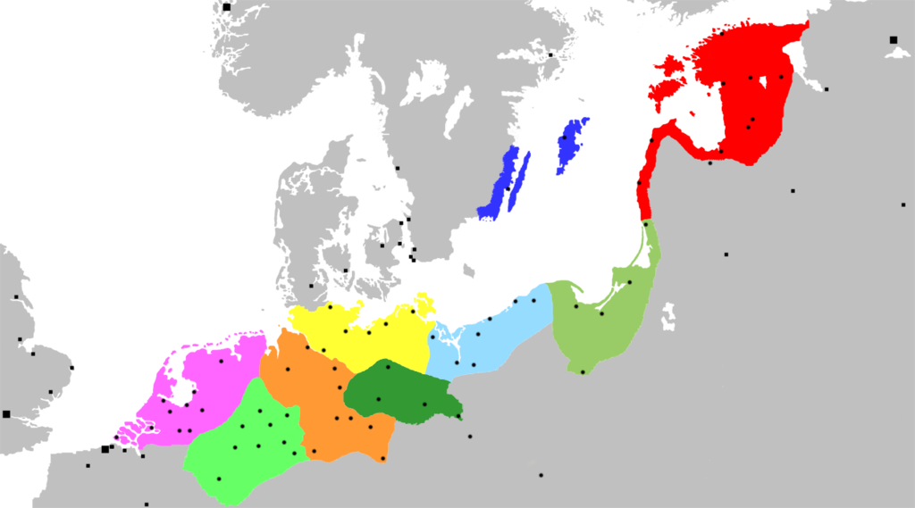
THE RANGE OF HANZA ABOUT 1400

Slide 3

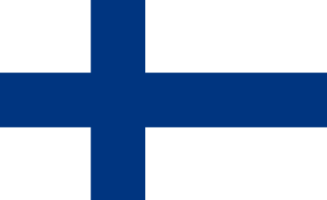

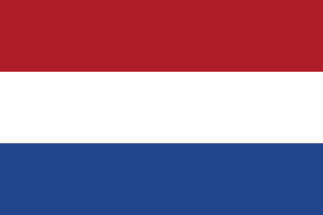

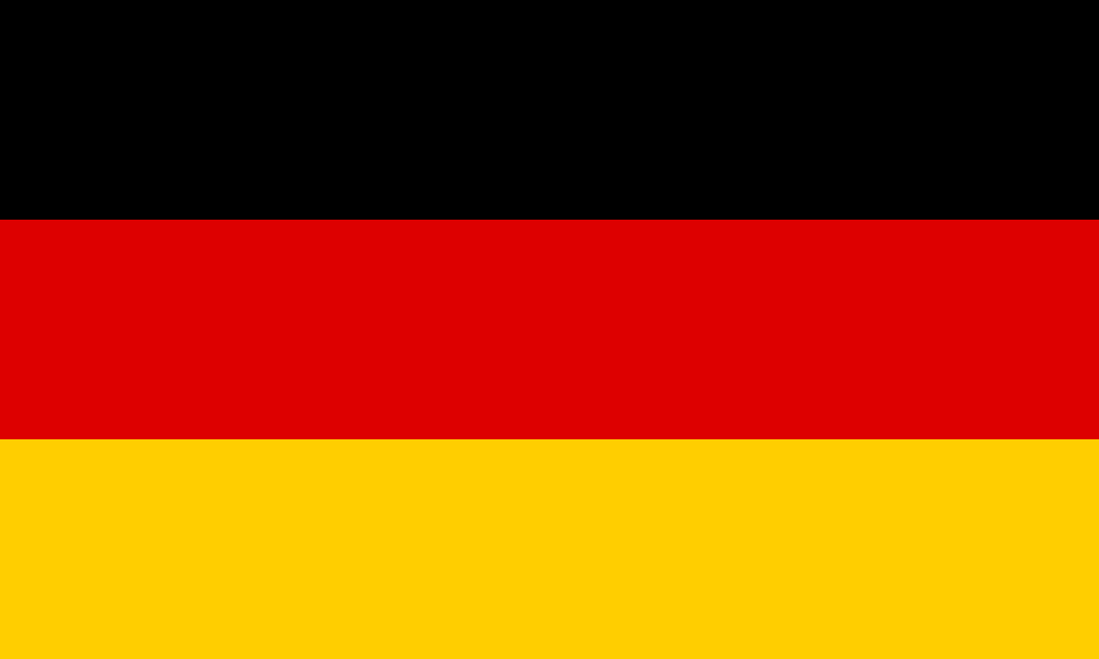
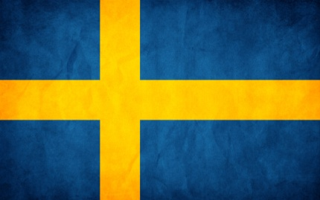
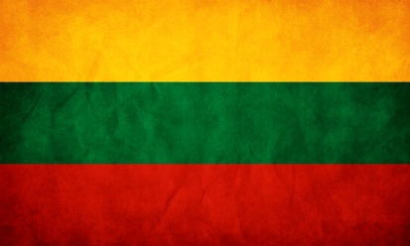
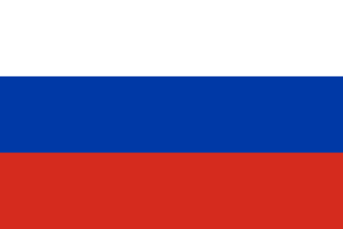

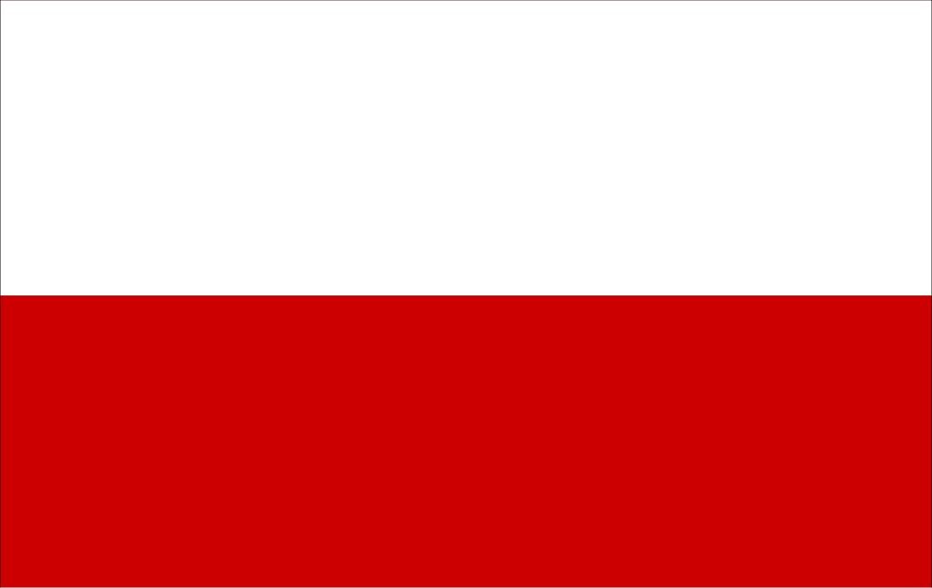
Currently, the Hanza Route runs through 11 European countries

Slide 4
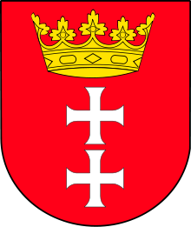
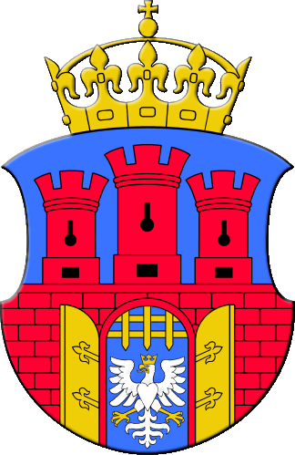
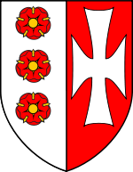
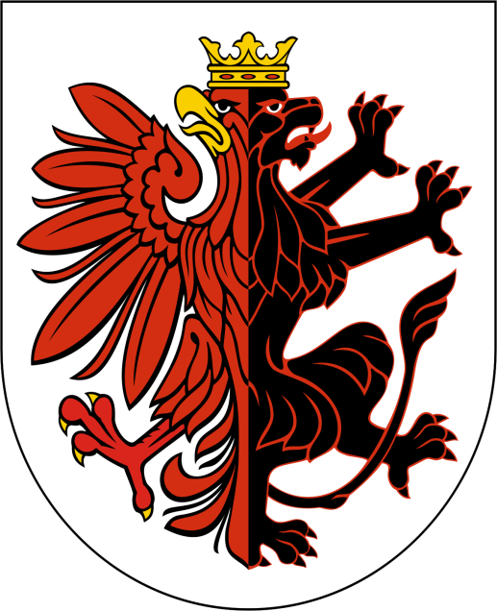
POLISH PART OF THE HANSA

Slide 5
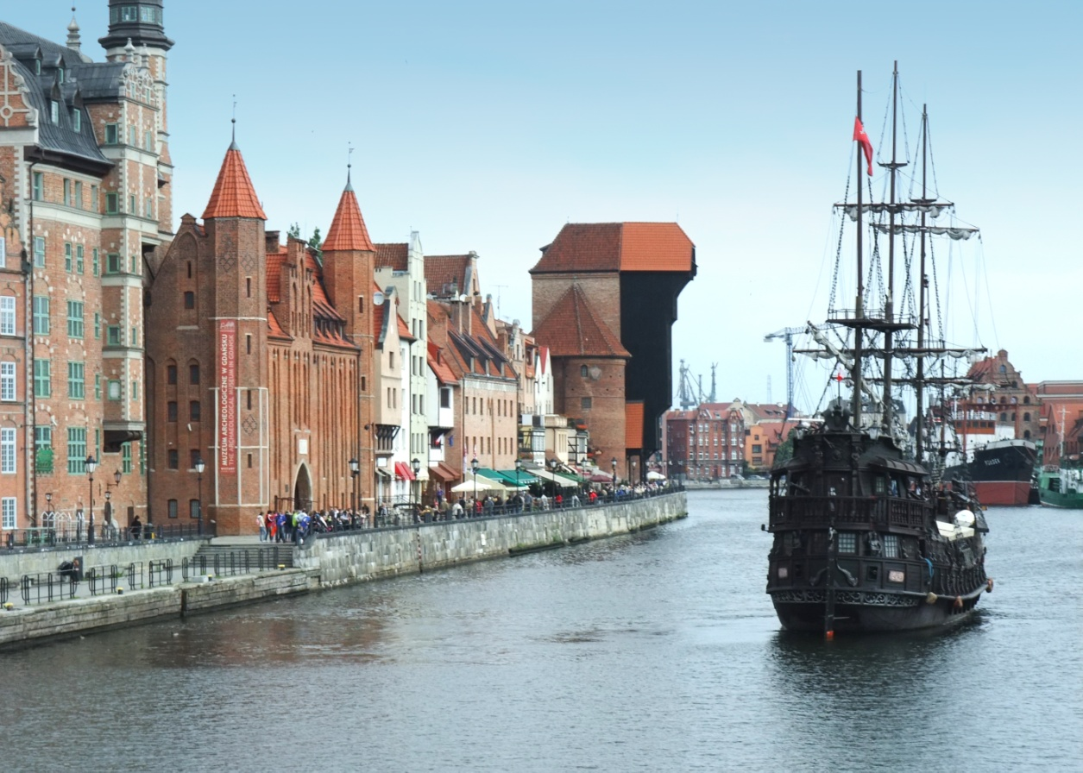
GDAŃSK
GDAŃSK was the largest of the Hanseatic cities in this part of Europe. Due to the favorable location at the intersection of north-south and east-south routes, it had a large commercial tradition dating back to early medieval times. The economic importance of the mouth of the Vistula forced Gdańsk to expand the city and create a port. This also resulted in an increase in Gdansk's activity and involvement in Hanseatic politics. Gdańsk was present at all Hanza conventions,

Slide 6
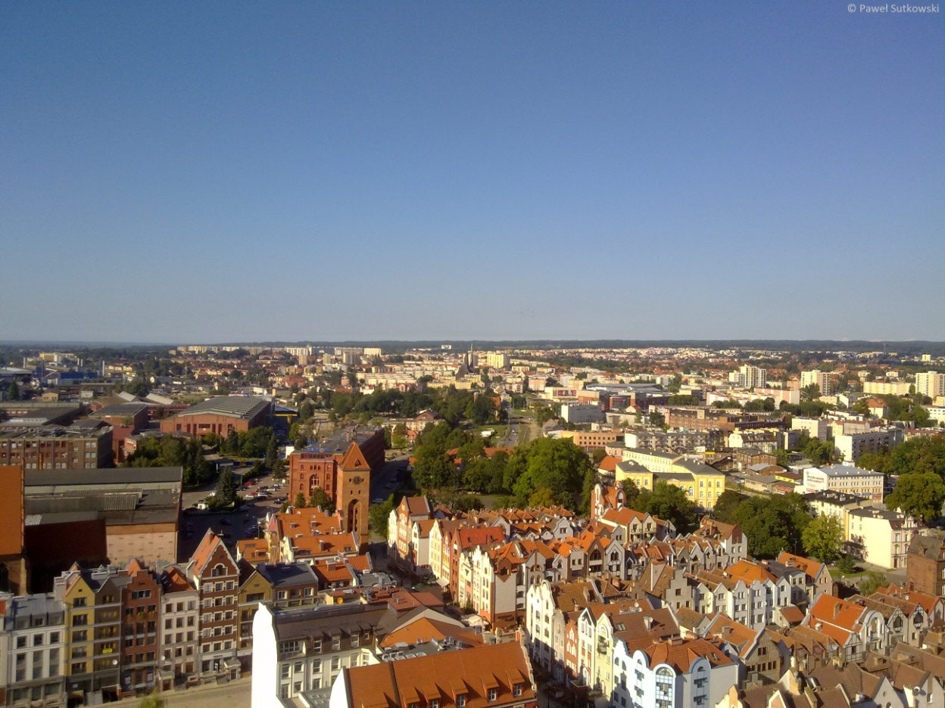
ELBLĄG
ELBLĄG is located in the Warmian-Masurian Voivodeship. It was founded in 1237. Elbląg is a center of heavy, food, furniture and tourist industry. The main attractions located within the city are old churches and cathedrals

Slide 7
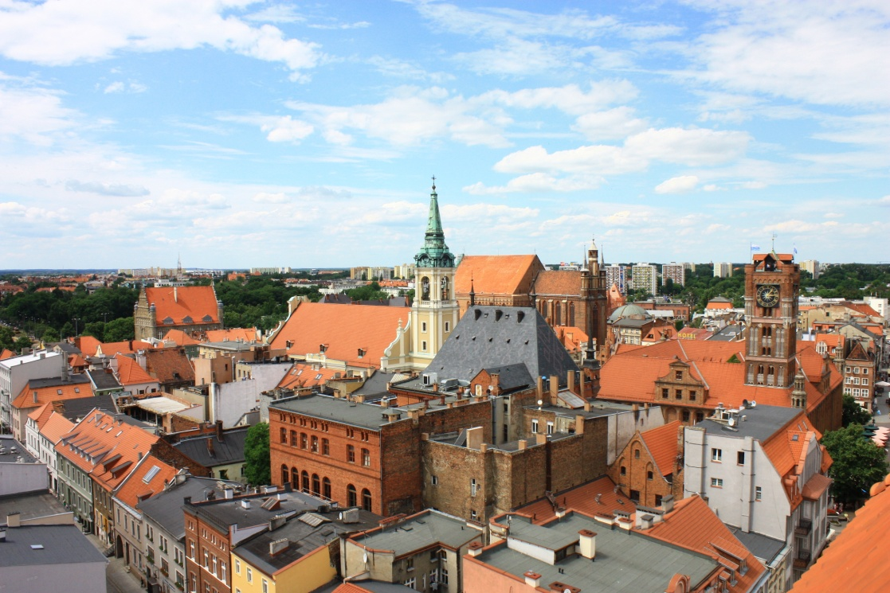
TORUŃ
TORUŃ has maritime traditions and its largest development of trade conducted by sea. The former size and prosperity of Toruń, its monumental and valuable gothic monuments and political significance were the result of such a geographical location. In the 13th and 14th centuries Toruń was the largest port connected with sea shipping in the territories of today's Poland. Already before 1280, he belonged to the Hanseatic League as one of its most important members, performing important functions. Through this port trade exchange of Prussian, Polish, Ruthenian and Hungarian lands with Western Europe took place.

Slide 8
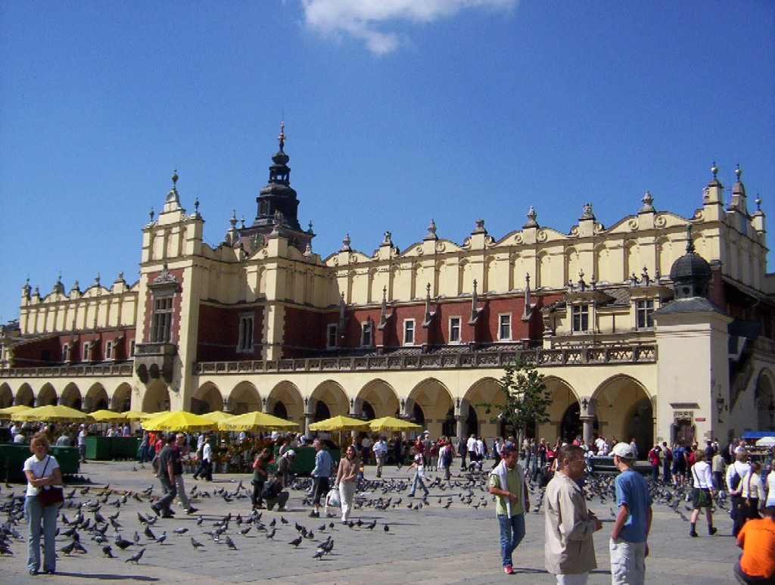
KRAKÓW
KRAKÓW is located in southern Poland. It is one of the largest cities in Poland. In this place there are 43 parks, which cover about 400 hectares and 5 nature reserves. We also have two spas here - Swoszawice and Mateczny. Unfortunately, Krakow is one of the most polluted cities in Poland. This city was the second capital of Poland. In the past, it belonged to the Hanseatic League, associating the most important shopping centers in Europe. There are many interesting places here that are noteworthy.

Slide 9
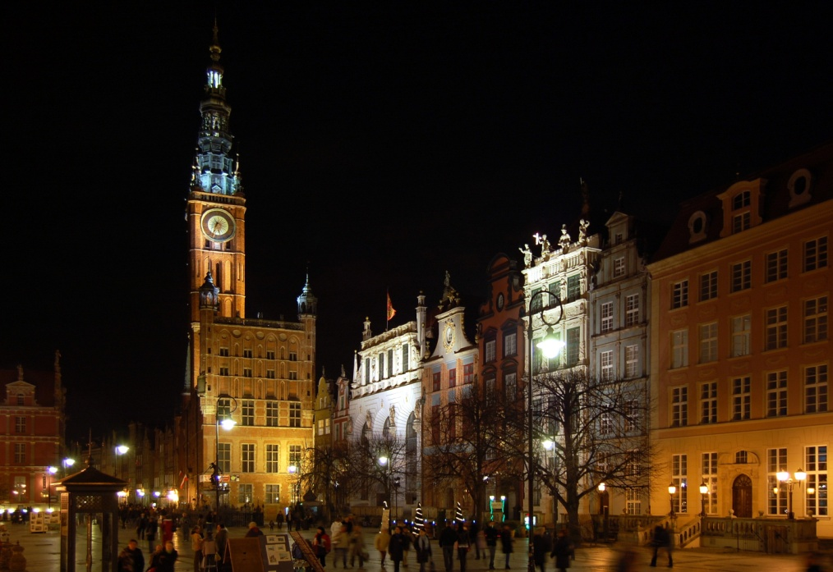
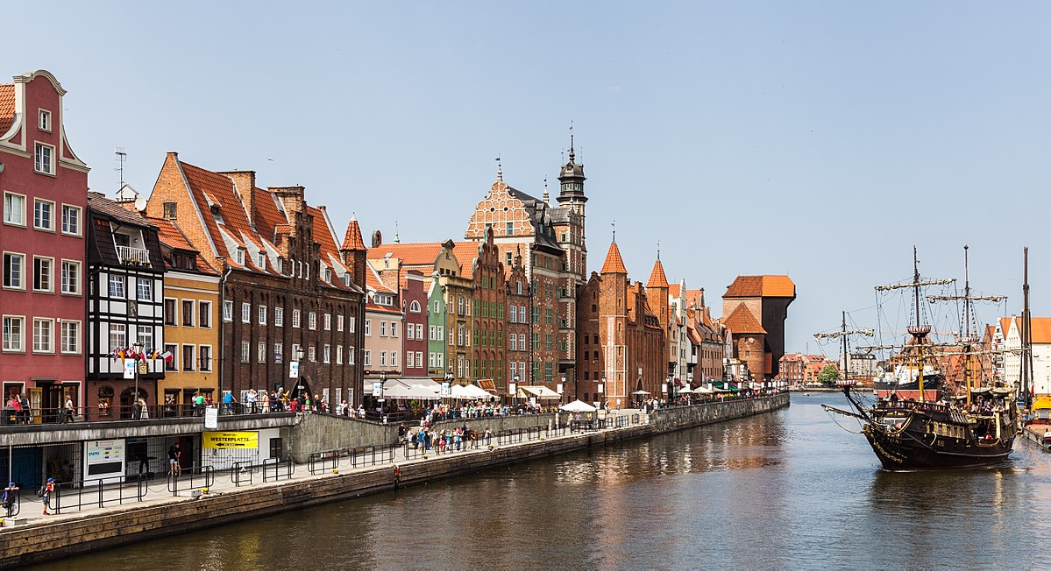
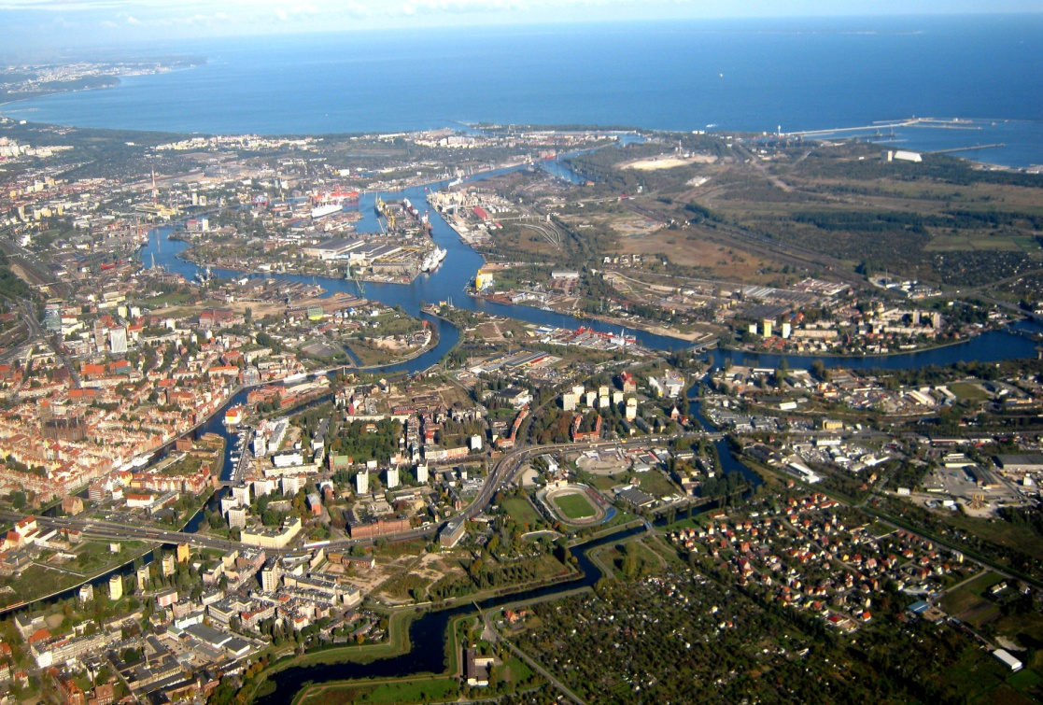
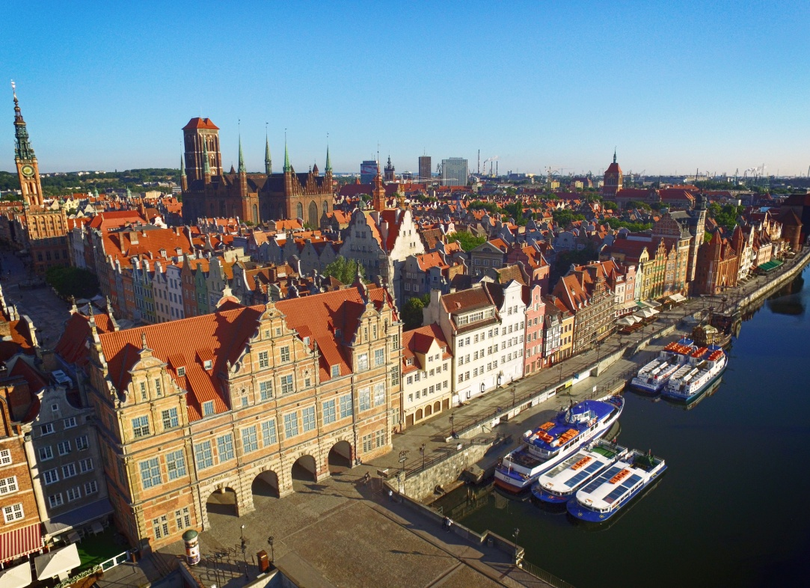
GDAŃSK

Slide 10
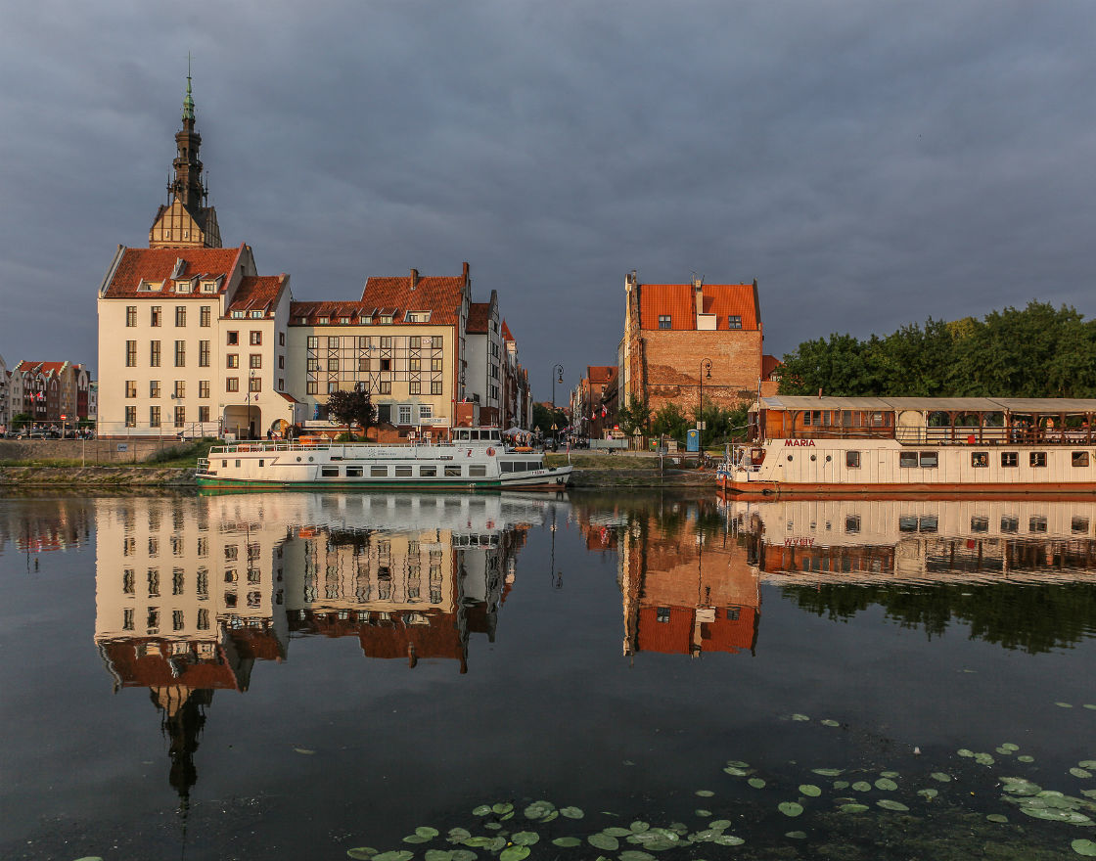
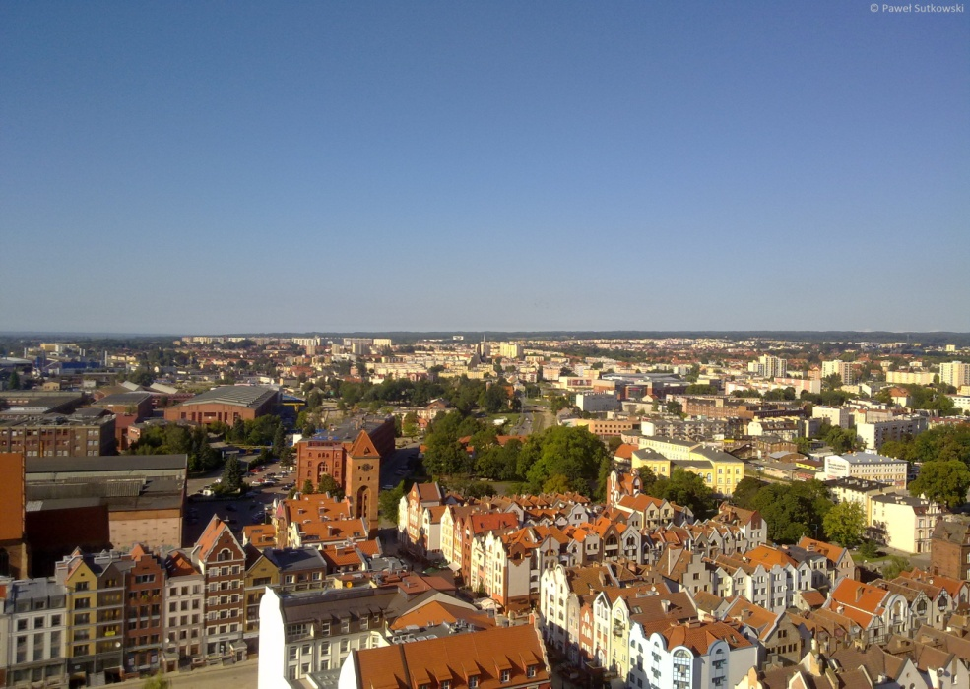
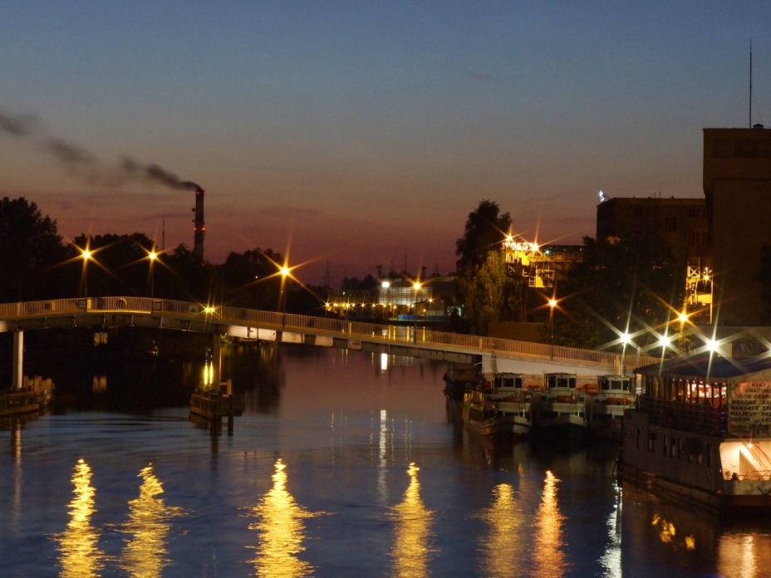
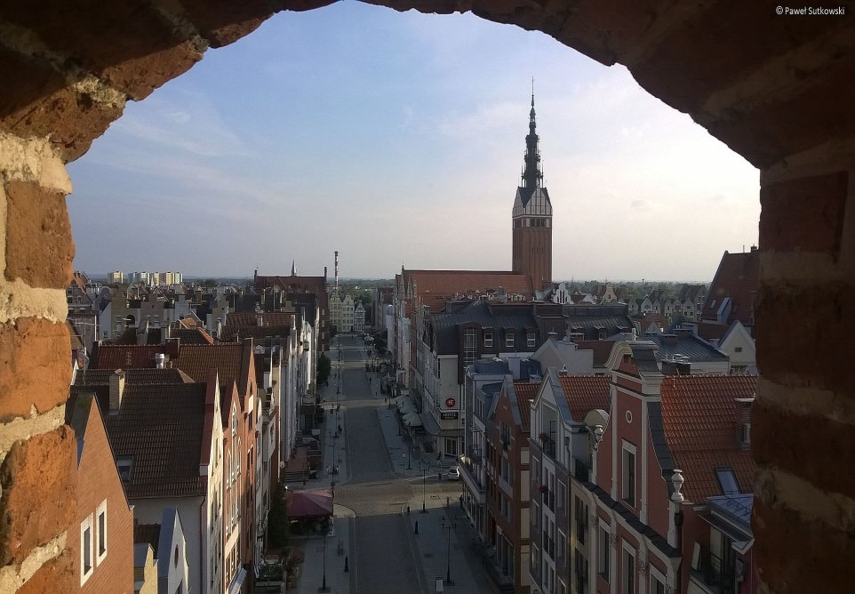
elbląg

Slide 11
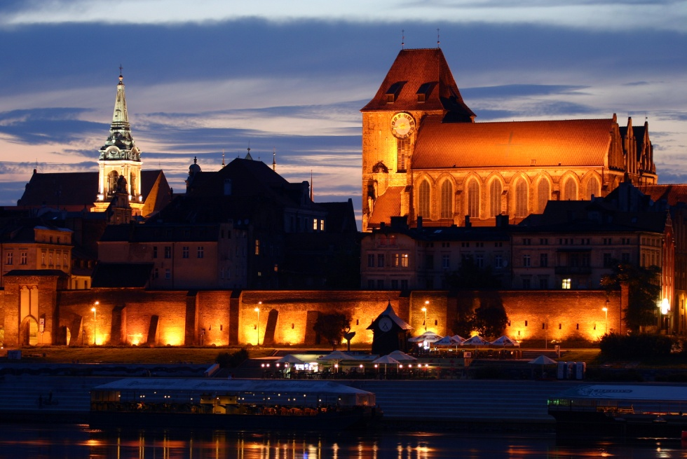
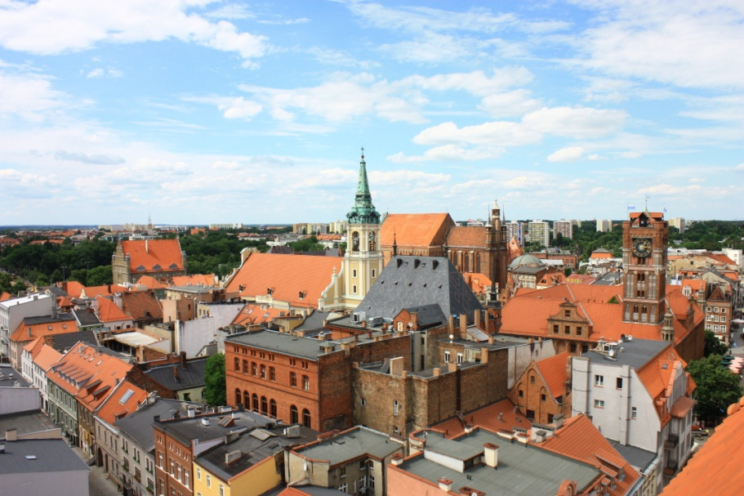
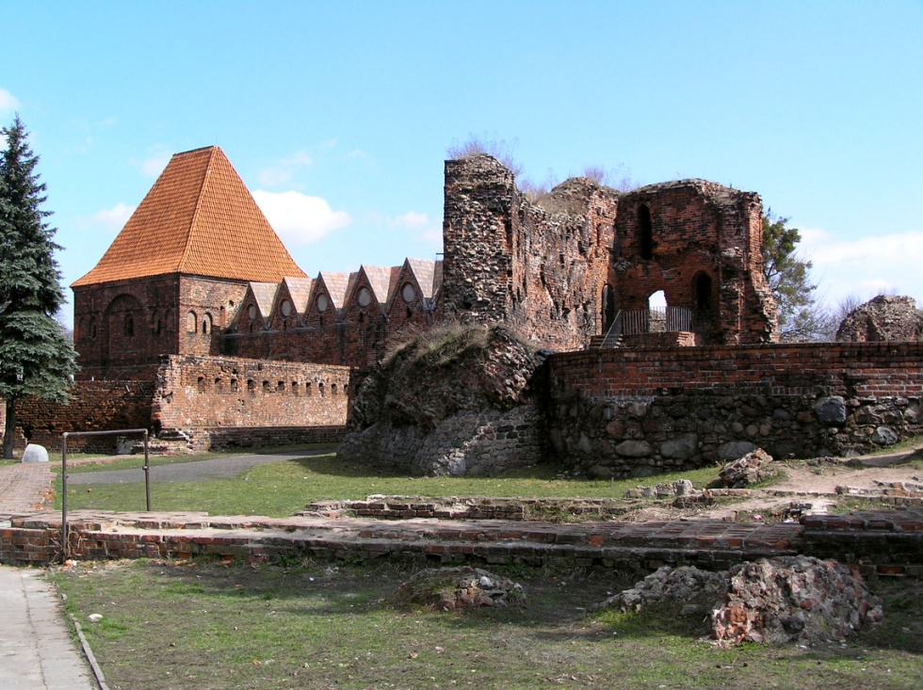
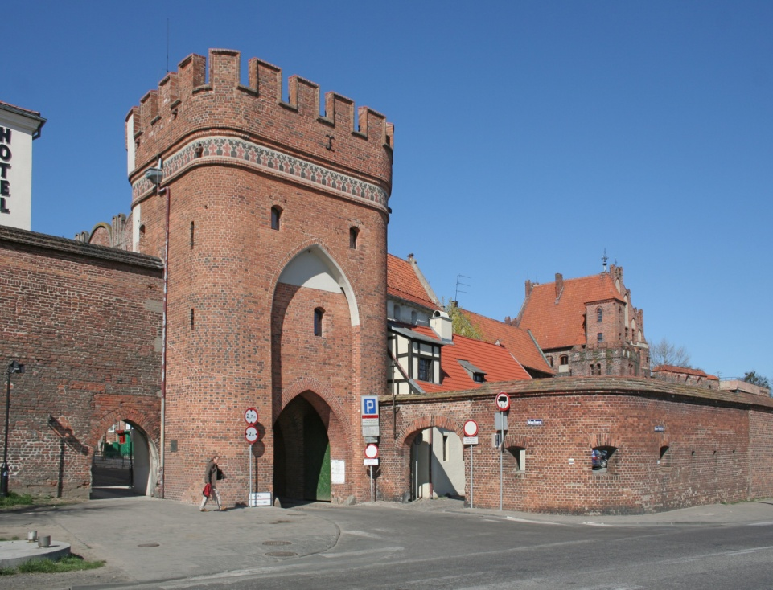
toruń

Slide 12
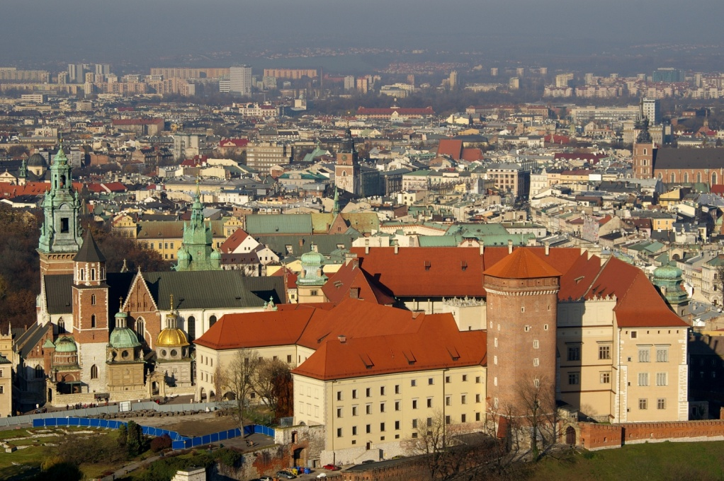
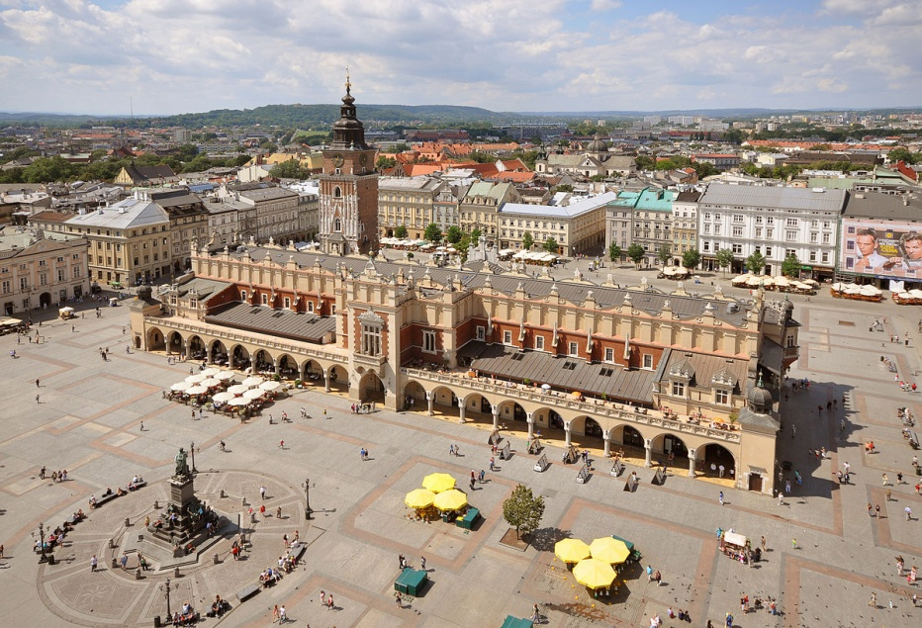

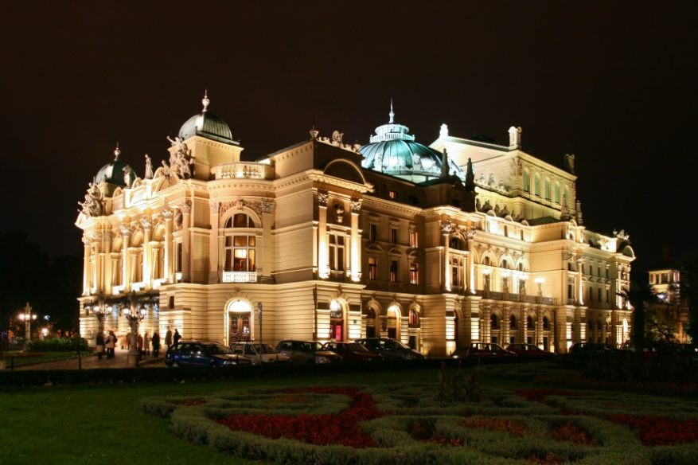
krAKÓW

Slide 13

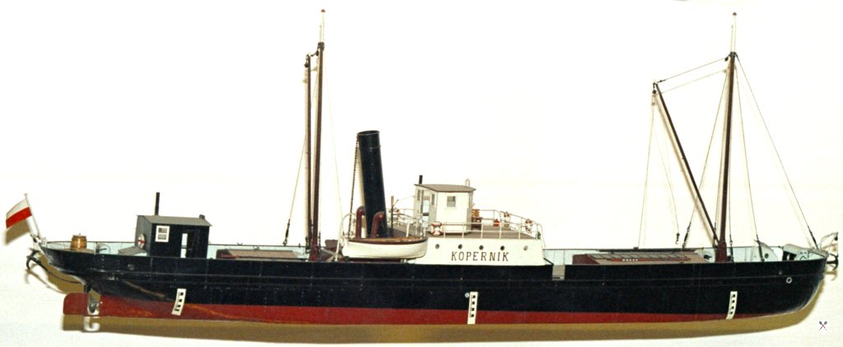

HOW TO BEAT THE HANSEATIC TRAIL?

Slide 14

AND WHAT ABOUT PEOPLE WITH DISABILITIES? DO THEY NOT HAVE THE OPPORTUNITY TO USE THESE ROUTES?

Slide 15
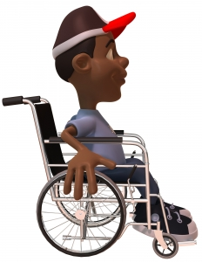

Well, no. Each of us can overcome this route. But why? Because Hanza covers only the city, where all facilities are easily accessible to everyone.

Slide 16



Project „Paths of Europe”- co-funded under the European Union Erasmus program
The publication reflects only the views of its authors and the European Commission and the National Agency of the Erasmus + Program are not responsible for its content.
Made by
Adam Pietrusiewicz
and
Monika Błaut

