Slide 1
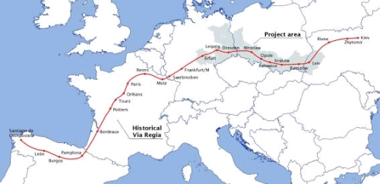
TRAIL VIA REGIA

Slide 2
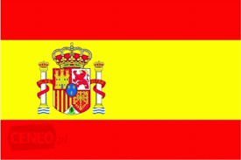
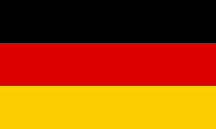
COUNTRIES
SPAIN
FRANCE
BELGUM
GERMANY
POLAND
UKRAINE

Slide 3
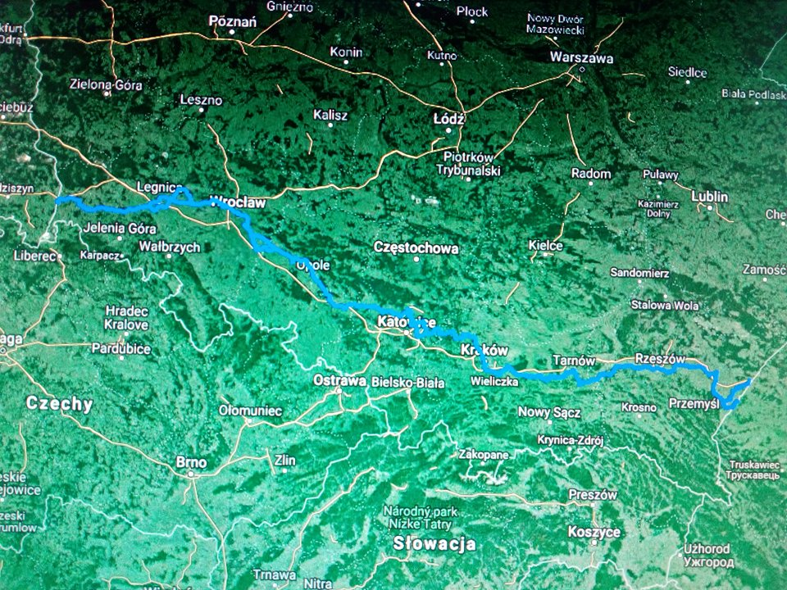
POLISH VIA REGIA TRAIL

Slide 4
Kraków, Ojców, Pieskowa Skała, Przegina, Olkusz, Bukowno
1. Kraków 2. Ojców
Royal Castle, Cathedral, Royal Tombs
Main market
St. Mary's Basilica
Church of St. Wojciech
Sanctuary of the Divine Mercy in Kraków-Łagiewniki 3. Pieskowa Skała
Pieskowa Skała Castle
Hercules's mace 4. Przegina
5. Olkusz 6. Bukowno
Basilica of St. Andrew the Apostle (Rynek)
Regional Museum PTTK (Rynek, building "Batorówka")
Museum of Olkuska Land Fire Stefan Ząbczyński (Floriańska 5 Street)
The Africanist Museum (34 Szpitalna Street)
Baszta (Basztowa St.)
Tomb of Francesco Nullo (cemetery at Kazimierza Wielkiego Street)
Monument to Poles fighting in Italy (cemetery at Kazimierza Wielkiego Street)

Slide 5
Sławków, Sosnowiec Maczki, Gołonóg, Trójkąt 3 cesarzy
1.Sławków
Chapel. St. James
Church of St. Cross
The ruins of the Krakow bishops' castle
The cemetery
Inn "Austeria" (former colloquial name: "Pierwocha") 2. Sosnowiec Maczki
Church of the Apostles Peter and Paul (Sosnowiec Maczki, Skwerowa 19 street)
Sosnowiec Maczki railway station (ruined ..)
Church of the Holy Body and Blood of Christ (Sosnowiec Kazimierz, Armii Krajowej St.) 3. Gołonóg
Sanctuary of Saint. Antoni Padewski (20 Kościelna St.) 4. Trójkąt 3 cesarzy

Slide 6
Góra Zamkowa, Góra Św. Doroty, Czeladź, Grodziec
1.Góra Zamkowa
A fortified castle from the 14th century
Church of St. Trinity
A Jewish cemetery from the 19th century
Church. St. Thomas from Canterbury
House of Prayers in the Cukerman's Gate
2. Góra Św. Doroty
Historic church of Saint. Dorothy 3. Czeladź
Będzin Syberka, Sanctuary of the Golgotha ​​of the East (on the route towards Czeladź)
The cemetery 4. Grodziec
Church of St. catherine
Ciechanowski Palace
Ruins of Grodziec cement plant

Slide 7
Rogoźnik, Sączów, Piekary Śląskie
1. Rogoźnik 2. Sączków
Church of St. James the Apostle (1 Szkolna St.) 3. Piekary Śląskie
Basilica of St. Mary and St. Bartholomew
Kalwaria Piekarska

Slide 8
Possible route to travel is: infantry.
Disabled people can use the trail.
There are no restrictions on the route.
The owner of the trail is the national management
During this time, new cities were also built - Lwówek Śl., Złotoryja, Środa Śl., Legnica and Lubań have the oldest municipal rights in Poland today. Via Regia did not have one pre-determined course - it was rather a "communication corridor", changing depending on political conditions, floods, rising and burning inns
Also other activities around Via Regia (such as the association of cities "On a trade route" or the longest Polish A4 motorway) have a chance to show how this Road is High. And above all - still alive.

Slide 9
PRACE WYKONAŁY: Jessica Sutowicz Agata Ciołkiewicz
Projekt „Paths of Europe”- współfinansowany w ramach programu Unii Europejskiej Erasmus+
„Publikacja odzwierciedla jedynie stanowisko jej autorów i Komisja Europejska oraz Narodowa Agencja Programu Erasmus+ nie ponoszą odpowiedzialności za jej zawartość merytoryczną”.

