Slide 1
KOŃSKIE
small town with rich
interior and interesting
surroundings

Slide 2
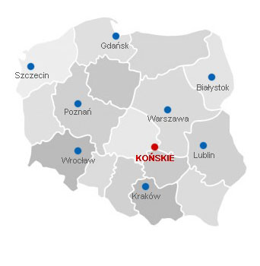
What should you know about Końskie?
Końskie is located in southern Poland, in Świętokrzyskie voivodeship
19 774 people live in Końskie
The Końskie’s surface is 34,7 km²
Końskie is also city of sport
Końskie isn’t a big city, but it has several schools with high levels

Slide 3
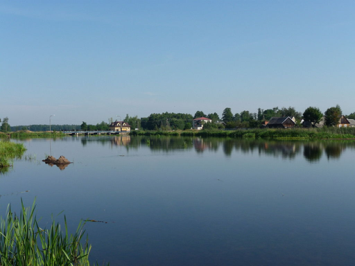
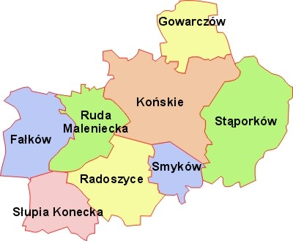
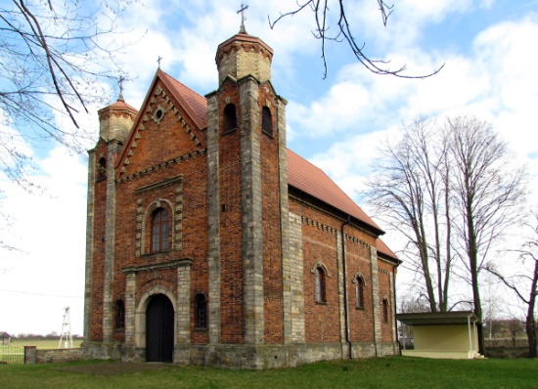
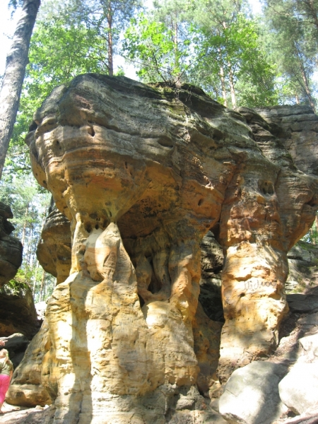
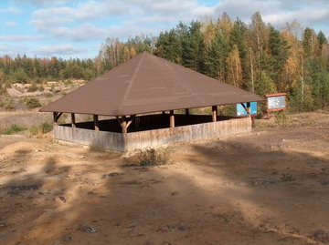
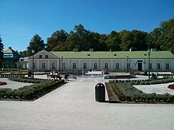
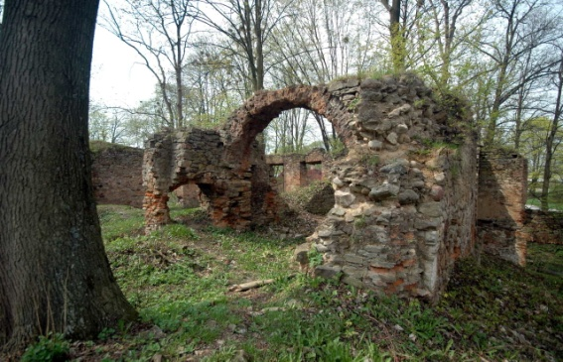
But the most important thing is that we have many beautiful places

Slide 4
WELCOME TO THE GAGATY SOŁTYKOWSKIE

Slide 5
What is Gagaty Sołtykowskie?
Gagaty Sołtykowskie is an inanimate nature reserve which is located in the north-western part of Świętokrzyskie Mountains. The landscape of the park resembles the volcanic surface of the moon, where we can see the uncovered trails of inhabitants of the Jurassic Park before 200 milllion years ago

Slide 6
LOCATION

Slide 7
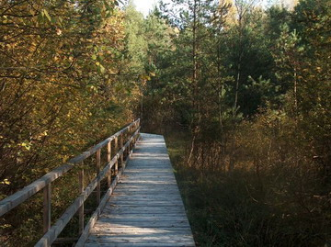
MOON LANDSCAPE
In the reserve we can find syderyty. The color of the mudstone rocks and the iron compounds contained therein tinted the whole reserve is red. Thanks to this, we can admire unusual landscape to the illusion resembling the landscape of the surface of the moon. There are also black amber which were used to make jewellery

Slide 8
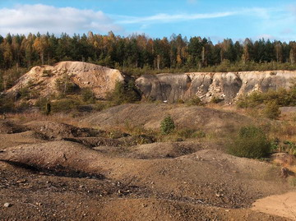
DINOPARK
The dinosaur tropics that lived there 200 million years ago have been discovered in the reserve. One of them is the largest footprint of dinosaur in Poland which is over 60cm in lenght. The second is the remains of the oldest and largest herbivorous dinosaur.

Slide 9
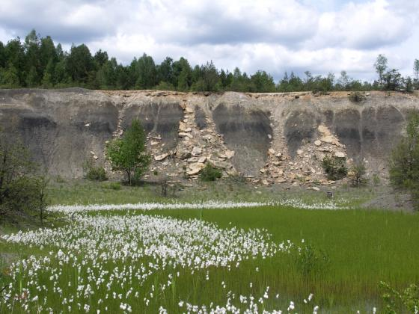

Slide 10
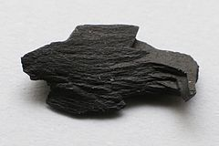
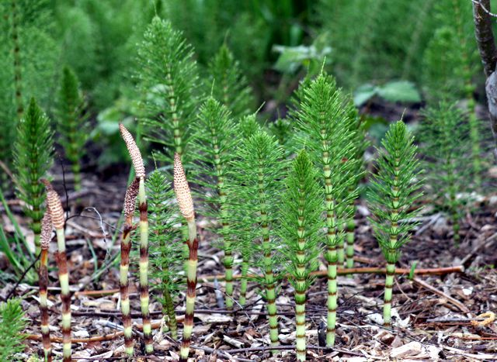
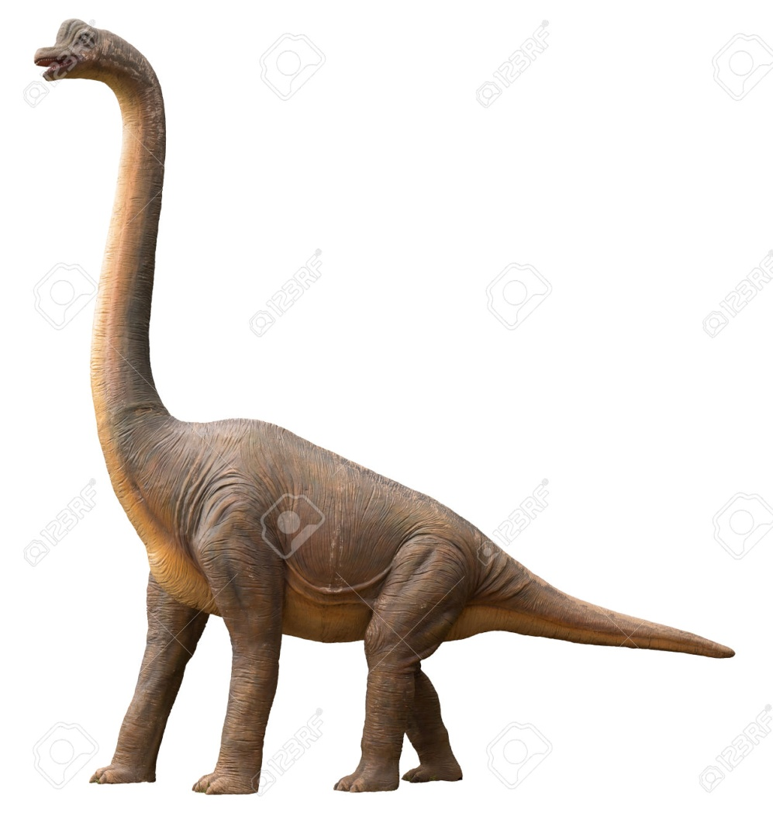
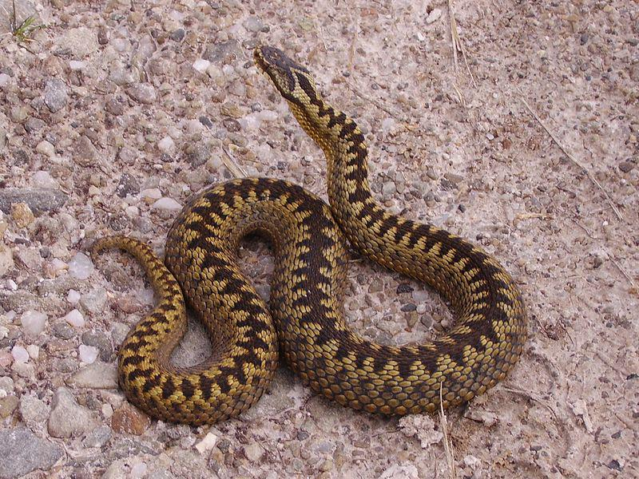

Slide 11
If you were in Poland, you wouldn’t forget to visit this wonderful place

Slide 12
THE PRESENTATION WAS PREPARED BY
MONIKA
BŁAUT
JULIA
PAWŁOWSKA

Slide 13
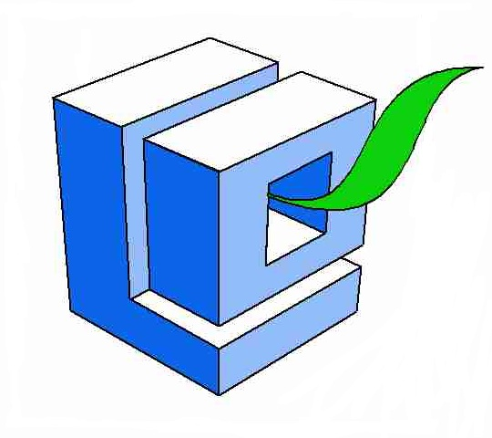
Projekt „Paths of Europe”- współfinansowany w ramach programu Unii Europejskiej Erasmus+
„Publikacja odzwierciedla jedynie stanowisko jej autorów i Komisja Europejska oraz Narodowa Agencja Programu Erasmus+ nie ponoszą odpowiedzialności za jej zawartość merytoryczną”.

