Slide 1
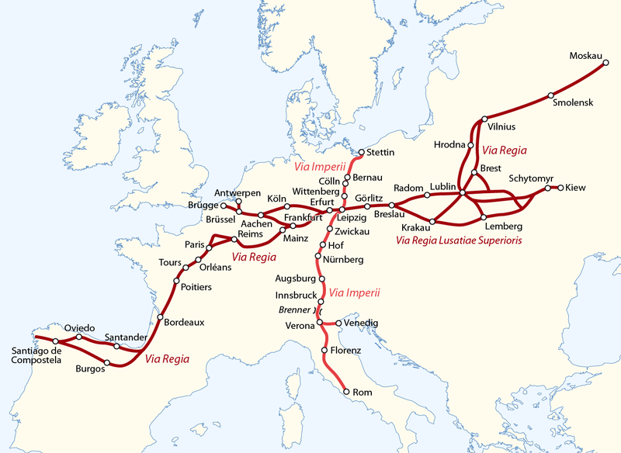
Via Regia

Slide 2
Via Regia runs through:
Spain
France
Belgium
Germany
Poland
Ukraine

Slide 3
Polish section of the trail
In Lower Silesia, in Brzezina, there is the original monument left, which is related to the modernization (imbricating) of the Via Regia section between Brzeg and Oława in 1584. Via Regia is also one of the main threads of St. Jacob's pilgrimage route, also known as the St. James's Trail, which leads to Santiago de Compostela in Spain. In Poland it is officially marked (2010) in the section from Góra św. Anny (St. Anne Mountain) through Opole, Wrocław, Legnica and Lubań to Zgorzelec.

Slide 4
How to travel across the trail?
You can travel by bicycle, by car, by train and on foot.
The route is available for disabled people.
There aren’t any special cash restrictions. You only need money for your own needs like food or accommodation.

Slide 5
Via Regia
The owner of Via Regia is mangement.
On the route there are some restaurants like
„Restauracja Magnolia”.
You can also find a place to sleep for example
„Dom turysty” or „Pensjonat Miejski”.

Slide 6
THE PRESENTATION WAS PREPARED BY: Sandra Boczek and Oliwia Nowak

Slide 7
Projekt „Paths of Europe”- współfinansowany w ramach programu Unii Europejskiej Erasmus+

