Slide 1
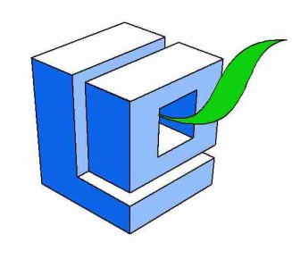
Paths of Europe Kielce
Projekt „Paths of Europe”- współfinansowany w ramach programu Unii Europejskiej Erasmus+

Slide 2
Kielce
Is the nearest big city to us.
It’s placed 40 minutes by car from Końskie.
There live almost 200 thousends of people. The city is located in the middle of the Świętokrzyskie Mountains, also known as the Holy Cross Mountains, on the banks of Silnica river, in the northern part of the historical Polish province of Lesser Poland.

Slide 3
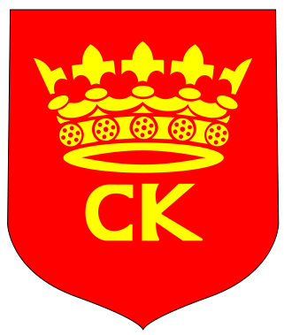
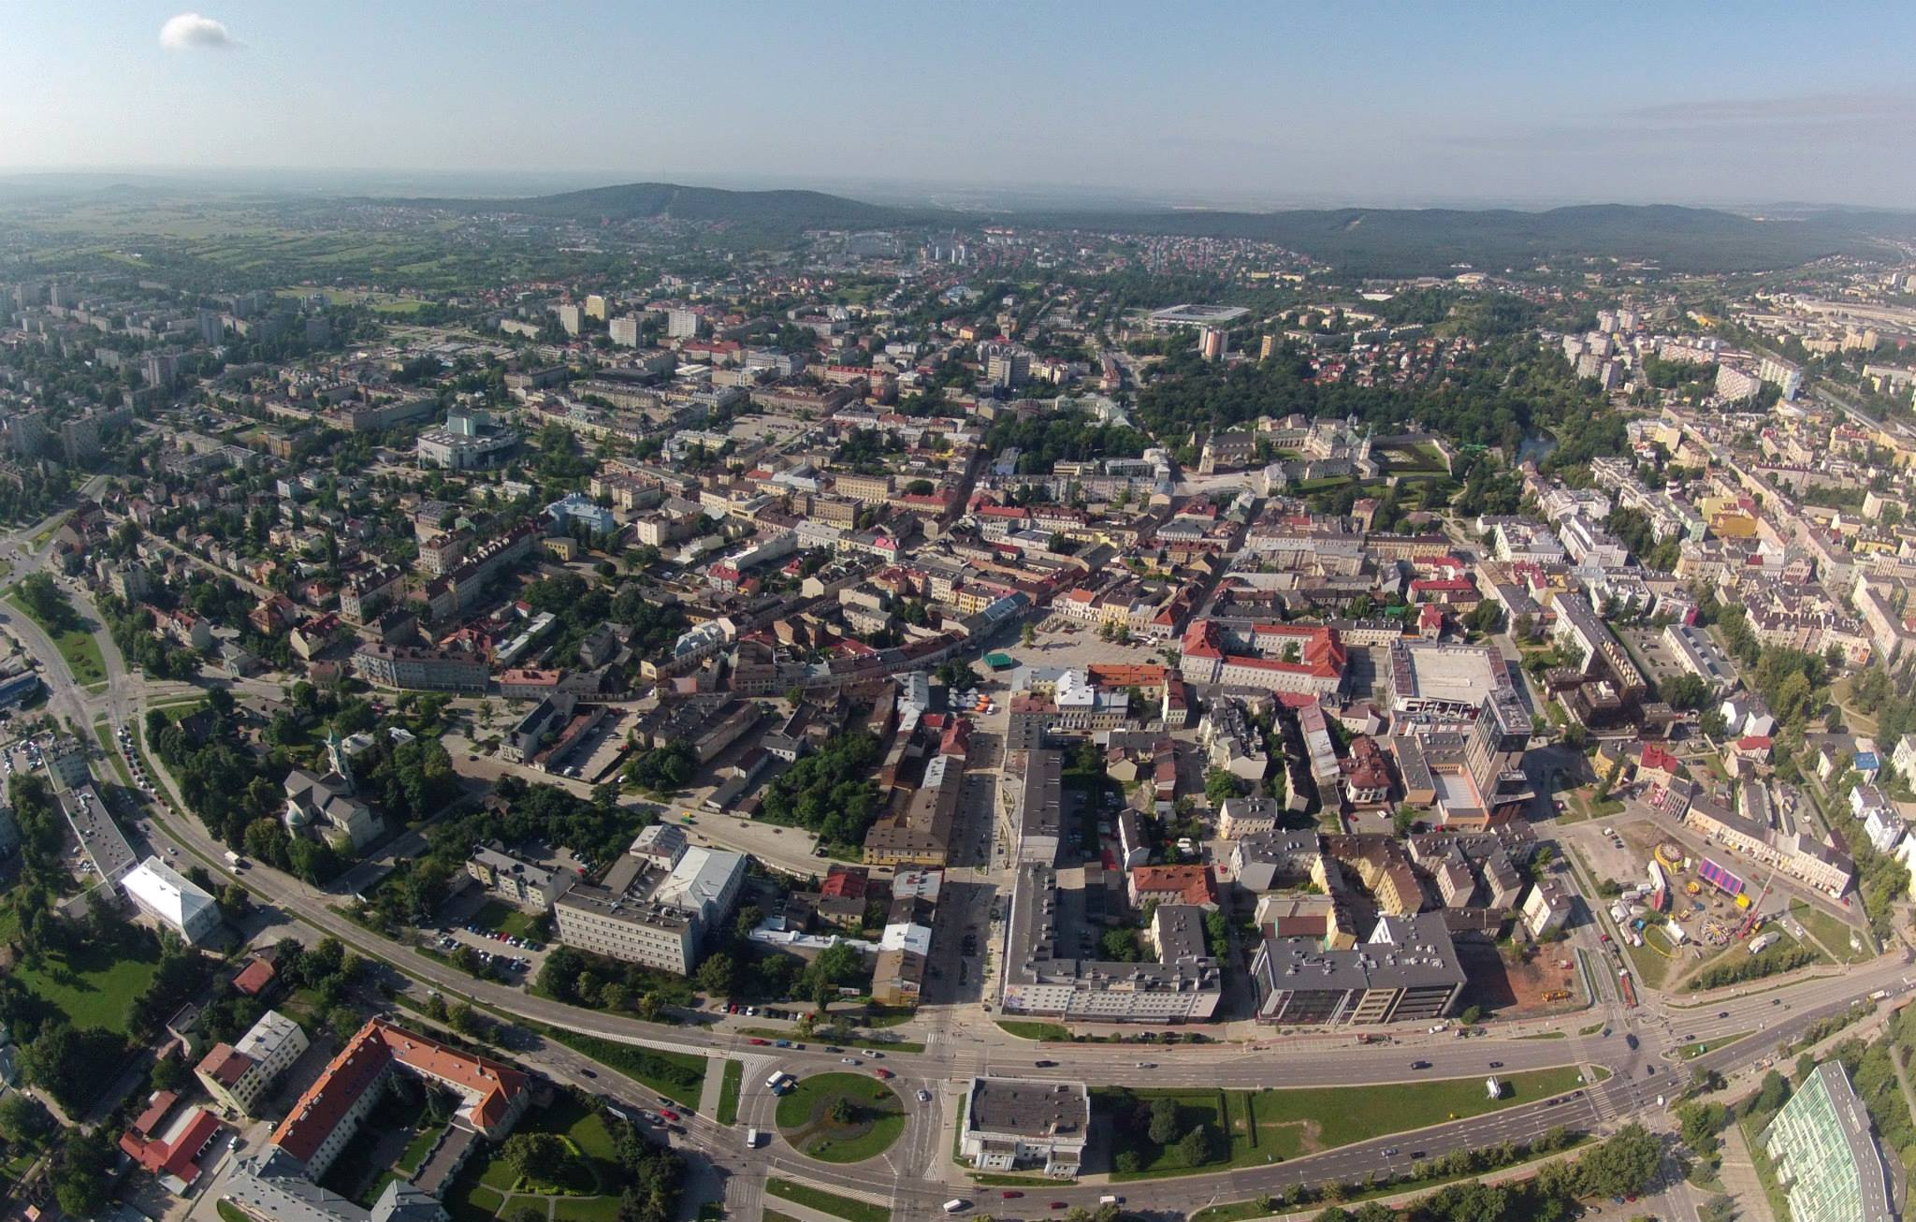
Arms of Kielce

Slide 4
It was once an important centre of limestone mining with sandstone and marble from nearby quarries, and is now a centre of trade and commerce with factories such as spark plug and bearing makers, a paper mill and chemical industries.
If you want to have fun, eat good food, arrange documents, meet great creative people you have to visit this city. We will show you some of the points you have to definitely see.

Slide 5
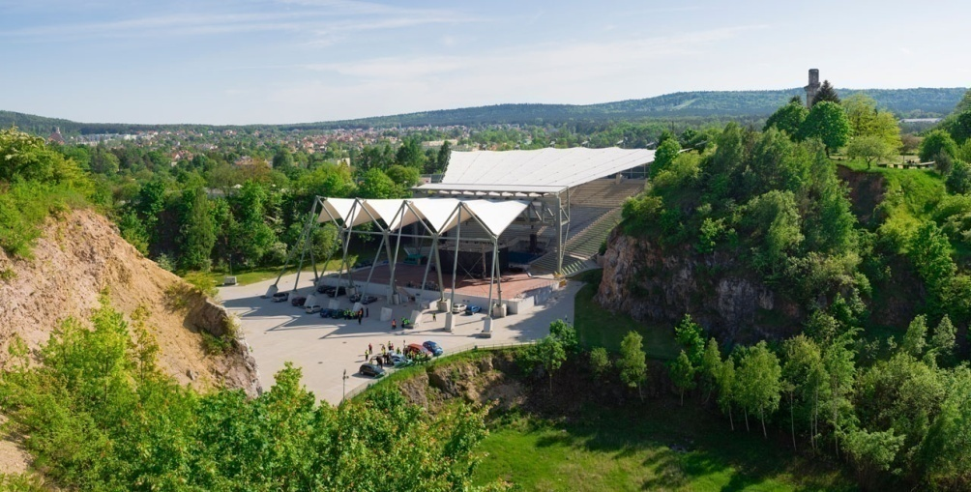
Kadzielnia- the biggest stars, a lot of laugh and breathtaking view
Kadzielnia is an old quarry, which used to be filled with water. Since 1962 there is a Nature Reserve Kadzielnia.
It's a great area for a long walk, see concerts or events, and has great viewing spots at the top for panoramic views.

Slide 6
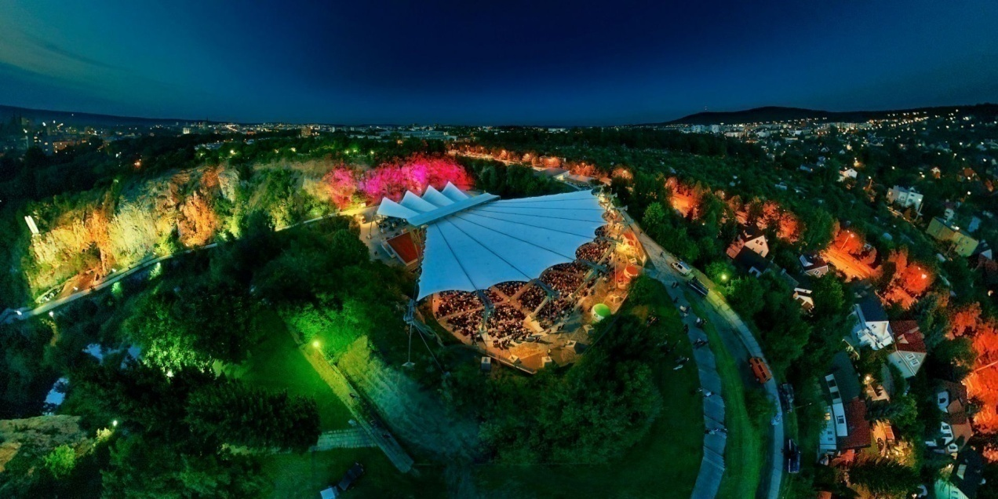
Amphitheater was completely renovated in 2010.The amphitheater now houses 5.5 thousand people.
This place is renowned for cabarets and the bigests stars performances, festivals and social events.
I was there and I really enjoyed it. Participation in such an event was an amazing experience for me.

Slide 7
Sienkiewicz Street
The city's most famous landmark is sienkiewicza street. It was built in the middle of the 19th century.
Probably one of the longest shopping streets in this part of Poland.
You can buy there the most fashionable clothes from the most famous designers.
A very nice walk from the Railway Station to the H. Sienkiewicz statue.
The air is filled with the fabulous smells of tradicional polish food and many other world cuisines. Restaurants which we recommend is „Burger & Co.”, „Oranżeria”, „Oddysey”.

Slide 8
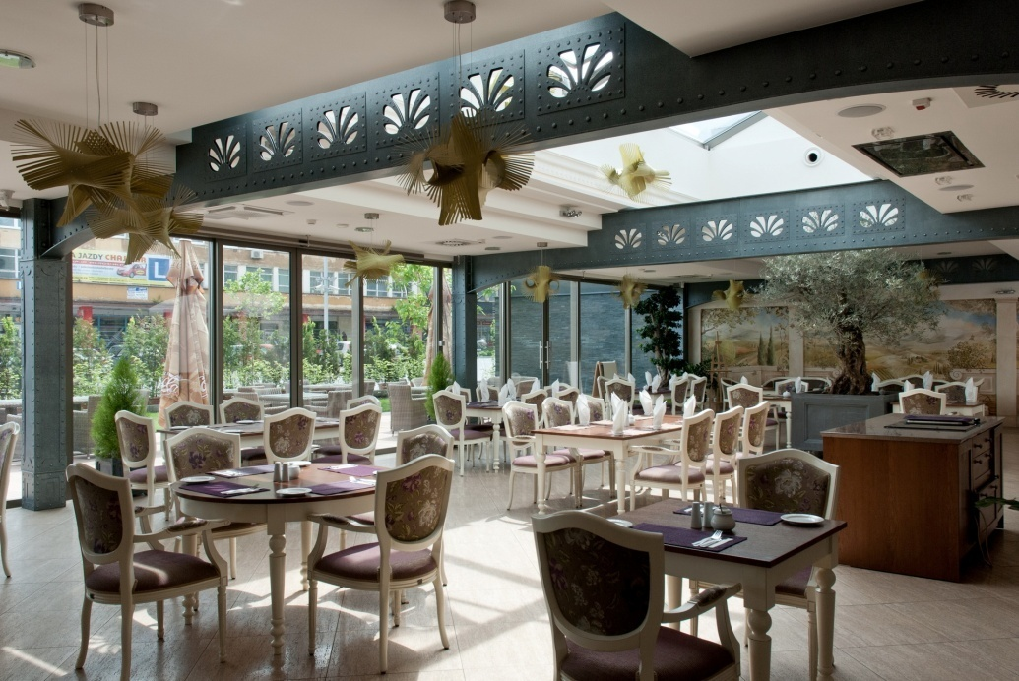
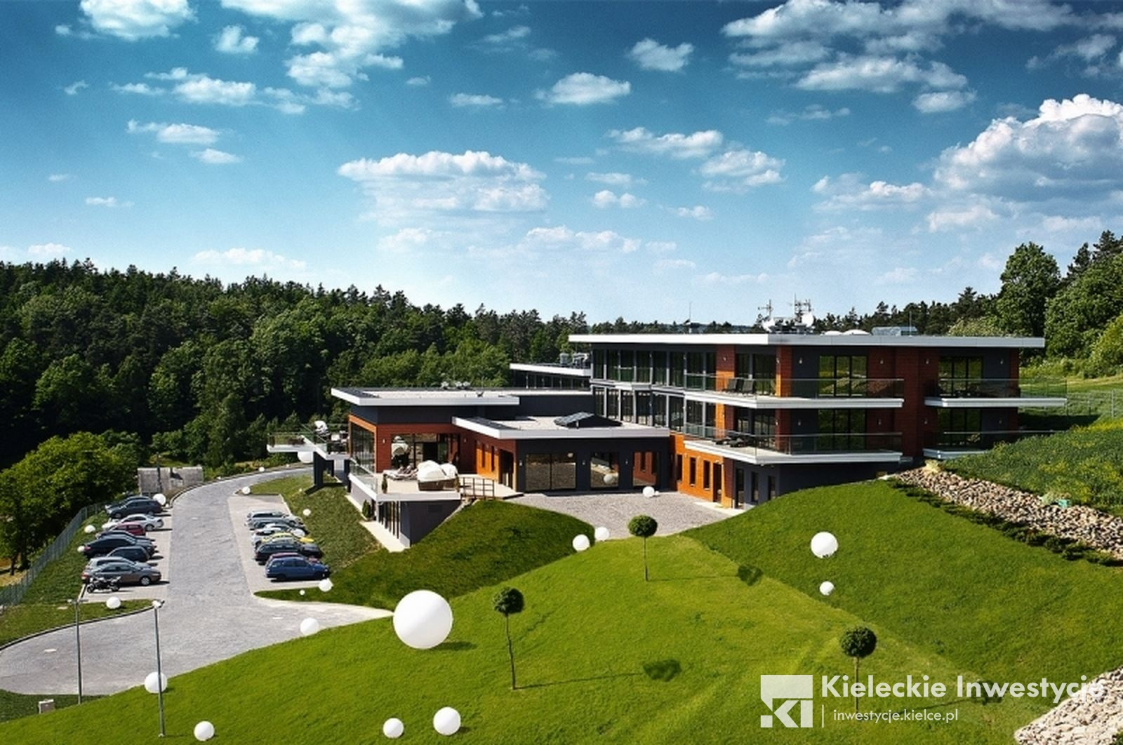

Slide 9
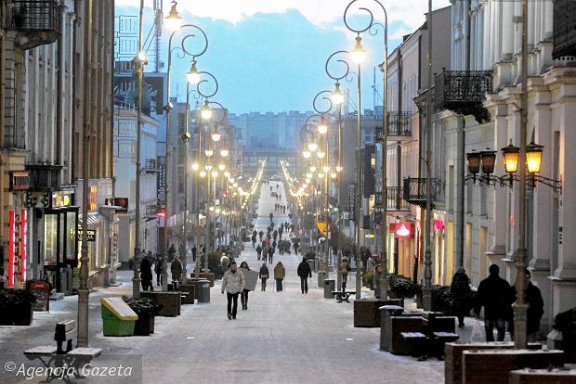
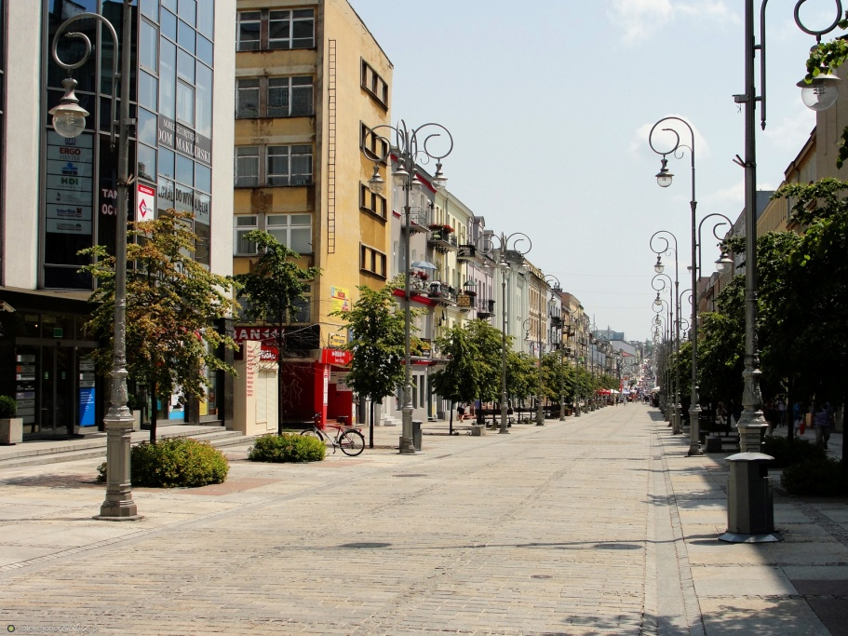
Fantastic place for toddlers, kids, but also preteens. Everyone can enjoy playing and having fun there. So are the adult. Amusement park is one thing, and mini-world another, so much enjoyed by adults, too. Its like all the most popular landmarks in one place.

Slide 10
Theatre-if you want to get a little more education
Existing since 1945, it is located in a period house of the second half of the 19th century, where formerly the Hotel Polski was located. It gives several premieres every year.
Apart from its own repertoire, the theatre invites other companies with their production. Some of the performances staged in the edifice in Sienkiewicza Street are world premieres of Polish contemporary playwrights. At the end of each season, there is the Wild Rose Poll, when the public awards the best actors and the most popular performances.

Slide 11
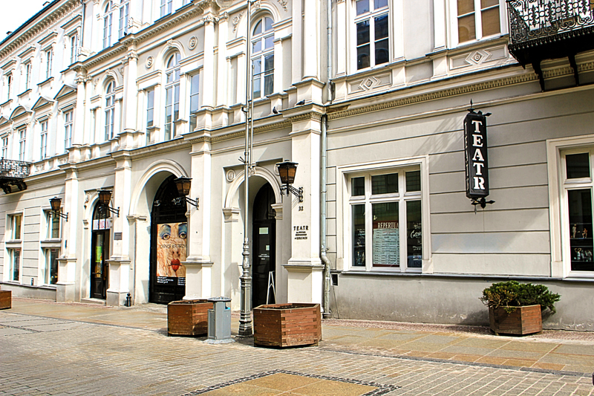
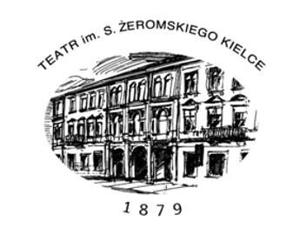
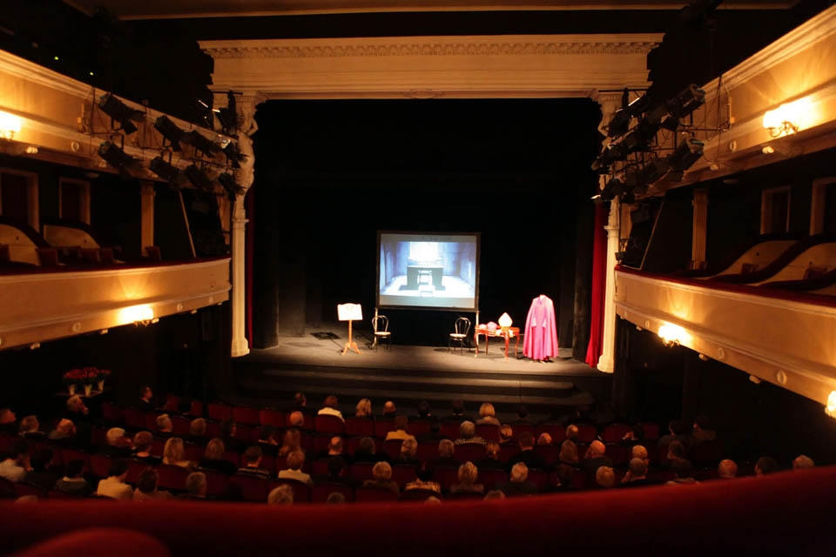

Slide 12
Geopark
Educational park placed in Kielce.The object is located on the Świętokrzyski Archeological Trail. At present within the Geopark Kielce the following objects are active:
Geo-education Center
Amphitheater Kadzielnia
Botanic Garden
Creative Workspace
Nature reserves:
Nature reserve Kadzielnia,
Nature reserve of Ślichowice,
Nature reserve of Wietrznia,
Underground Tourist Route

Slide 13
It's one of the most interactive museums in the region, where you can learn more about geological history. What's more museum is located in amazing plaze called Wietrznia, from which you can have great views on Telegraf Hill and some part of Kielce. Exhibition of the centre presents a rich and unique in the world scale collection of animals living in the prehistoric periods, among others while Kielce was flooded with very warm Devonian sea, full of coral reefs.
The great attraction is also a time-capsule with 5D cinema, where everyone may take a journeyto the centre of the Earth. Visitors may also take part in field researches, theoretical and practical geoeducational classes, workshops, walks through the paths in the park surrounding the object. Some creatures are really amazing and strange. The models are accompanied by photos, texts and other graphics introducing places, geology or history.

Slide 14
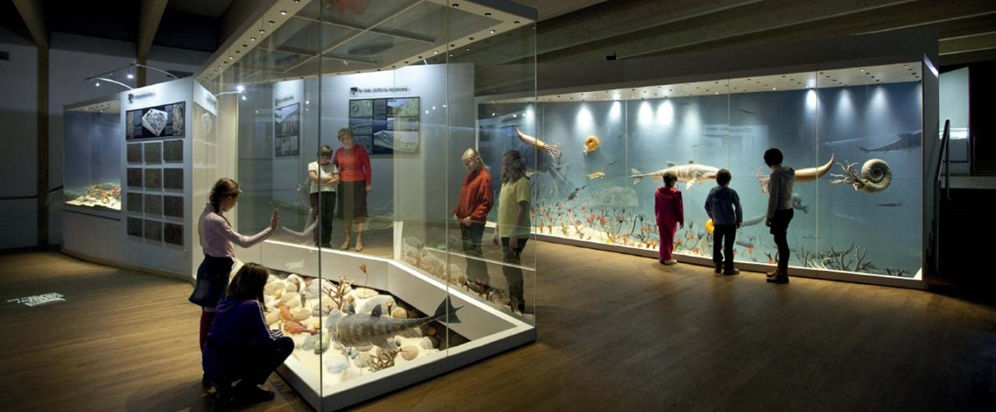
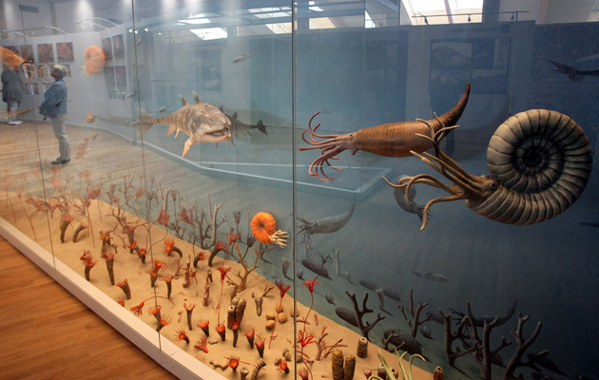
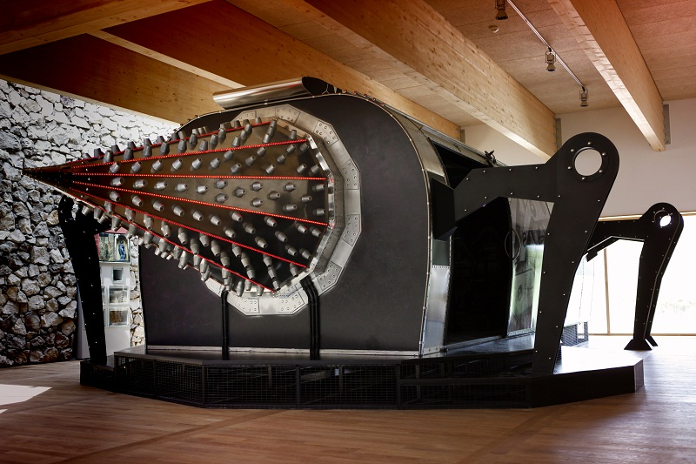

Slide 15
Botanic Garden
The establishment of the Botanical Garden is yet another major step towards promotion of tourist must-sees in the city of Kielce and Świętokrzyskie region as a geotourist and naturalist’s paradise, bringing education as well as geological and ecological experience to the visitor’s fingertips.
The entire facility and green area complex have been designed on the axis of the historic road which led to the monastic complex and the natural reserve of Karczówka hill.

Slide 16
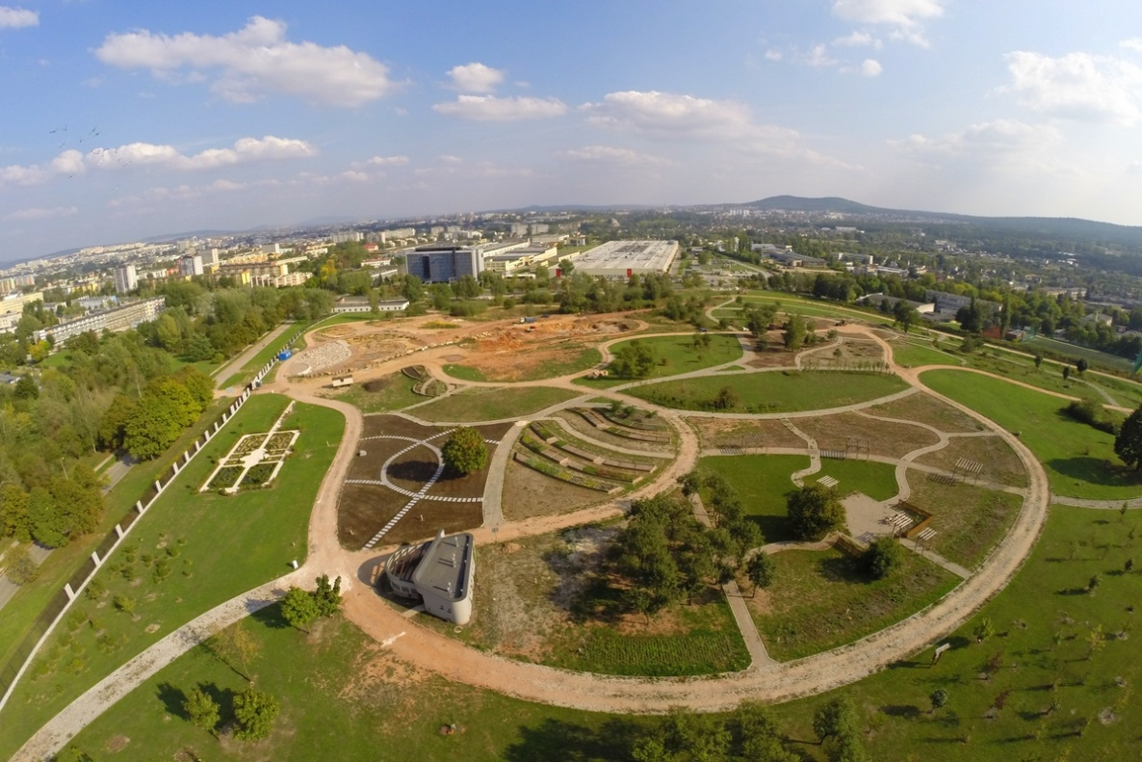

Slide 17
Nature reserve of Ślichowice
The „Ślichowice" Geological Reserve, which was also established in a former quarry, is an interesting example of Hercynian tectonic influence exerted on the Swietokrzyskie Mountains which can be seen in the form of simple yet strongly undulating lime rocks.
An interesting geological profile can be seen here with its reversed rock fold.

Slide 18
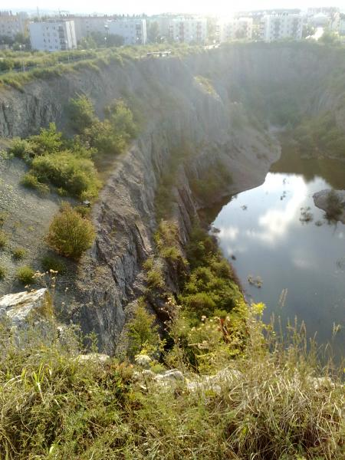
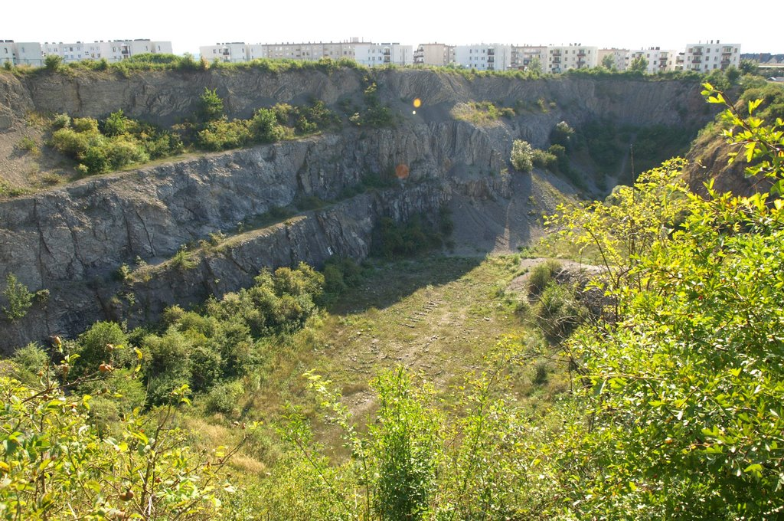

Slide 19
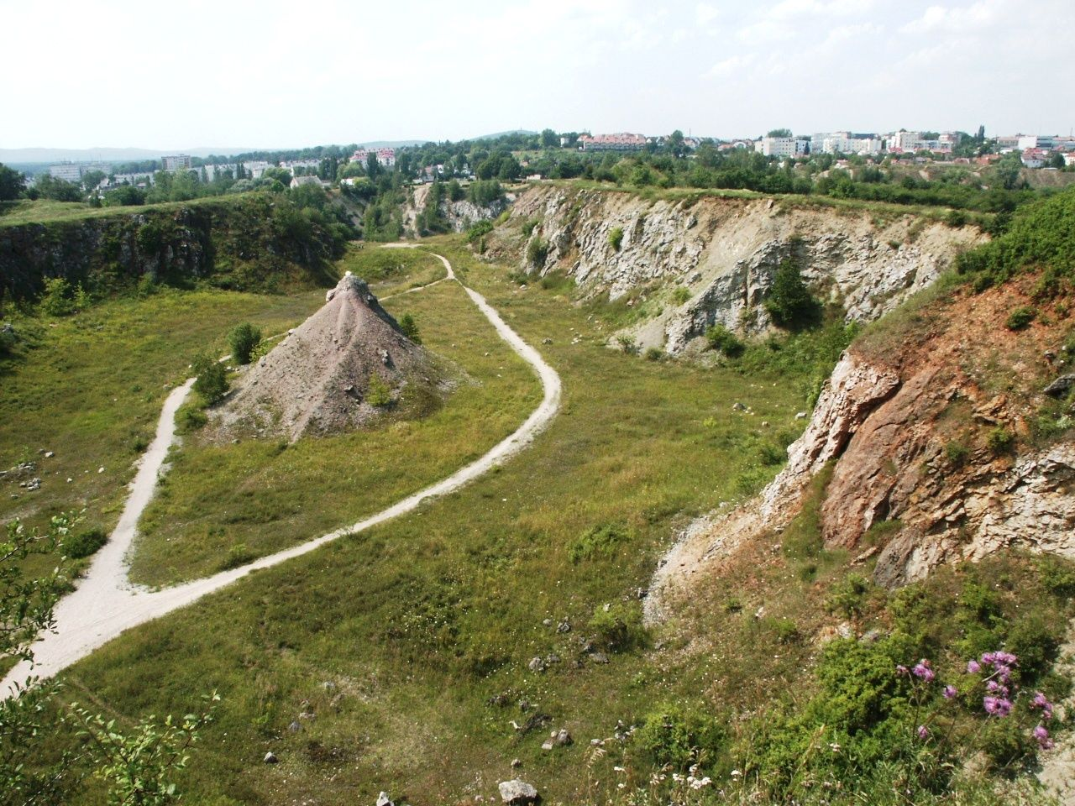
Nature reserve of Wietrznia
The "Wietrznia" Reserve, on the eastern edge of the "Kadzielnia" range, has very good examples of Late Devonian limestone with bands of variable thickness containing fossilised remains of brachiopods, corals, snails, bivalves, trilobites, lilies and armoured fish.

Slide 20
Chęciny Castle
Chęciny Royal Castle was built in the late 13th century in Chęciny, Poland.
It fell into ruin in the 18th century and remains in that state to this day.
According to legend remarkable ruins of the castle in Chęciny are often visited by the ghost of White Lady. The spirit started to appear soon after the death of Bona Sforza, Queen of Poland who lived during the 16th century.
Sforza, who came to Poland from Italy, is believed to hide some treasures somewhere in the castle.
Due to this legends, it is supposed that she comes to Chęciny to search for them.

Slide 21
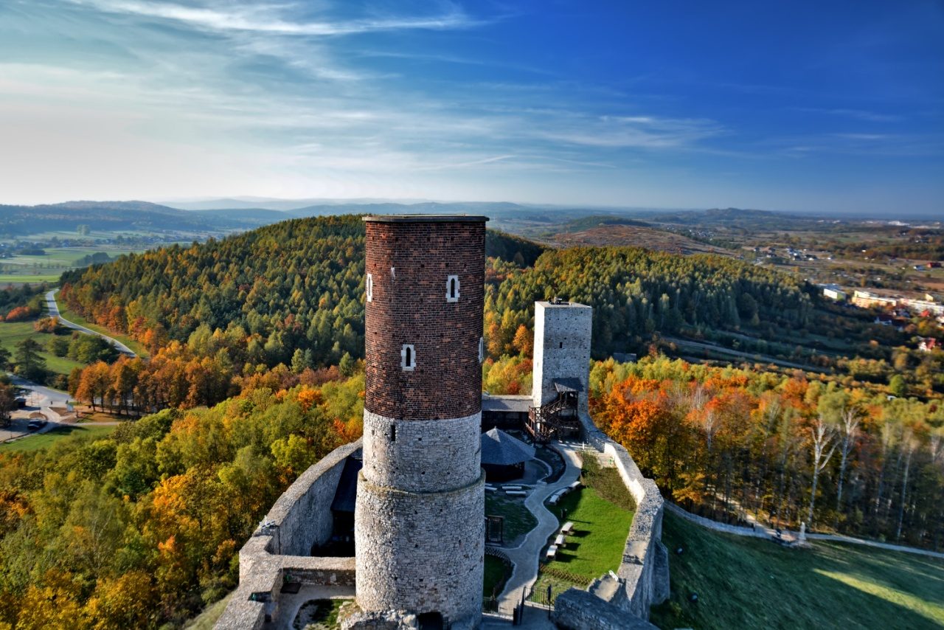
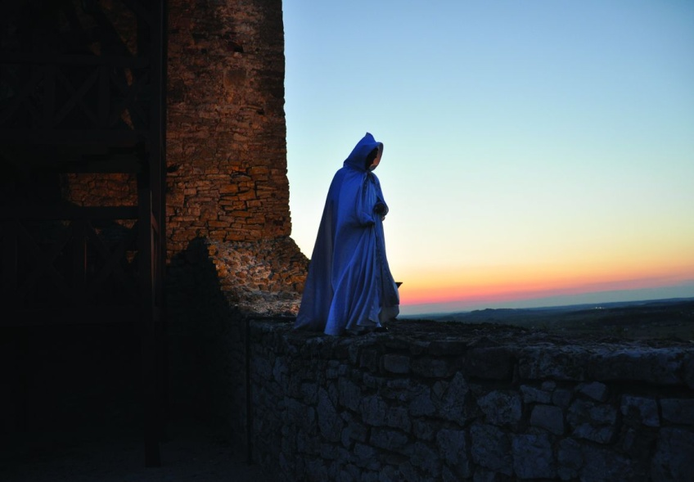
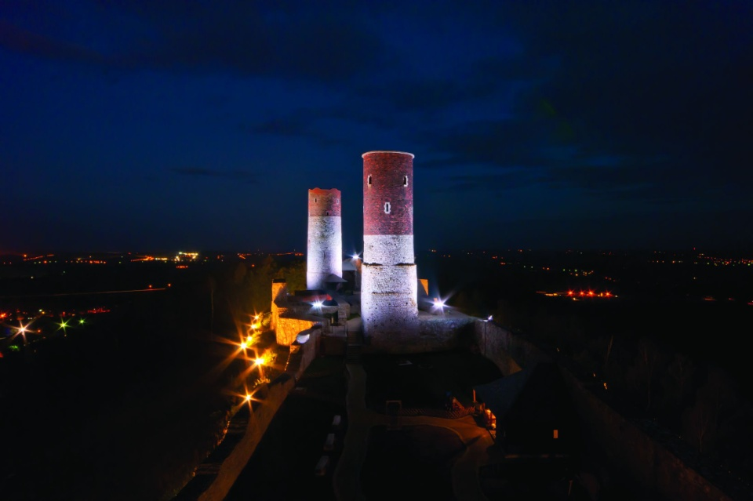

Slide 22
Telegraph Kielce
If you like winter sports like skiing then you will find something for you here.
The ski resort is located in the range Dymiński (Świętokrzyskie Mountains), in Chęciny-Kielecki Landscape Park on the northern slope of the Telegraf Hill (408 m n.p.m.).
Along the chair lift to the top of the Telegraph there is a main ski track, in which the lower part also has a ski lift and a beginner's trail.

Slide 23
Slope is a place of many events, sports and cultural activities for the inhabitants of Kielce and its surroundings. There were, among others things:
Cycle race CUP MTB series
Polish Mountain Bike Championship MTB
Cup of the Świętokrzyskie Mountains in Alpine Skiing and Snowboarding
qualifying for the IX Polish Amateur Championship in the Kross Family Cup

Slide 24
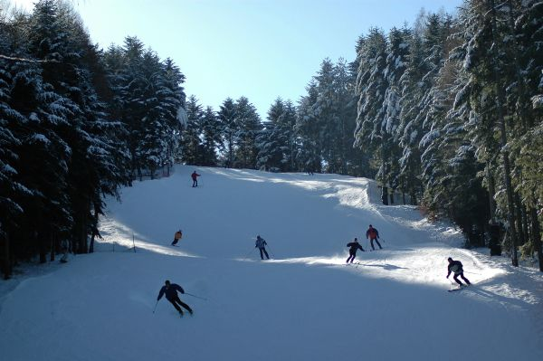
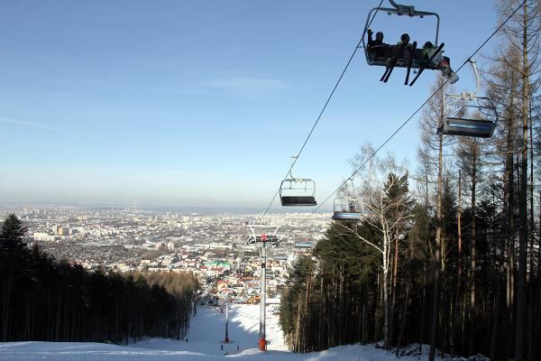
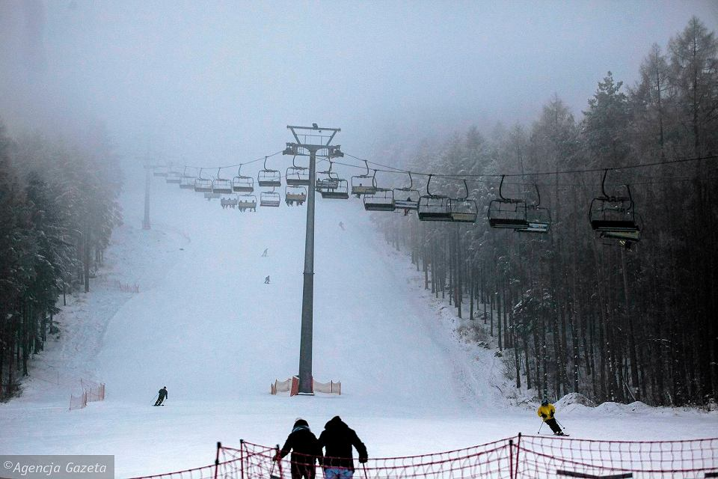

Slide 25
Thank you for your attention.
Presentation prepared:
Martyna Ziomek
Nina Kiersznowska
Publikacja odzwierciedla jedynie stanowisko jej autorów i Komisja Europejska oraz Narodowa Agencja Programu Erasmus+ nie ponoszą odpowiedzialności za jej zawartość merytoryczną.

