Slide 1
Kurozwęki
Podtytuł
Notes:
UWAGA: Chcesz mieć inny obraz na tym slajdzie? Zaznacz obraz i usuń go. Teraz kliknij ikonę Obrazy w symbolu zastępczym,aby wstawić swój własny obraz.

Slide 2
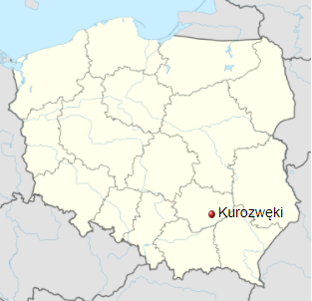
Kliknij, aby dodać tekst
Kurozweki is a very interesting and unique place, not only on the scale of the świętokrzyski voivodship but also in Poland. The biggest attraction of Kurozwęki is an impressive palace, and a former castle, where the hotel is now. Around the palace there are also some interesting attractions, including peculiar American buffalo breeding, which features unique bison safaris, the Mini Zoo and even a famous maze of corn.

Slide 3
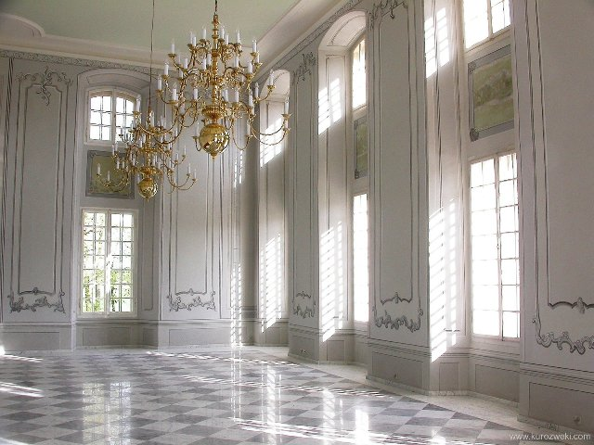
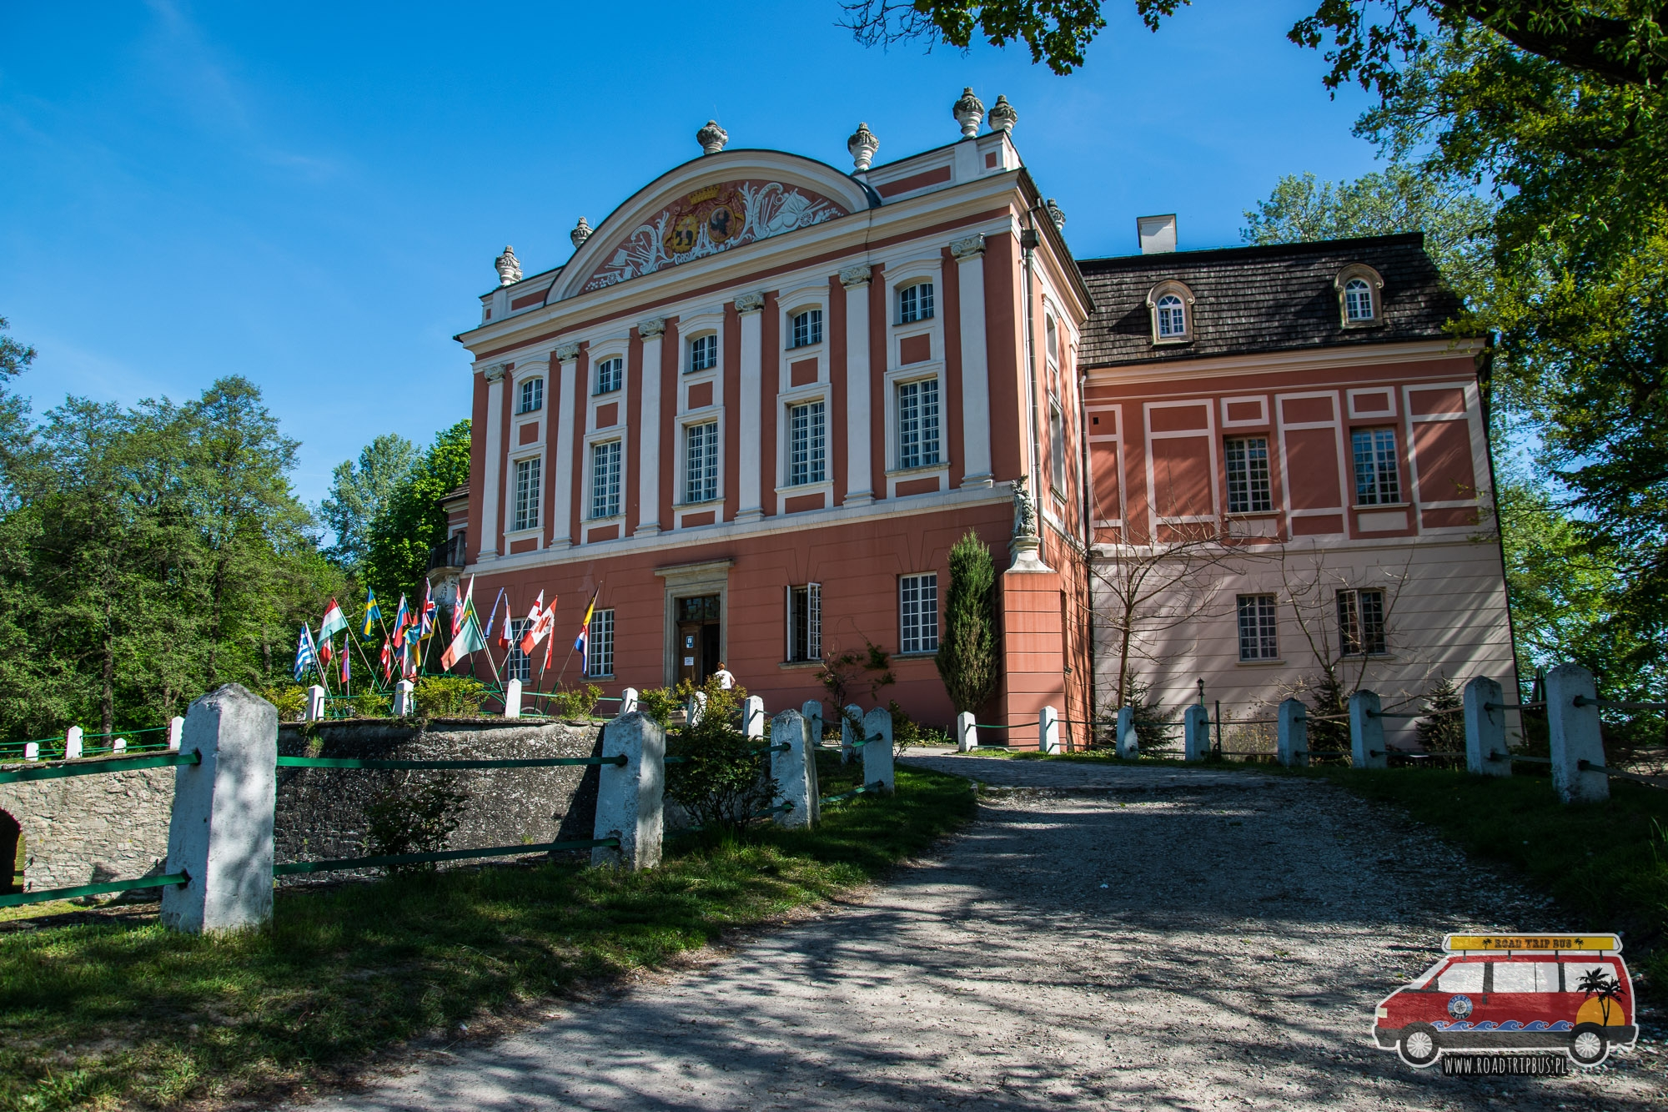
Palace in Kurozweki
Probably at the turn of the 13th and 14th century Dobieslaw from Kurozweki built here a defensive wooden-brick castle, which was one of the first brick knight castles in Poland.
Today, the former Gothic castle, after many renovations, is a beautiful palace, encouraging tourists to explore and relax. At present we can see the palace in Kurozwęki in its full splendor.
The residence has been transformed into an elegant hotel that offers its guests and other tourists traditional sightseeing and a range of attractions.

Slide 4
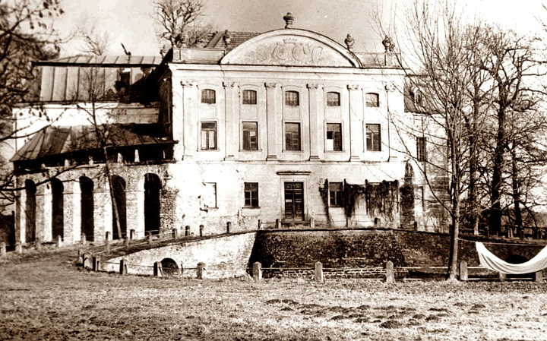
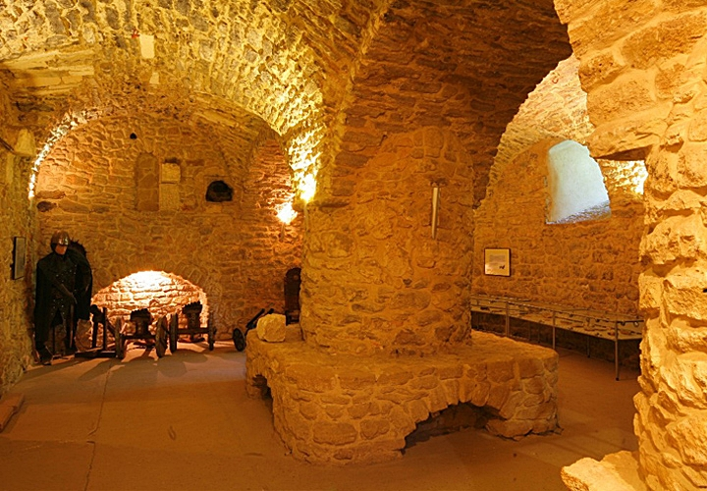
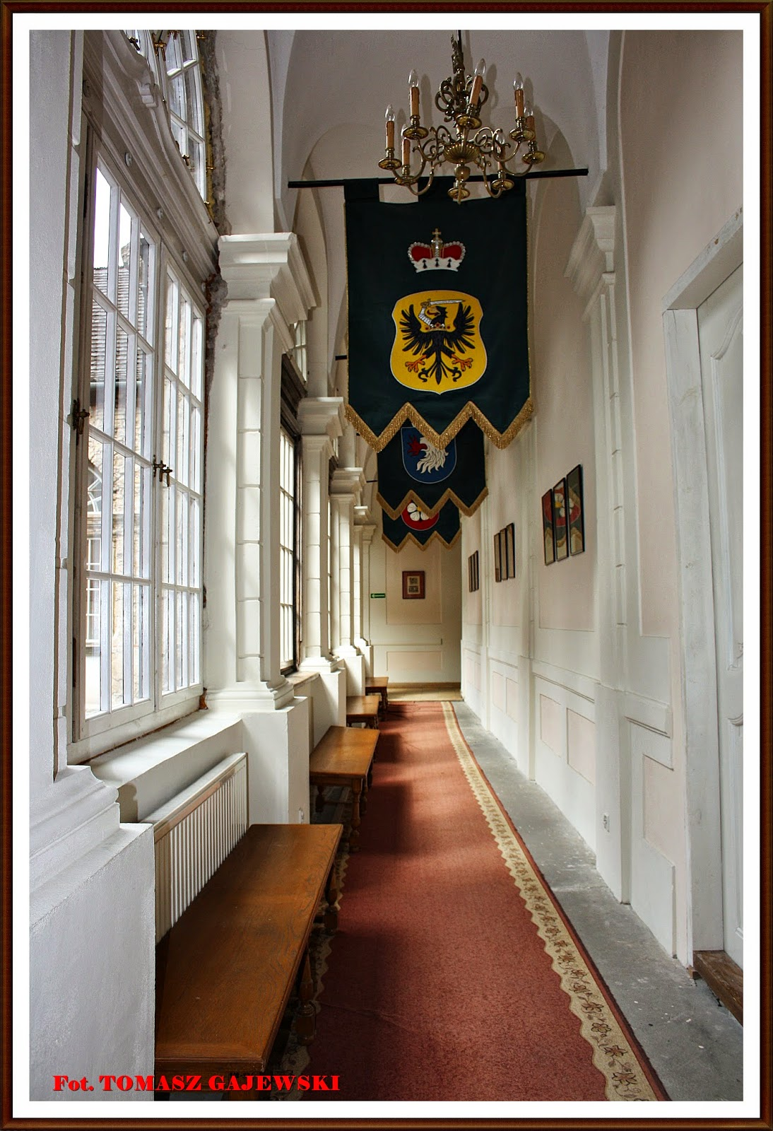
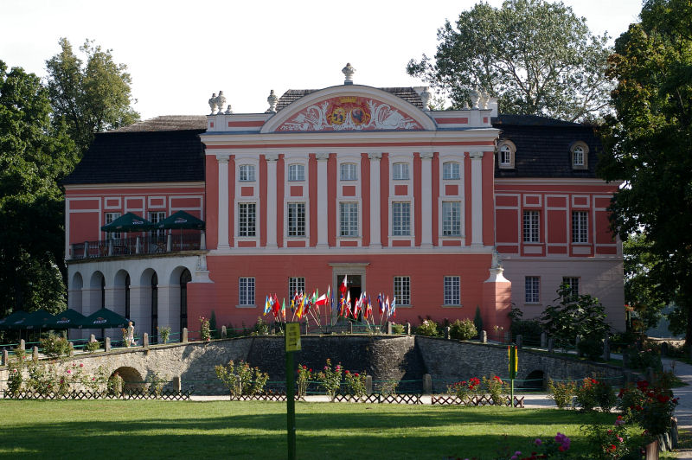

Slide 5
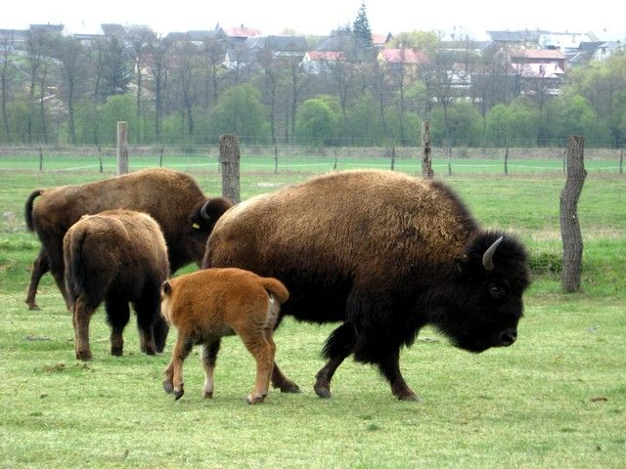
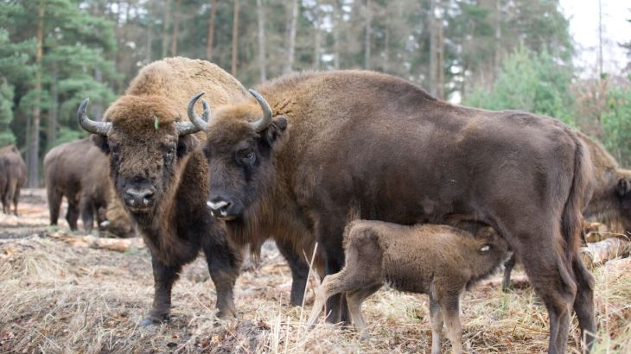
American bisons
In kurozweki there is the only American bison breeding in Poland. The first bisons appeared here in December 2000. The bisons came from Belgium in the amount of 22 (including two bulls) and started the first and largest breeding in Poland.
Today, the herd is about 70 and every year new bisons are born. The herd can be seen in the meadow behind the Kurozwęcki palace.

Slide 6
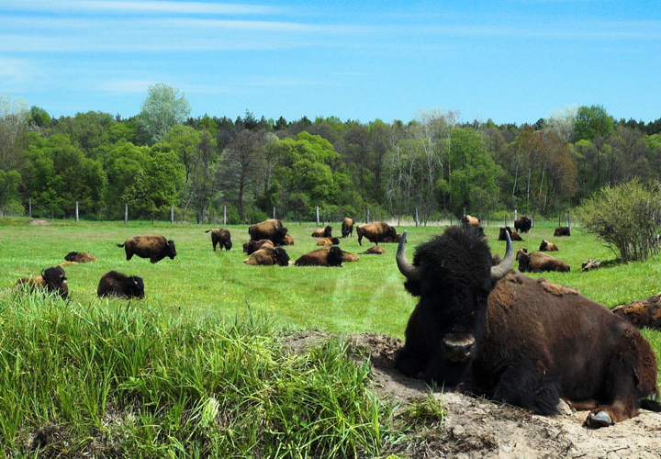
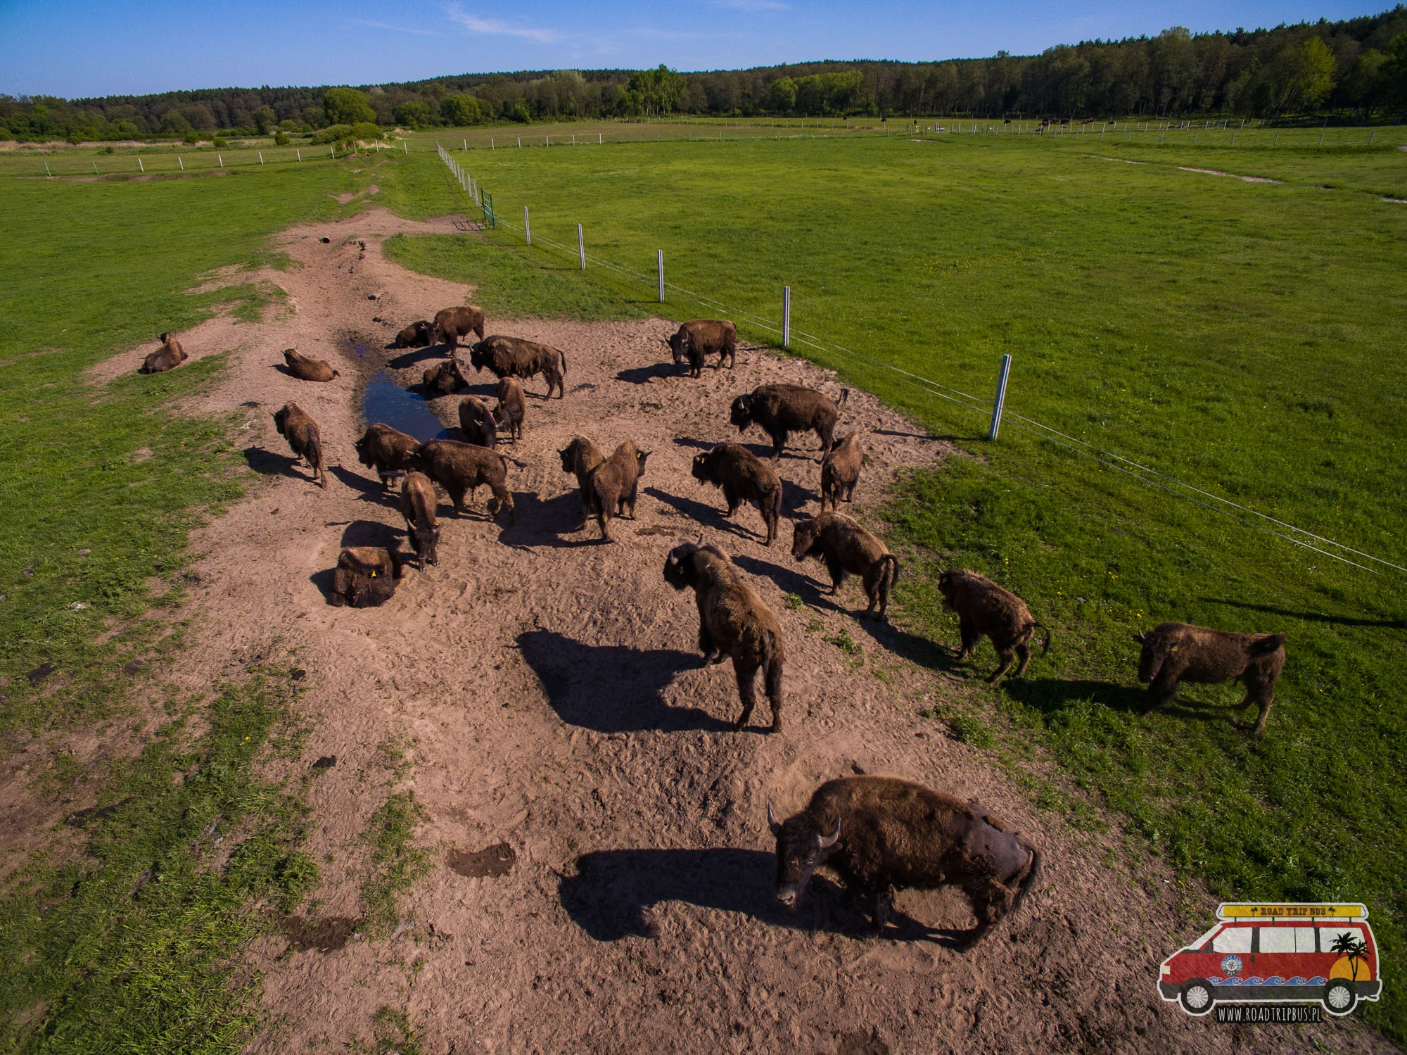
You can go for a walk and watch the buffalo from a distance or use the "safari bison" car which along with the guide enters the meadow among the bisons.

Slide 7
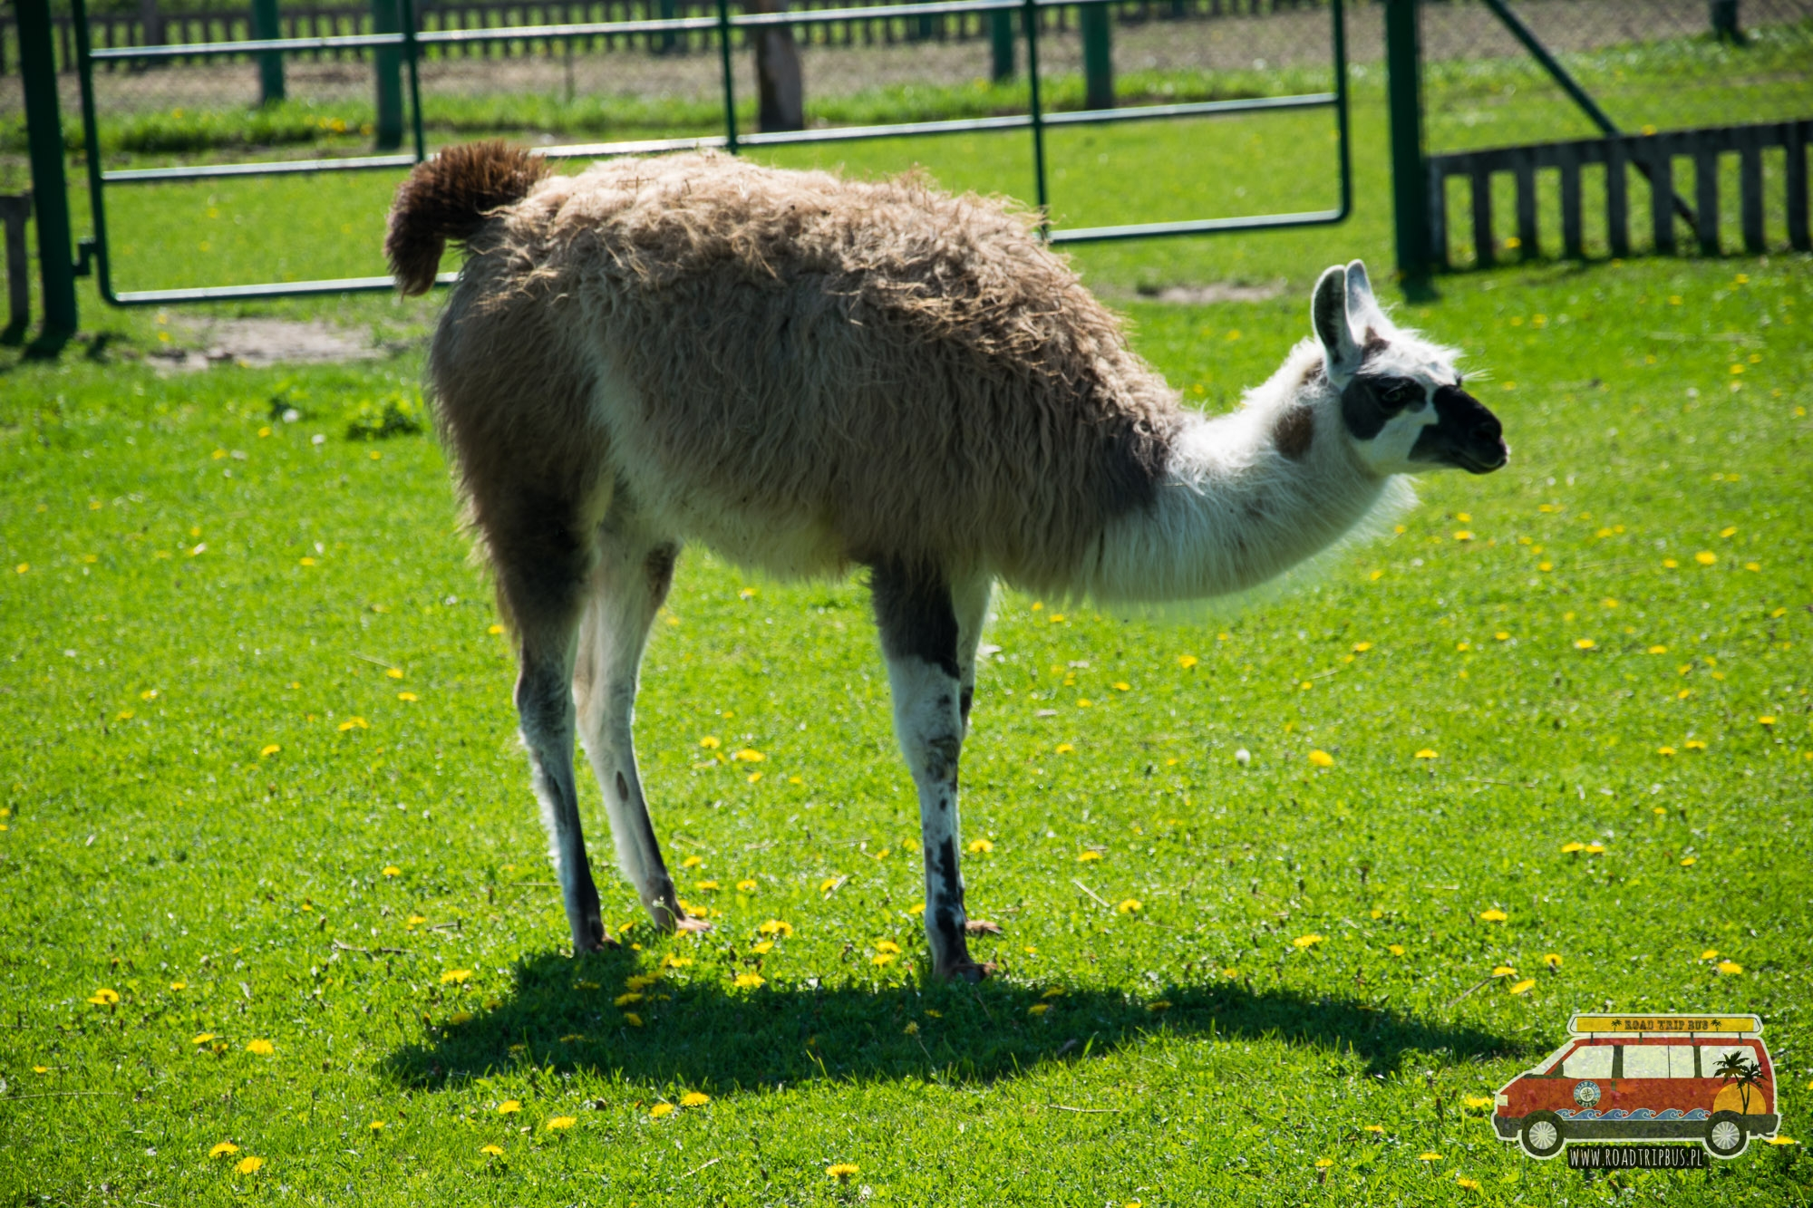
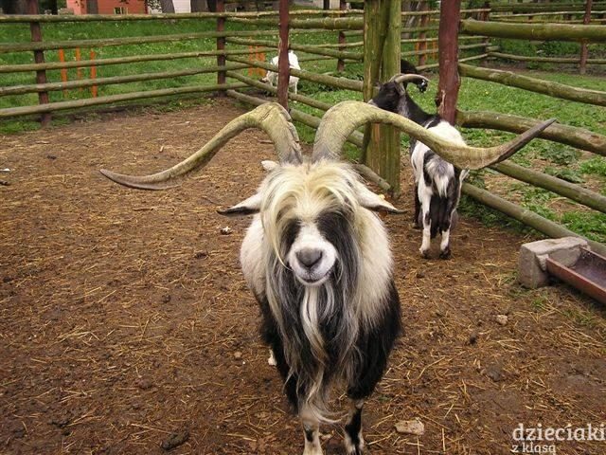
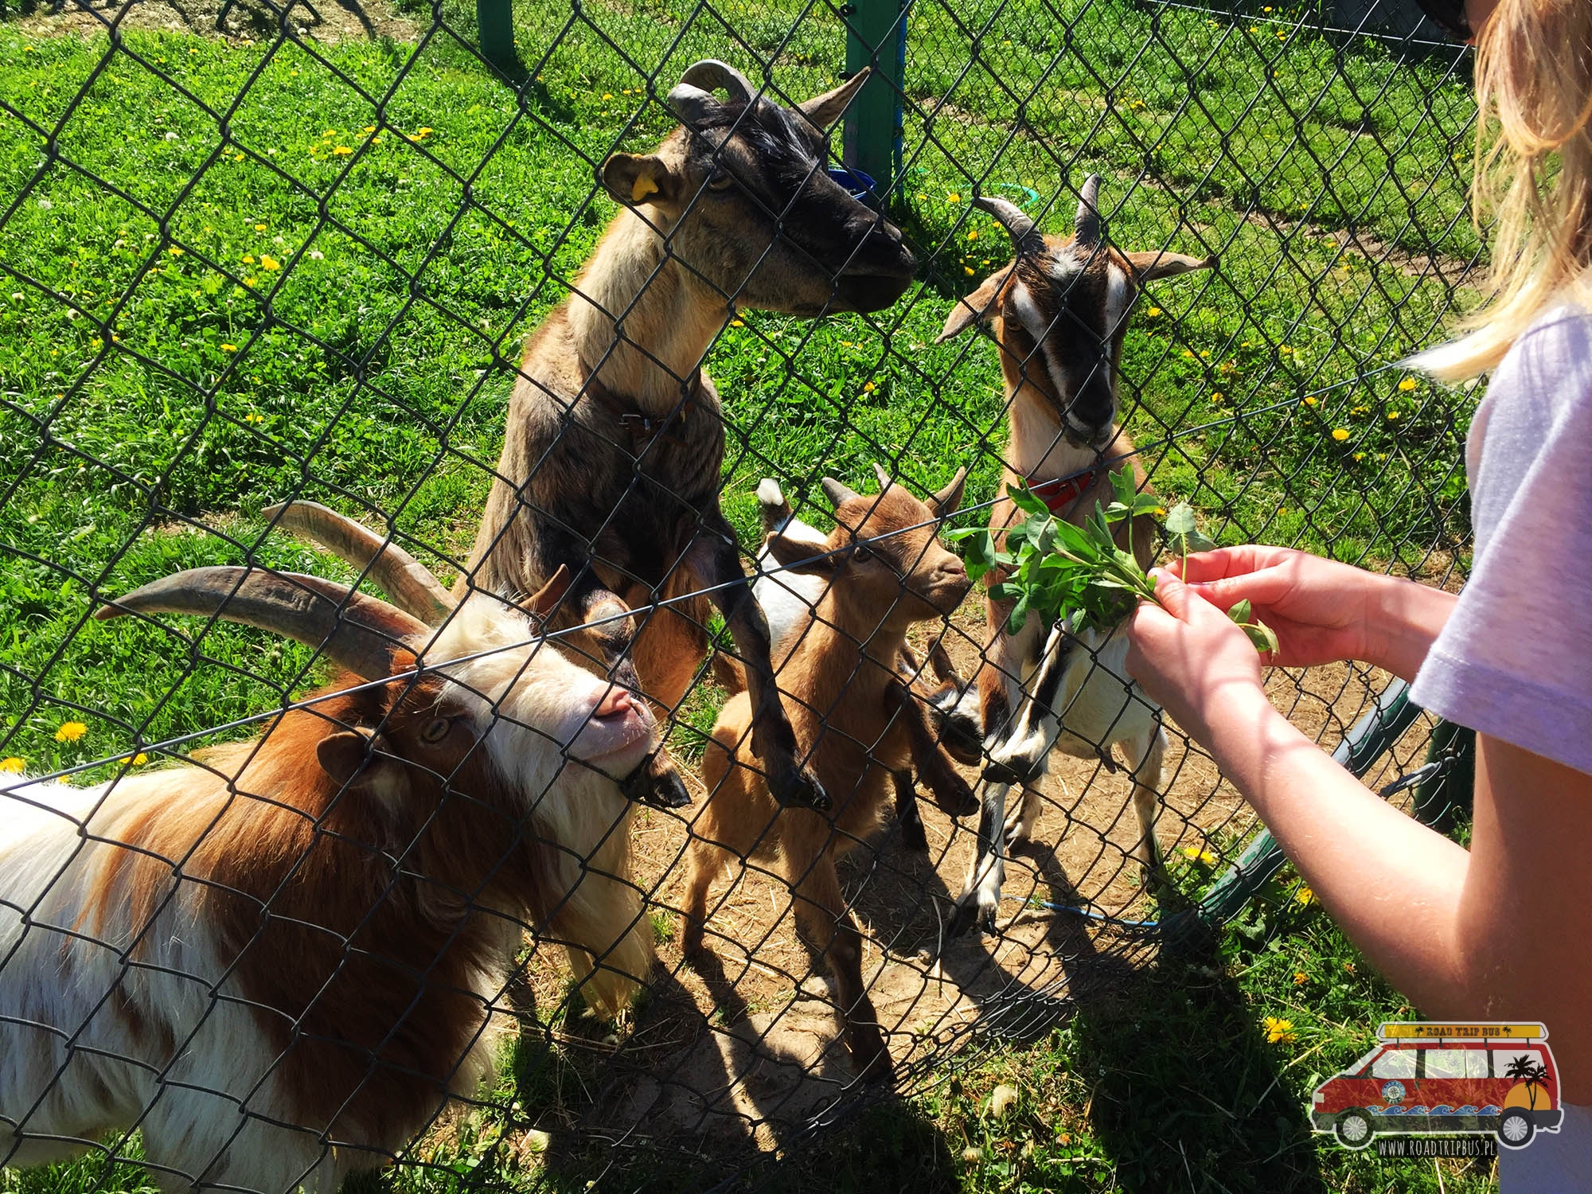
In addition to the buffalo safari, there is also a mini zoo where you can meet llamas, donkeys, rabbits, sheds, Cameroonian sheep, ostriches, Scottish buffaloes, goats, Vietnamese pigs, wild boars, a Shetland pony and various species of birds.

Slide 8
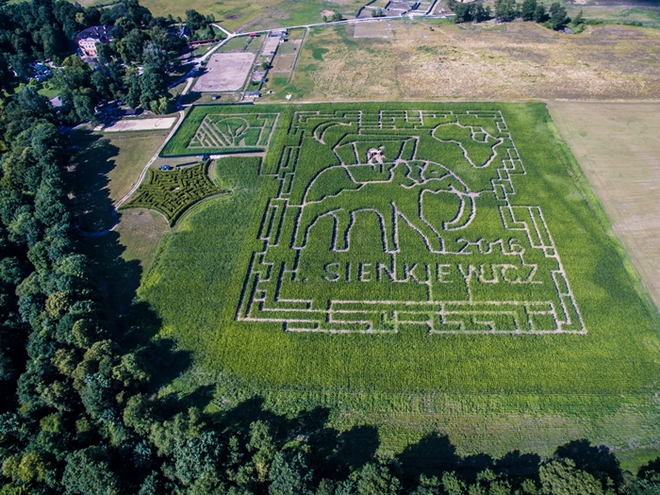
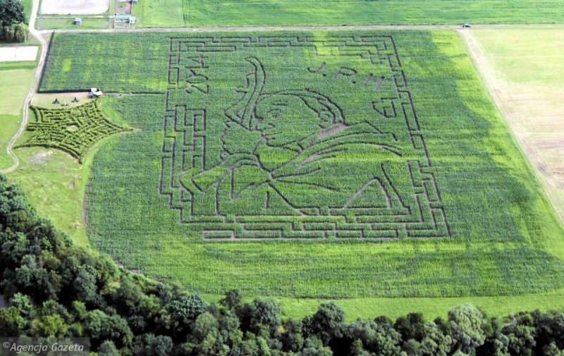
In 2006 a maze made in the corn field was opened for the first time. The maze is now one of the landmarks of the Kurozwęki Palace. Over the years it was enlarged, and each year it took a different pattern, related to important events or their anniversaries. The corn maze was temporarily replaced by a maze of cannabis.
Labyrinth in Kurozweki

Slide 9
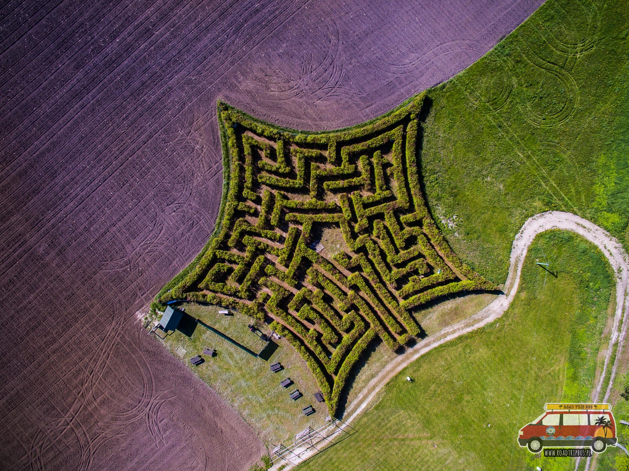
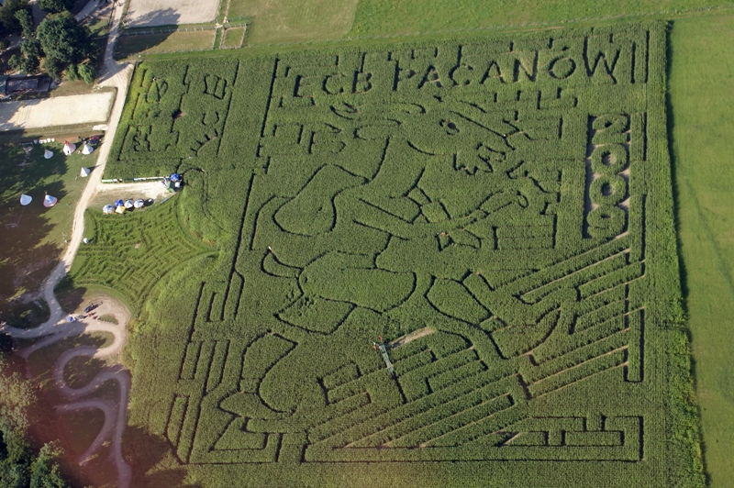
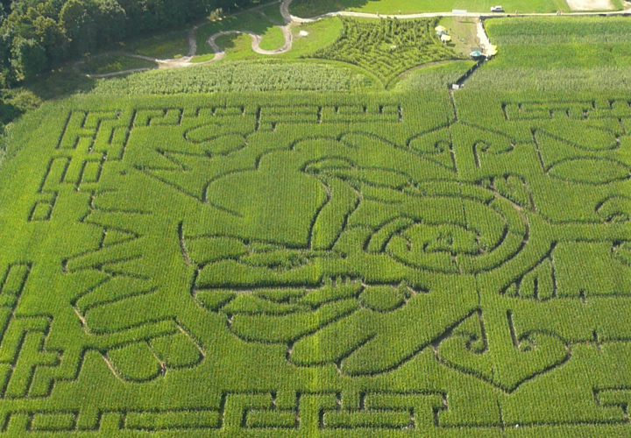
At present in Kurozweki there are usually three labyrinths:
the largest one, with corn (about 4.5 hectares) - the shortest path of passing this maze is usually about 2.5 km,
a smaller one, with hemp, connected to the larger one
and the smallest one with beech

Slide 10
Kurozweki is a picturesque corner, which is a great place for quiet walks as well as to experience many interesting adventures. Although Kurozweki has not much left of its former glory, the town boasts a magnificent memento of that period.

Slide 11
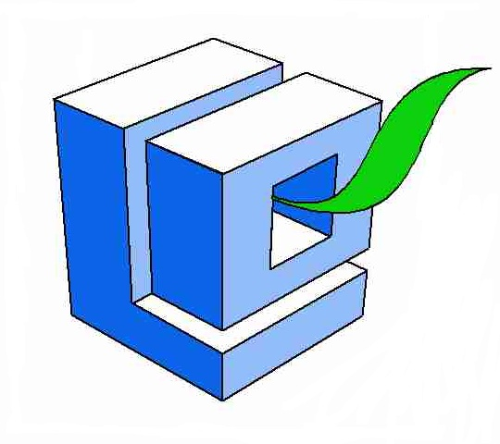
Paths of Europe”- współfinansowany w ramach programu Unii Europejskiej Erasmus+
Publikacja odzwierciedla jedynie stanowisko jej autorów i Komisja Europejska oraz Narodowa Agencja Programu Erasmus+ nie ponoszą odpowiedzialności za jej zawartość merytoryczną.
Kliknij, aby dodać tekst
Julia Kijowska
Julia Pękala

