Slide 1
Hanza - relationship
of trading cities

Slide 2
Hanza
Hanza the relationship of northern European trade cities from the Middle Ages and the beginning of the modern era.
The cities belonging to the union supported in the economic field, hindering the work of merchants from cities that were not part of the union, while at the same time creating real political and sometimes military power.

Slide 3
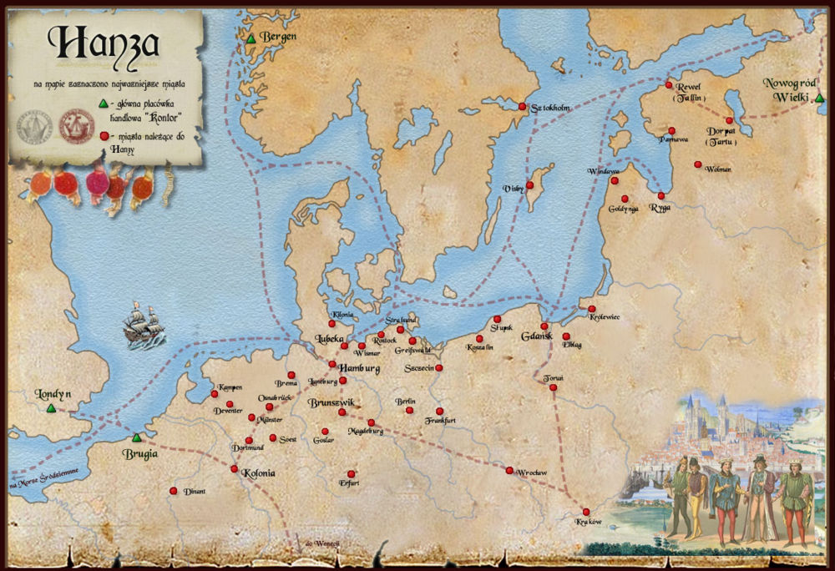

Slide 4
Cities and trade routes of Hanza
Hanza runs through such countries as Belgium, Estonia, Finland, Germany, Latvia, Lithuania, the Netherlands, Poland, Russia, Sweden, the United Kingdom.
In addition to German cities, other trading cities in northern and central Europe also joined the Hanseatic League. The cities of Hanza were divided by regions into quarters, including: the Wendish quarter (including Lübeck, Hamburg, Kiel), the Pomeranian quarter (including Szczecin, Rostock, Stralsund), the Prussian quarter (Toruń, Chełmno, Elbląg , Gdańsk, Królewiec, Braniewo), the Saxon quarter (Braunschweig, Göttingen, Goslar, Lüneburg), the March quarter (Stendal, Nordhausen), the Lower Rhine-Westphalian quarter (Cologne, Dortmund, Soest, Münster, Wesel, Düsseldorf).
In addition, the union also included the cities of the Netherlands (Groningen, Deventer, Arnhem, Nimwegen), other Polish cities (Krakow, Wroclaw), cities of the Baltic region (Riga, Rewal, Dorpat) and Sweden (Stockholm, Visby).

Slide 5
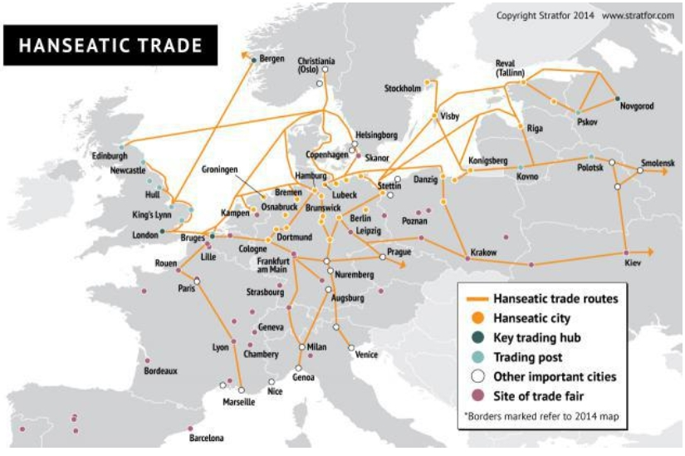

Slide 6
New Hanza
The association of northern European partner cities founded in 1980 in Dutch Zwolle. The goal of this relationship is the development of tourism and trade in member cities. The new Hanza took over the traditions of the medieval Hansa.
The New Hanza organizes annual conventions in one of the cities - members (Hansa Days). The most important organ of the Union is the Congress of Hanseatic Cities, in which delegates from each member city take part.

Slide 7
The new hanseatic logo

Slide 8
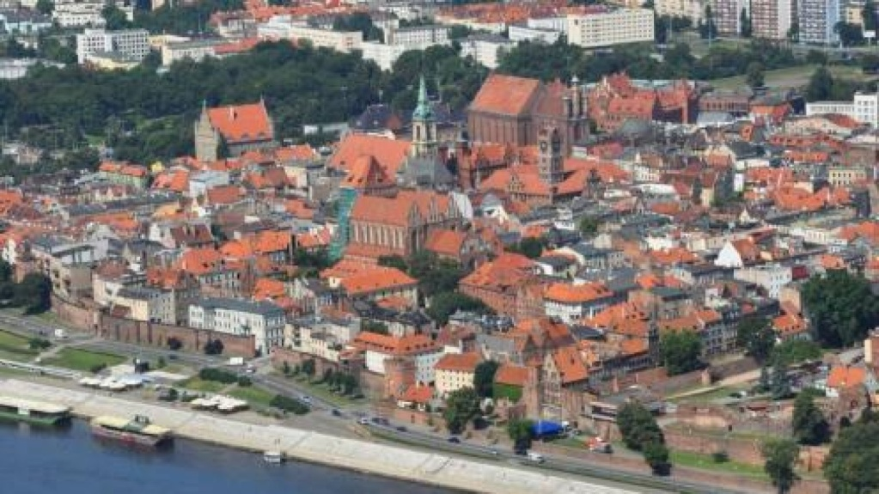
The most important Polish part of the Hanseatic route
Toruń
The city of Toruń from 1295, next to Elbląg (and later, from the 15th century also Gdańsk). In the fourteenth century, the role of Toruń as the initiator of convening the conferences of Prussian cities and the coordinator of trade policy issues on foreign markets became established.

Slide 10
Toruń in the 13th and 14th centuries took part in the most active part of both the HaHan and the Flemish life. Representatives of Toruń often performed the function of older so-called the Westphalian-Prussian tide in a bureau in Bruges, existing since 1347.
The early development of Toruń's European trade, especially the trade in Flanders with flannel, is confirmed by the construction of a merchant house (cloth) in 1259 (today part of the Old Town Hall). It was the first, and for 38 years, the only such investment in the cities of the Teutonic Order!

Slide 11
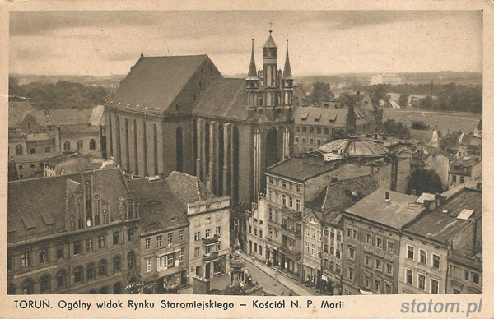
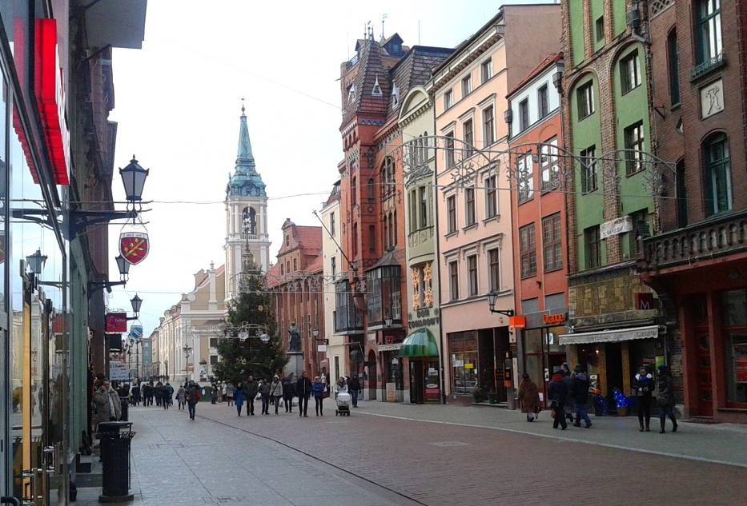
In the spring of 2009, 22 stylized coats of Hanseatic cities, with which Toruń maintained lively trade relations in the Middle Ages, created a unique alley in the pedestrian street, ul. Wide.
The boards were made of steel, brass, reddish brass and black stone. 22 signs are supposed to remind the inhabitants and tourists of the time of the greatest prosperity of Toruń - the Middle Ages and the Early Modern Age.

Slide 12
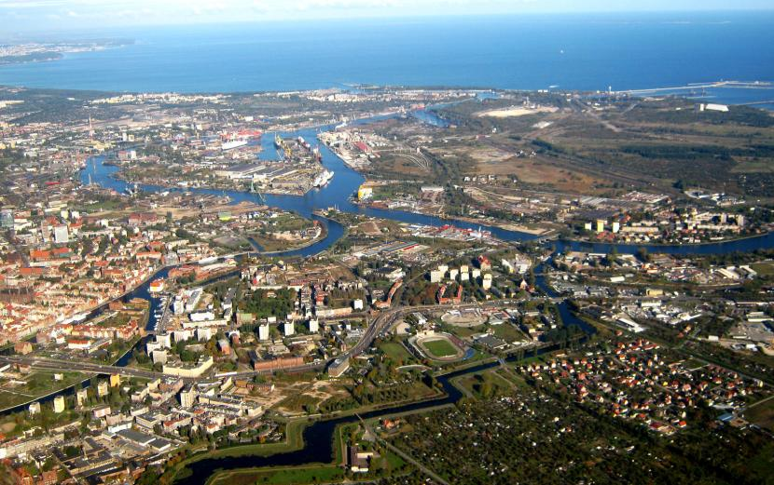
Gdańsk
Gdańsk was the largest of the Hanseatic cities in this part of Europe. Due to the favorable location at the intersection of north-south and east-south routes, it had a large commercial tradition dating back to early medieval times. The economic importance of the mouth of the Vistula forced Gdańsk to expand the city and create a port. This also resulted in an increase in Gdansk's activity and involvement in Hanseatic politics.

Slide 13
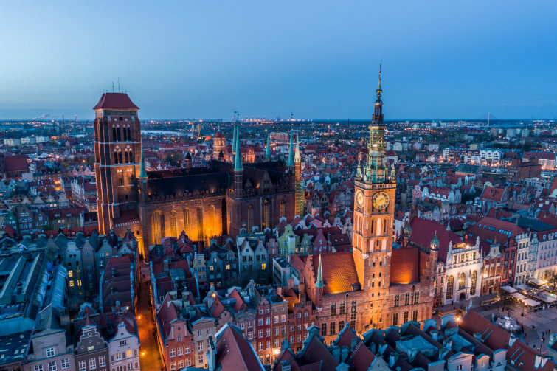

Slide 14
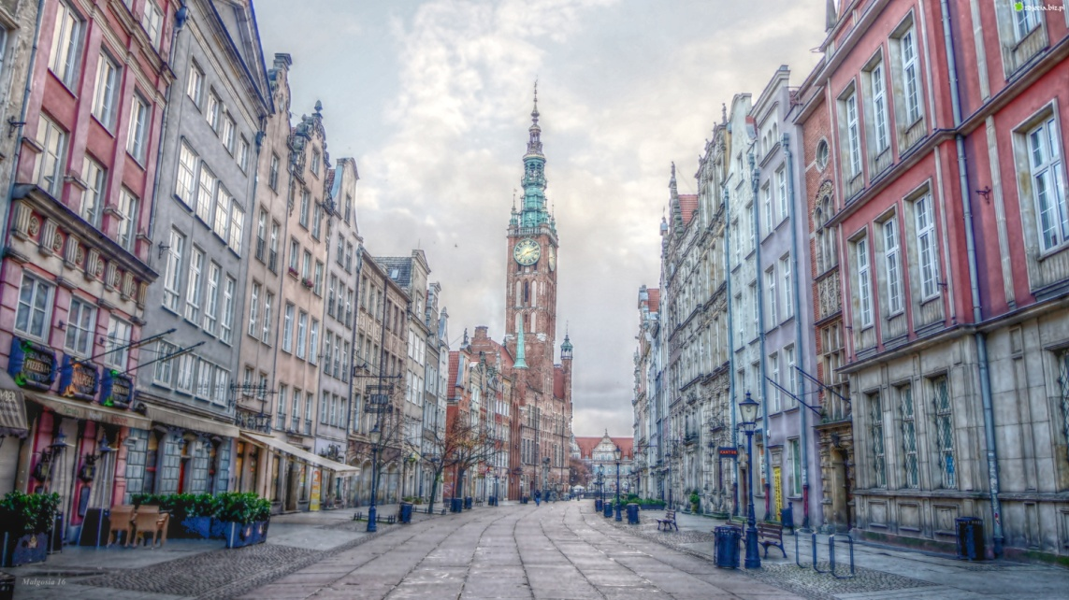
The city maintains the memory of the Hanseatic League and the “Golden Age”, with every street having its own charm. The admirable Royal Road, which leads from the High Gate to the Green Gate, fascinates with its facades of stately burgher houses, the prestigious Town Hall and historic Artus Court. The Long Bridge on the Motlawa River is a magnificent promenade, running near the historical granaries and the huge crane gate, formerly part of the port facilities of old Gdansk. A romantic mood prevails in quiet Mariacka Street, which leads from the mighty Mariacki church, through the Mariacka Gate to the Long Bridge

Slide 15
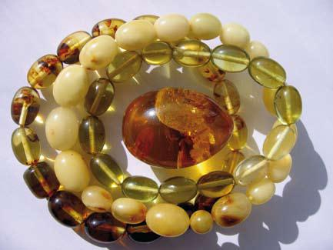
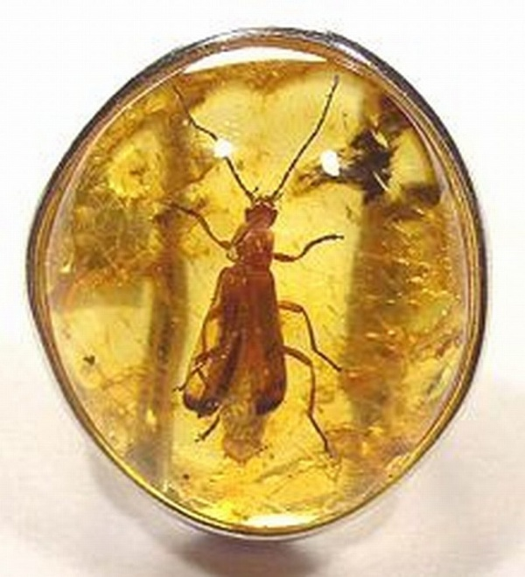
This is a magnificent example of early Gdansk architecture, with its famous porches and the narrow, richly decorated facades of houses that once belonged to rich goldsmiths and merchants. For centuries Mariacka Street has attracted artists, craftsmen and jewellers, while today the street is full of jewellery workshops and unique amber galleries. Gdansk continues to cultivate its century-long tradition as the world’s capital of amber.

Slide 16
Hansa Square
This name was worn from 1898 by a square located in the area of ​​today's Wały Piastowskie and Łagiewniki Streets. This square, established in the place of dug modern embankments, had an area of ​​1.24 ha and contained, among the greenery, several playgrounds for children's play. It was surrounded by avenues planted with rows of limes, maples and ash trees. After 1945, the Hansa Square ceased to exist.
At the end of the later Hansa Square, once stood the Oliwa Gate. The building of the State Archives (Staatsarchiv) built in 1901 adjacent to the Hanse Square was in operation until today as the State Archives in Gdańsk. On the corner connecting the Hanse Square with Lagiewniki a school was built. Piotr (today I LO). There were villas on the opposite side to the Archives, and the most-known villa of the President of the Senate, WMG, from Dyrekcyjna Street.
After the war, a building was erected on the Square, which today houses, among others, Solidarity headquarters and Wały Piastowskie street widened. Hanse Square as a large square ceased to exist.

Slide 17
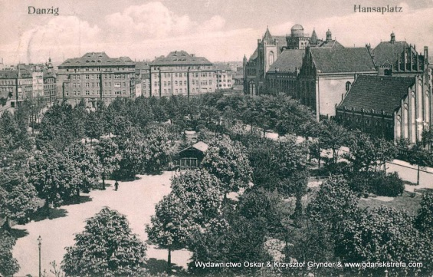
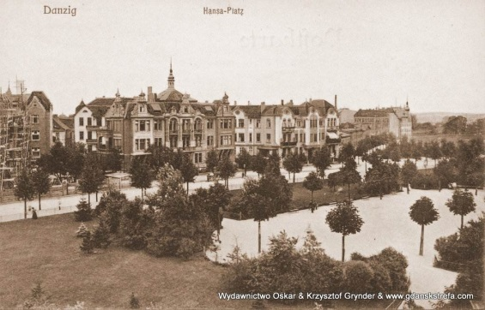

Slide 18
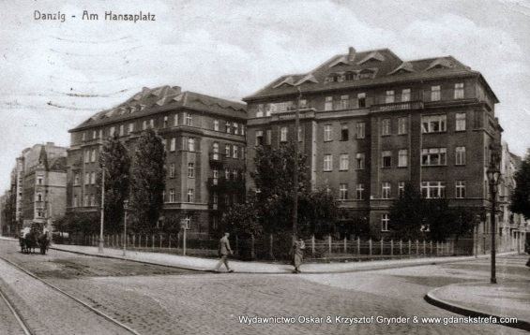
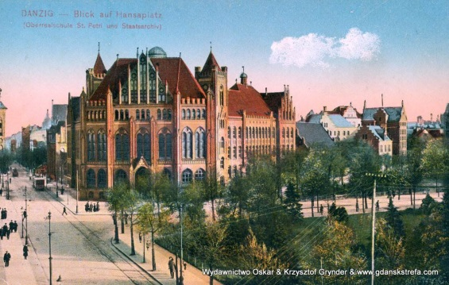

Slide 19
Bike trail R10, Seaside Hanseatic Trail
R10 is an international circular bike trail of the EuroVelo network running around the Baltic Sea basin with a total length of 8,539 km. The Polish section of the 588 km route runs through the areas of the following provinces: West Pomeranian, Pomeranian and Warmian-Masurian.
The coastal landscape with dunes and cliffs is diversified by the coastal lakes Wicko, Gardno and Łebsko.
The greatest natural attraction on this section of the route is the Słowiński National Park. Part of the route between Ustka and Rowy (over 20 km) runs the so-called along the "Coiled Track" trail, a good ground surface on the former embankment of the railway line dismantled after the Second World War. In the area of ​​the National Park, you can cycle along all designated tourist routes, but some of them may be impassable due to the marshy and sandy areas on which they run.

Slide 20
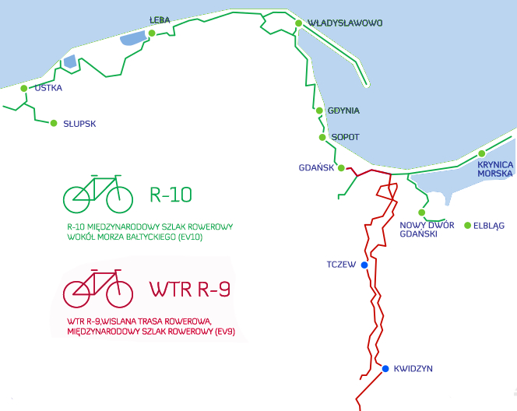

Slide 21
The Hanseatic Cities Route in Poland
Goes through 163 cities from 16 European countries and covers Polish cities: Stargard Szczeciński, Goleniów, Koszalin, Słupsk and Gdańsk. Coordination the project is being dealt with by the German organization Die Hanse based in Lübeck (www.hanse.org).
The trail in Poland is not it is marked, although there are Polish materials advertising or guides regarding Hanza trail. Tourist organizations or representatives of marshal offices sometimes they take part in conventions of Hanseatic cities, however, interest in functioning the route from the authorities is minimal.

Slide 22
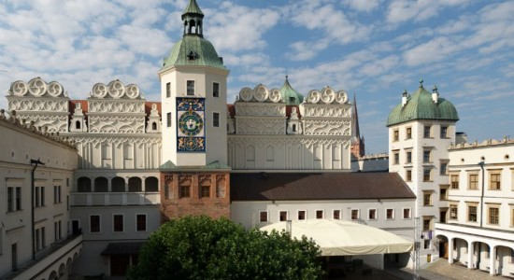
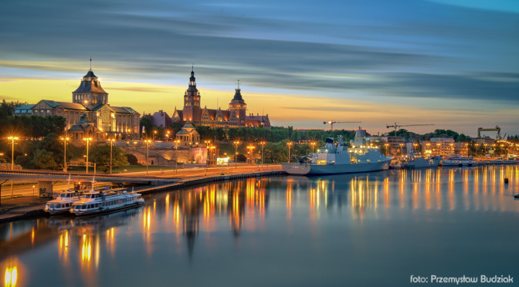
Traveling this trail, we can admire beautiful monuments and places, among others, in Szczecin (Wały Chrobrego, the Pomeranian Dukes' Castle, the Royal Gate, Solidarity Square, Karłowicz Philharmonic, birthplace of Tsarina Catherine II, Basilica of St. Jacob, Loitz's tenement house, Seven Pillars Tower)
The trail is accessible to everyone, it is best to walk it on foot or by car, sometimes trips from different cities are organized. There are no restrictions on the road.

Slide 23
Thank you for your attention!
Martyna Ziomek
Nina Kiersznowska

