Slide 1
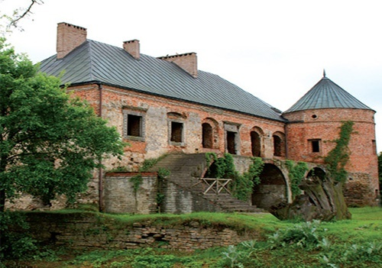
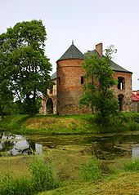
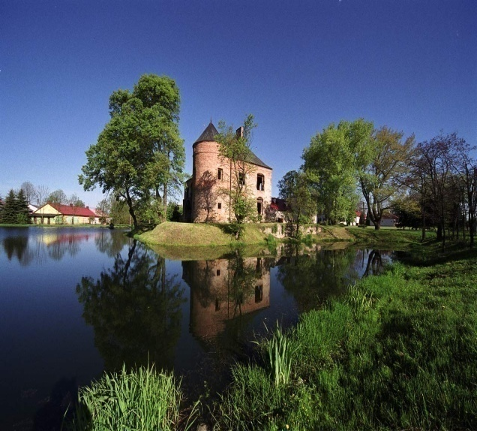
Manor House in Modliszewice
Manor House in Modliszewice

Slide 2
,
Beginning
The manor house is located in Wojewódzki Ośrodek Postępu Rolniczego. This place is close at the weekends, but you can use the bell and ring to ask for an invite.

Slide 3
Description
In small village Modliszewice near Końskie there are grandly riuns of defensive court. They are located on a fake land and till today surrounded by water.The present appearance is the effect of not finished works from the 80’s. Original walls are fixed with the conteporary ones. There is also a small part of short wall which has sourounded once an object. The court has been built along the lines of rectangle. There are two floors and two defense buildings. We can also notice a really interestnig architectural details, windows, doors, terraces. Of course inside there is nothing but next to the doors there is a latin inscription taken from the Wawel’s gate. Near the court there is a renovated building with shooting holes and an object called smithy. The ruins are waiting for an owner who will finish this construction.

Slide 4
Position and Approach
North part of a świętokrzyskie county. Two kilometers from north-west from town Końskie. Thirty-three kilometers from south from Opoczno. You can get to Końskie by the train. Next get a bus or go on foot. The buliding is just next to the road.

Slide 5
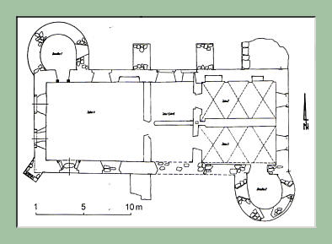
Plan

Slide 6
History
Defensive Court in Modliszewice was built by Andrzej Dunin Modliszewski who was the owner of those grounds. He built it on the old place of castle or court ‘Odrowążów’ but we don’t know antyhing about that court.
First there was built a main object and then other two towers. The wooden bridge leads to the court.

Slide 7
• XVII century – Jan Lipski bought Modliszewice from ‘herb Łada’. He was an Archbishop of Poland * 1630 – He built a multi-storey object and he surrounded whole building by a short wall. *End of XVII century – The court was taken by Humiecki. *First half of XVIII century – and then it was taken by Małachowscy. They built a block called smithy. Tarnowscy were the next owners but they didn’t do antyhing with the court. *1939-45 –during the occupation court was the place of cruel German named Fitting. He forced Polish to the murderous work and he stole all people’s areas. He ordered to build a shooting tower because he was afraid of the coup. It didn’t help him because he was killed of the command of the national army. *1976 – archeology research were performed by E. Gąssowska and L. Kajzer *1983 - 85 - Wojewódzki Ośrodek Doradztwa Rolniczego rebuilt this object, gates and smithy. *1985 - 90 –the court was rebuilding but the works were stopped. The reason of that was the lack of money.

Slide 8
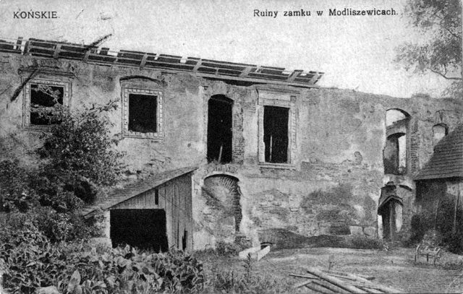
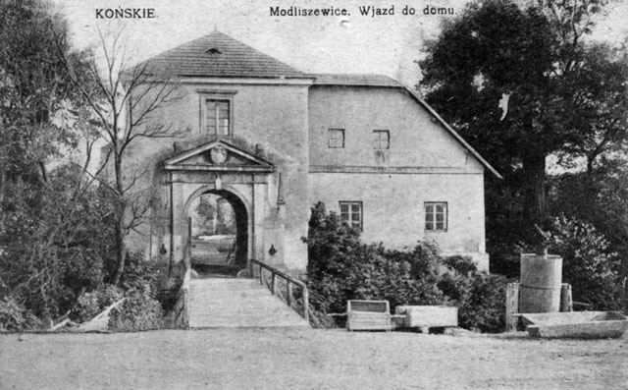
Beginning

Slide 9
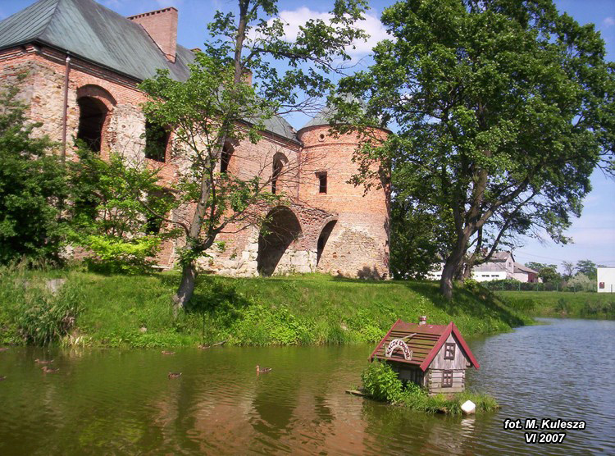
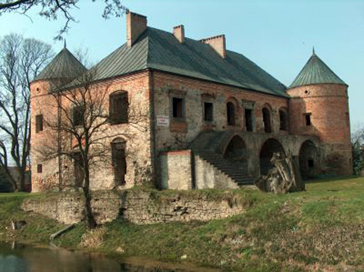
Now

Slide 10
Wykonały: Sandra Boczek Oliwia Nowak

