Slide 1
POLAND

Slide 2
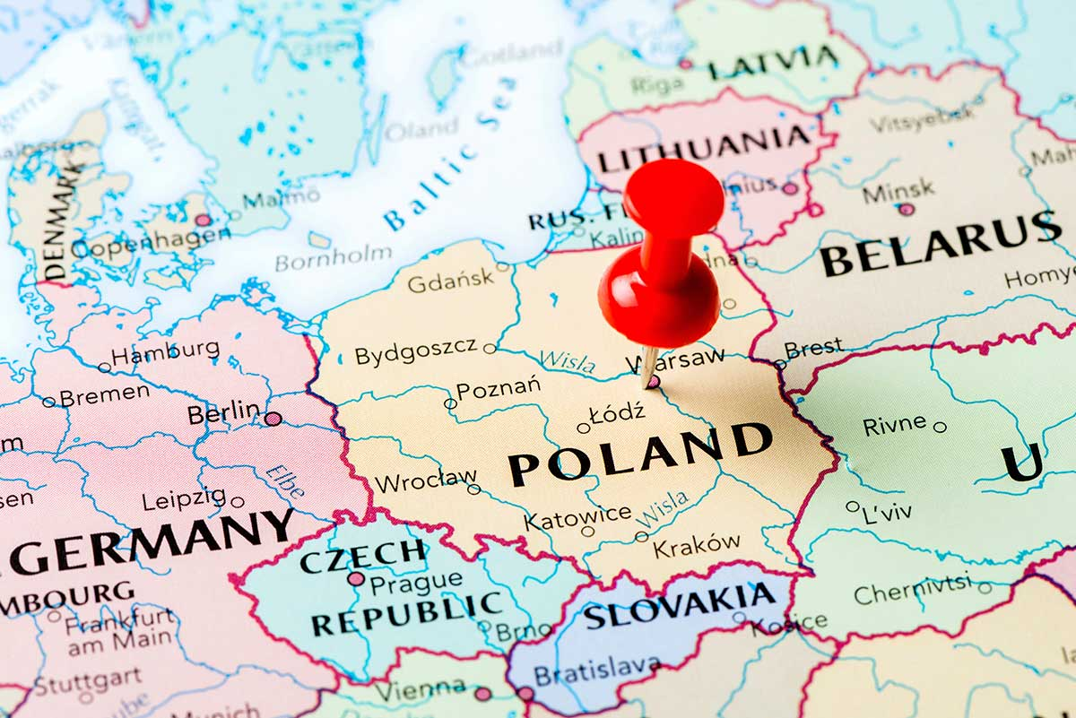
THE HEART OF EUROPE
Poland is a country in central Europe, bordered by Germany to the west; the Czech Republic and Slovakia to the south; Ukrainne, Belarus and Lithuania to the east; and the Baltic Sea and Kaliningrad Oblast, a Russian Exclave, to the north.

Slide 3
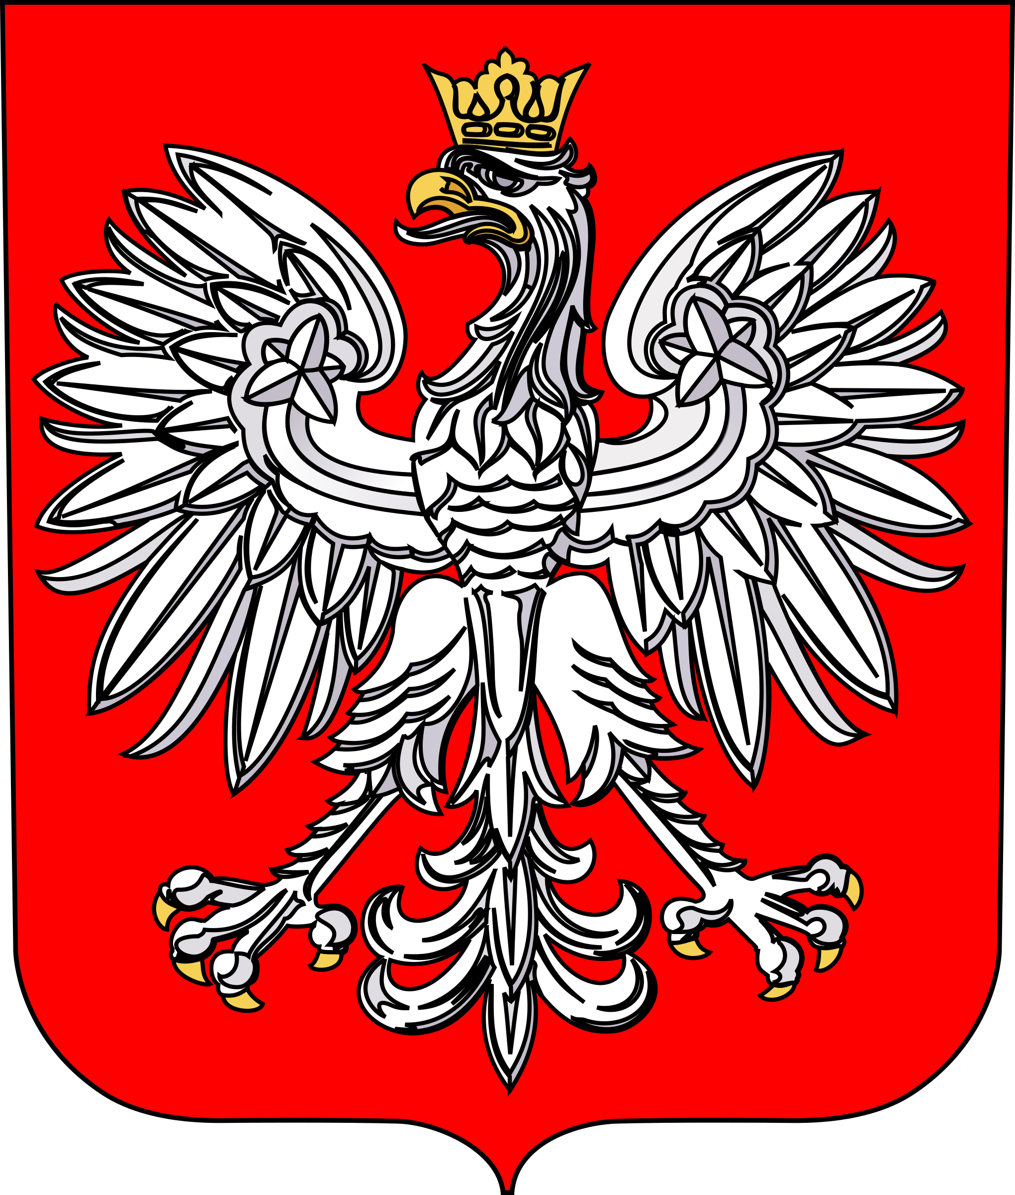
NATIONAL SYMBOLS
The flag of Poland consists of two horizontal stripes, the upper one white and the lower one red.
The White Eagle is the national emblem. It is an image of a crowned white eagle with a golden beak and talons, and wearing a golden crown, in a red shield in a red field.
Mazurek Dąbrowskiego is the national anthem of Poland.
The lyrics was written by Józef Wybicki in 1797.

Slide 4
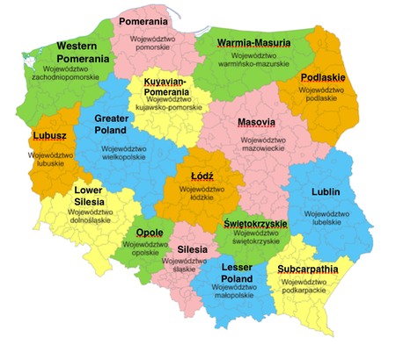
REGIONS IN POLAND
Poland is divided into 16 districts (called voivodeships). The biggest one is Masovia with the capital city Warsaw.
The total area of Poland is 312,679 square kilometers, making it the 69th largest country in the world and the 9th largest in Europe.
Poland has a population of over 38.5 milion people, which makes it the 34th most populous country in the world and 6th most populous member of the European Union.

Slide 5
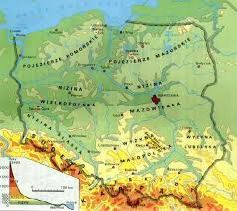
GEOGRAPHICAL FEATURES
The Polish landscape is very diverse, starting from the Mountains in the south through the central lowlands to the Lake District Masuria and the Baltic Sea – in the north.
The Vistula River is the longest river in Poland - 1,047 kilometers in length.
The north-western summit of Rysy in the High Tatras is the highest point of Poland with 2499 metres above the sea level.
Śniardwy in the Masurian Lake District is the largest lake in Poland – 113.8 square kilometers.

Slide 6
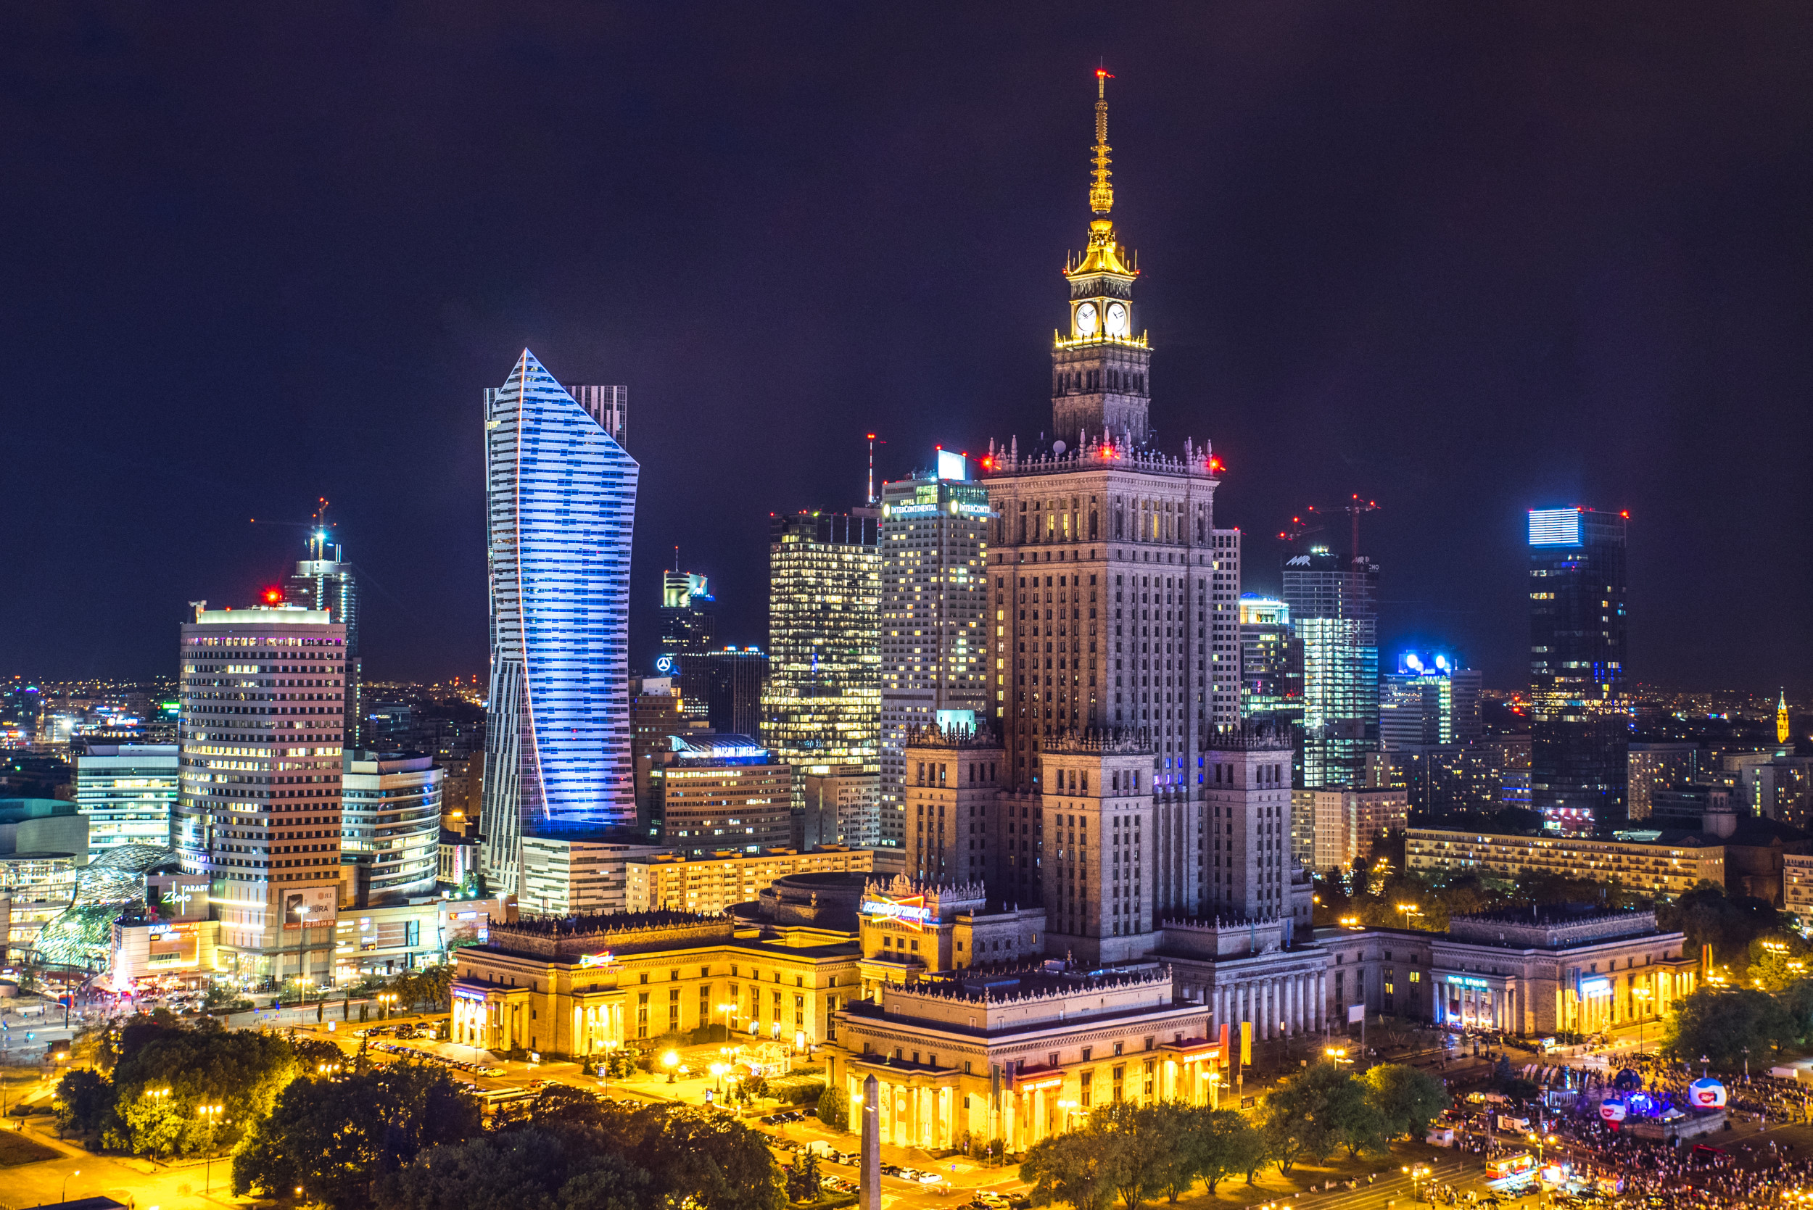
WARSAW - THE CAPITAL CITY
Warsaw is the largest city of Poland. It is located on the Vistula River. It has a population of about 1,8 milion residents. Warsaw is an economic, political, and cultural centre. Warsaw is a bustling metropolis and features an unforgettable history. It’s a city where a fourth of the terrain is covered by parkland and a city of culture for all tastes and budgets.
The symbol of the city is the Mermaid, featured on the city seal.

Slide 7
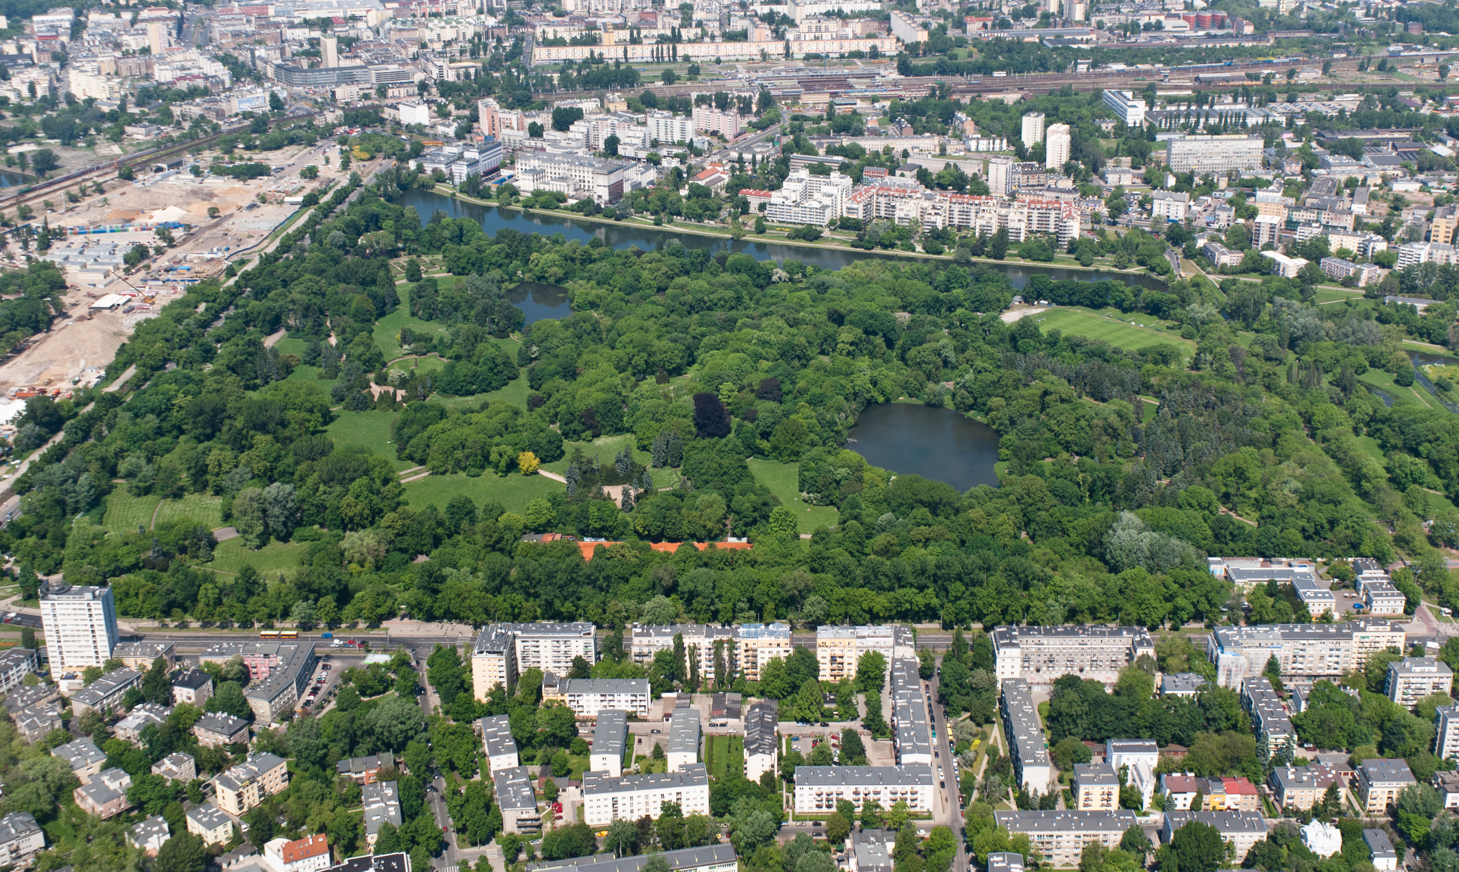
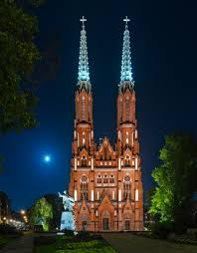
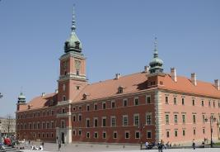
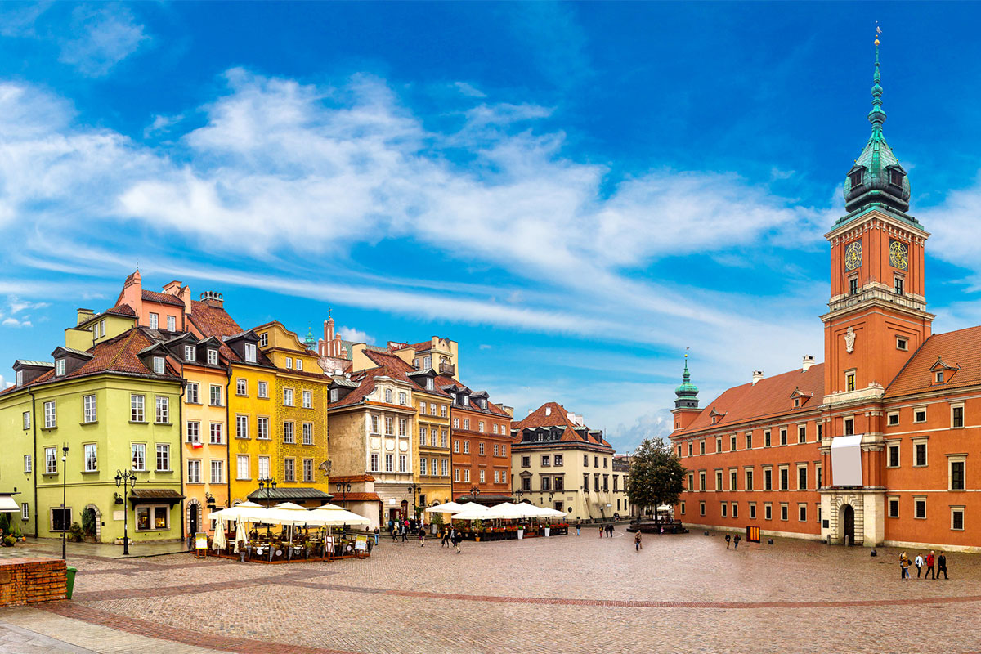
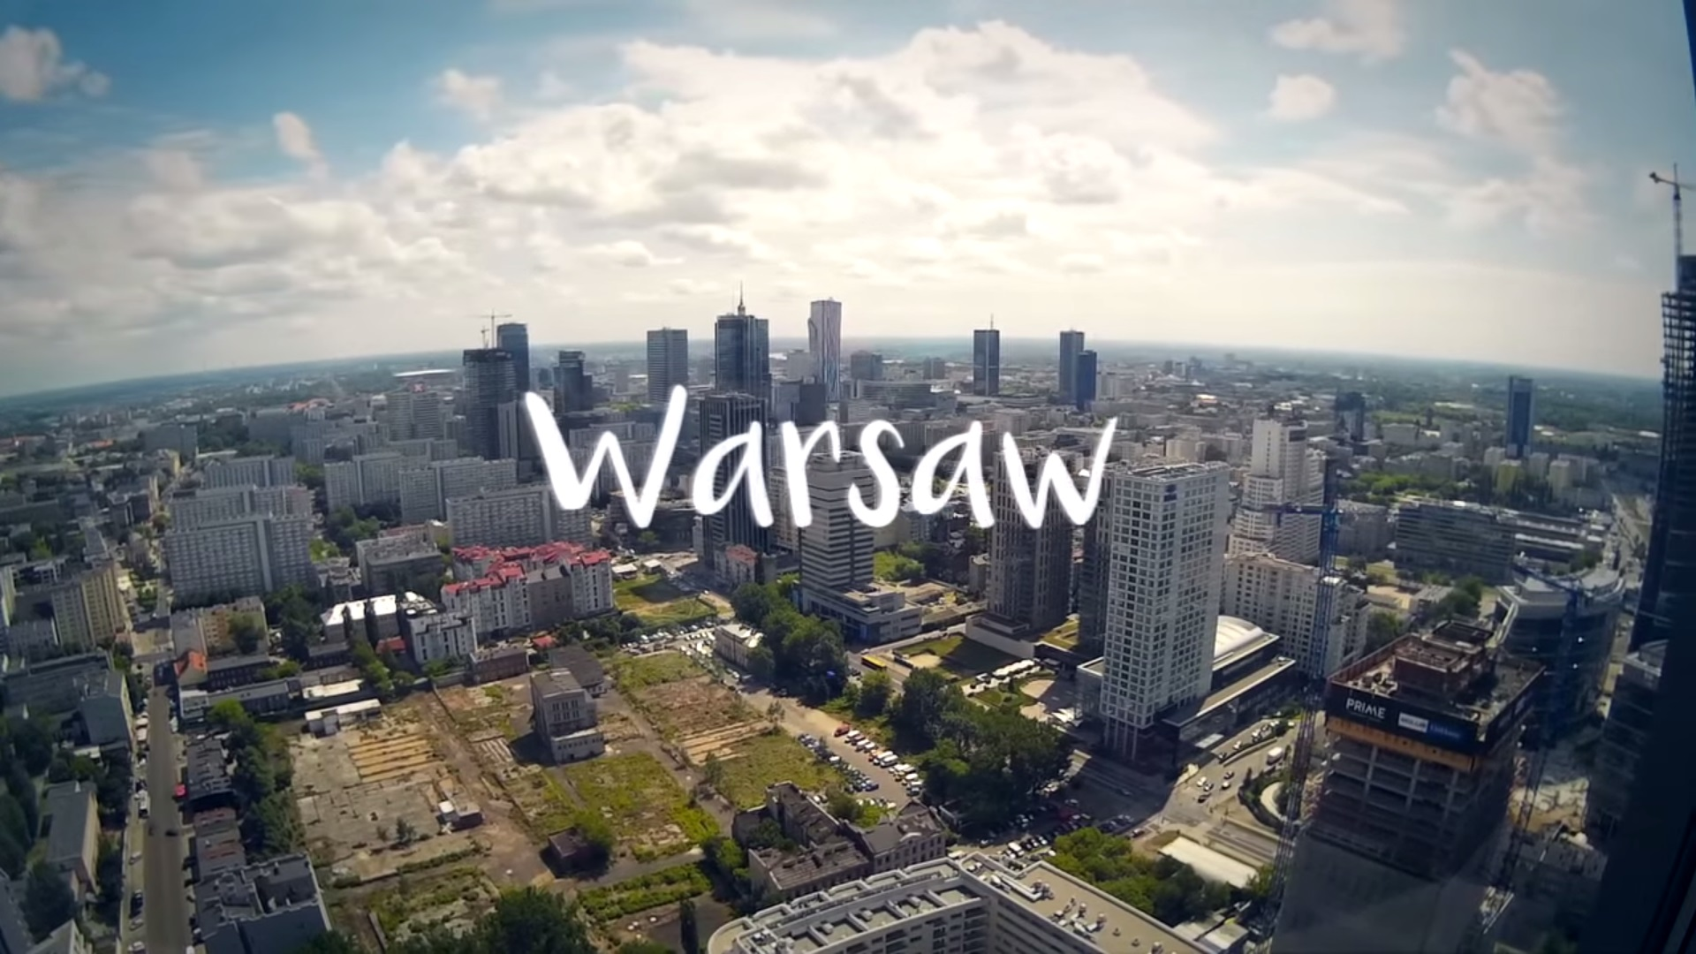
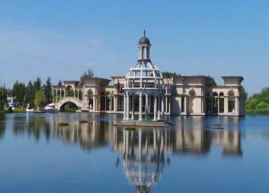
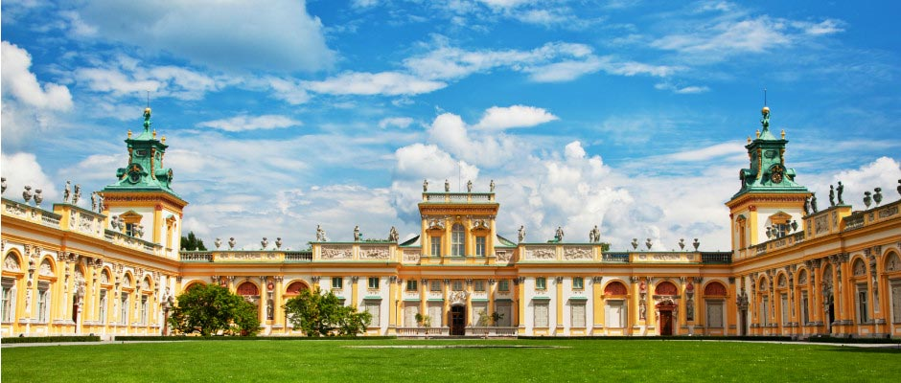
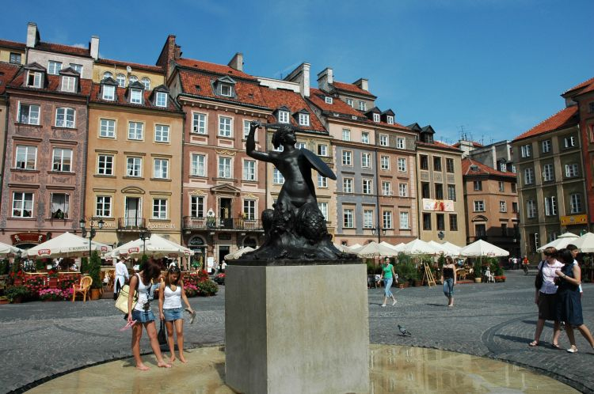
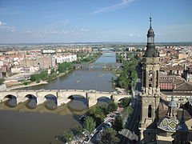
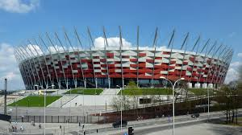

Slide 8
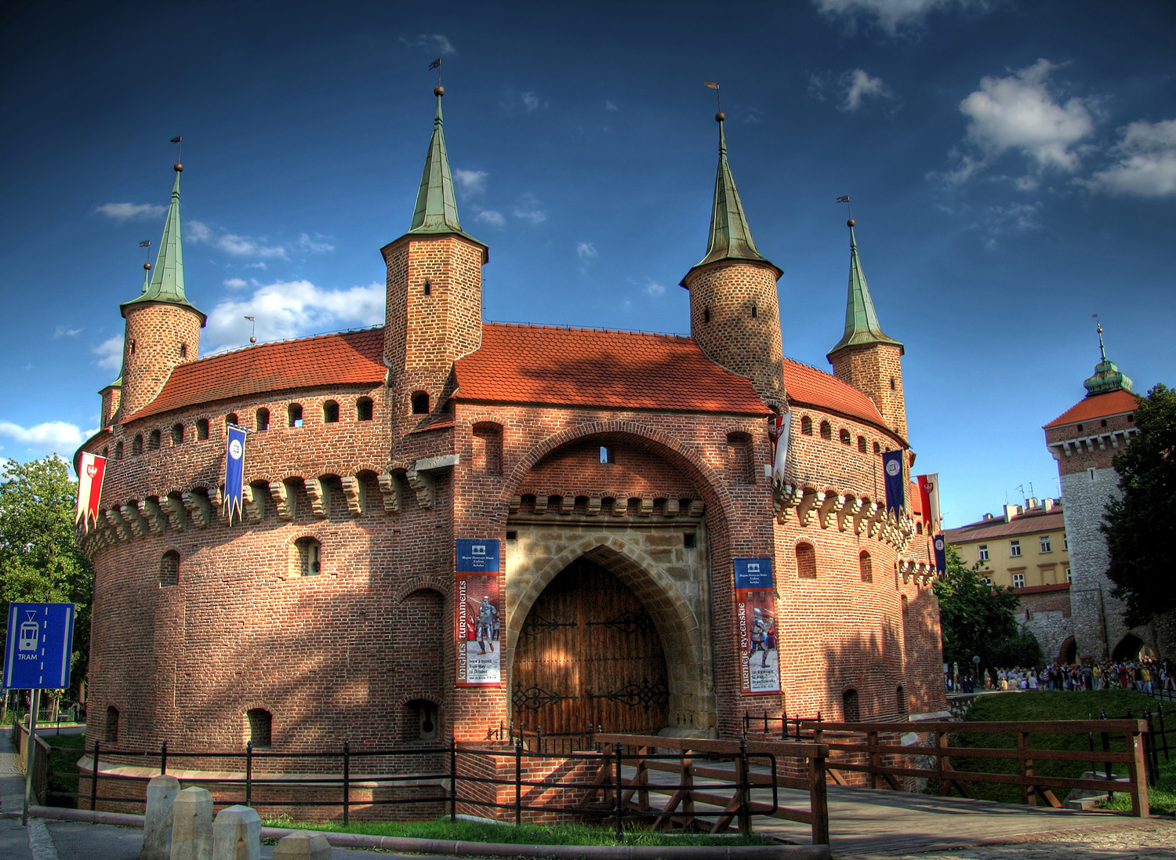
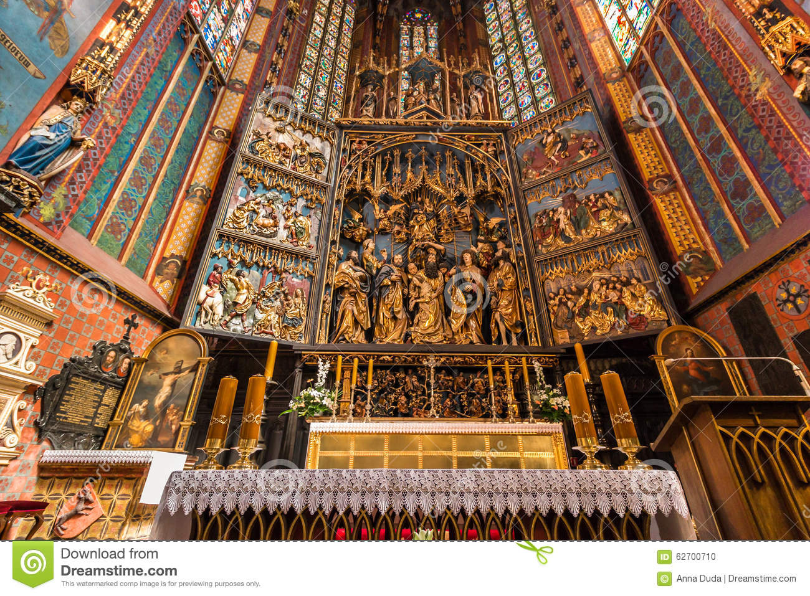
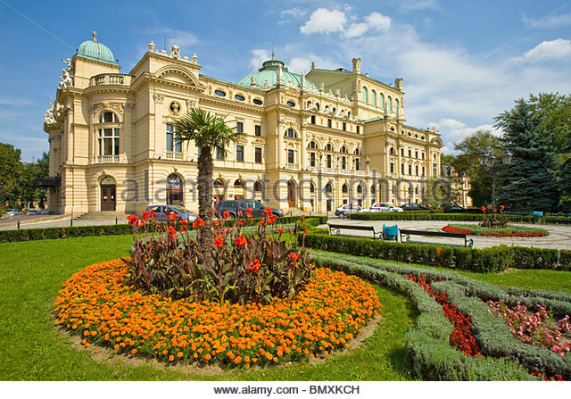
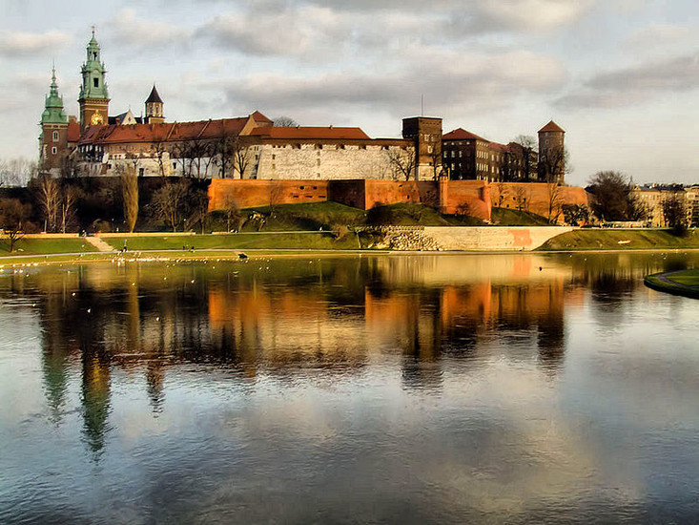
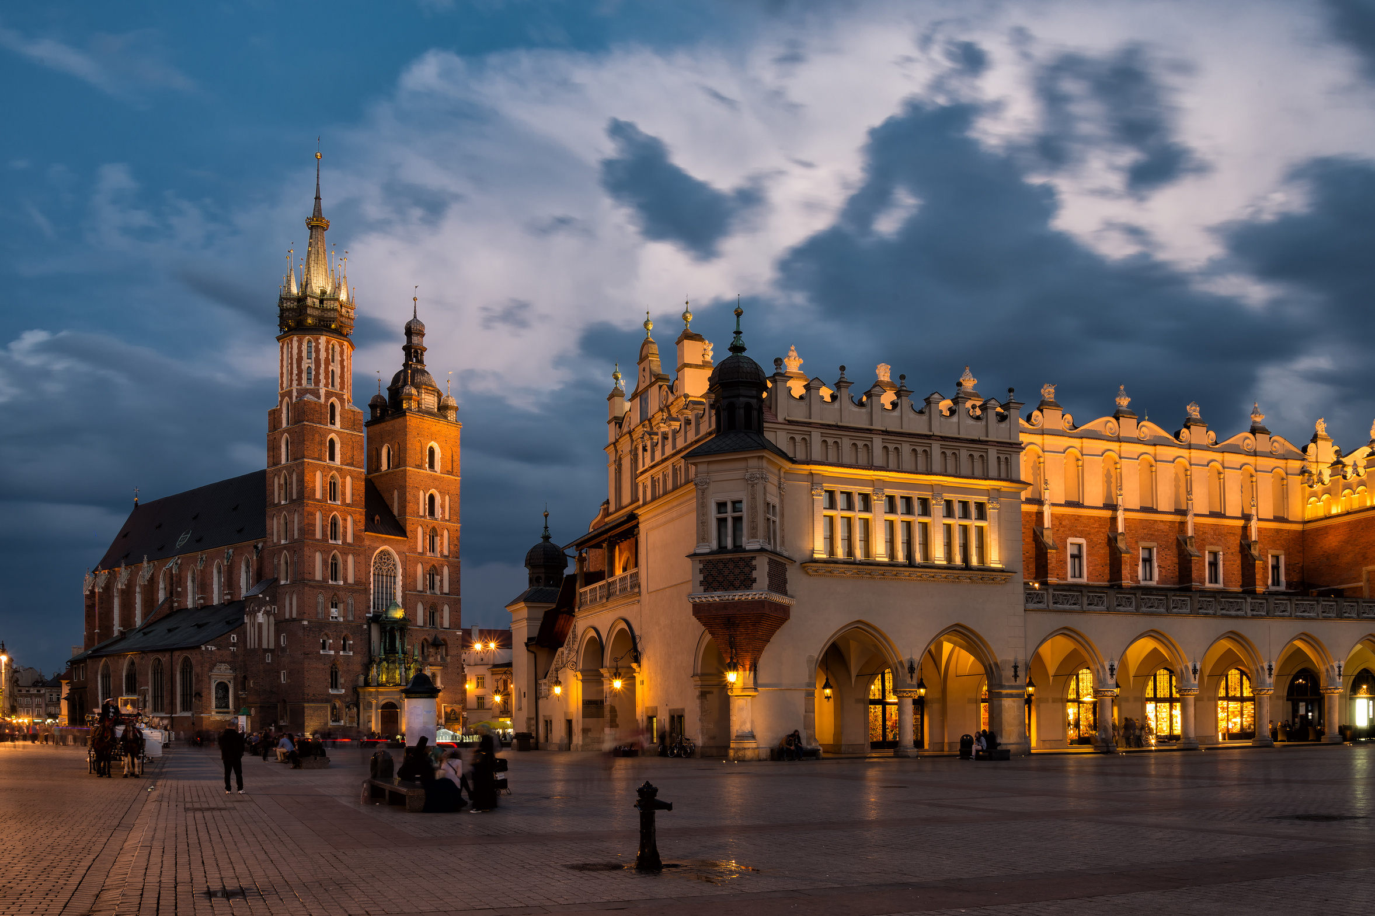
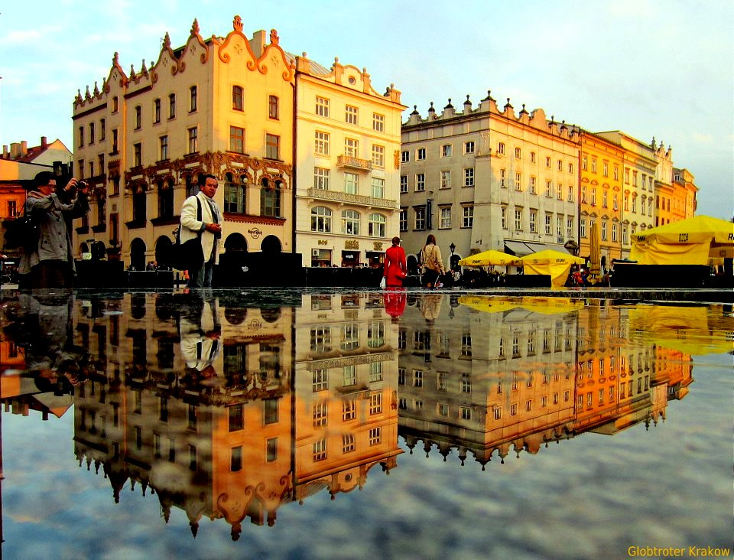
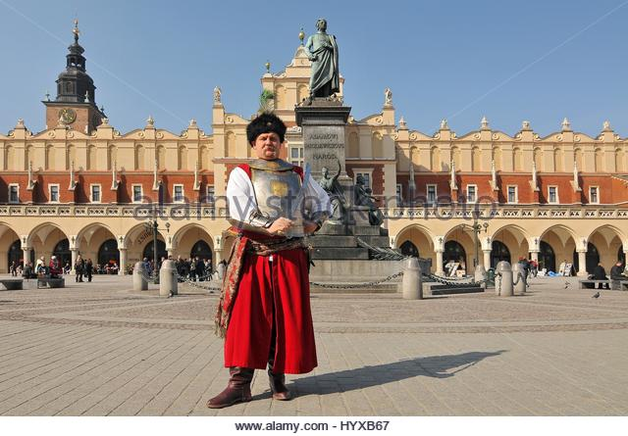
CRACOW is the second largest and one of the oldest cities in Poland

Slide 9
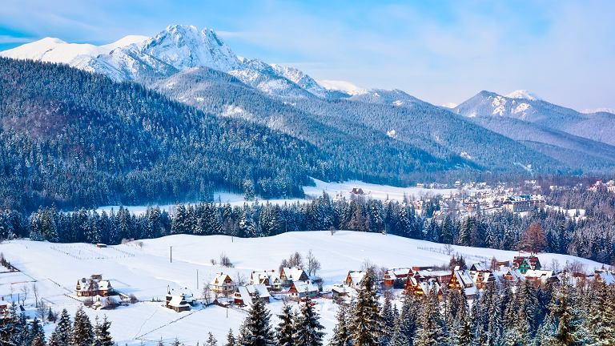
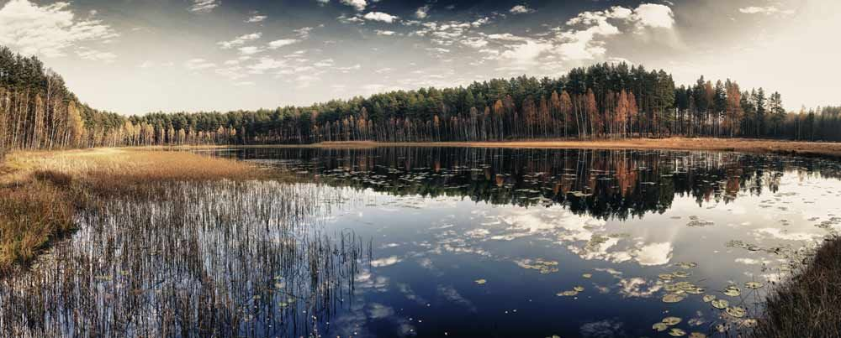
TOURISTS ATTRACTIONS IN POLAND
ZAKOPANE
WROCŁAW
MASURIA
TORUŃ
GDANSK
BALTIC SEA

Slide 10
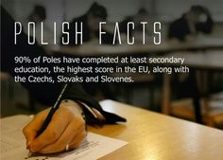
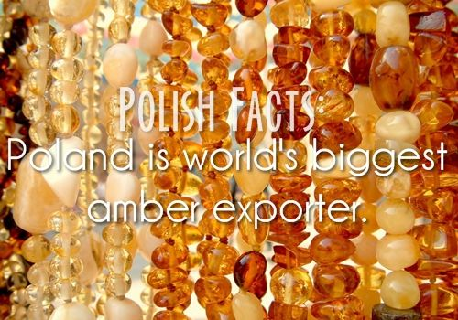
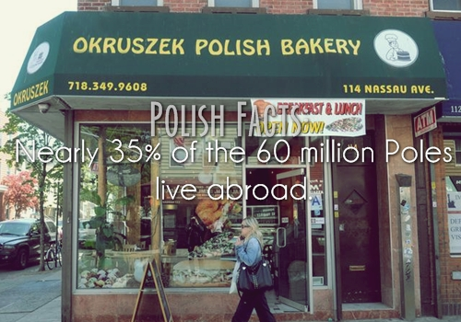
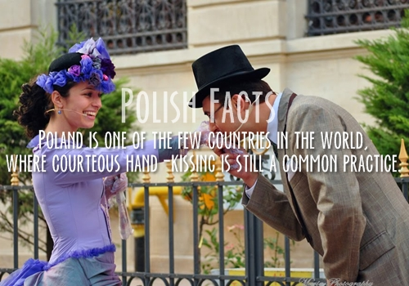
FACTS ABOUT POLAND

Slide 11
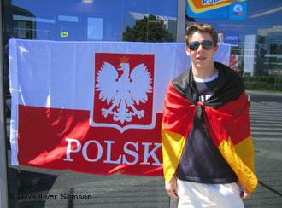
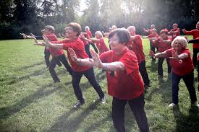
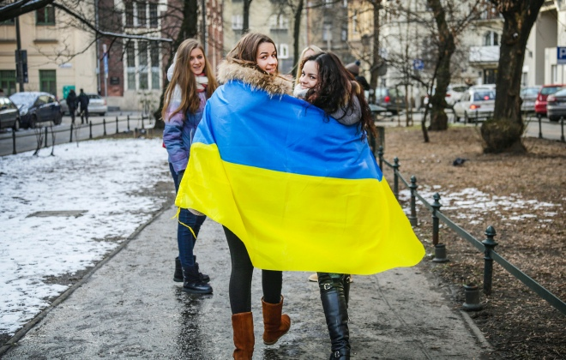
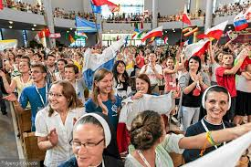
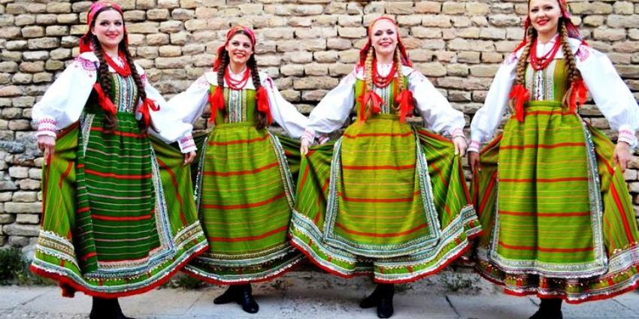
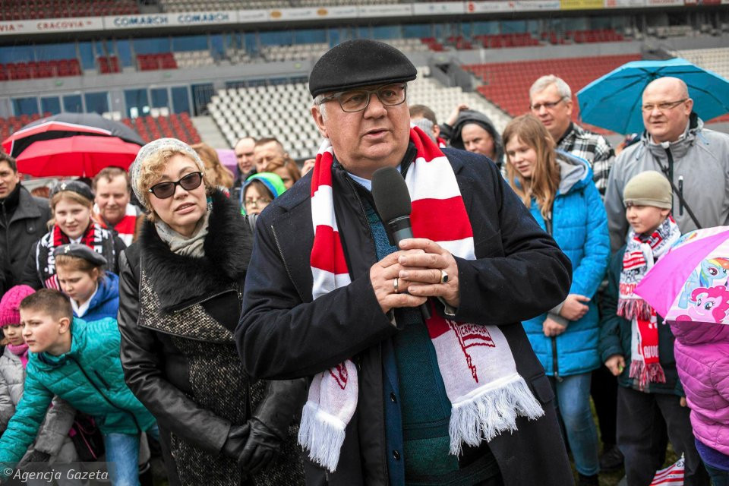
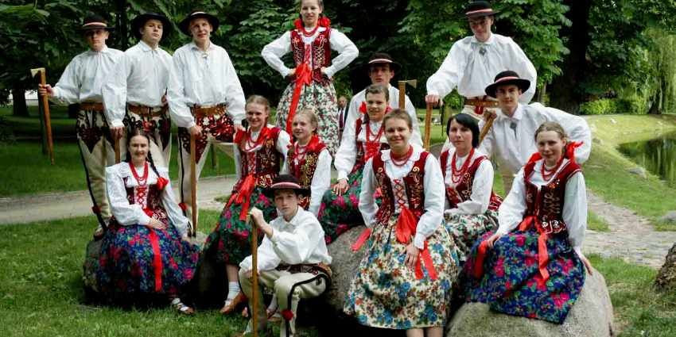
PEOPLE
Polish 97.6%
German 1.3%
Belorussian 0.6%
Ukrainian 0.5%

Slide 12
POLIsh language
Polish is an Indo-European language belonging to the West Slavonic group. Polish began to emerge around the 10th century.
The first written texts in Polish were translations of Latin prayers and sermons.
Polish is an inflected language with seven cases, two numbers, three genders in singular and two in plural.
Polish has five major dialects, spoken in Silesia, Malopolska, Mazovia, Wielkopolska and Kashubia.
This film shows how Polish is percived by foreigners.

Slide 13
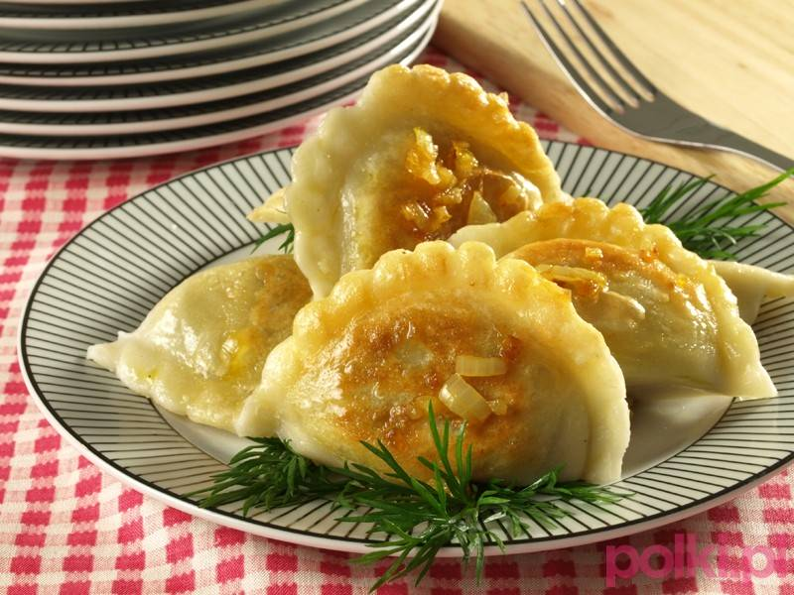
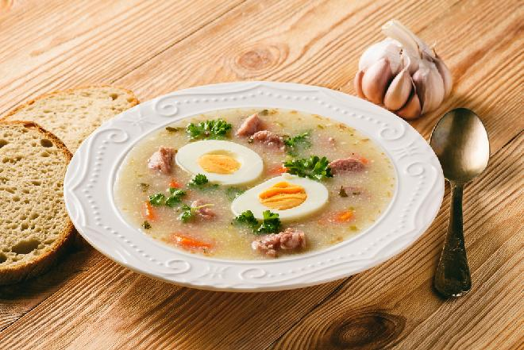
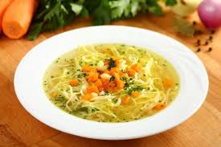
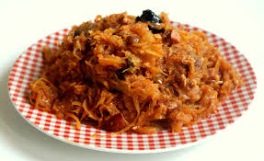
Polish food is very diverse and unique. Polish cuisine shares some similarities with other Central European and Eastern European traditions. Polish national cuisine is rich in meat, especially in pork, chicken and beef, vegetables and spices. There are many varieties of dishes prepared with cabbage, barely, beet, patatoes and wild mushrooms. Among the mos popular Polish national dishes there are:
PIEROGI
ŻUREK
ROSÓŁ
BIGOS

Slide 14
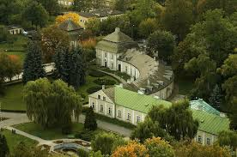
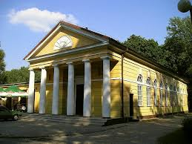
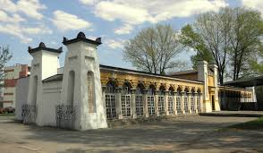
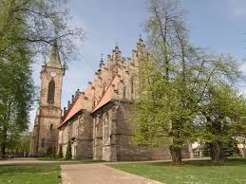
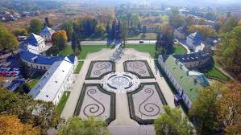
KOŃSKIE-OUR TOWN
Końskie is a town in central Poland situated in Świętokrzyskie Region with about 20 thousand inhabitants.

Slide 15
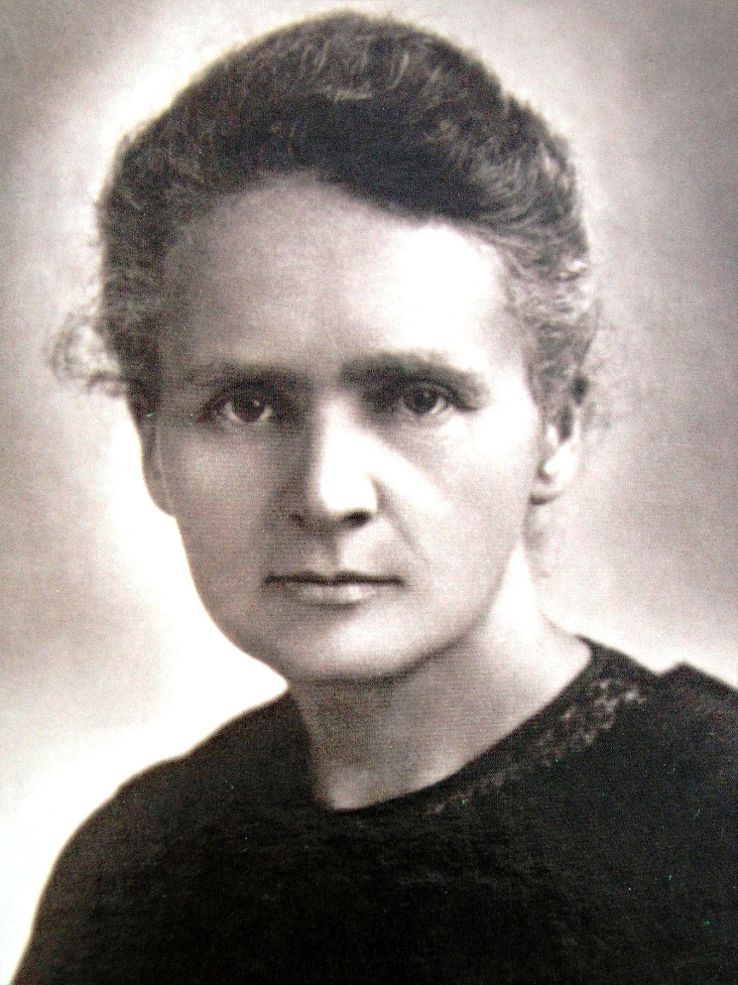
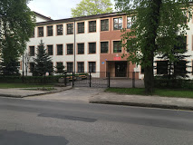
OUR SCHOOL
II LICEUM OGÓLNOKSZTAŁCĄCE im. MARII SKŁODOWSKIEJ-CURIE
SCHOOL
LOGO
PATRON
Our school is a secondary school of general education preparing students to national exams and studies at University. It lasts for three years and provides education for students aged 16-19. The school offers the students extended programme in foreign languages, maths, geography and other subjects needed for further education.
Marie Sklodowska-Curie was a Polish scientist who was the first woman to win a Nobel Prize and the only person to win the award in two differengt fields – physics and chemistry.

Slide 16
And there is much, much more…
Come to Poland and see for yourself!

Slide 17
Thank you for your attention!
Projekt „Paths of Europe”- współfinansowany w ramach programu Unii Europejskiej Erasmus+.
Publikacja odzwierciedla jedynie stanowisko jej autorów i Komisja Europejska oraz Narodowa Agencja Programu Erasmus+ nie ponoszą odpowiedzialności za jej zawartość merytoryczną.

