Slide 1
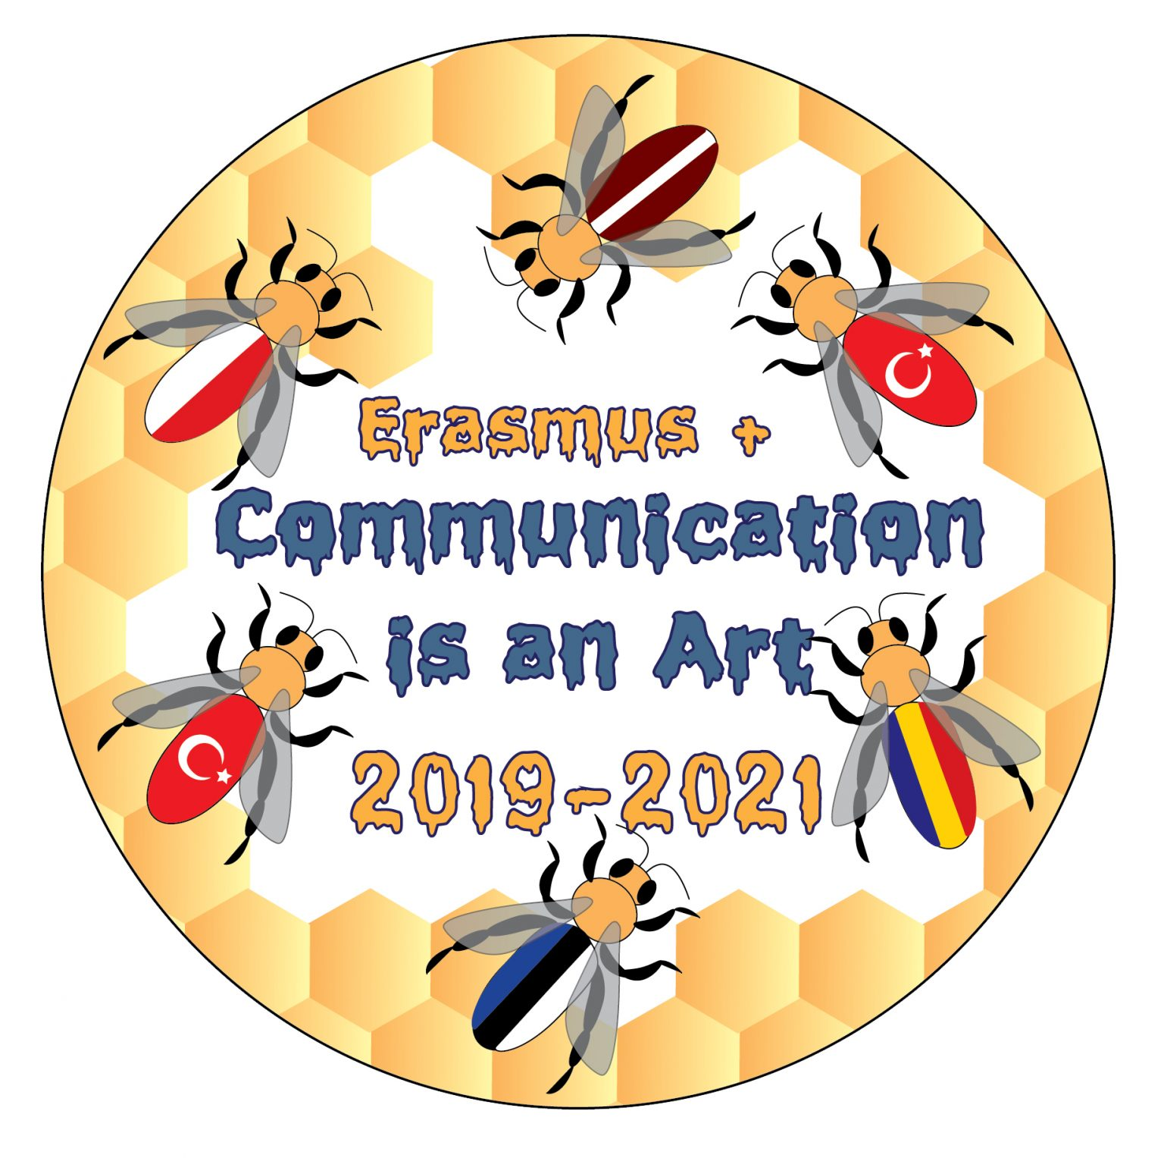
Communicating for Understanding
Jaunmārupes primary school
Latvia

Slide 2
What is communication?
Communication means transferring thoughts, information, emotion and ideas through gesture, voice, symbols, signs and expressions from one person to another.
Notes:
https://www.communicationtheory.org/types-of-communication/

Slide 3
How do we communicate?
Three things are most important and essential in any communication process they are Sender, Receiver and the Channel (medium).
The Sender is encoding the messages in any form like voice, written or any signs. So they often called as Encoder. The Receiver is decoding the message from the sender to understand the message. So they often called as Decoder.
Channel: Any message or Information needs some channel or a medium.
Example: television is an audio visual medium which decode the electronic signals into an audio-visual to the audience.

Slide 4
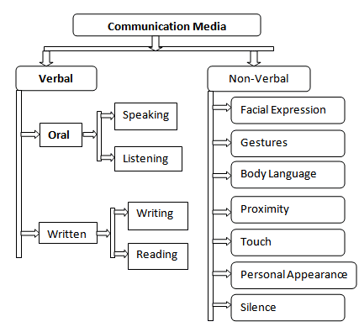
What are the types of communication?
Notes:
https://thebusinesscommunication.com/types-of-media-communication/

Slide 5
Visual communication
By definition, visual communication is the practice of graphically representing information to efficiently, effectively create meaning. There are many types of content in the realm of visual communication, with examples including infographics, interactive content, motion graphics, and more. The possibilities are endless. But no matter the medium, all incorporate at least some of the following elements: interactivity, iconography, illustration, supporting text, graphs, data visualization, and animation.
Notes:
https://killervisualstrategies.com/blog/category/visual-communication-2

Slide 6
Intercultural Communication
Intercultural communication is the verbal and nonverbal interaction between people from different cultural backgrounds. Basically, 'inter-' is a prefix that means 'between' and cultural means… well, from a culture, so intercultural communication is the communication between cultures. Sometimes, this is used to describe a single person trying to interact in a foreign environment but more often, it is a two-way street, where people from both cultures are trying to improve their communication..
Notes:
https://study.com/academy/lesson/intercultural-communication-definition-model-strategies.html

Slide 7
Why do we need communication?
Building Trust
Preventing or resolving problems
Providing clarity and direction
Creates better relationships
Increases engagement
Improves productivity
Promotes team building
Notes:
https://climb.pcc.edu/blog/the-7-benefits-of-effective-communication-in-personal-and-professional-settings

Slide 8
How have we communicated so far, what we have planned in the future and how it will benefit us?

Slide 9
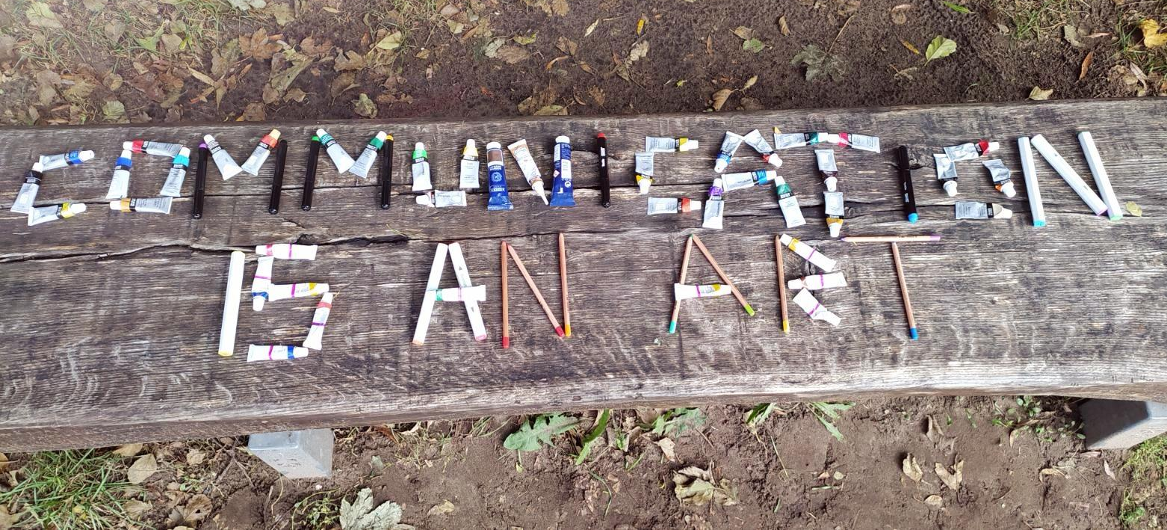
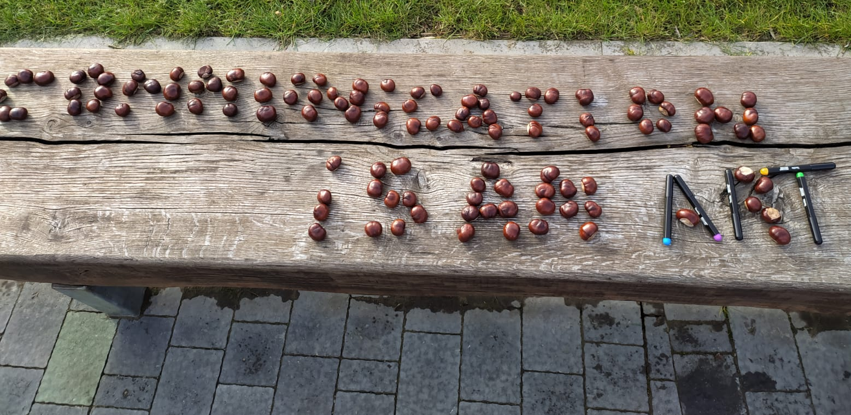
Creating the Erasmus+ Corner and Collage Event
Verbal and visual communication
Promoting teamwork, solving problems, creating better relationships etc.

Slide 10
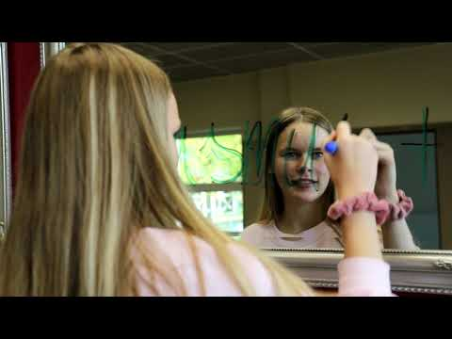

Slide 11
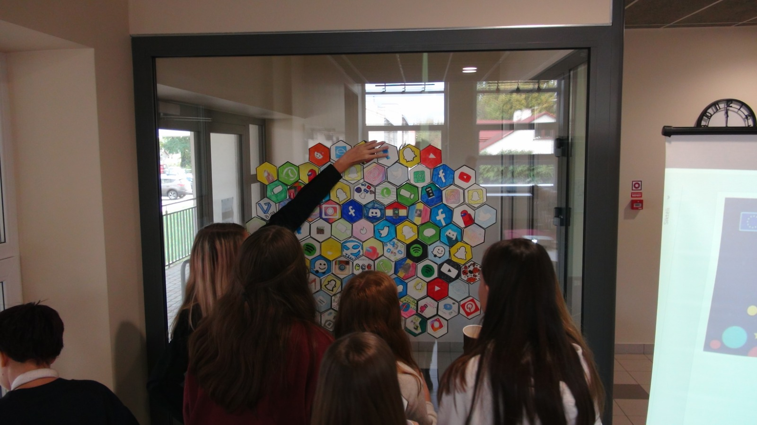
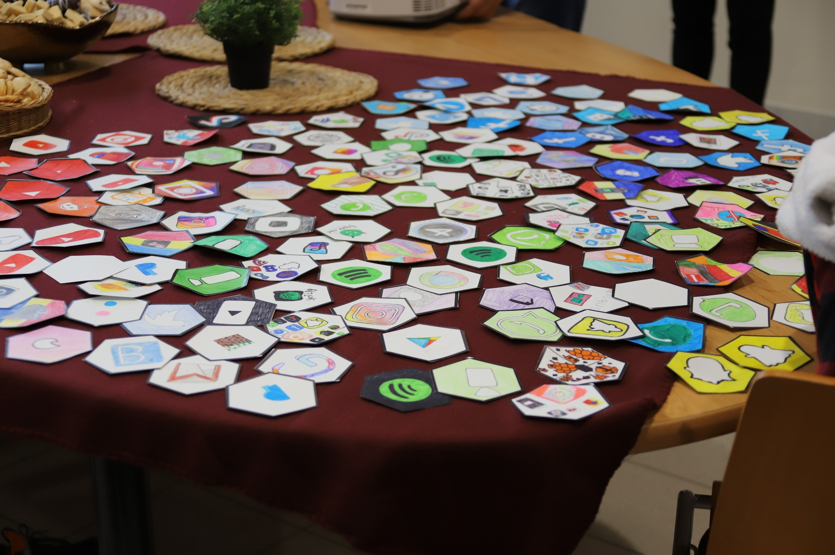
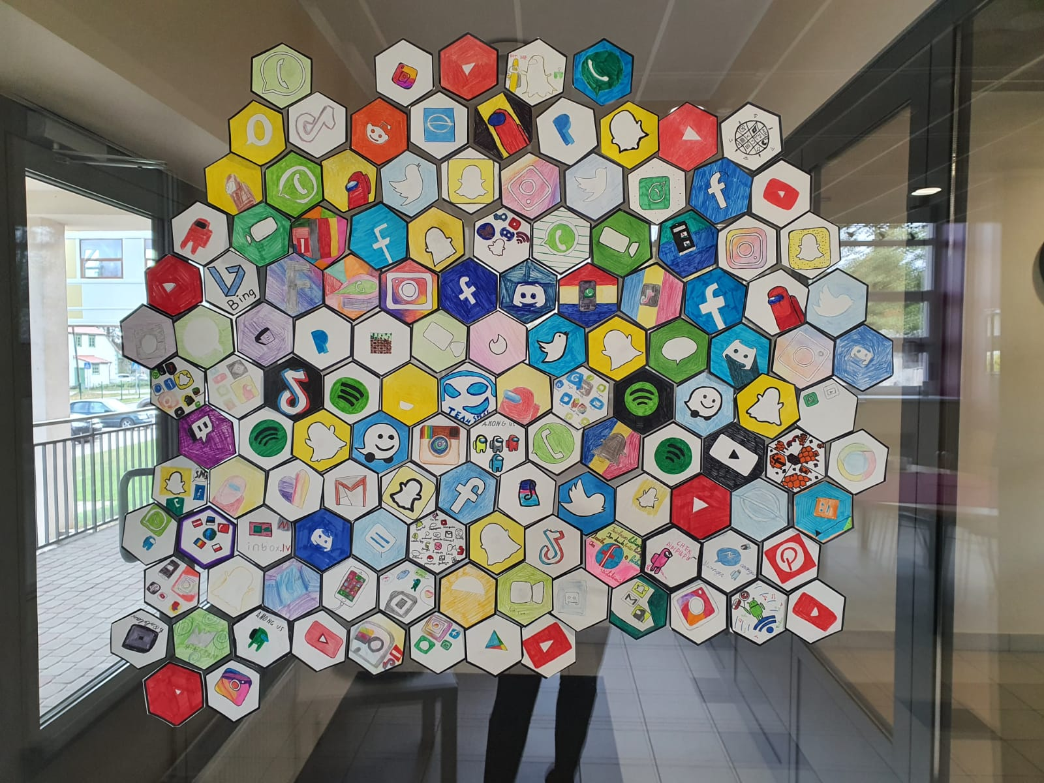
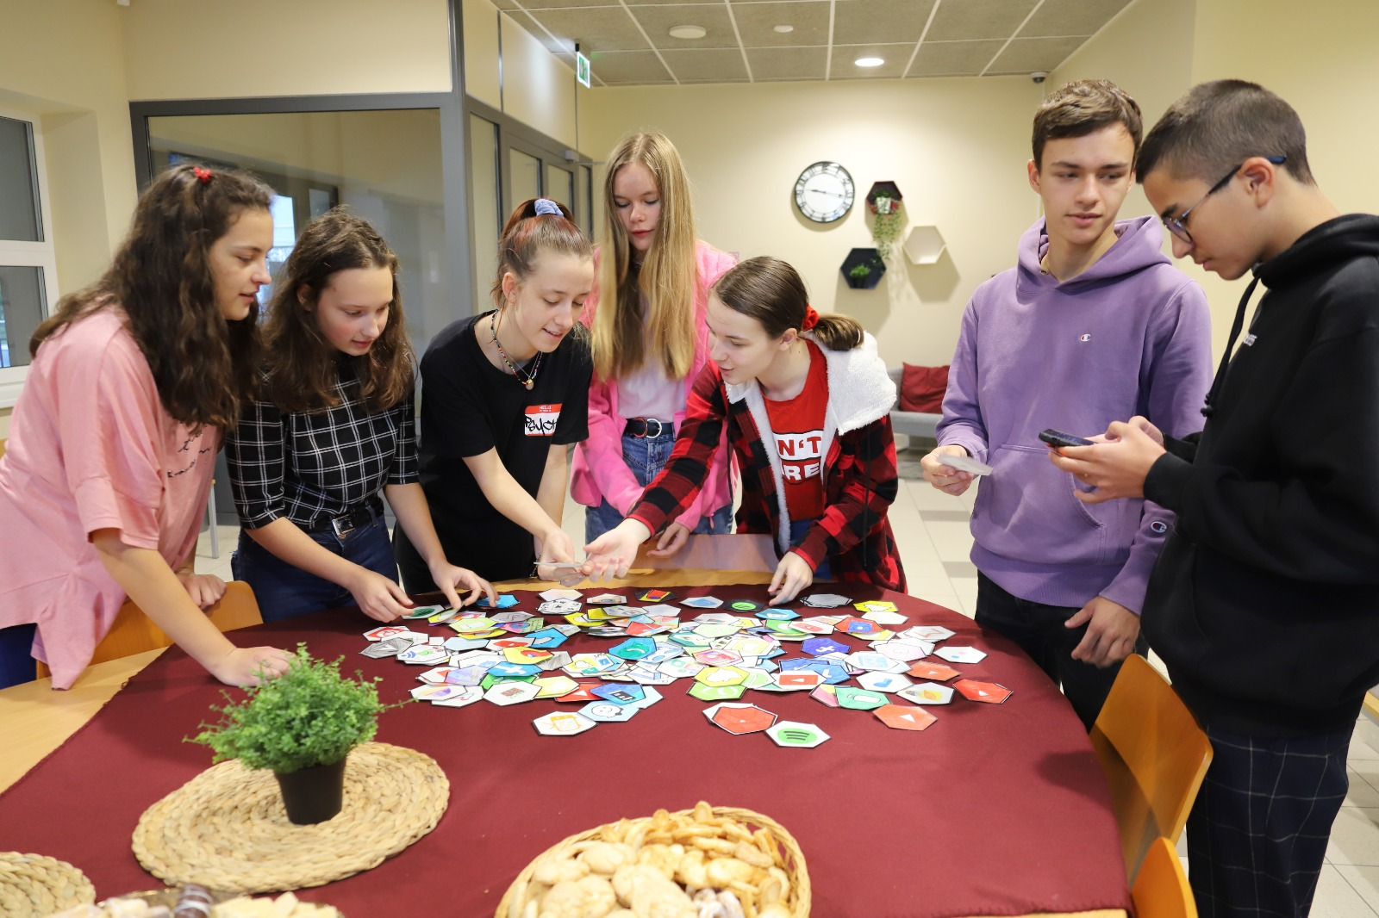
Creating pictograms for Erasmus Days
Verbal and visual communication
Increases engagement, improves productivity, helps team building...

Slide 12
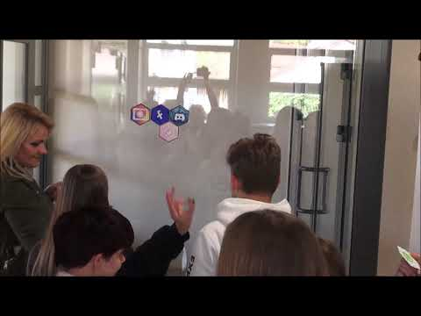

Slide 13
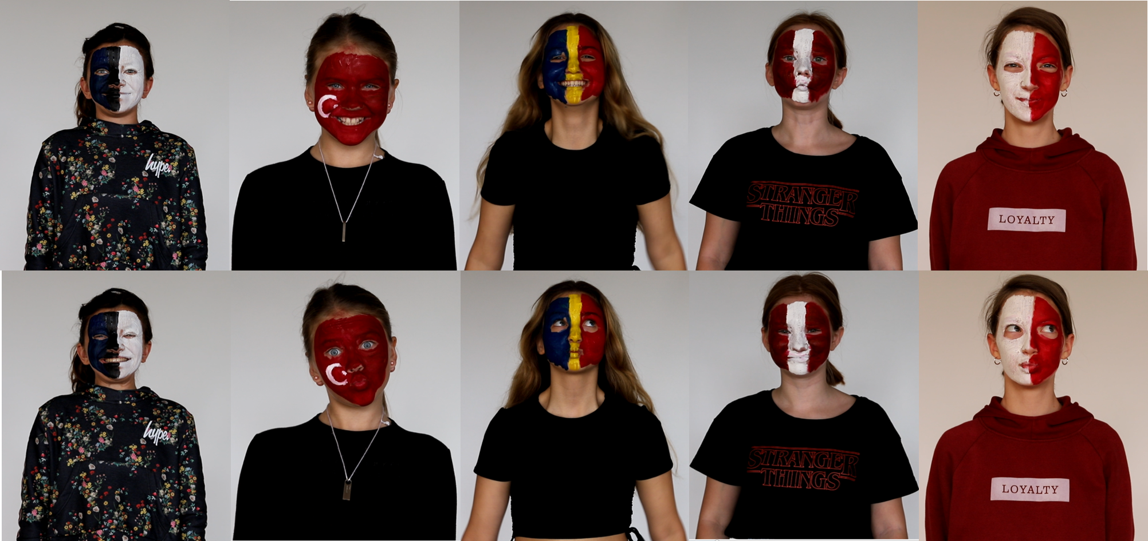
Silent theater - facial expressions and dance flash event
Non-verbal and visual communication; Clarity, engagement and team-building

Slide 14
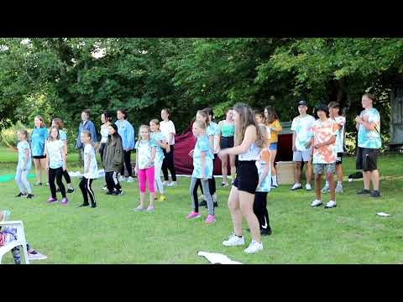

Slide 15
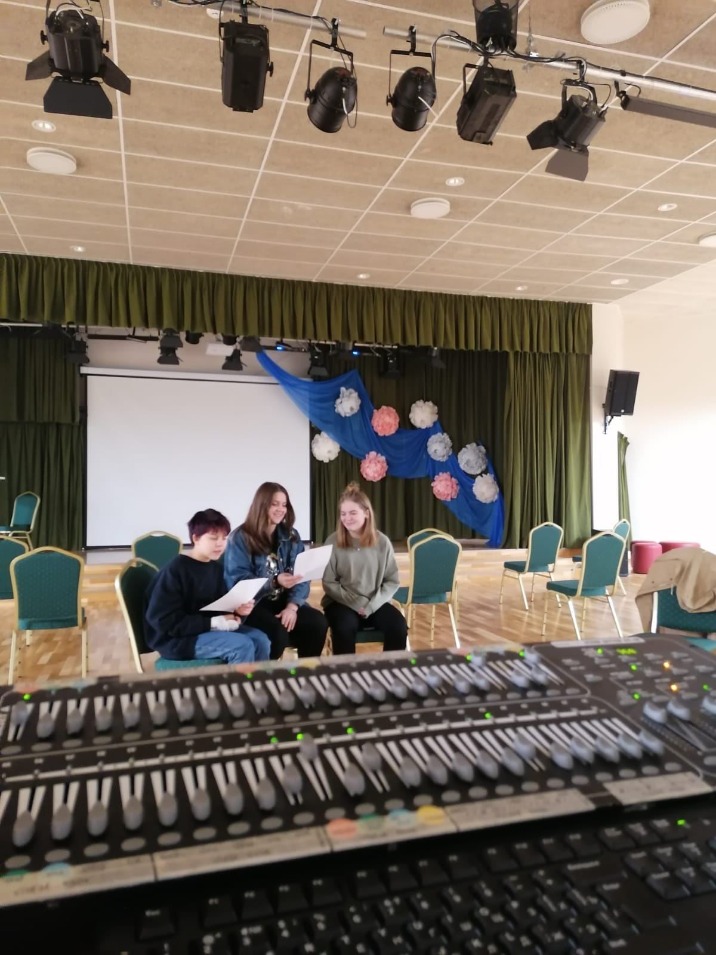
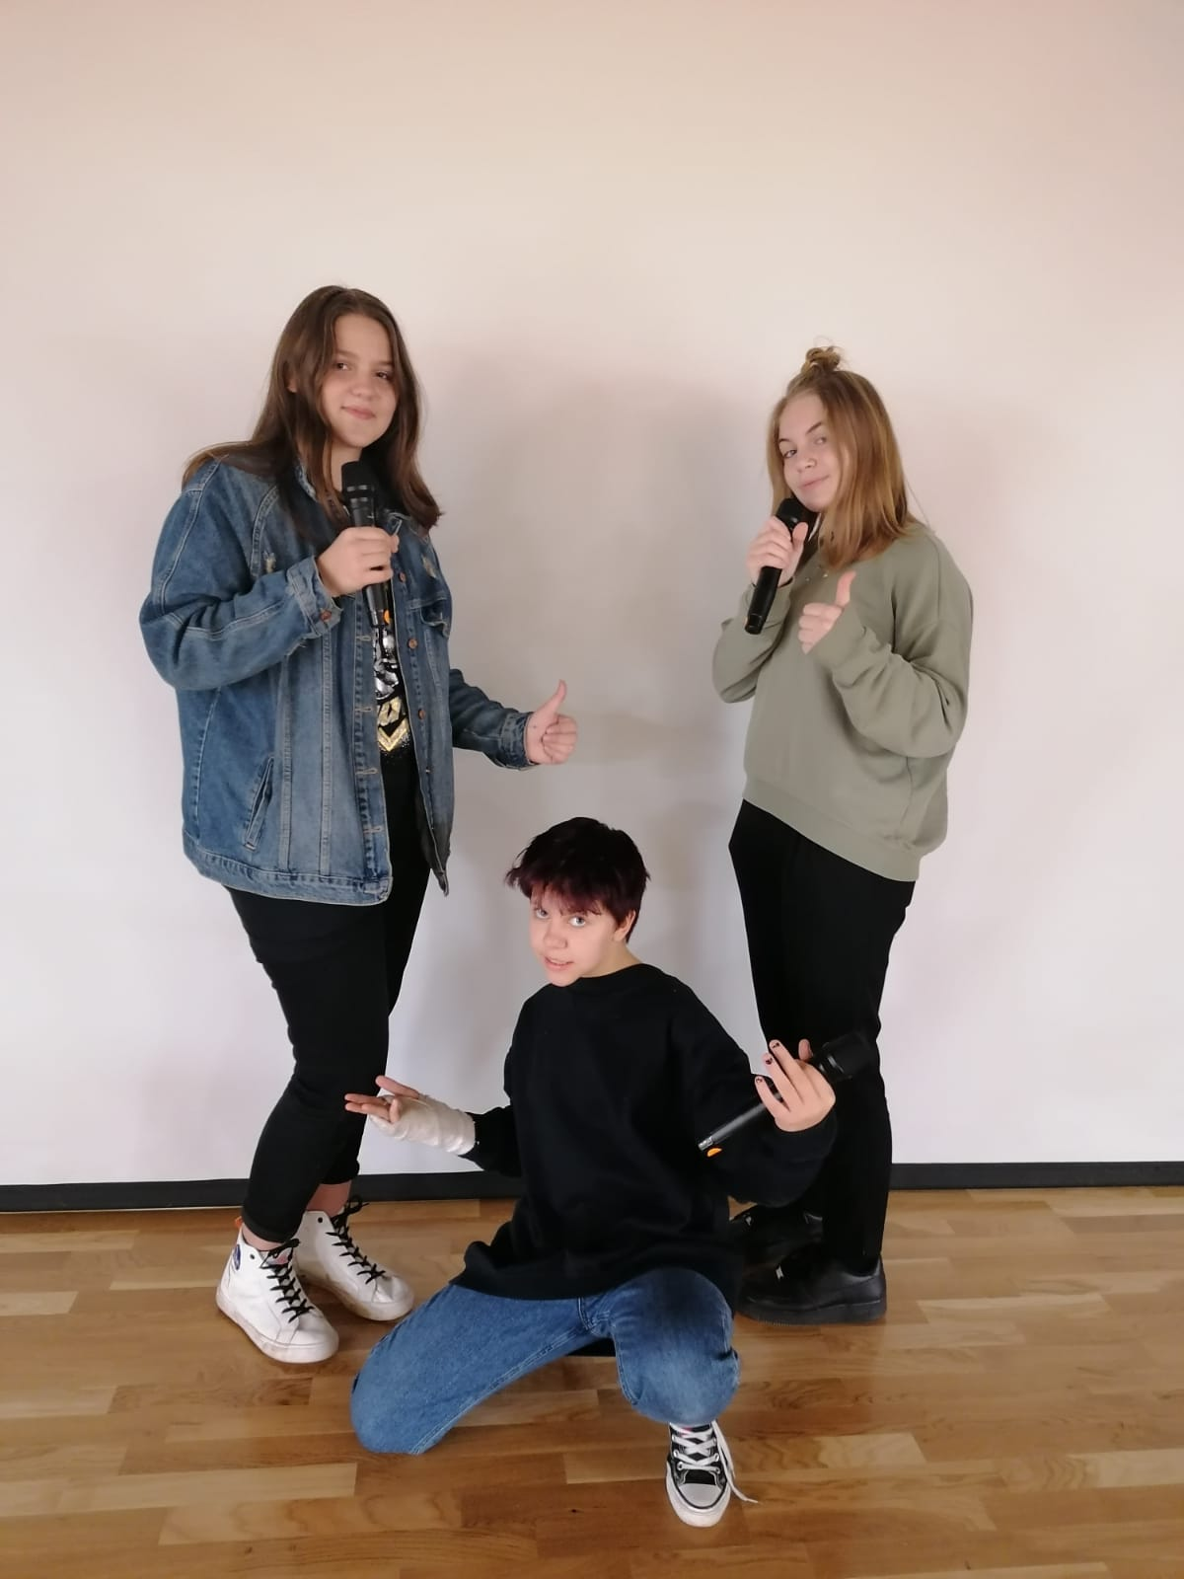
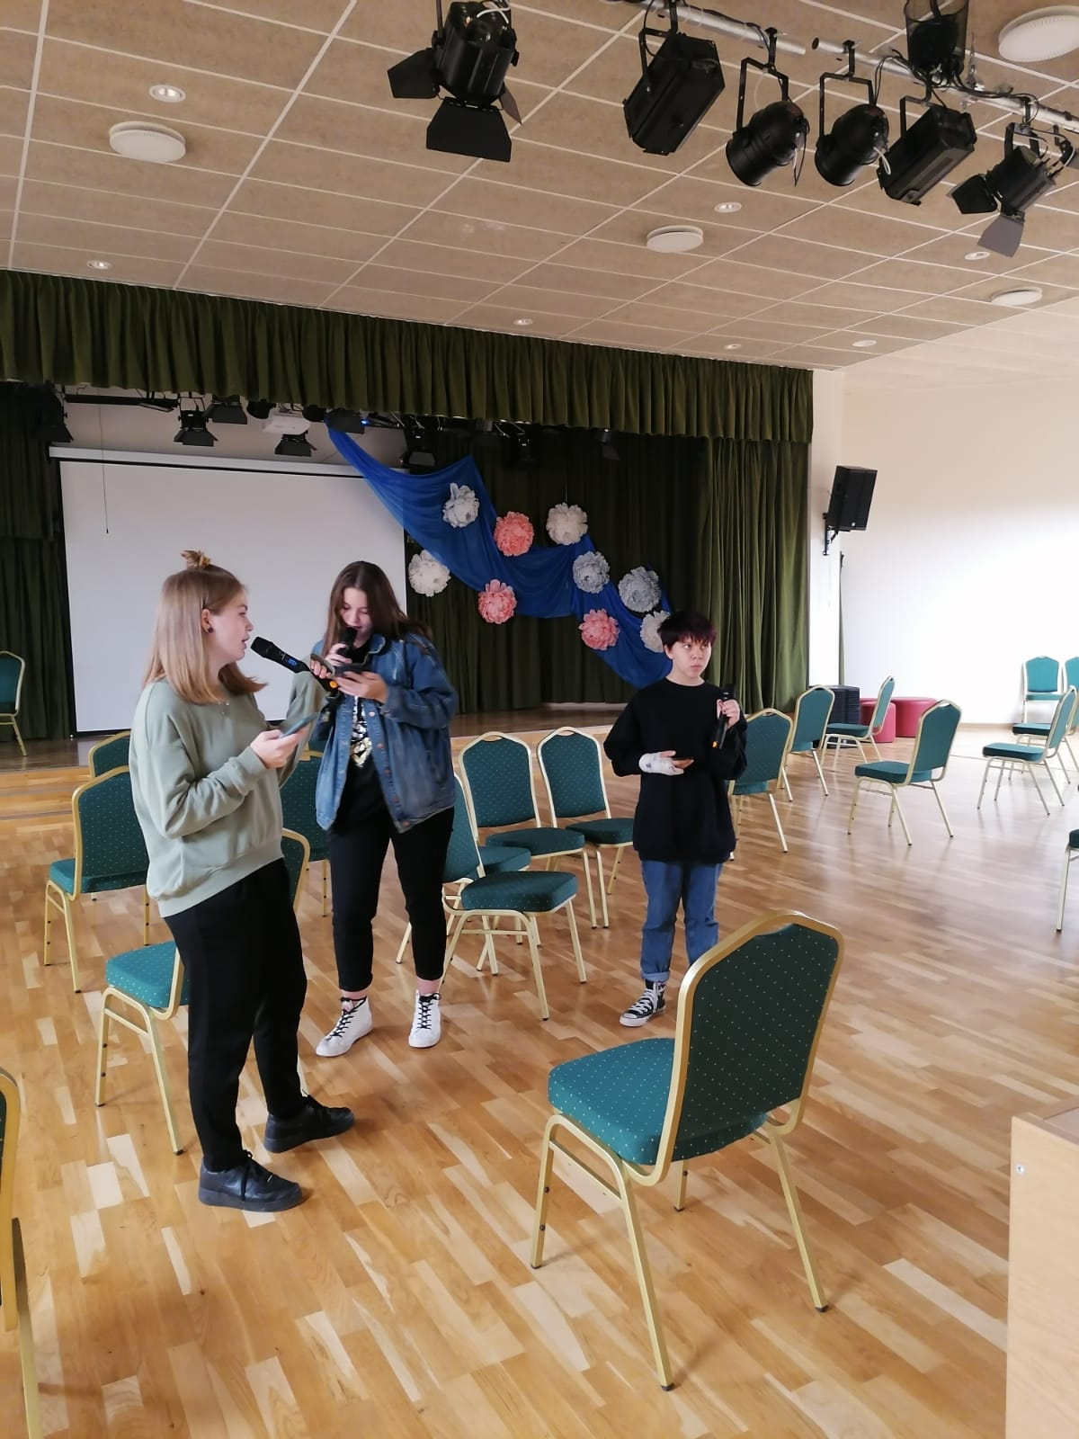
Preparing the project song
Verbal, non-verbal, visual and intercultural communication
Promoting teamwork, solving problems,creating better relationships etc.

Slide 16
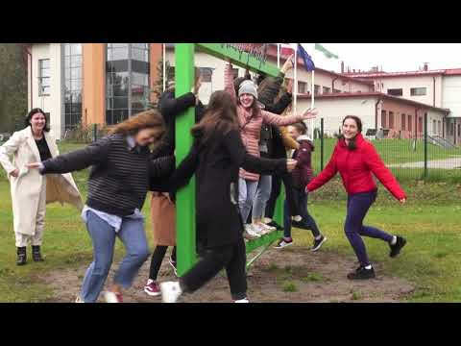

Slide 17
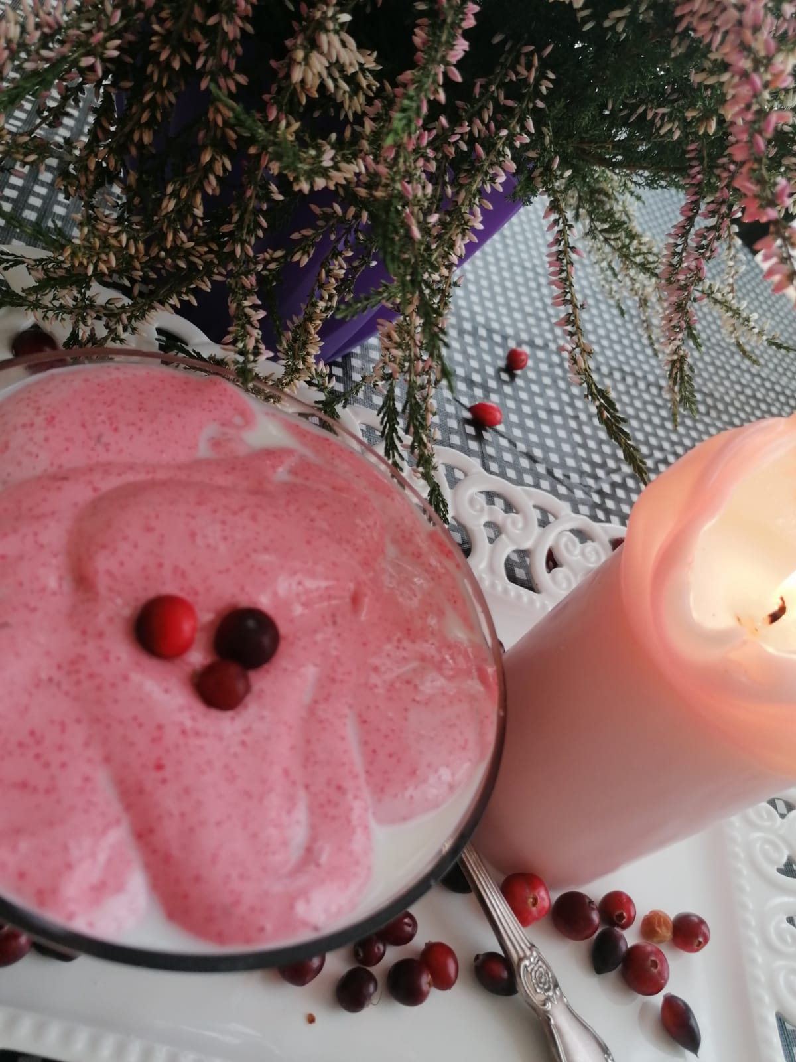
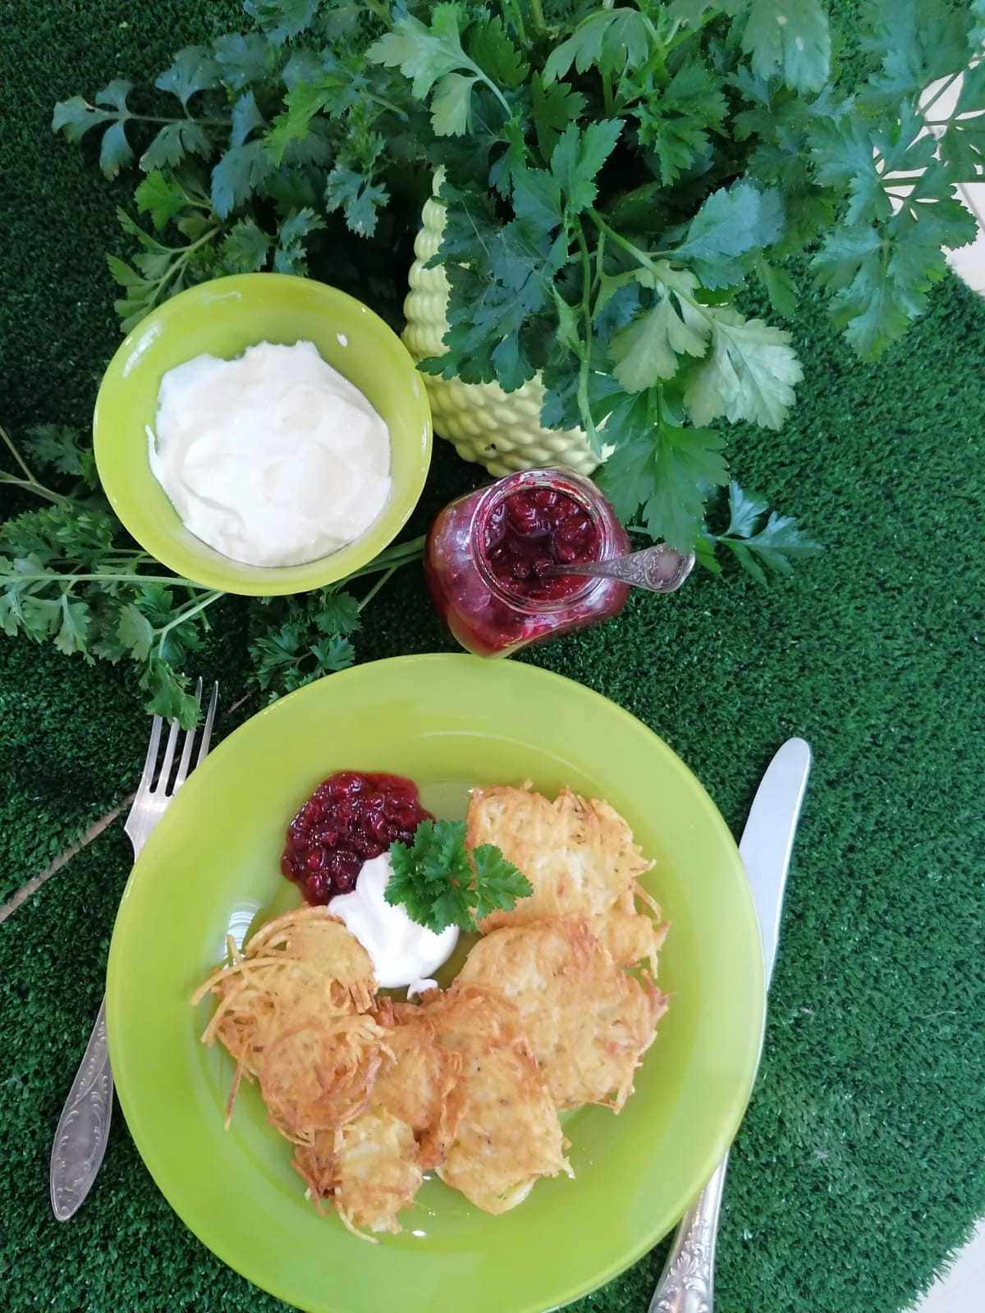
Cooking recipes from partner countries
Non-verbal, visual ,intercultural communication
PPT: https://docs.google.com/presentation/d/1xViMkeAW_3RbOvaOMFm8OR-VmhzYyGRLoNpPy0JtDiE/edit?usp=sharing

Slide 20
Let’s continue communicating and better understanding each other!

