Slide 1
PROBIOTICS
Alexandra Oravcová
Nina Martičeková
Lenka Tokárová
Tamara Veliká
Gymnázium Cyrila Daxnera, Vranov nad Topľou
SLOVAKIA

Slide 2
Our school carried out a survey on the use of probiotics and their occurence. We collected data. Mostly our students took part in the survey and we came to these results:

Slide 21
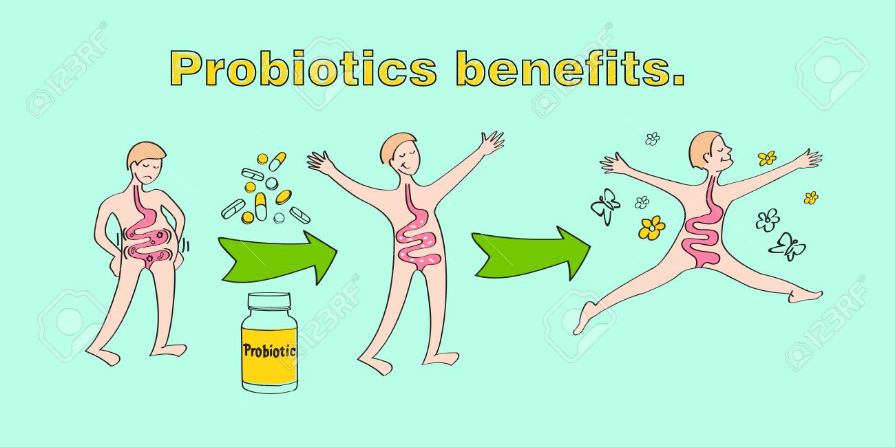
The results showed that many young people have knowledge about probiotics and their use. Probiotics are made up of good bacteria that helps keep your body healthy and working well. So take your probiotics everyday and be healthy! ☺

