Slide 1
All Disease Begins in the Gut
PROBIOTICS AWARENESS SURVEY

Slide 2
Gender
1. Male
2. Female
Total

Slide 3
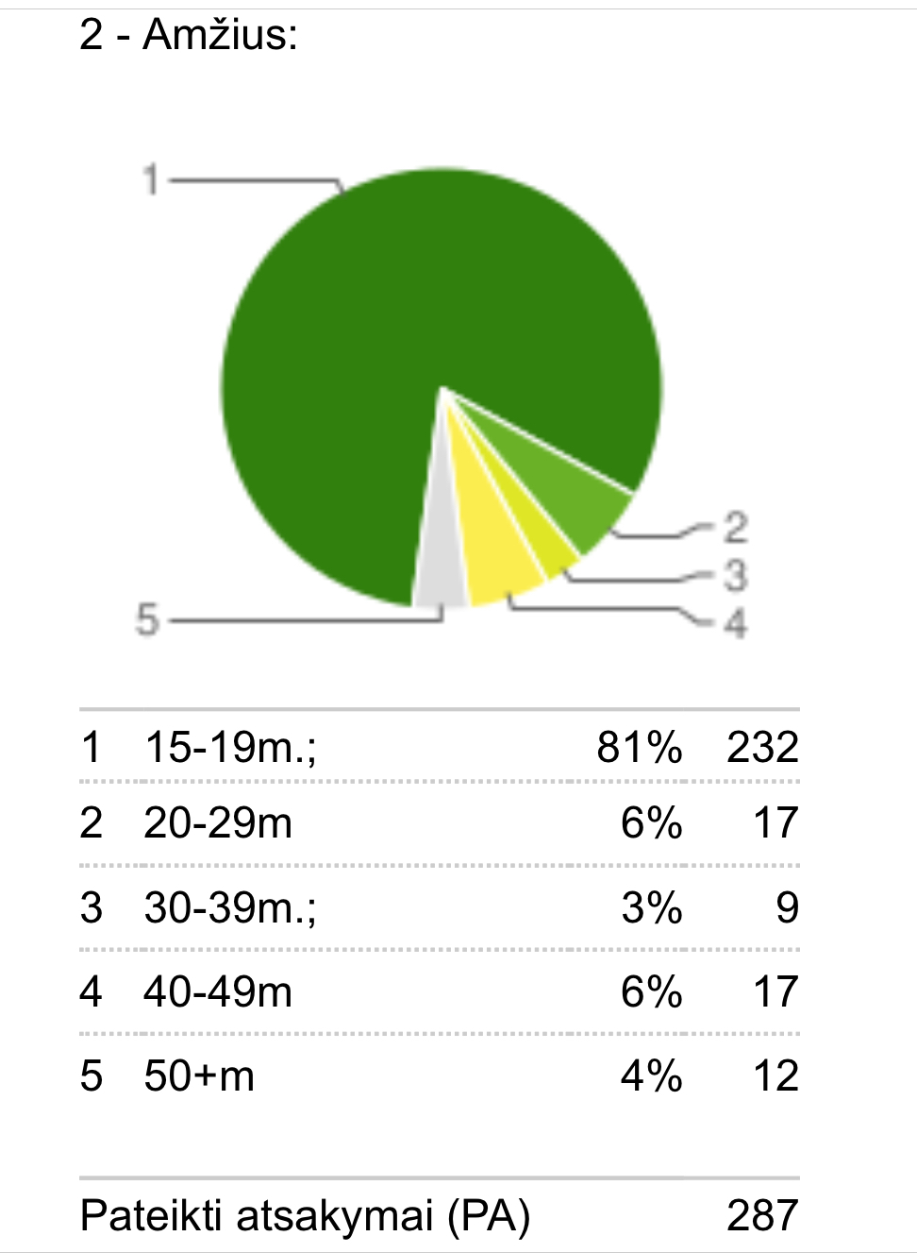
Age
1. 15-19
2. 20-29
3. 30-39
4. 40-49
5. 50 +
Total

Slide 4
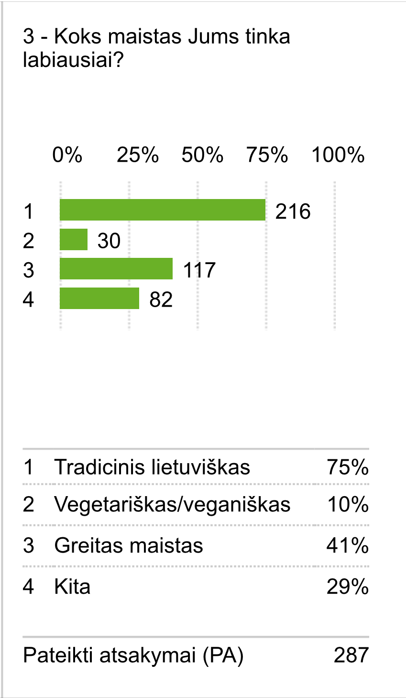
3. Which of the following dietary best fits you?
1. Traditional Lithuanian
2. Vegetarian / Vegan
3. Fast Food
4. Other
Total

Slide 5
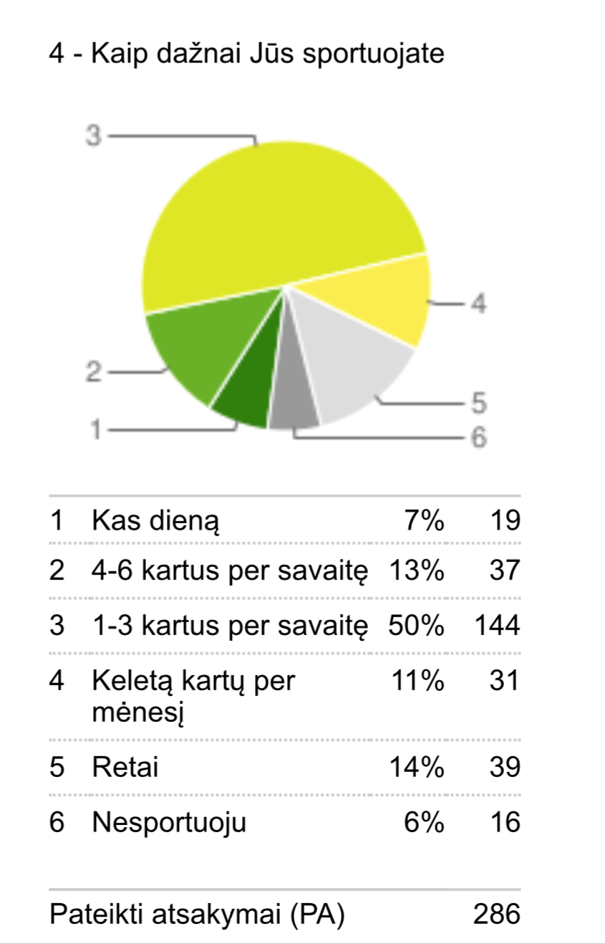
4. How often do you do sports?
1. Everyday
2. 4-6 times a week
3. 1-3 times a week
4. Several times a month
5. Rarely
6. I don’t do sports
Total

Slide 6
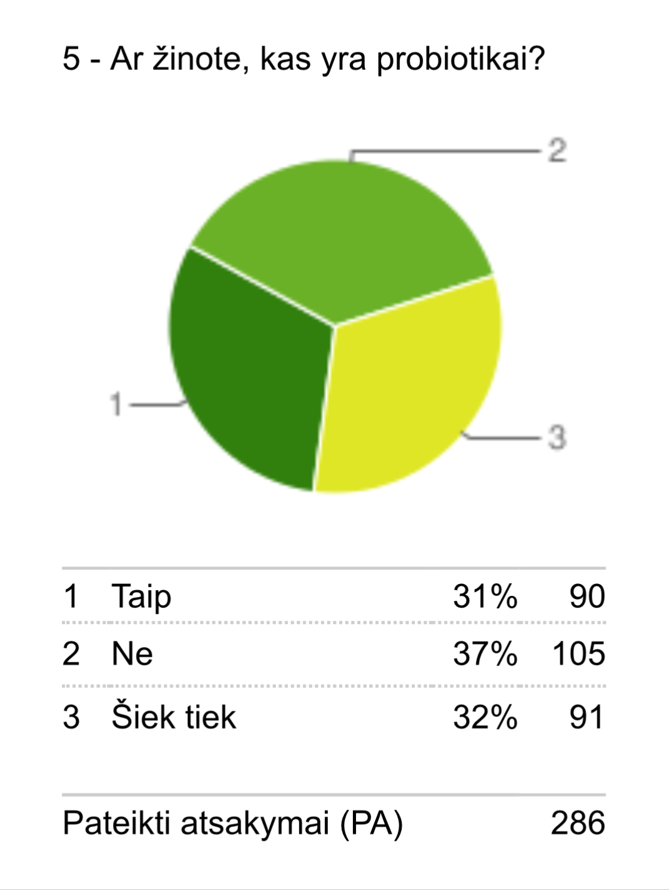
5. Do you know what probiotics are?
1. Yes
2. No
3. A little bit
Total

Slide 7
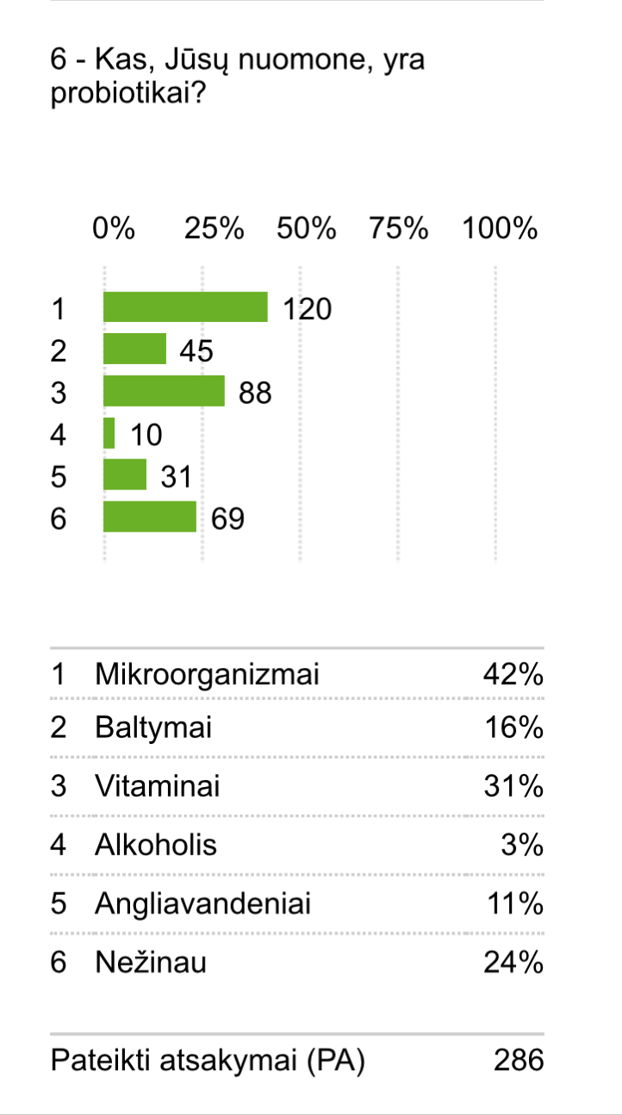
What do you think Probiotics is?
1. Microorganisms
2. Protein
3. Vitamine
4. Alcohol
5. Carbohydrates
6. I don’t know
Total

Slide 8
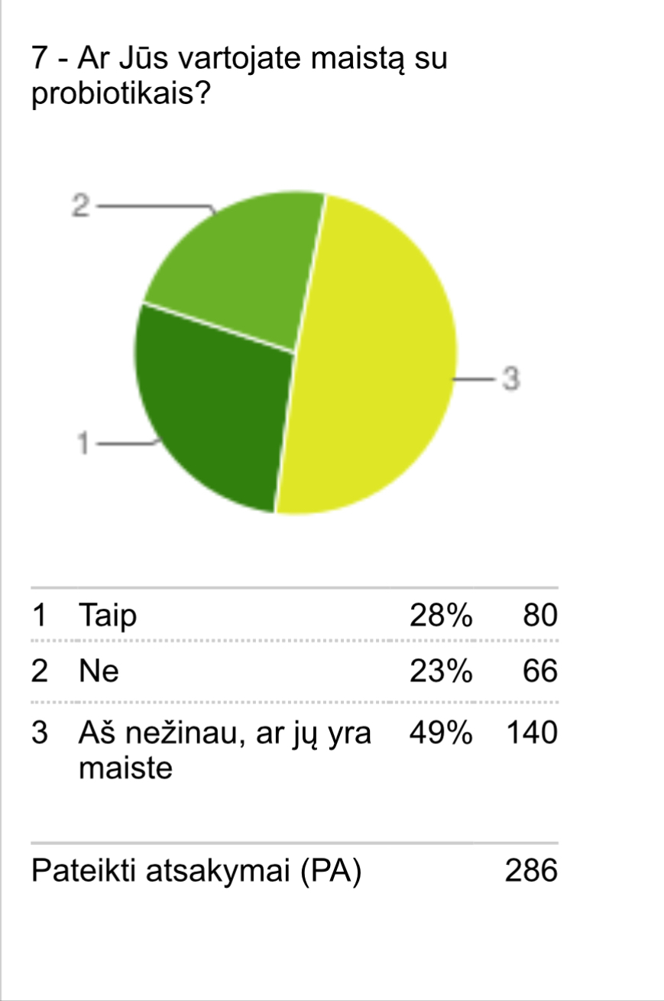
7. Do you consume foods that include probiotics?
1. Yes
2. No
3. I have no idea what they are
Total

Slide 9
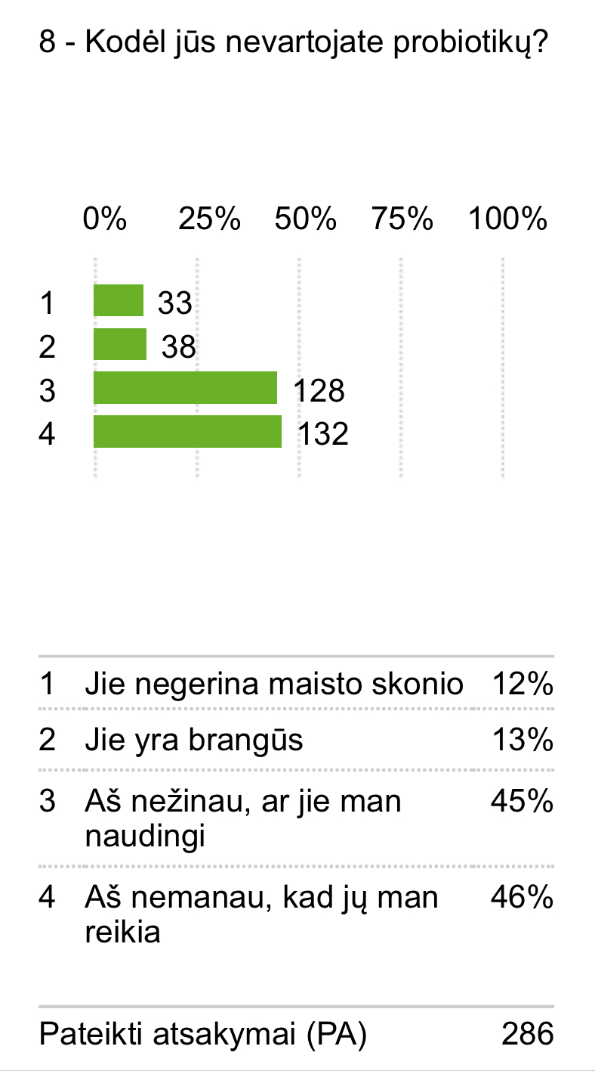
8. What are the reasons for not consuming?
1. They don’t taste good
2. They’re expensive
3. I don’t think they’re useful.
4. I don’t think I need to
Total

Slide 10
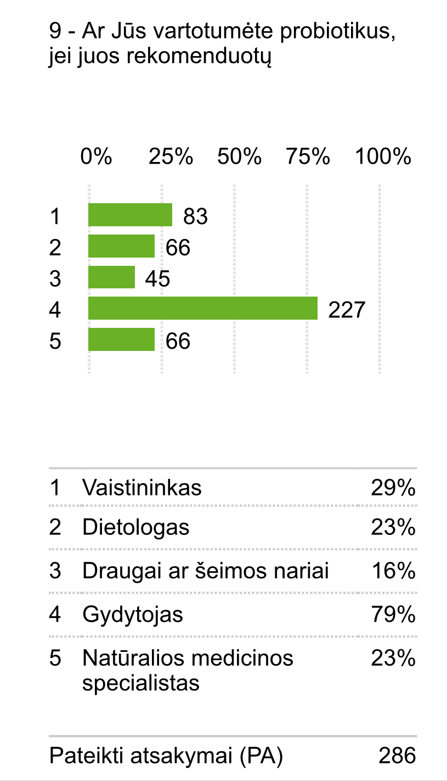
9. Would you use probiotics if they were recommended by
1. Pharmacist
2. Dietician / Nutritionist
3. Friend or family member
4. Doctor
5. Naturopath
Total

Slide 11
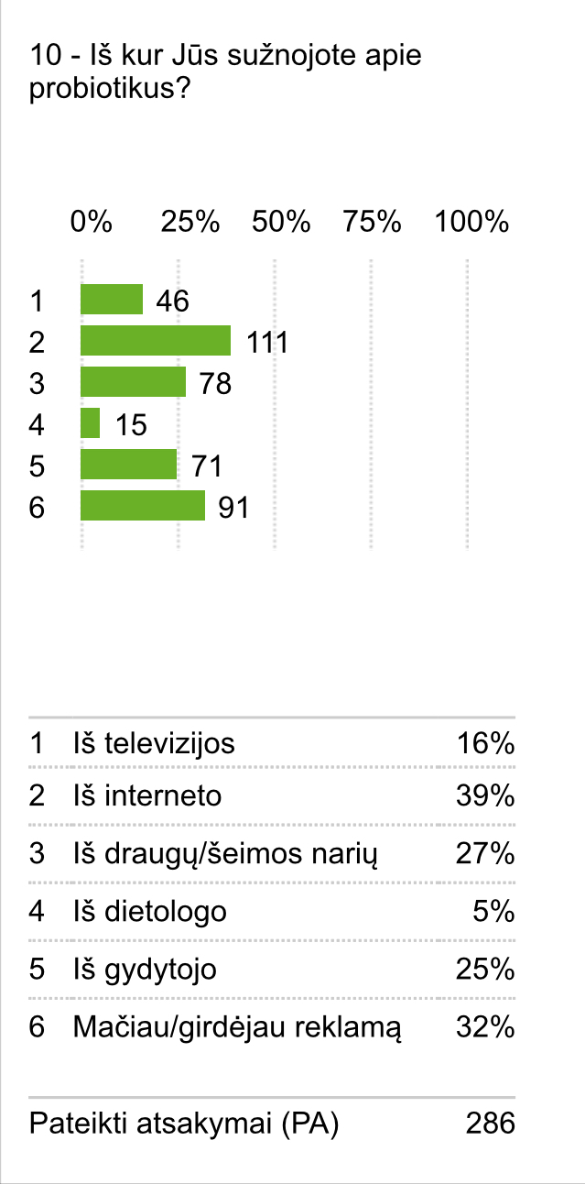
10. How would you reach information about probiotics?
1. Television
2. Internet
3. Friends / Family members
4. Dietician / Nutritionist
5. Doctor
6. Ads
Total

Slide 12
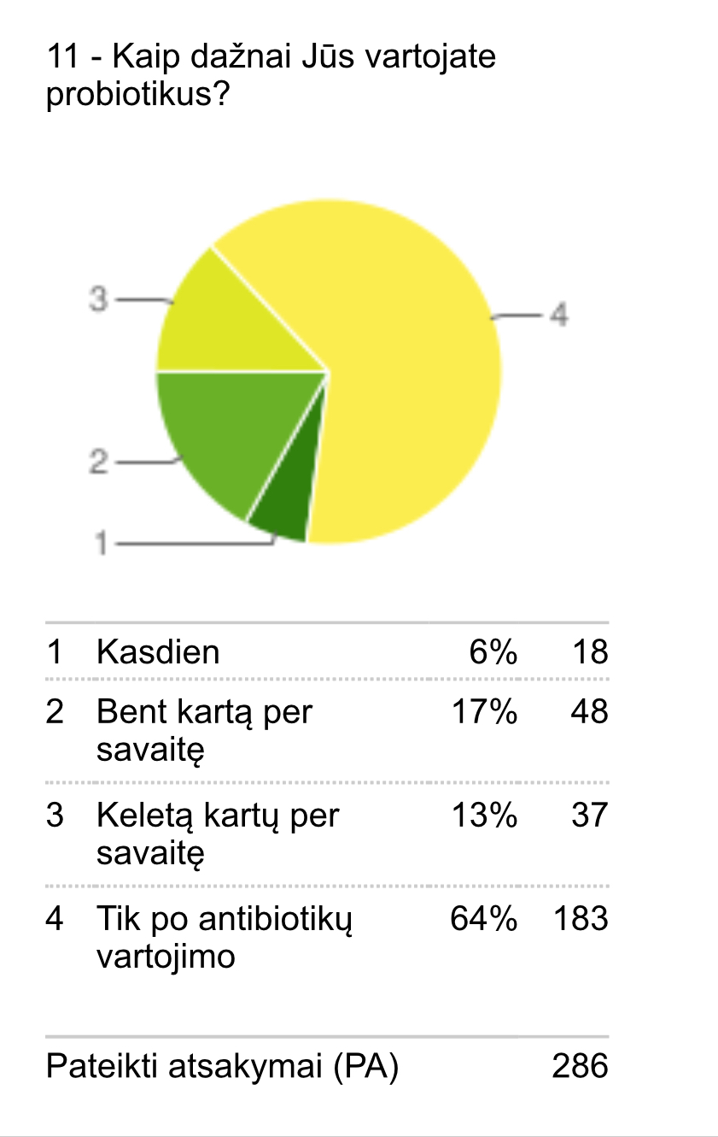
11. How frequently do you consume probiotics?
1. Daily
2. Weekly
3. Several times a week
4. Only after consuming antibiotics
Total

Slide 13
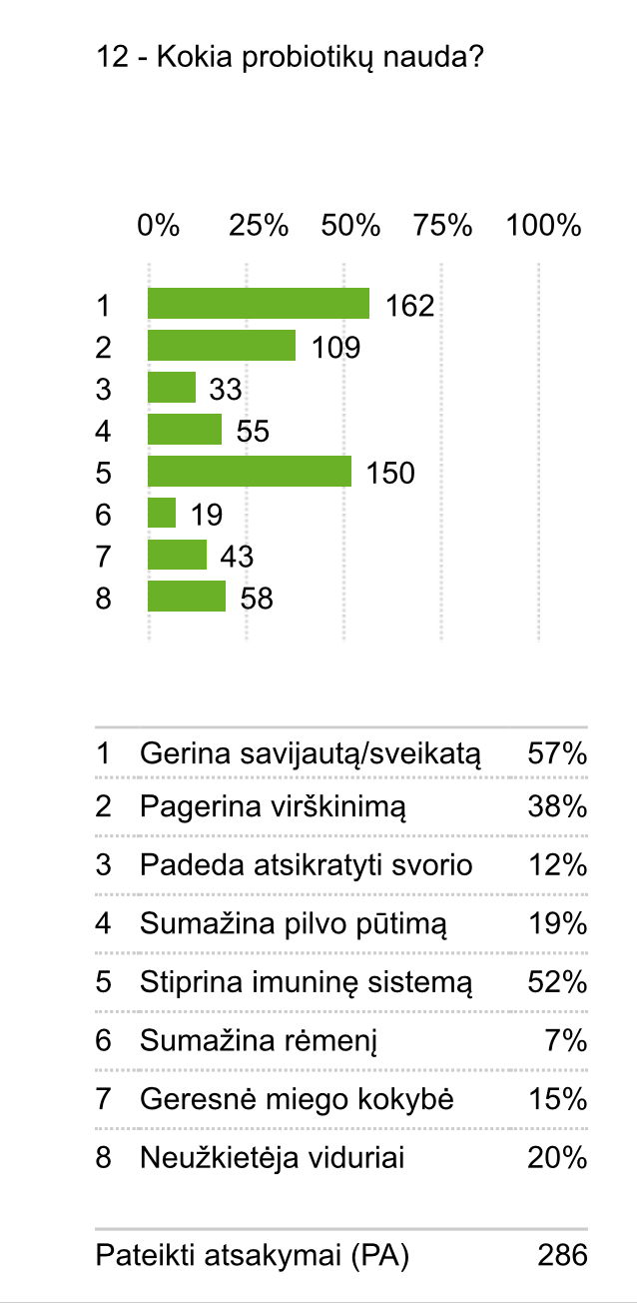
12. What benefits do you think probiotics can offer?
1. It’s healthy
2. Improve my digestive health
3. Help me lose weight
4. Reduce bloating
5. Support my immune system
6. Relieve heartburn
7. Help me sleep better
8. Prevent constipation
Total

Slide 14
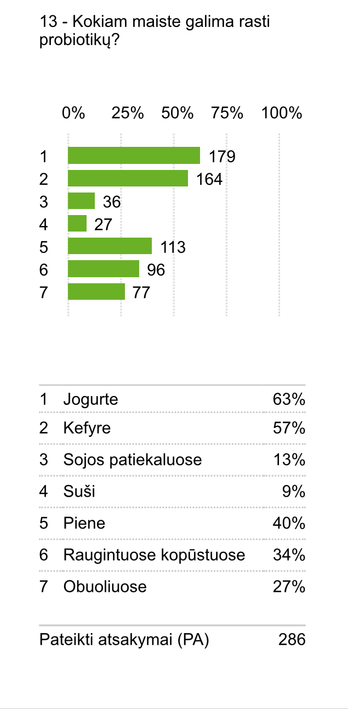
13. In which of the following foods will you typically find probiotics?
1. Yoghurt
2. Kefir
3. Soya products
4. Sushi
5. Milk
6. Sauerkraut
7. Apples
Total

Slide 15
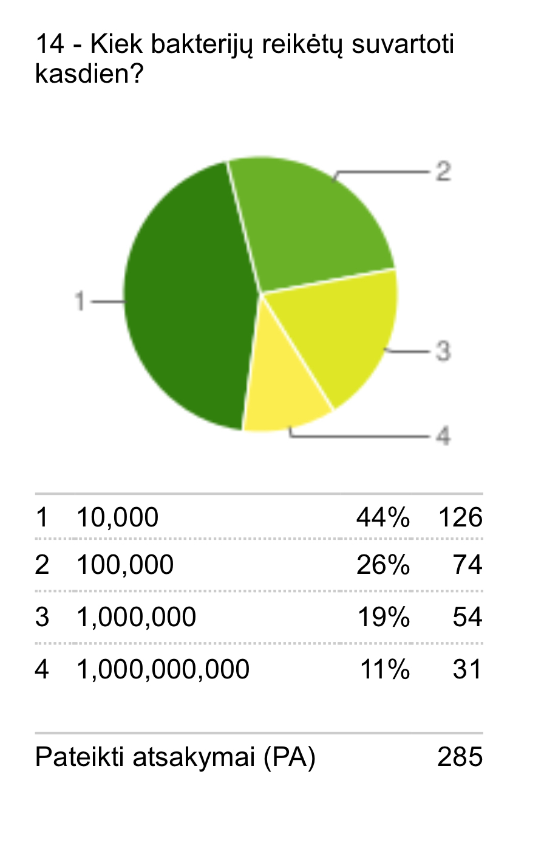
14. How many probiotic bacteria should be consumed each day for optimum effect?
1. 10,000 (ten thousand)
2. 100,000 (one hundred thousand)
3. 1,000,000 (ten million)
4. 1,000,000,000 (one billion)
Total

Slide 16
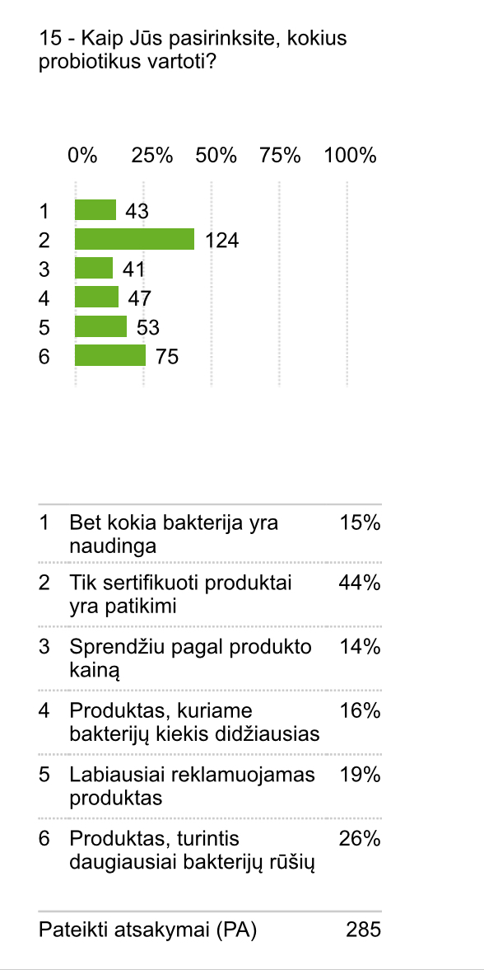
15. How would you select which probiotic to consume?
1. Any bacteria is helpful
2. Only documented specifis strains should be trusted
3. The most expensive product
4. The product containing the highest number of bacteria
5. The products with the most adversitising
6. The product with the most bacterial strains.
Total

Slide 17
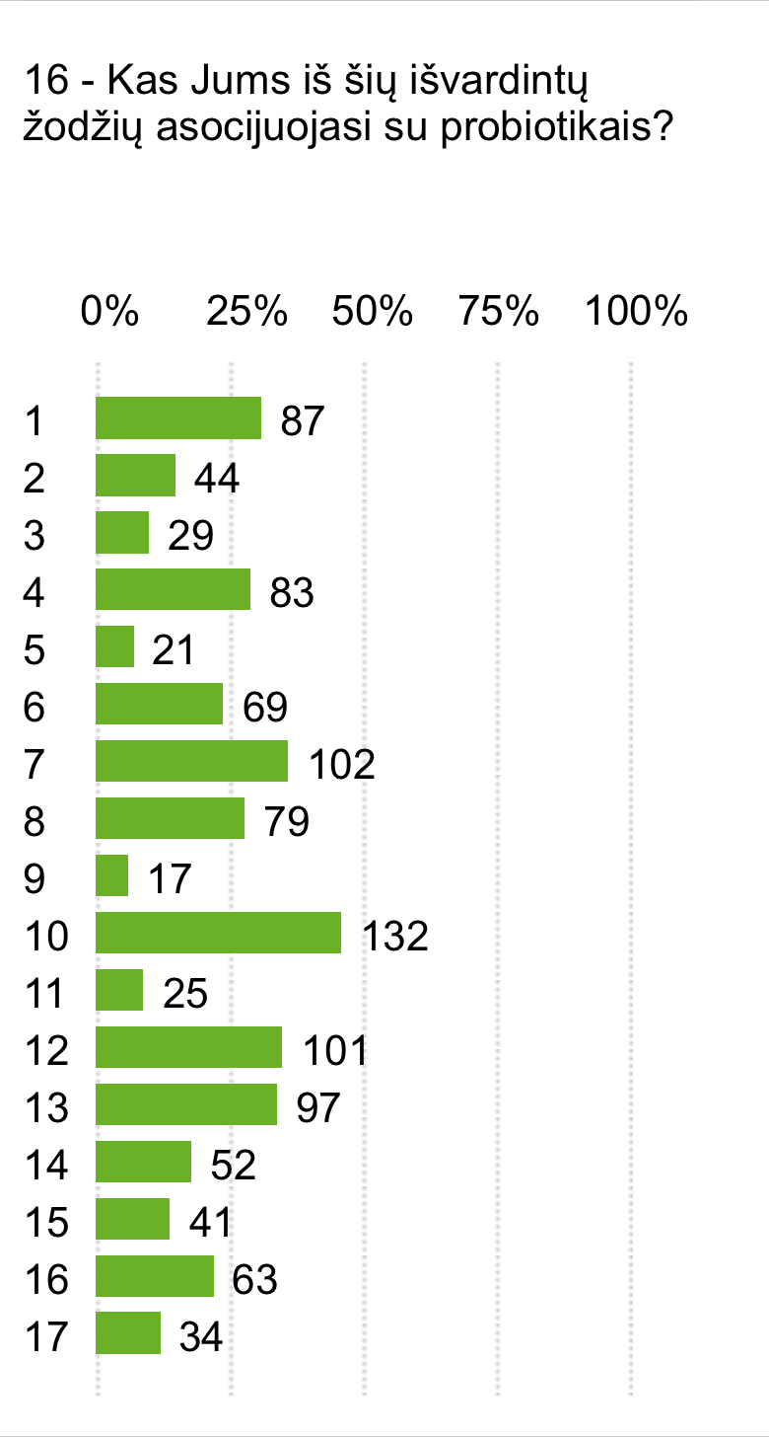
16. Which of the following words, or products do you associate with probiotics? (select all that apply)
1. Organic
2. Yeast
3. A2
4. Bifidus Actiregularis
5. Yakult
6. Fibre
7. Bifidobacterium
8. Linex
9. Inulin
10. Yoghurt
11. Activated Almonds
12. Kefir
13. Lactobacillus casei
14. Lactobacillus acidophilus
15. Chia seeds
16. Sauerkraut
17. LGG
Total

Slide 18
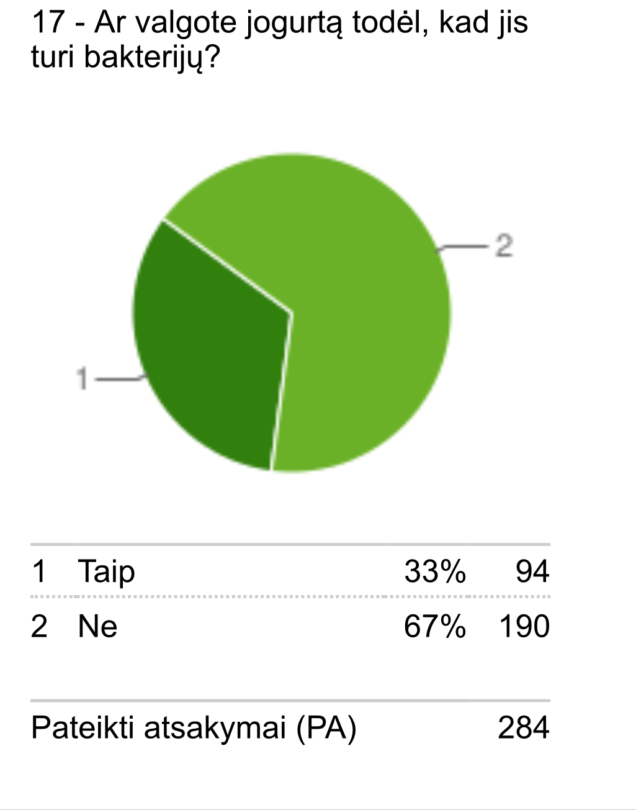
17. Do you include yoghurt in your diet because it contains probiotics?
1. Yes
2. No
Total

Slide 19
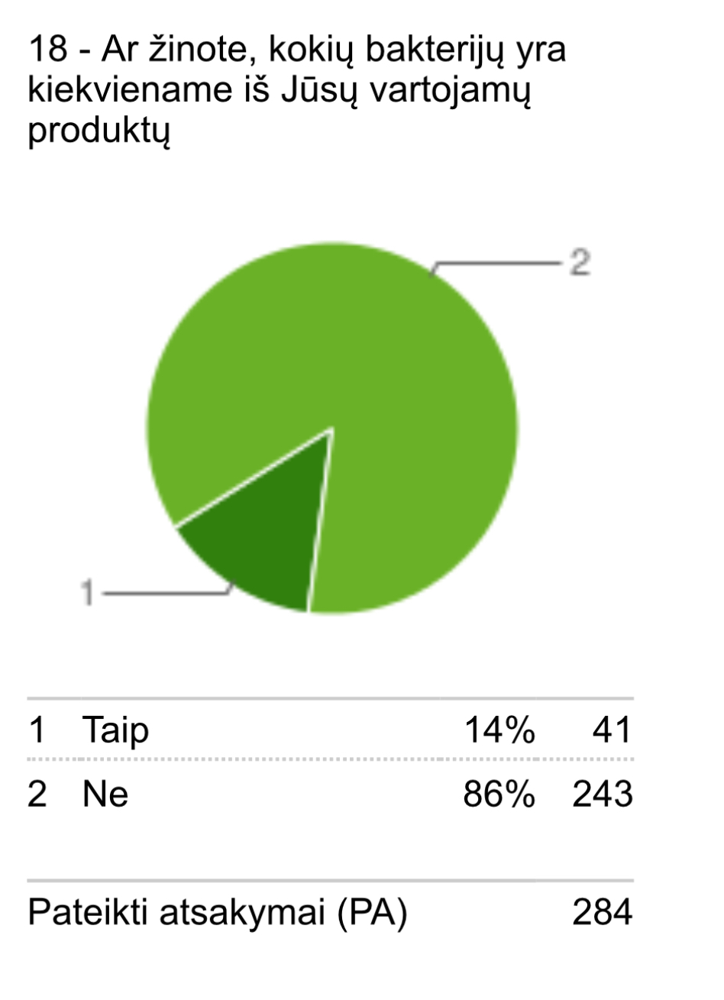
18. Do you know which bacteria the product you consume contains?
1. Yes
2. No
Total

Slide 20
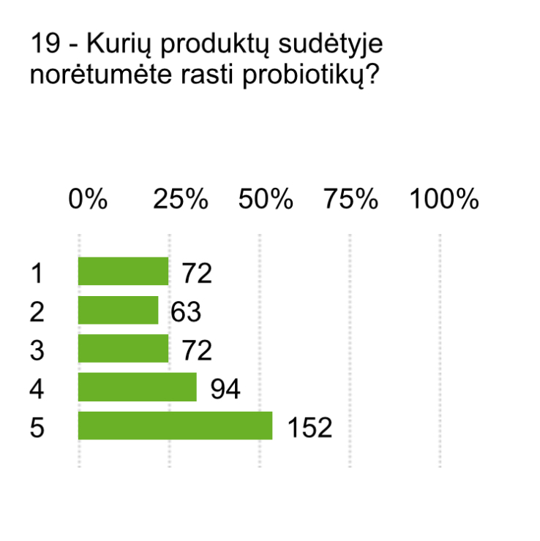
19. In which of the following products would you like probiotics to be used ?
1. Pasta
2. Biscuit
3. Bread
4. Drinks
5. Other
Total

Slide 21
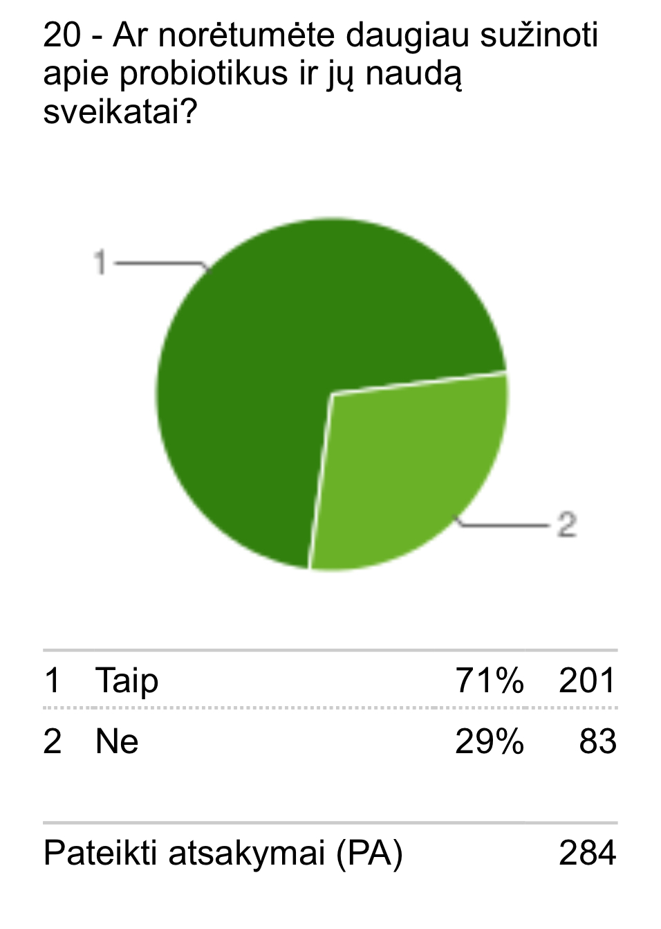
20. Would you like to know more about probiotics and how they benefit your health?
Yes
No
Total

Slide 22
Outcomes of the survey
A total of 287 people were interviewed at Klaipeda Tourism School. 69% of these were women and 31% were men. The majority of students interviewed (81%) were 15-19 year old. As many as 50% of those surveyed exercise 1-3 times a week. Only a third of respondents know what probiotics are. About half of the respondents do not know whether the food they consume contains probiotics. 64% of respondents use probiotics only after taking antibiotics. Most think you should consume 10,000 bacteria daily. 71% of participants surveyed are aware of the benefits of probiotics. For most of the respondents, traditional Lithuanian food is suitable. 42% believe that probiotics are microorganisms. Almost all of the participants does not know what probiotics are and whether they are beneficial. Most would trust if probiotics were suggested by a doctor. However, most people learn about probiotics from the internet and advertising. Half of those surveyed believe that probiotics improve well-being and strengthen the immune system. 63% think probiotics are found in yogurt. 44% trust only certified products. Kefir, yogurt, bifidobacteria, lactobacteria, linex - these words are often associated with probiotics.
After interviewing the respondents, it can be concluded that this is very important topic, but the awareness is rather limited. It’s great that most respondents want to know more. We hope that the project activities will encourage us not only gain more knowledge, but lead to a healthier life too.

